Slide 1
Robustness Analysis
3 AFS Controllers: HINF, MIDAAS, ILAF
Margins checked at direct I/O used for each controller (e.g., ILAF controller uses symmetric L1/R1, Hinf uses independent L1/R1)
Complete controller that includes the SAS and autopilots is used to check margins
Individual RFS calculated at all individual criteria: Classical loop-at-a-time for: Input GM, Input PM, Output GM, Output PM; Multi-loop Input Disk Gain Margin
Threshold criteria: 6 dB GM, 45º PM
Absolute RFS is based on Classical loop-at-a-time criteria only
Code: RobustnessAnalysisAP.m (2/18/2019)
Geri model includes actuator dynamics with 25 sec. time delay (4th order Pade) and sensor dynamics (no engine dynamics currently)

Slide 2
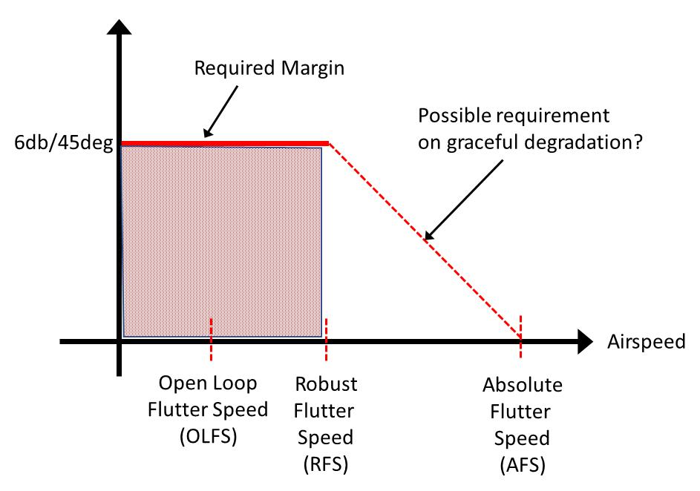
Defining Robust Flutter Speed
The speed at which a defined robustness margin is violated.
We are using the classical gain and phase margins for each individual loop at both inputs and outputs.
A different margin could be defined and the analysis would be the same.

Slide 3
SAS and Autopilots - description
Roll Damper
Gain
p to aileron
Pitch Controller (pitch attitude command)
PI
Theta error to elevator
Roll Controller (roll attitude command)
PI
phi error to elevator
Auto throttle (speed command)
PI
u error to thrust
Altitude hold
Gain
h error to theta command (pitch controller input)

Slide 4
HINF AFS - description
4 inputs
L1
R1
L4
R4
8 outputs
qcg [rad/s ]
pcg [rad/s ]
nzCBfwd [ft/s^2]
nzCBaft [ft/s^2]
nzLwingfwd [ft/s^2]
nzLwingaft [ft/s^2]
nzRwingfwd [ft/s^2]
nzRwingaft [ft/s^2]
Fixed controller for all airspeeds
15 states
Targets 2 flutter modes

Slide 5
MIDAAS AFS - description
4 inputs
L1
R1
L4
R4
8 outputs
qcg [rad/s ]
pcg [rad/s ]
nzCBfwd [ft/s^2]
nzCBaft [ft/s^2]
nzLwingfwd [ft/s^2]
nzLwingaft [ft/s^2]
nzRwingfwd [ft/s^2]
nzRwingaft [ft/s^2]
Fixed controller for all airspeeds
2 states
Targets 2 flutter modes

Slide 6
ILAF AFS - description
1 Input
Symmetric Body flaps (L1+R1)
2 outputs
nzCBfwd [ft/s^2]
nzCBaft [ft/s^2]
Gain scheduled with airspeed – a net gain, no change in dynamics.
3 states
Controller designed SISO: output is difference between accelerometers
Targets a single flutter mode

Slide 7
Robust Margin Summary
HINF
Robust Flutter Speed: 40.8 m/s
Absolute Flutter Speed: 42.0 m/s
Individual RFS:
RFS due to PM at Input: 40.8 m/s
RFS due to GM at Input: 42.0 m/s
RFS due to PM at Output: 41.1 m/s
RFS due to GM at Output: 42.0 m/s
RFS due to GM at Multi-Input: 20.0 m/s
MIDAAS
Robust Flutter Speed: 36.3 m/s
Absolute Flutter Speed: 40.5 m/s
Individual RFS:
RFS due to PM at Input: 37.1 m/s
RFS due to GM at Input: 36.7 m/s
RFS due to PM at Output: 36.3 m/s
RFS due to GM at Output: 37.5 m/s
RFS due to GM at Multi-Input: 34.5 m/s
ILAF
Robust Flutter Speed: 31.2 m/s
Absolute Flutter Speed: 37.0 m/s
Individual RFS:
RFS due to PM at Input: 33.8 m/s
RFS due to GM at Input: 34.8 m/s
RFS due to PM at Output: 33.3 m/s
RFS due to GM at Output: 31.2 m/s
RFS due to GM at Multi-Input: 32.5 m/s

Slide 8
HINF – Robustness Margins Results

Slide 9
HINF – Robustness Margins Results

Slide 10
HINF – Robustness Margins Results

Slide 11
MIDAAS – Robustness Margins Results

Slide 12
MIDAAS – Robustness Margins Results

Slide 13
MIDAAS – Robustness Margins Results

Slide 14
ILAF – Robustness Margins Results

Slide 15
ILAF – Robustness Margins Results

Slide 16
ILAF – Robustness Margins Results

