Slide 1
Bluma
More than just metal

Slide 2
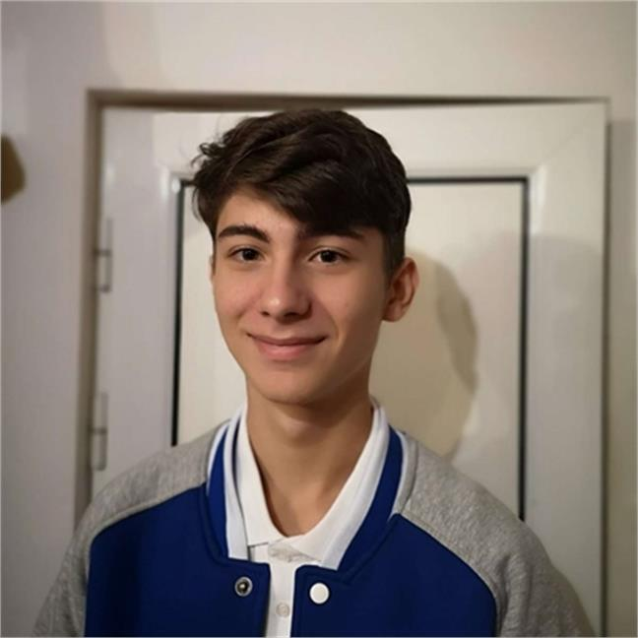
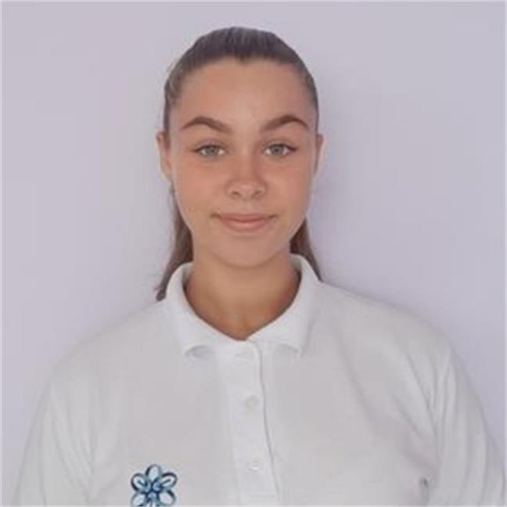
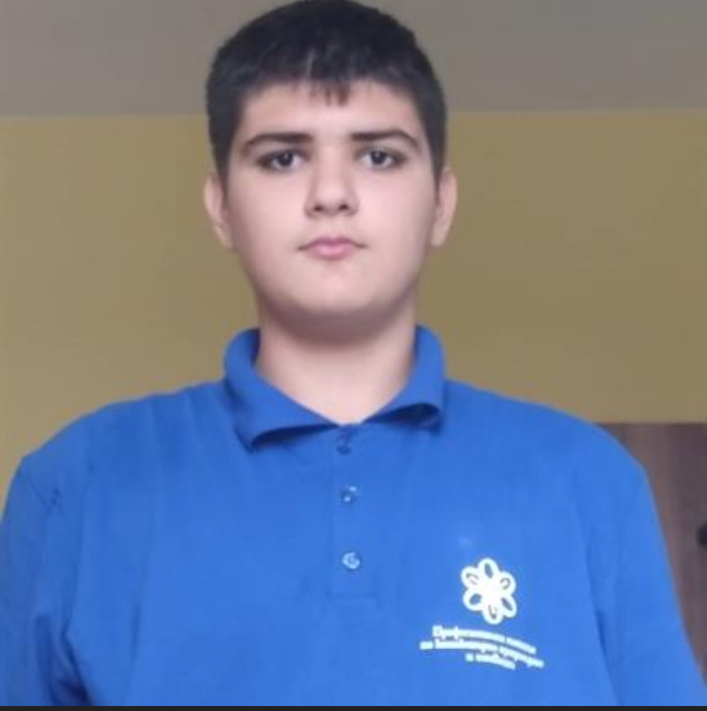
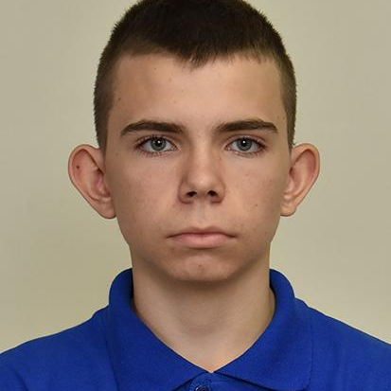
OUR TEAM
PANAYOT ANDONOV
ZHAKLIN YANKOVA
DEAN PETKOV
KONSTANTIN NACHEV
Scrum trainer
Designer
Front-end-developer
Front-end-developer

Slide 3


OUR IDEA

Slide 4



STAGES OF DEVELOPMENT
1.
3.
2.

Slide 5








THE PROGRAMS WE USED

Slide 6
LETS JUMP TO THE PROJECT!

