Slide 1
Econ Geo in R
Pierre-Alexandre Balland
M&T specializations

Slide 2
Workflow
Morning homework: read IDS notes & scripts + EconGeo manual
Afternoon class: presentation of class, lecture & lab, project
Day 1
Day 2
Day 3
Day 4
Day 5

Slide 3
Workflow
Day homework: Meeting with the group to come-up with a data science solution to a real-world problem. Iteration between topics/data available
Day 1
Day 2
Day 3
Day 4
Day 5

Slide 4
Workflow
Morning homework: Prepare the data according to the structure presented in day 1
Afternoon class: present initial idea/data + proposed indices
Day 1
Day 2
Day 3
Day 4
Day 5

Slide 5
Workflow
Morning homework: Compute proposed indices in day 3
Afternoon class: Q&As - troubleshooting during class
Day 1
Day 2
Day 3
Day 4
Day 5

Slide 6
Workflow
Morning homework: Prepare the final slide deck
Afternoon class: final presentation
Day 1
Day 2
Day 3
Day 4
Day 5

Slide 7
Goal of this class
Build skills to solve real-world problems with data science solutions
Can be EG-specific or build on EG techniques and applied in a slightly different field

Slide 8
Key skills
High-level understanding of the problem to solve
High-level understanding of the methods available
Overview of the data available (access + limitations)
Data management techniques
Ability to compute the key metrics
Analytical skills

Slide 9
Use case #1
Which industries/technologies to
foster regional development?
IOT
AI
Biotech
7/45

Slide 10
Bottleneck: increasing complexity of the technological landscape

Slide 11
Applied artificial intelligence +
high-end data visualization tools
Hydrogène

Slide 12
Applied artificial intelligence +
high-end data visualization tools
Support regions to re-invent themselves and prioritize investments decisions
Hydrogène

Slide 13
Methods
1
Theoretical framework of economic complexity
2
Analysis of large datasets (patents, publications, …)
3
Applied Artificial Intelligence (ML/NS)
4
High-end interactive data visualization tools (HTML)

Slide 14
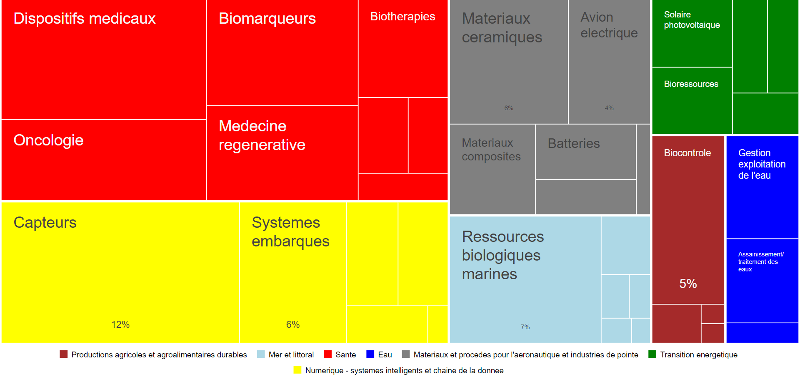
Regional eco-system mapping: patents

Slide 15
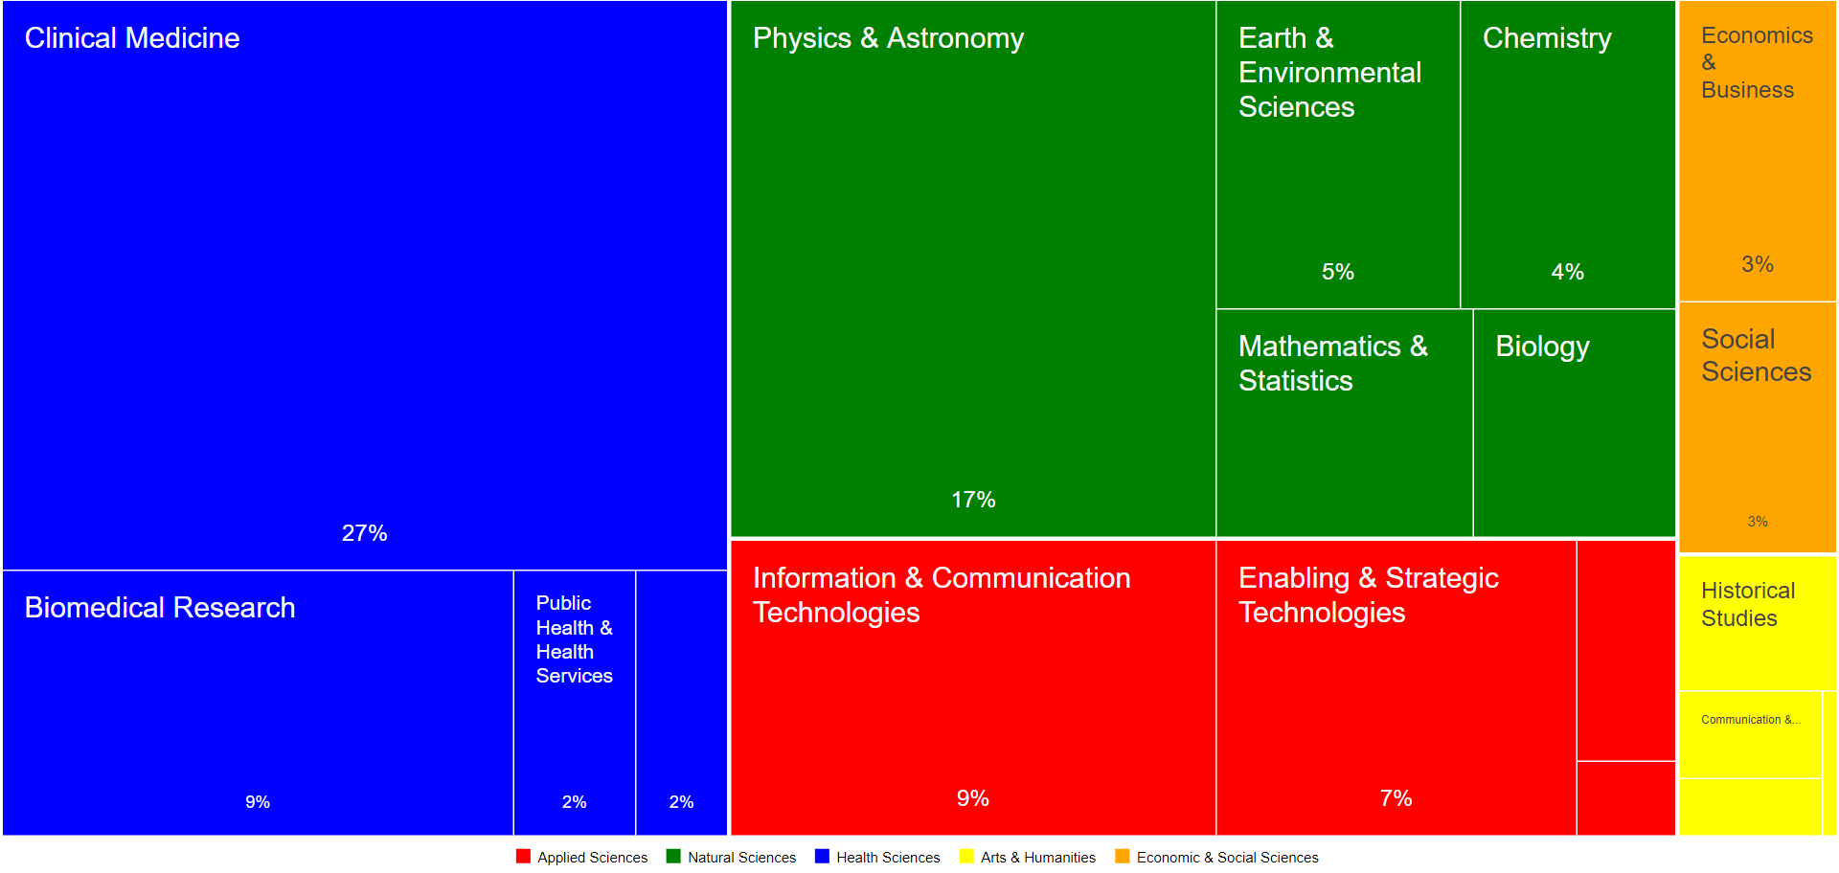
Regional eco-system mapping: publications
26/45

Slide 16
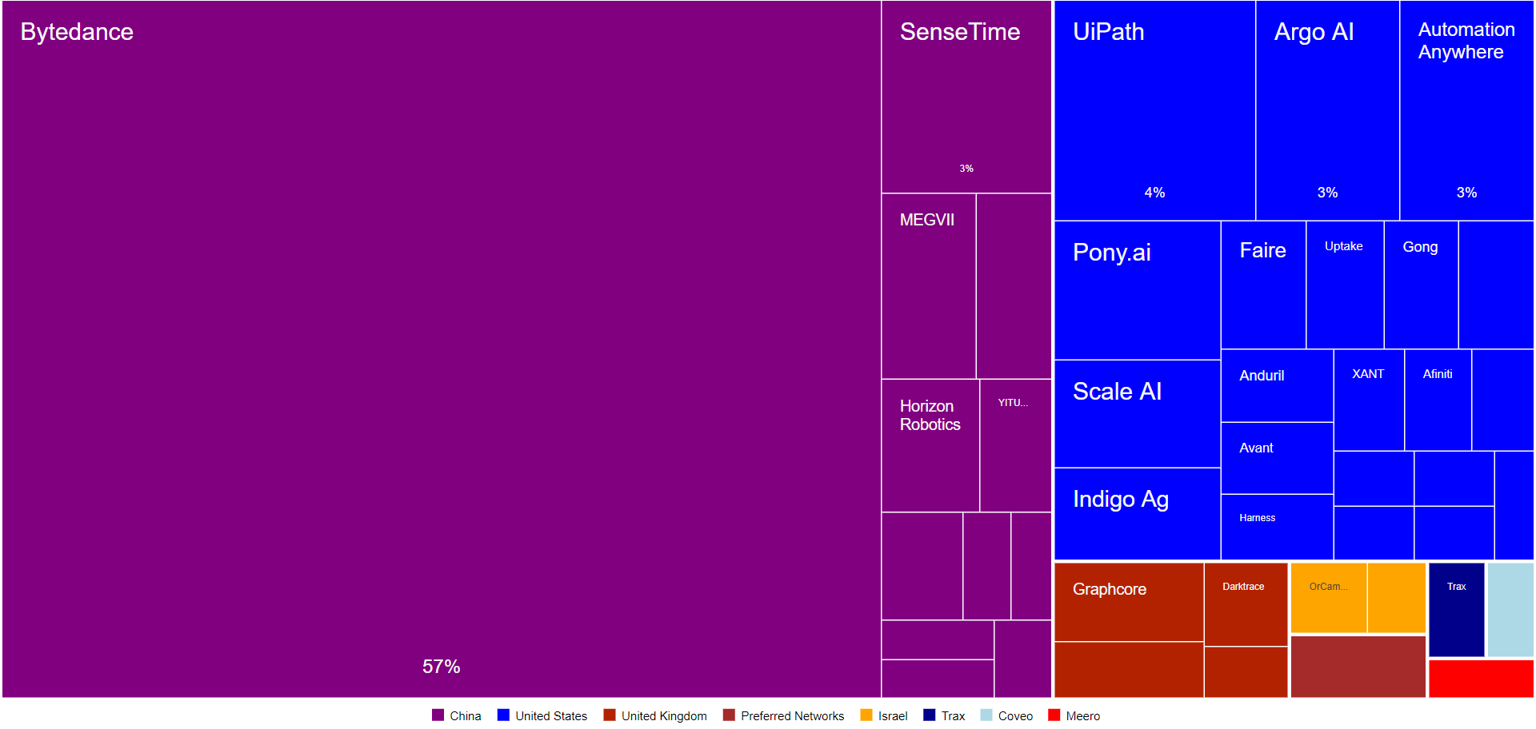
Regional eco-system mapping: start-ups
26/45

Slide 17
Key principles of smart specialization
1. Develop new specializations (products, techs) in more complex activities
2. Develop new specializations (products, techs) that are related to existing activities
Notes:
Holaamor

Slide 18
Smart specialization analytics
Complexity
High Risks
High Benefits
Low Risks
High Benefits
High Risks
Low Benefits
Low Risks
Low Benefits
Relatedness
Balland, P.A., Boschma, R., Crespo, J. and Rigby, D. (2019) Smart Specialization policy in the EU: Relatedness, Knowledge Complexity and Regional Diversification, Regional Studies, 53 (9): 1252-1268

Slide 19
Mapping opportunities
Complexity
AI
Relatedness

Slide 20
Mapping opportunities
Complexity
Animal Protein
Relatedness

Slide 21
Data sources
Data USA: https://datausa.io/
OEC: https://oec.world/
Data Africa: https://dataafrica.io/
Bureau of labor stats: https://www.bls.gov/
Eurostat: https://ec.europa.eu/eurostat
Crunchbase: https://www.crunchbase.com/
UU data: https://www.uu.nl/en/university-library
Stanford net data: https://snap.stanford.edu/data/
Dataverse: https://dataverse.harvard.edu/
Google

Slide 22
Data sources
R&D projects (FPs)
Structural Business Statistics (Industries)
Labor Force Survey (Occupations)
Companies/Univ websites
Twitter/Linkedin
User-generated content
Notes:
Holaamor

Slide 23
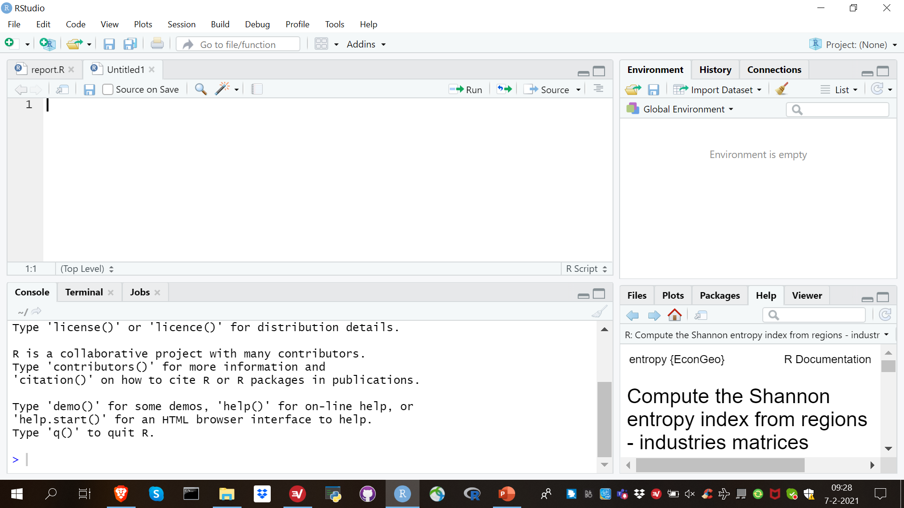
Let’s get back to R

