Slide 1
Deliverables 4.1 Smart Specialization Charts – Industries Smart Specialization Charts – Occupations Relatedness Density Maps – Industries Relatedness Density Maps – Occupations Full webpage of interactive charts/maps for D.4.1 available here: https://paballand.github.io/asg/dg-regio/links.html

Slide 2
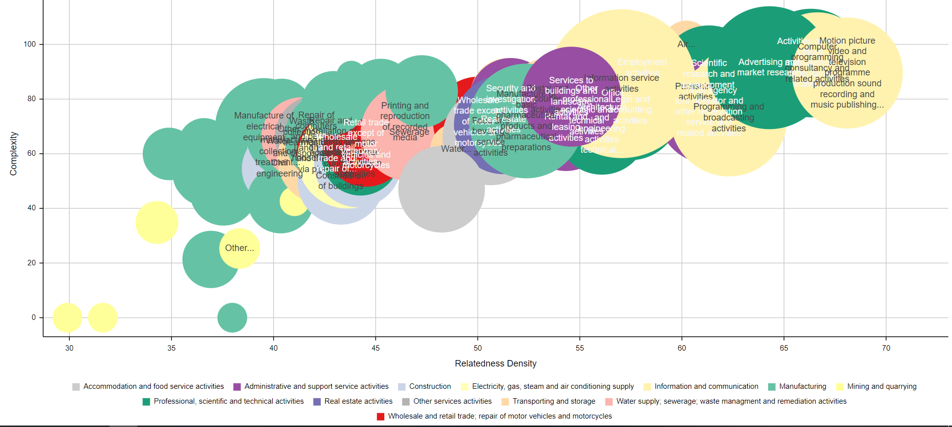
Smart Specialization Charts – Industries (Vienna)
https://paballand.github.io/asg/dg-regio/smart-specialisation-graphs/industries/AT13.html

Slide 3
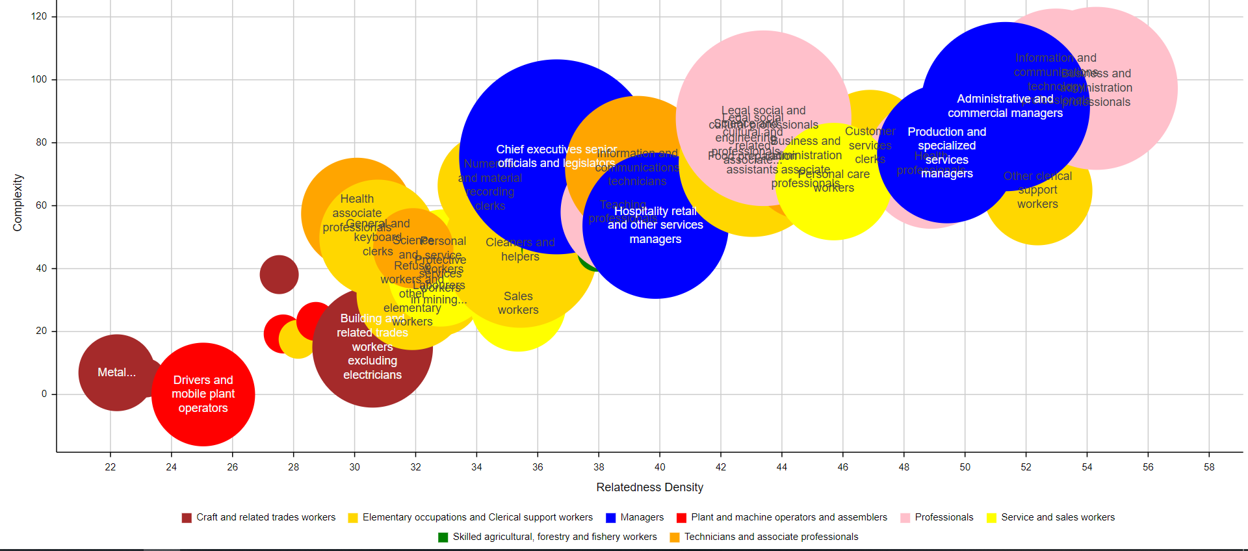
Smart Specialization Charts – Occupations (Brussels)
https://paballand.github.io/asg/dg-regio/smart-specialisation-graphs/industries/BE10.html

Slide 4
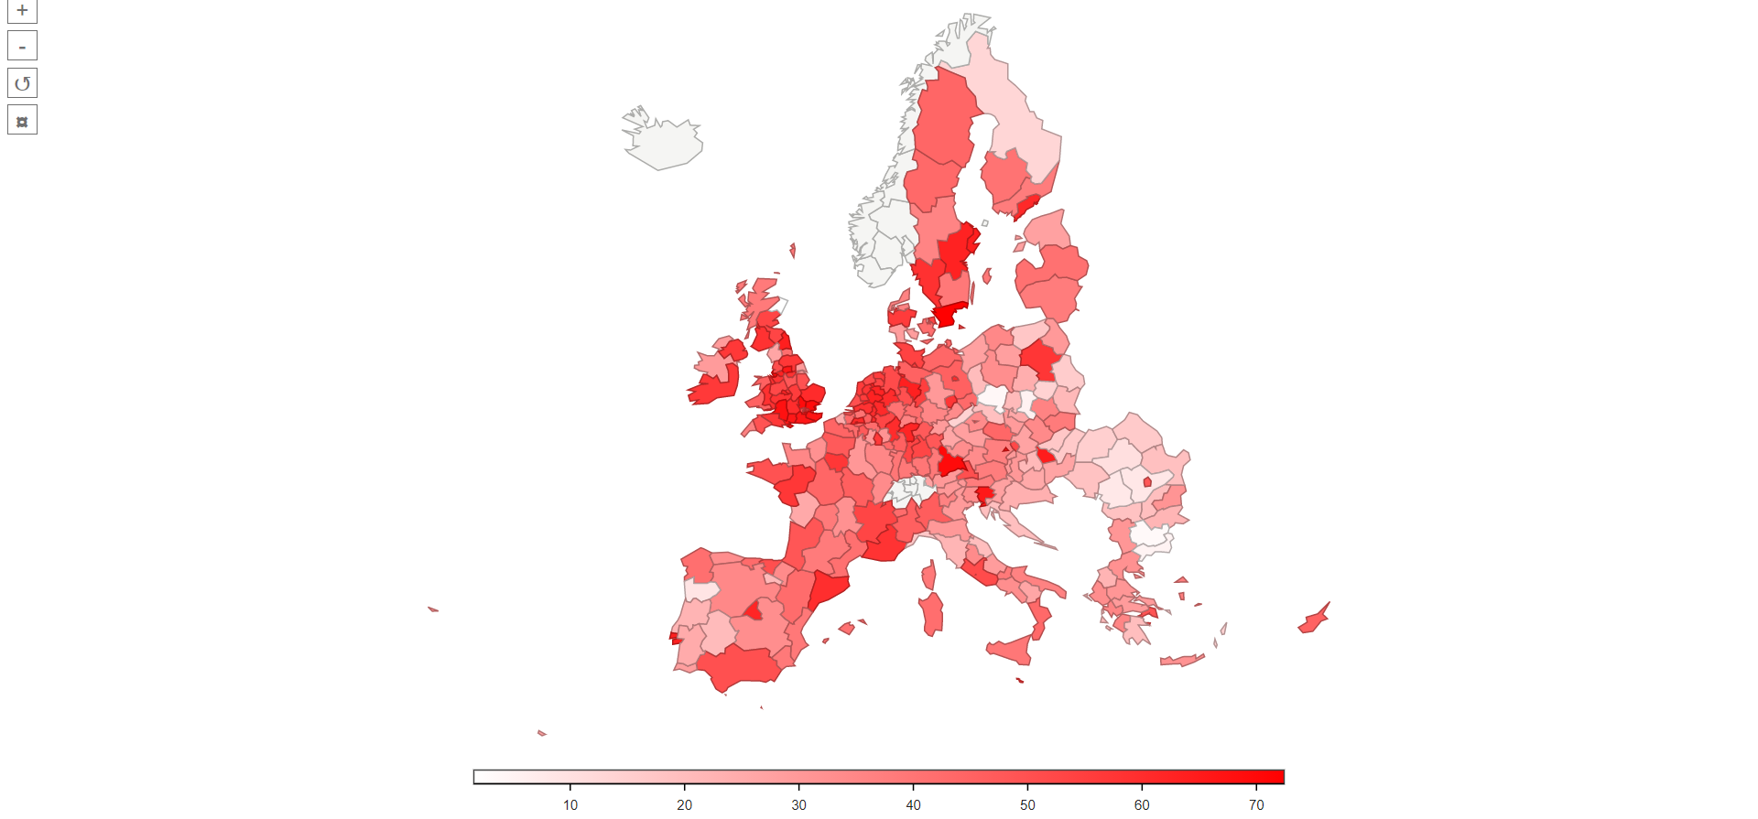
Relatedness Density Maps – Industries (Computer programming consultancy and related activities)
https://paballand.github.io/asg/dg-regio/relatedness-density-maps/industries/nace-62.html

Slide 5
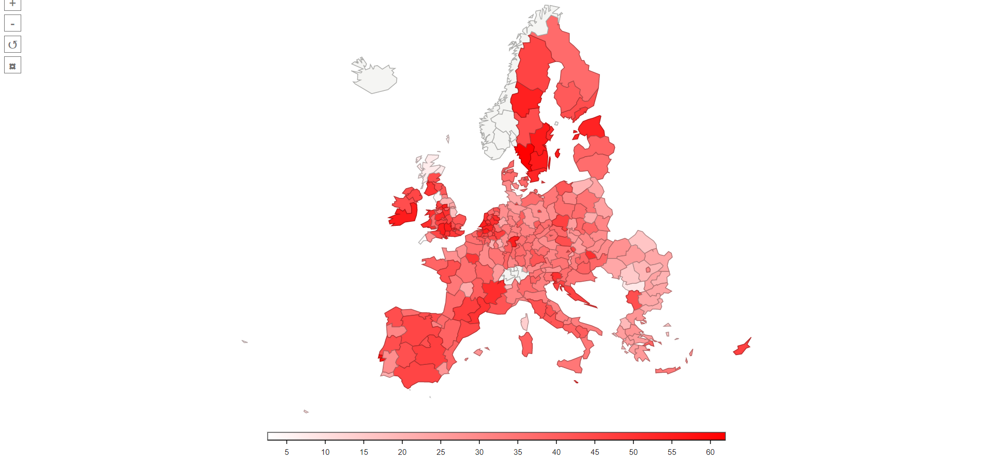
Relatedness Density Maps – Occupations (Health professionals)
https://paballand.github.io/asg/dg-regio/relatedness-density-maps/occupations/isco-22.html

