Slide 1
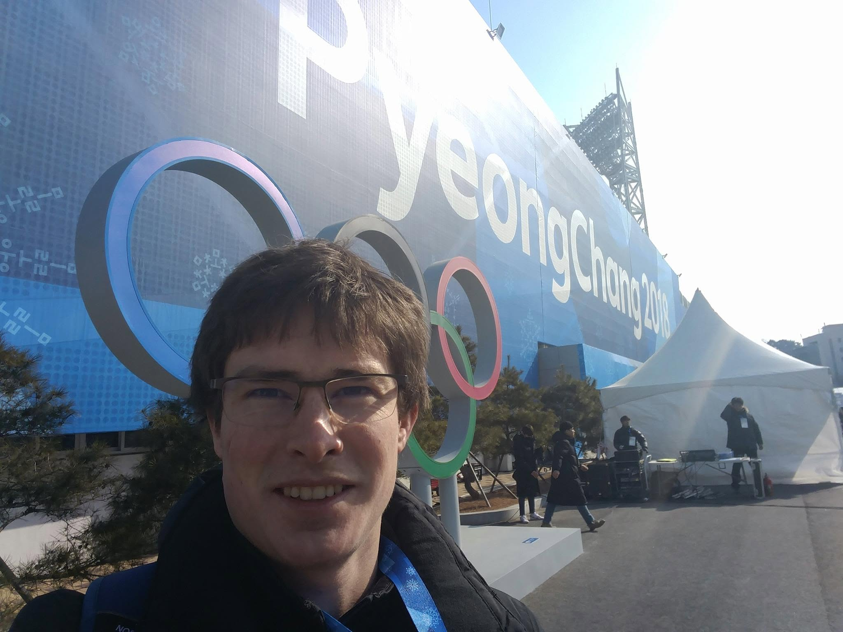
dr. Maarten Slembrouck
ABOUT ME
Notes:
A short introduction at the start of the session.

Slide 2




My path
Master
Master of Science in Applied Engineering Electronics/ICT
PhD
Doctor of Engineering
Postdoc
PostDoc @ UGent-imec
PhD
"3D reconstruction of persons and objects using multiple cameras with overlapping views in the presence of occlusion"
Notes:
From a master's in electronics/ICT to a PhD on 3D reconstruction with multiple cameras, then a postdoc at UGent-imec.

Slide 3


What I do today
80%
20%
PostDoc @ IDLab-IMPACT
Faculty of Engineering and Architecture
PostDoc @ Movement and Sport Sciences
Faculty of Medicine and Health Sciences
Notes:
My time is split over two faculties: engineering, and movement and sport sciences.

Slide 4




My role at HILO
Support (PhD) students in data analytics
Help (PhD) students in automating data analytics tasks
Create awareness about the importance of dataset sizes and data consistency
(IT support)
Notes:
At HILO I support (PhD) students in data analytics and in automating it.

Slide 5

Beyond research
Short track coach
Short Track Speed Skating
Notes:
Beyond research, I coach short track speed skating.

Slide 6

Beyond research
Founder/CTO of RouBack (Spin-off)
Cycling Safety through course screening and active sensing
Notes:
Beyond research, I am founder and CTO of RouBack, a spin-off on cycling safety.

