Slide 1


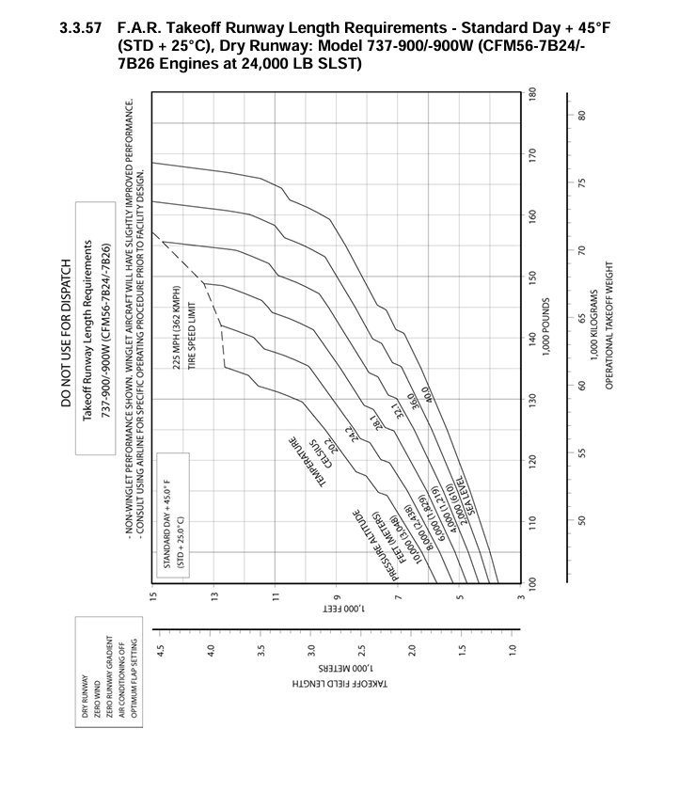
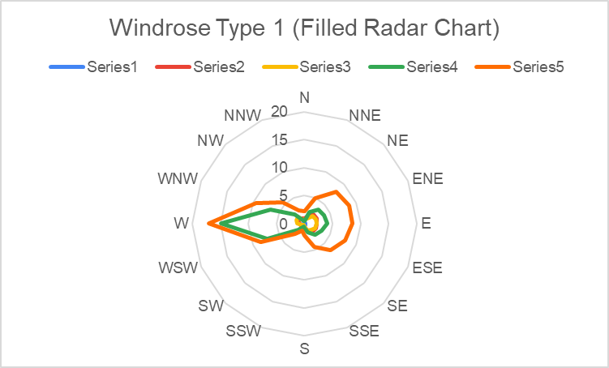
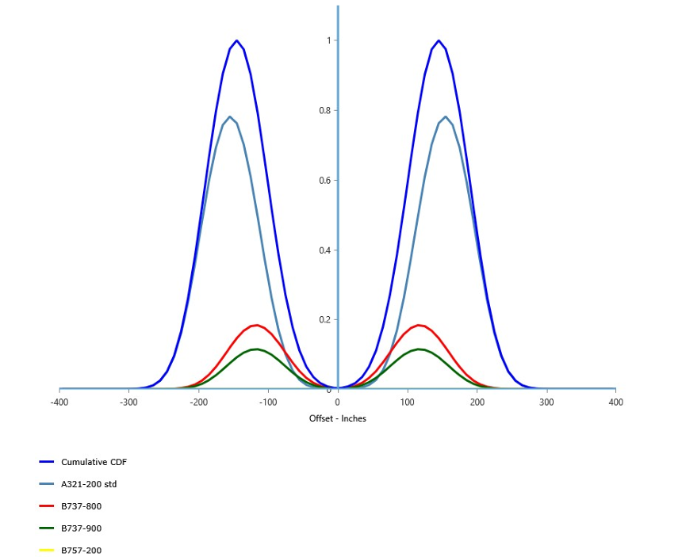
PRECISION RUNWAY ENGINEERING: AN INTEGRATED APPROACH TO SITE SELECTION,WIND ALIGNMENT, AND PAVEMENT STRUCTURAL DESIGN
Professional Association For Civil Engineering, NITK Surathkal
Mentor: Gajendra Kinodiya, Sanjana, Aarshi Sinha Mentees:Shreya V. Buchade, Hitee Yadav, Bogala Lakshmi B., Kaushik Patel, Astik Kumar,
Tanush Karkade, Anubhav Narayan Rob
Introduction
● Context: Airport infrastructure is a vital driver of regional economic development, requiring precise engineering to ensure multi-modal connectivity in Karnataka.
● Objective: To establish a comprehensive, scalable, and cost-effective framework for airport planning by integrating geospatial automation with mechanistic-empirical design.
● Core Focus: Optimization of runway site selection, wind-based alignment, and pavement structural integrity for high-capacity narrow-body aircraft.
● Methodology: Utilizing a JavaScript-based Google Earth Engine (GEE) pipeline for spatial filtering combined with ICAO-standard meteorological and FAARFIELD structural analysis.
.
● Structural Modeling: FAARFIELD 2.0 was used to calculate a Cumulative Damage Factor (CDF), ensuring the structure withstands a 20-year traffic mix.
● Pavement Metrics: Determined a required �exible pavement thickness of 27.0 inches
(68 cm) to support a taxi weight of 174,700 lbs.
Results and Discussion
● Primary Candidate: Gulbarga (Site R1) emerged as the top-ranked location with a score of 94.2 and 13.9 km² of available area.
● Regional Suitability: High-potential clusters are concentrated in Gulbarga (31%),Belagavi (25%), and Vijayapura (19%).
● Optimal Alignment: The East-West orientation minimizes crosswinds from the dominant Westerly monsoon patterns of the Deccan Plateau.
● Final Runway Dimensions: A adopted runway length of 3,200 m and width of 45 m meets all Code 4C safety requirements.
● Maneuverability: Designed taxiway turning radii of 550 m far exceed the 153.9 m minimum steering requirement for the Boeing 737-900.
● Subgrade Assessment: Red loamy/lateritic soils with a soaked CBR of 7% (Subgrade Modulus: 10,500 psi) were identified as the design baseline.
● Structural Composition: The optimized cross-section consists of 4" HMA Surface, 9"Crushed Aggregate Base, and 14" Granular Subbase.
● Bearing Capacity: The final PCN Rating is established as 61/F/C/W/T, matching the Aircraft Classification Number (ACN) of the CDA.
● Verification: Manual CBR calculations (estimating 580–620 mm) closely validated the FAARFIELD software outputs.
● Automation Efficacy: The study proves that GEE-based remote sensing can drastically reduce the cost and time of preliminary feasibility surveys.
wind rose diagram
F.A.R. Takeoff Runway Length Requirements - Standard Day + 45°F (STD + 25°C), Dry Runway
Scope
●Geospatial Extent: Covers the entire 191,791 km² boundary of Karnataka state to identify underserved, topographically suitable land clusters.
● Operational Class: Designed for Aerodrome Reference Code 4C, specifically supporting the Boeing 737-900W as the Critical Design Aircraft (CDA).
●Technical Depth: Includes 10-year historical wind data scrubbing, 20-year pavement fatigue modeling (CDF), and ICAO-standard runway length corrections.
FAARFIELD CDF Graph
Conclusions
The project successfully demonstrates an integrated, objective framework for modern aviation planning.By merging geospatial intelligence with rigorous structural and meteorological analysis, we identified technically and logistically viable sites capable of supporting high-capacity narrow-body jet operations in underserved regions of Karnataka.
Numerical Analysis
● Spatial Filtering: Sequential GIS filters (Land Cover and Slope < 5°) reduced the initial state area to 803 viable clusters over 3 km².
● Weighted Ranking: Sites were scored using a Multi-Criteria formula: 30% Area, 25% Slope, 20% Road Access, 15% Urban Safety, and 10% Growth Potential.
● Wind Usability: Analysis of 87,000+ observations confirmed that a 09/27 (East-West) alignment provides a 100% Usability Factor.
● Length Corrections: A basic runway length of 2,250 m was corrected for elevation (449m), Airport Reference Temperature (33°C), and gradient (0.3%).

