Slide 1


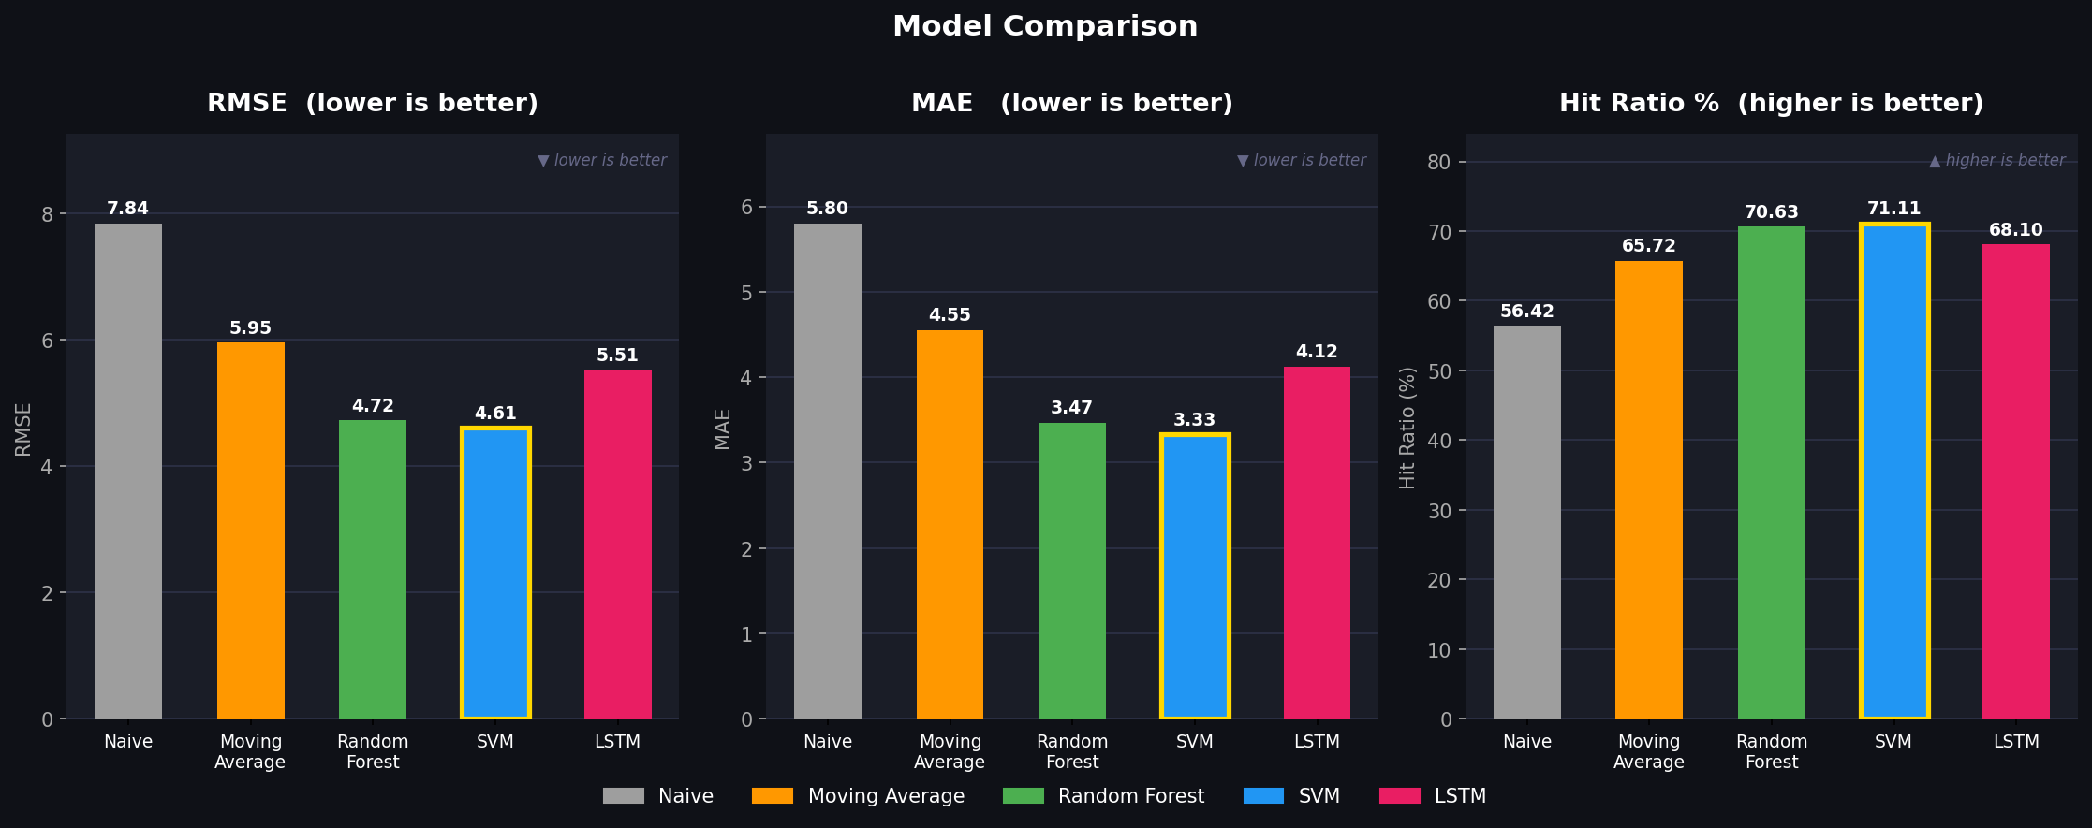


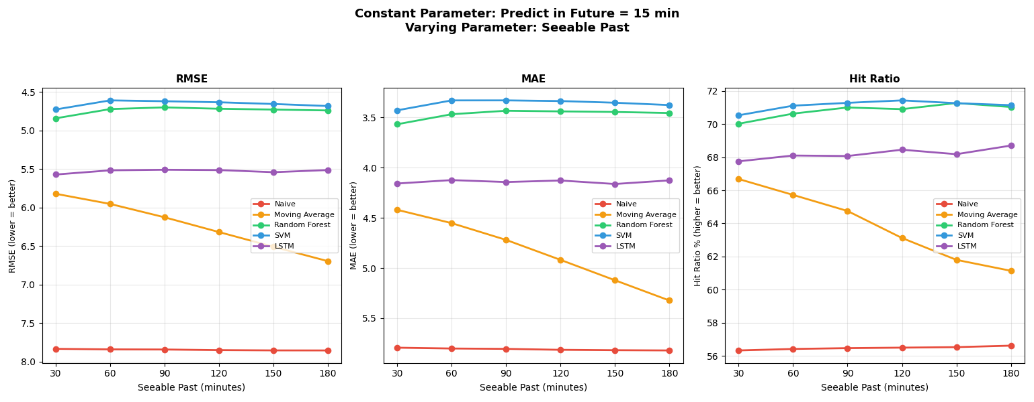
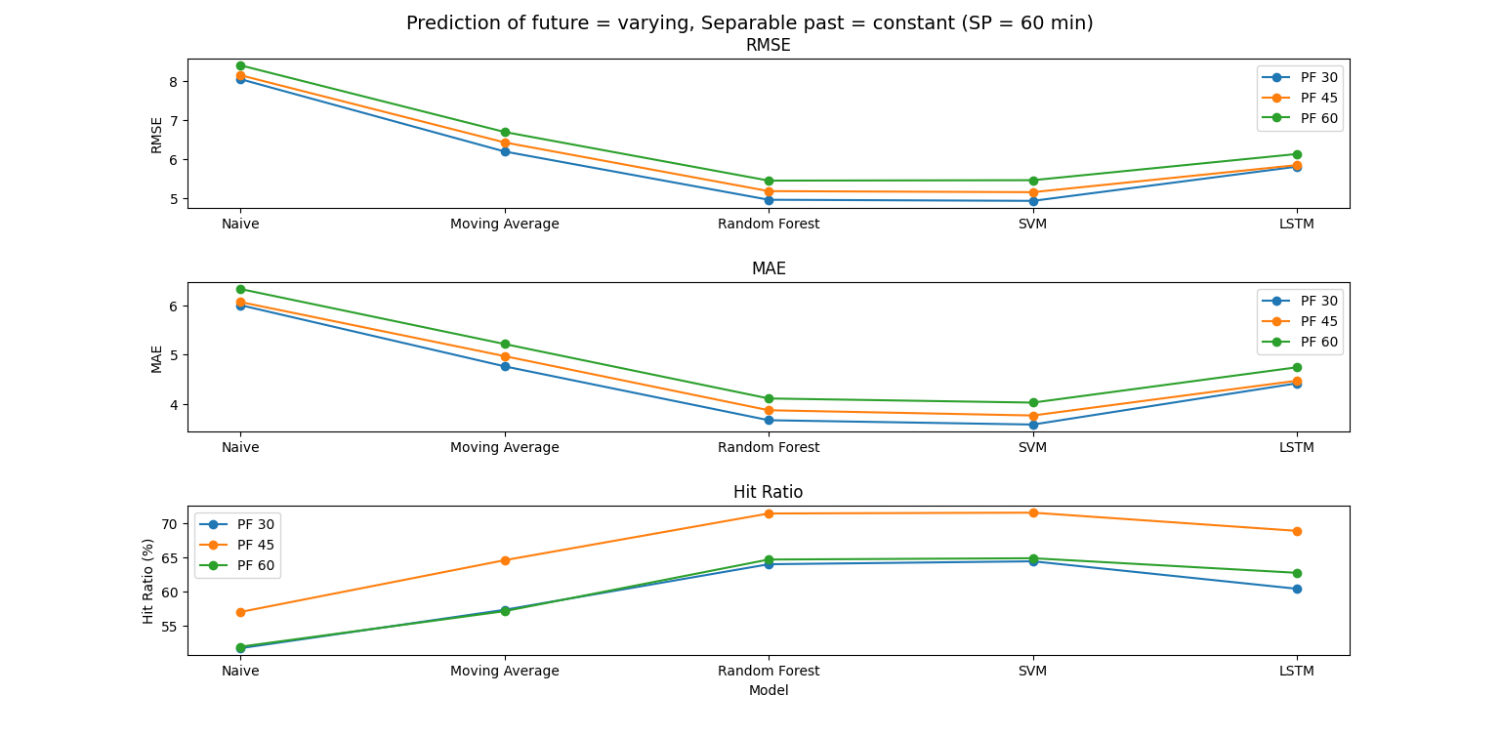
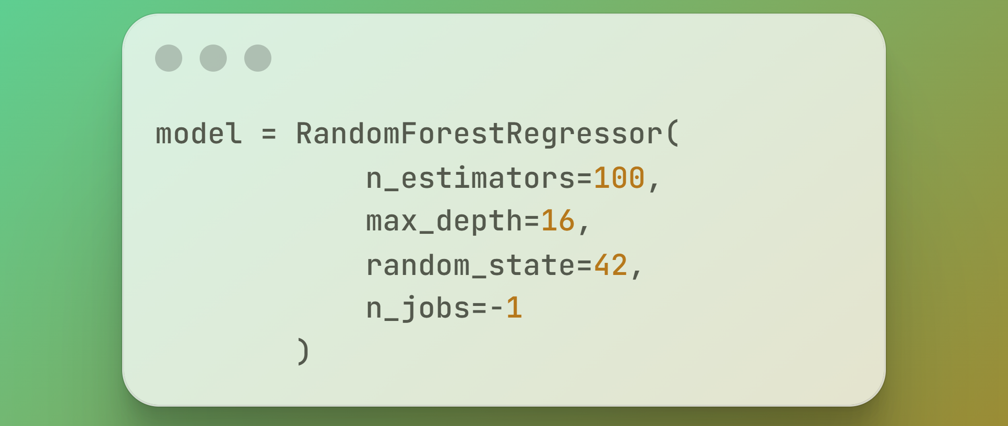

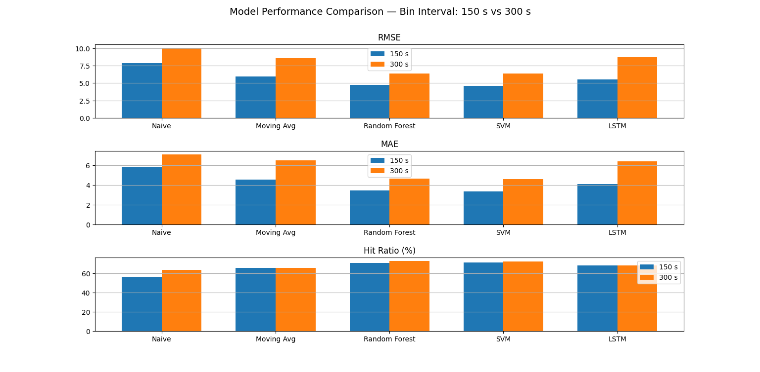
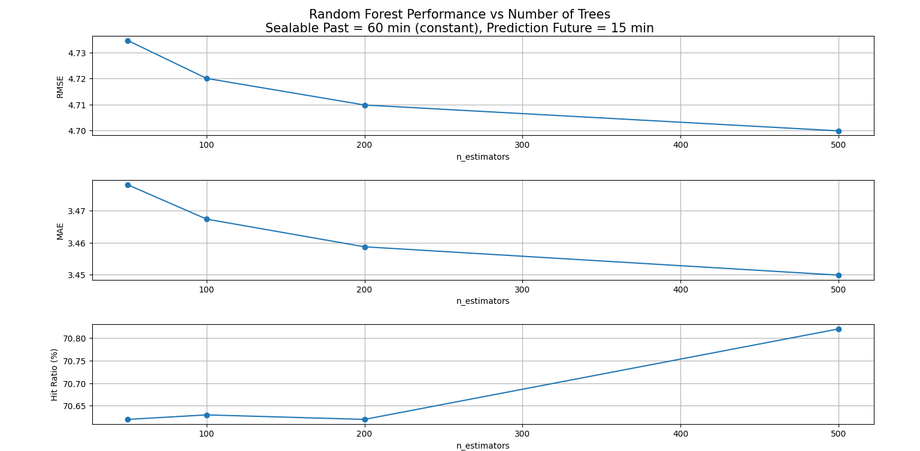
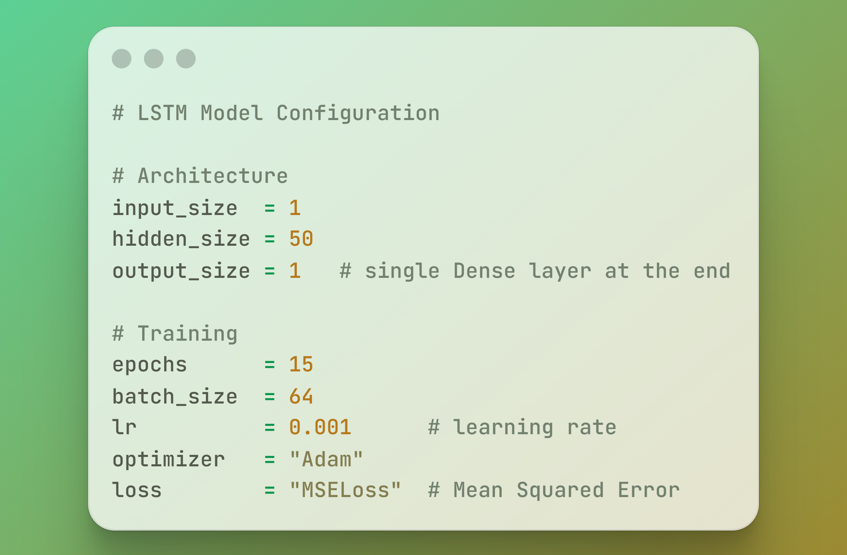
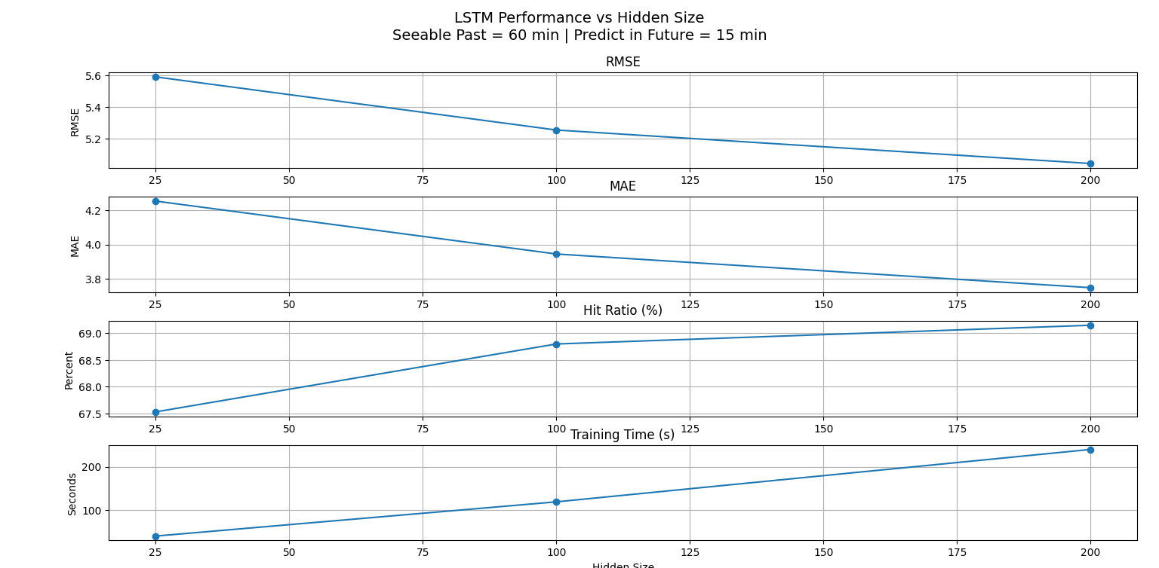
TRAFFIC FLOW PREDICTION USING MACHINE LEARNING AND DEEP LEARNING TECHNIQUES
Professional Association For Civil Engineering, NITK Surathkal
Mentor: Priyanshu, Muskan. Mentees: Gurubasava, Abraham, Kolluru, Neelkanth, Abhishek.
Introduction
Traditional ML and Deep Learning Models:
•Naïve Baseline: Simplest approach using the last known value as the prediction.
•Moving Average: Uses the average over a set window size of past values as the prediction.
•Random Forest: Builds many decision trees on random subsets of data and averages their predictions to forecast traffic flow
• Support Vector Machine: SVR finds a regression function within a defined margin (epsilon-tube), optimizing to minimize prediction error while controlling model complexity
•LSTM: LSTM uses gating mechanisms to selectively retain or discard information across time steps, enabling it to capture long-range temporal dependencies in sequential data.
Evaluation Metrics & Model Comparison:
To determine the superior forecasting method, the models were evaluated and compared across four critical dimensions:
Root Mean Squared Error (RMSE): Measures the magnitude of prediction errors (penalizes larger errors heavily).
Mean Absolute Error (MAE): Measures the average absolute difference between predicted and actual values.
Hit Ratio: The percentage of time steps where the model correctly predicted the direction of traffic flow change i.e., whether flow increased or decreased.
Computational Time: Tracks the time taken for model training and inference.
MODEL COMPARISION
Context: As cities grow, the number of vehicles on the road is rising fast, causing severe traffic jams. Traffic changes quickly and depends on both time and location, making it hard to predict. Using machine learning to accurately forecast traffic flow has become essential to manage roads smoothly and prevent gridlock before it happens.
Project Objective: To build and compare traditional machine learning models and deep learning models to find the best method for predicting traffic flow.
Core Focus: Building an accurate predictor to forecast the fundamental characteristics of traffic such as flow, density and speed.
Methodology: The project implements and evaluates both traditional learning models such as Naïve Baseline, Moving Average, Random Forest and Support Vector Machine and deep learning models such as LSTM using historical traffic data.
SVM is the best overall: lowest RMSE (4.607) and MAE (3.3294), highest Hit Ratio (71.11%).
LSTM underperforms: despite being the most complex model, sits closer to Moving Average, which is a traditional baseline. Classic case of deep learning needing more data and training to justify its complexity.
1. Varying seeable past parameter
2. Varying predicting future parameter
Scope
Data Collection and Preprocessing: Gathering raw traffic data, filtering it to focus on a single sensor (one specific road), and converting timestamps into seconds.
Feature Extraction: Grouping the data into 150-second intervals to calculate fundamental traffic characteristics (flow, density, and average speed).
Model Implementation: Preparing the processed data and feeding it into the selected traditional machine learning and deep learning models.
Hyperparameter Tuning: Fine-tuning the parameters of the models to optimize their performance.
Performance Evaluation: Comparing the models against each other using key metrics, including RMSE, MAE, Hit Ratio, and computational time taken.
More past data ≠ better. There's a sweet spot around 60 minutes of past data for a 15-minute prediction horizon. Beyond that, older data adds noise. Moving Average suffers most from too much history; LSTM benefits slightly but not significantly.
Predicting further into the future = worse performance. RMSE and MAE rise steadily as horizon increases from 15 to 60 minutes. Hit Ratio peaks around 45 minutes then drops. models handle short-to-medium term direction well but lose accuracy beyond that.
3. Comparing different bin intervals
4. Increasing no. of trees in RF
Numerical Analysis
Smaller intervals (150s) outperform larger ones (300s) RMSE/MAE drop by ~2 units. Hit Ratio stays nearly the same since the overall traffic direction doesn't change, just the precision.
300s smooths too aggressively, losing short-term traffic variations the models rely on. 150s hits the sweet spot granular enough to capture meaningful patterns, but not so fine that noise dominates.
More trees = better accuracy, but with diminishing returns. 50 to 200 trees gives meaningful gains; 200 to 500 barely moves RMSE/MAE (~0.01 difference) while training time more than doubles (10 to 28 sec).
Random Forests typically saturate around 100 to 300 trees depending on dataset size. Beyond that we are paying compute cost for near-zero gain. 200 trees is the optimal sweet spot here.
Data and Setup Specifications:
• Dataset Focus: Single-sensor traffic data (one specific road).
• Time Resolution: Raw timestamps converted to seconds, aggregated into 150-second intervals and 300-second intervals.
• Target Features: Fundamental traffic characteristics (Flow, Density, and Speed).
5. Fine tuning hyperparameter of LSTM
Unlike Random Forest, LSTM hasn't plateaued at 200 units, RMSE/MAE are still dropping meaningfully, expanding the project with a larger dataset, more training epochs, an increased hidden layer size, a finely tuned learning rate, and smaller batch sizes is highly likely to yield even better accuracy.
Training time doubles each step though, so it's a harder tradeoff than Random Forest.
Configuration Parameter | Setting / Value
Temporal Sampling Interval | 150 Seconds
Historical Input Horizon (SEEABLE_PAST) | 60 Minutes (24 steps)
Forecast Target Delay (PREDICT_IN_FUTURE) | 15 Minutes (6 steps ahead)
Cross-Validation Scheme | 4-Fold Sequential Time-Series Split
Computational Core | PyTorch CUDA Execution Engine (cuda)
Results and Discussion
Conclusions
Following is the performance of each model with the given configuration on the dataset, evaluated across sequential cross-validation folds to ensure temporal stability:
The traffic flow prediction project successfully demonstrated that both traditional machine learning and deep learning models can effectively forecast urban traffic characteristics. SVM emerged as the best-performing model overall, achieving the lowest RMSE (4.607) and MAE (3.3294) alongside the highest Hit Ratio (71.11%), outperforming all other models including LSTM. This demonstrates that for single-sensor, limited-horizon traffic prediction, well-tuned classical models can match or exceed deep learning approaches. LSTM, while underperforming in this setup, shows a clear improvement trend with increasing hidden units, suggesting that with a larger dataset, more training epochs, and finer tuning, it can surpass classical models.

