Slide 1
Workout Guide Application
Group 3:
Anish Haram 52
Harsh Keluskar 48
Pranay Mahadik 21
Varad Yelamkar 59

Slide 2
TABLE OF CONTENTS
01
04
Introduction
Screens
02
05
Literature Survey
System Requirement
03
06
Major Requirement
Conclusion & Refrences
Introduction to our Project
Output Of our Project
Survey done for our project
System Requirements for our app
Software’s used to develop our app
Conclusion and our references

Slide 3
Introduction
Workout Guide
Workout Guide, an application that might change the way of working out and can also make you fit without you going to any specific GYM center.
This application is absolutely made for you to workout on almost daily basis without using any GYM equipment. Exercises are surveillance and guided under professional trainer that will help you to get fit and in good physique. This application is quite different from the other application in the market as its main motive is to make people workout without using any equipment.
To start your workout of the day you just need to unlock your phone, run the application see the type of workout you have in your mind, click on it and go.

Slide 4
OUR MODULES
WORKOUT
DIET PLAN
This modules include three more sub modules, i.e Bigenner, Intermediate and Advance
This module Includes two more sub modules, i.e For gaining weight and Loosing weight

Slide 5
LITERATURE SURVEY
Apps loaded up on your smartphone doesn't matter if you're at the gym or working out at home the right app can get you started on a healthier life style. Most of the apps we've looked at help you exercise where you are, offering step-by-step instructions for getting the most out of your workouts, even if your gym is your home.
Then this app is specially made for you. You don’t have to use any gym equipment’s. This app will also provide you some diet plans that will provide your body required nutrients. To build this application we went through different apps and we concluded some points that were not present on those apps so we decided to take on this topic .

Slide 6
ADVANTAGES
During this global pandemic its really important to stay fit, and staying fit
without going out is a difficult task. This app might bring some ease to your
problem.
Without going to any GYM center you can workout at home very efficiently.
You do not need to spend money on the GYM equipment.
It will be free to use so anyone can download it and use it.

Slide 7
DISADVANTAGES
There won’t be any personal trainer to help you at your home. But no worries
all the exercises are guided under Professional Trainers, so you won’t go
through any problem.
You might feel lazy or demotivated every other day. But don’t worry once you will the launch application there will be a Quote full of Motivation and
Positiveness pop up on your screen, which will give you a good reason and motivation to perform your daily exercise.

Slide 8


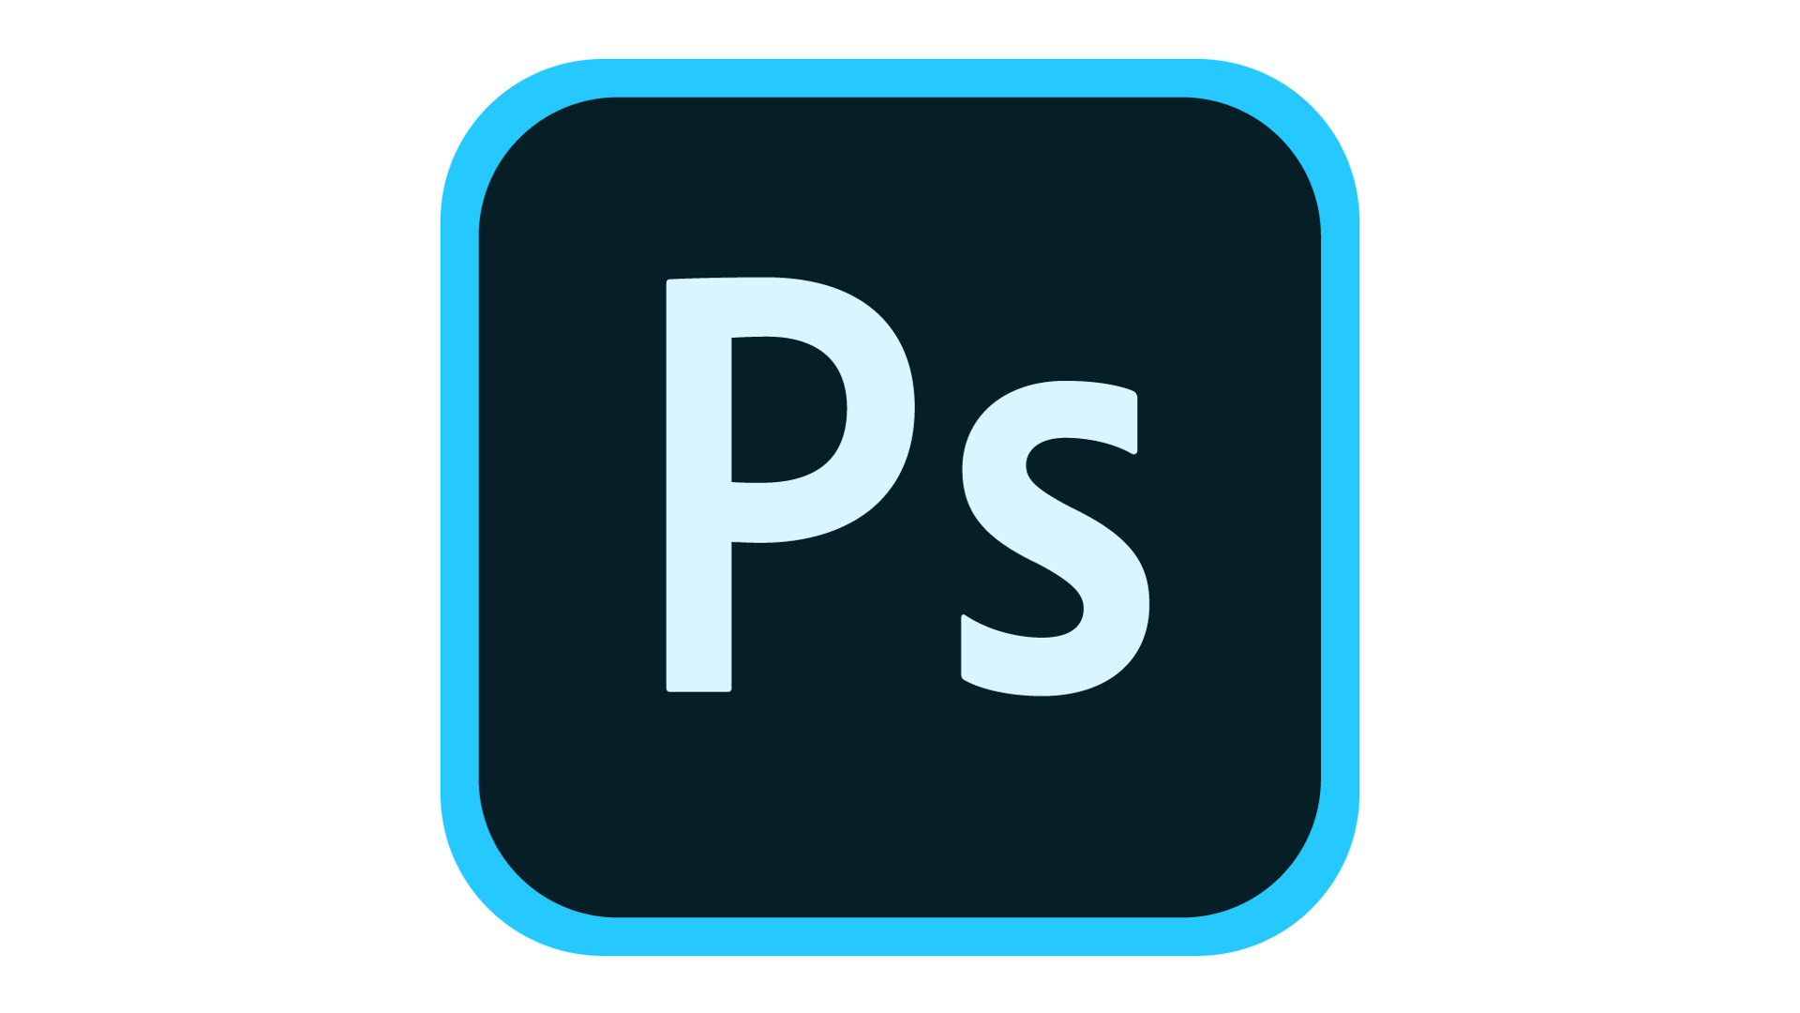
MAJOR REQUIREMENTS

Slide 9
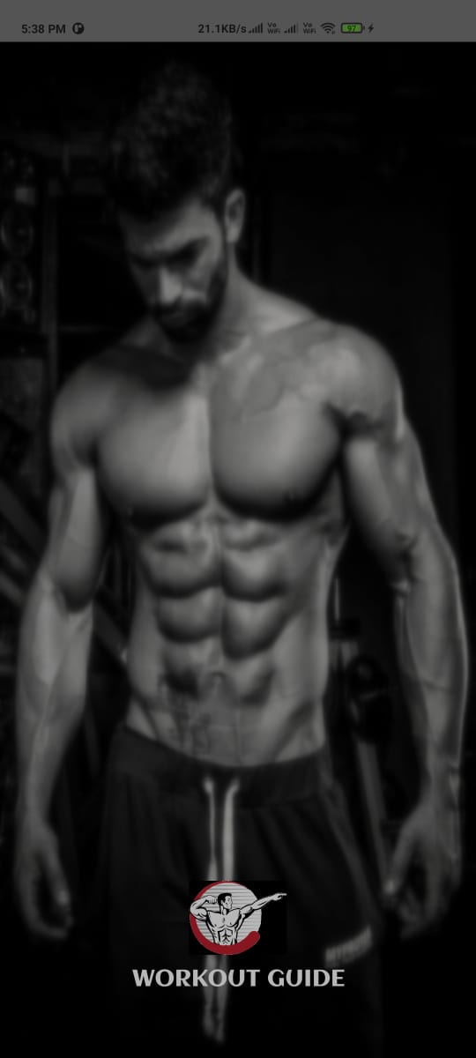
SCREENS
Splash Screen:
Once the Application is launched it this splash screen will pop up and it direct you to the home screen.

Slide 10
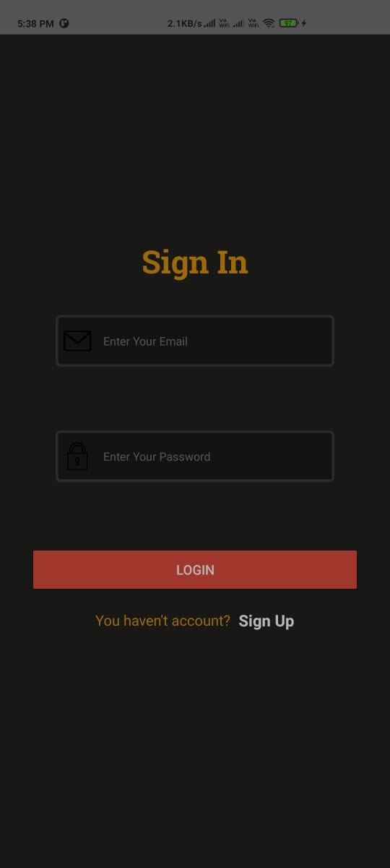
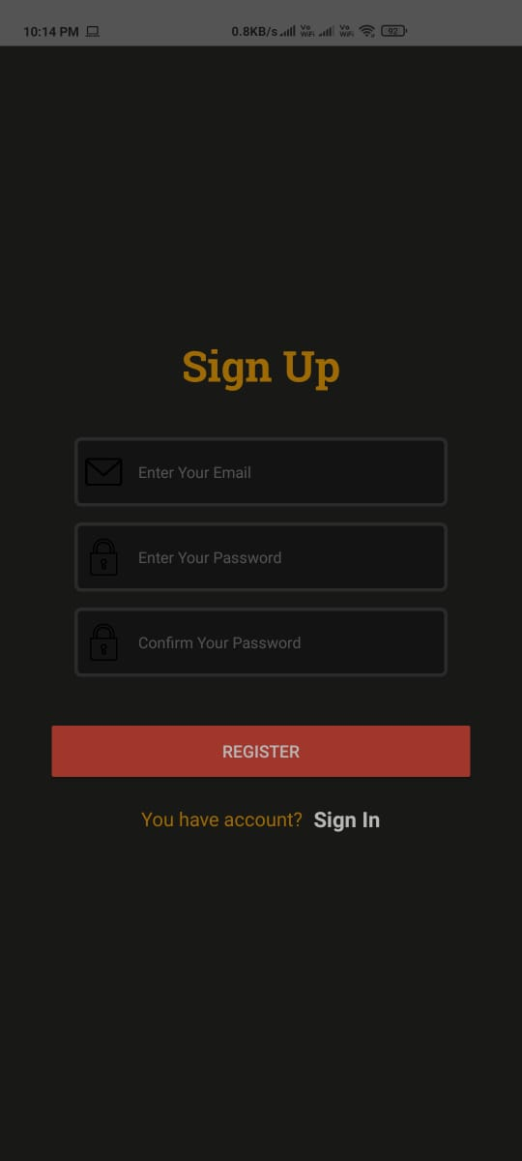
Sign In / Sign Up Screens:
Once you are pop on the Sign In screen you need to Sign In through your existing account. If you don’t have your account registered you can Sign Up for a new account through the Sign Up button given bellow. Once Signed In you will be directed to the Home Screen.

Slide 11
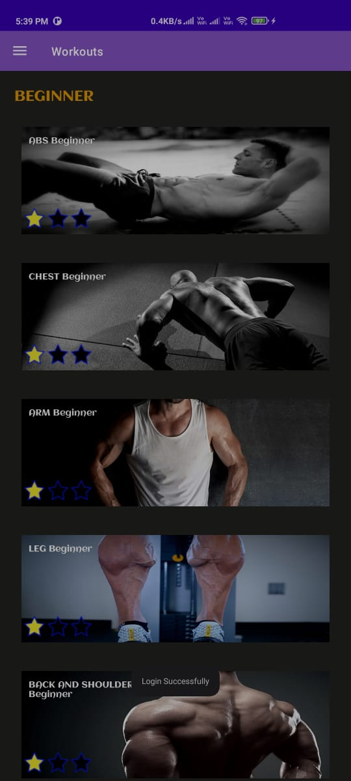
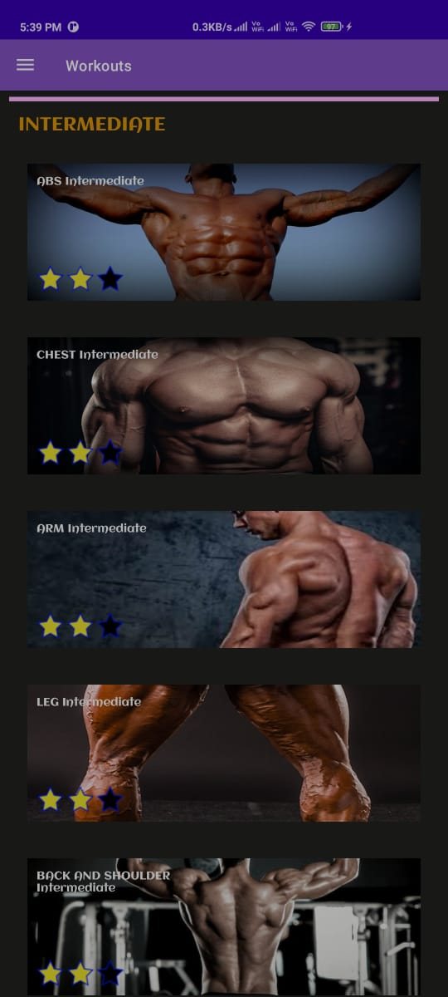
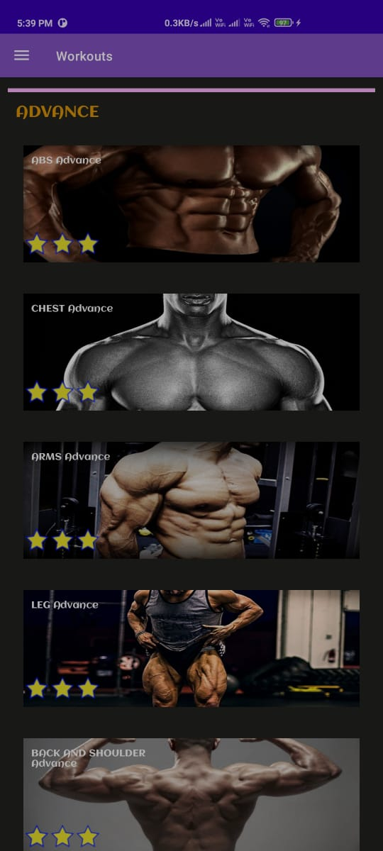
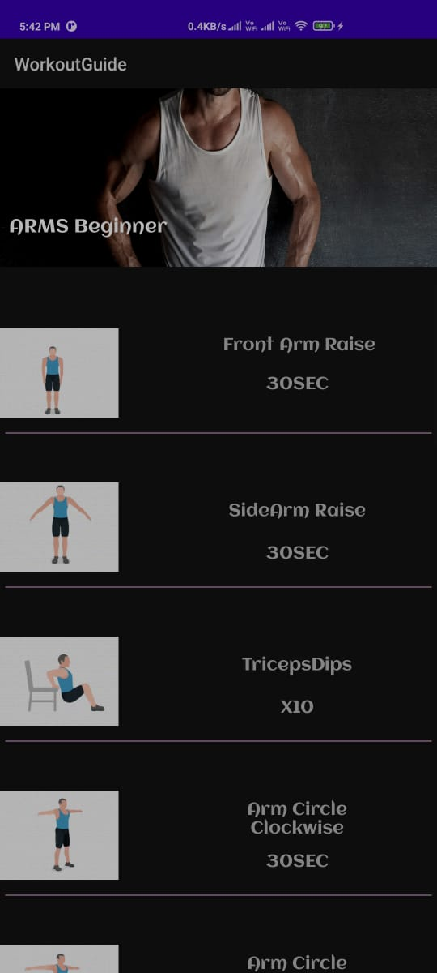
Workouts:
Here you can choose your suitable module and the exercise you want to do and start your daily fitness routine.

Slide 12
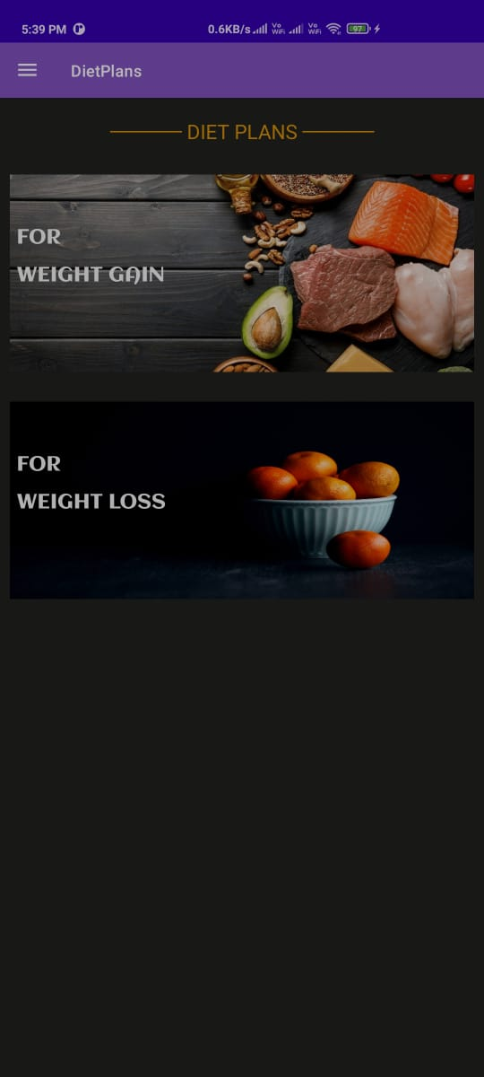
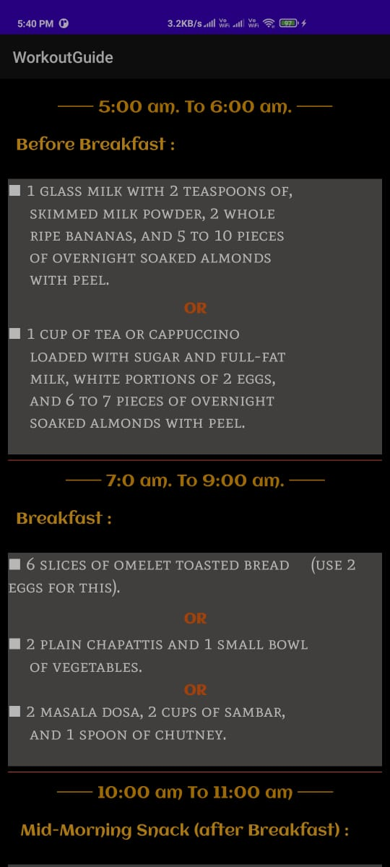
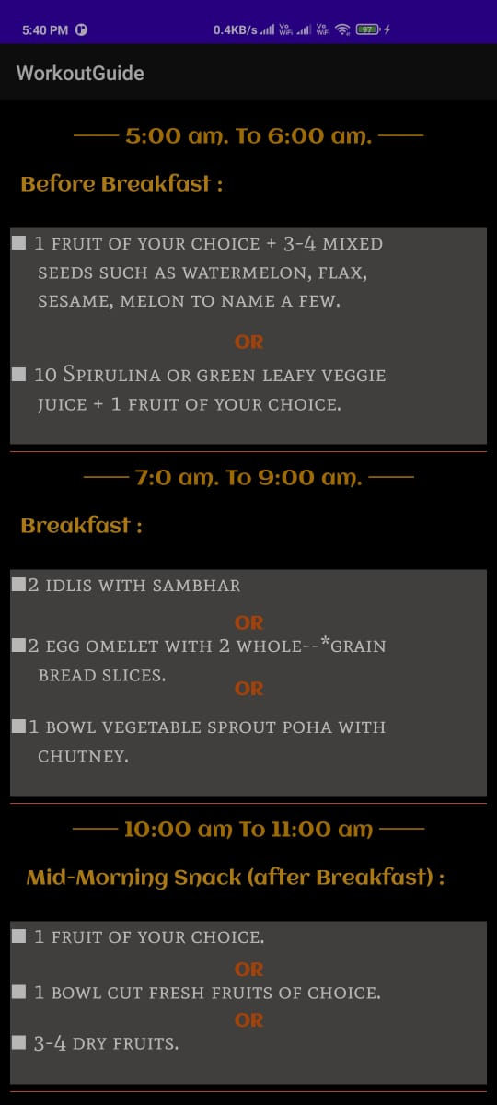
Diets:
Here you can choose your suitable module and the diet you want to do and start your daily fitness routine.

Slide 13
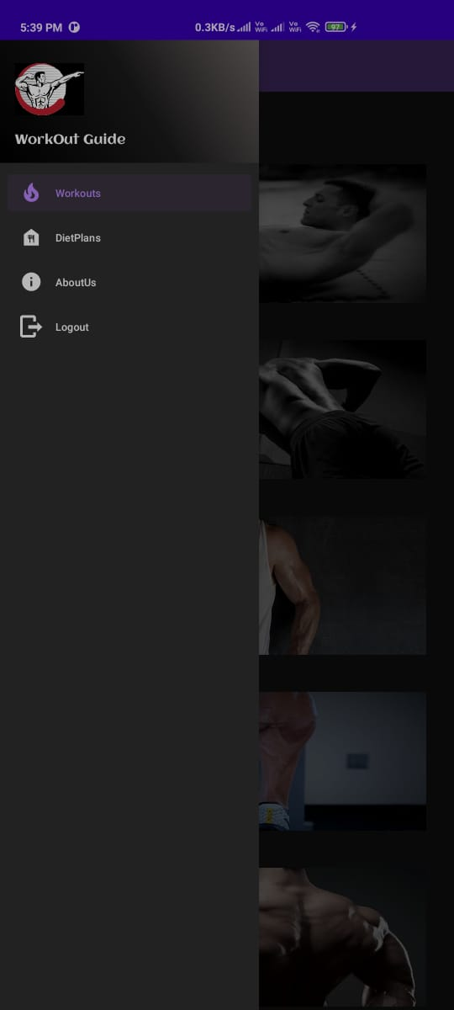
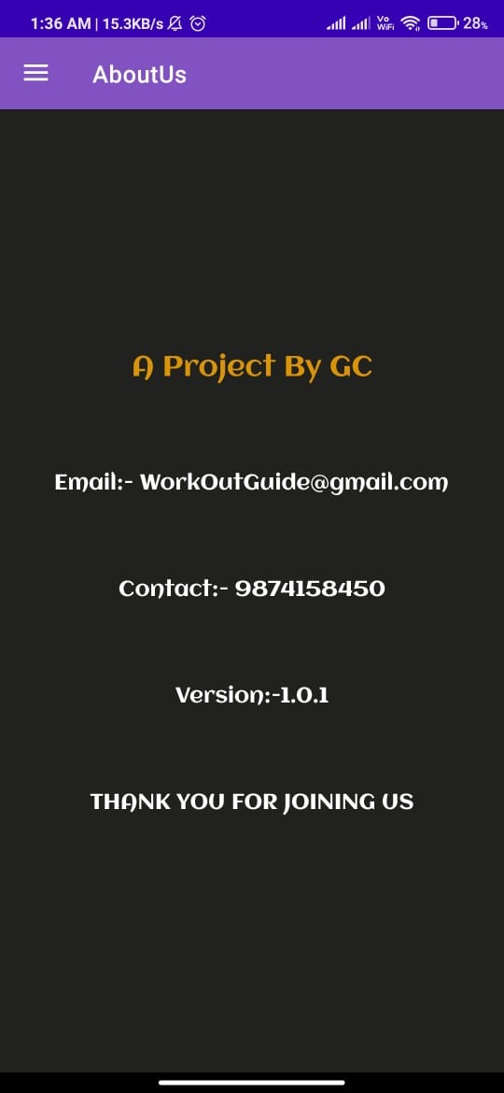
Navigation Bar & About us:
On the Navigation bar you can Switch to different screens such as Home screen, Diet Plan screen and About us. On About us page developers information and contact will be provided.

Slide 14
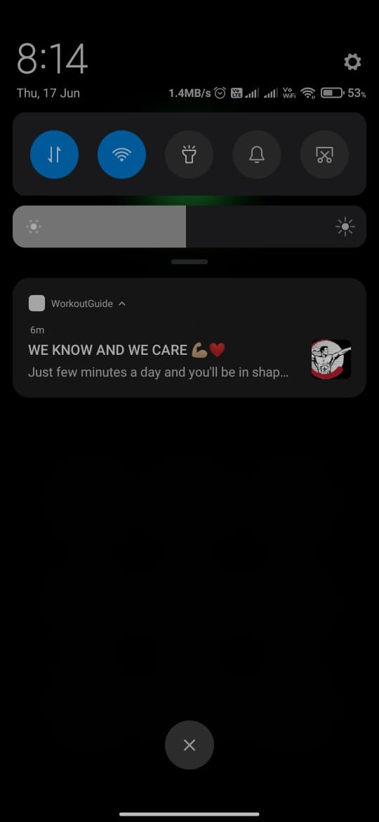
Notifications:
Notifications will be sent to users using Firebase’s Cloud Messaging. It is implemented to keep users connected to the app and use it to perform daily home workouts

Slide 15
CONCLUSION
So, we saw in how many different ways the mobile fitness apps help us in maintaining our heath. We saw how the technology can guide us towards a healthy lifestyle. It helps people struggling with obesity to adopt a healthy workout routine provided by this app. No wonder that, the app development process is exhausting, and overwhelming also. But, we have tried our best to cover multiple scenarios and possibilities you might encounter.

Slide 16
REFERENCES
www.google.com
www.youtube.com
www.stackoverflow.com
www.w3schoools.com
www.firebase.com
www.andriodstudio.com
www.ezgif.com
www.researchgate.net

Slide 17
THANKS!

