Slide 1
Padme dcs
By Simo from Sofia U. @ LNF

Slide 2
Goals and technology choice
Goals
  Easy to manage the experiment assets
    Configuration
      Version control
      Validity
    Operation conditions monitoring
    Single point operations management
  “Easy” to write
  Easy to add features
  Adequate
Technologies
  Python3
  Bottle (https://bottlepy.org)
  SQL database and simple ORM
  Vue.js (https://vuejs.org/)
Deliverables
  Command module
  Monitoring and logging of operational data
  Web interface, alerts, emergency actions

Slide 3
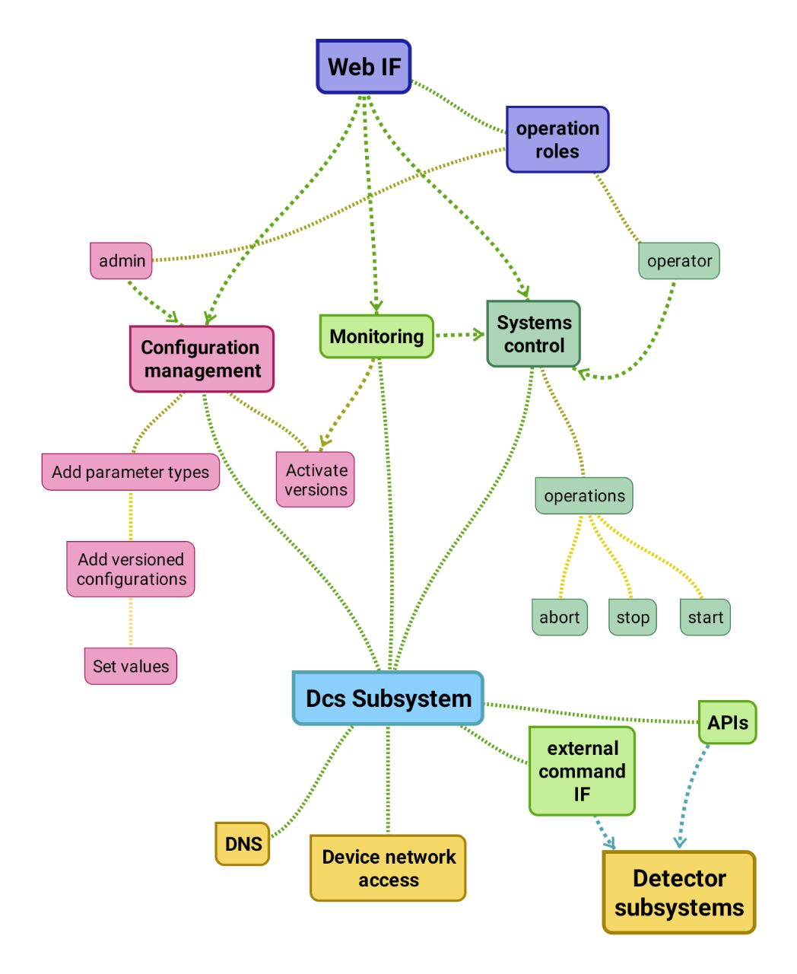
Functionality detail
  Configuration management:
      Default configuration/multiple versions
      Device configuration/multiple versions
      Device connections topology
  Monitoring:
      Heartbeats
      Op conditions data collection and display
      Monitoring of parameter deviations
      Logging and reaction
  Systems control:
      Interface with current text-based utilities or libraries
  Access control:
      Users and roles

Slide 4
Architecture overview
Web service - UI
Configuration store (database)
Operation parameters collection
Operation parameters monitor
Command system
Dependencies
  Addressing schemes
    General
    Network
  Project APIs and utilities’ interfaces

Slide 5
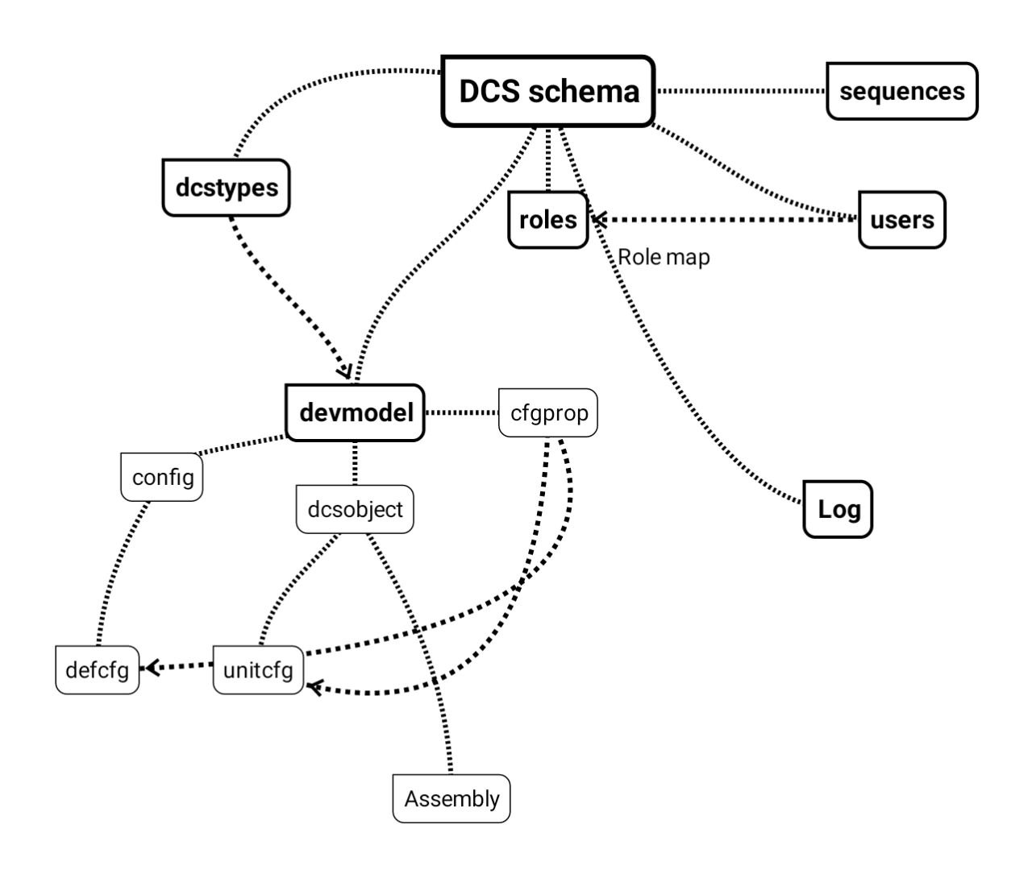
Database: user mgmt, device topology and configuration

Slide 6
Schedule
How long?
  Hopefully by next Friday
    User management
    Configuration system
    Command backend
      A prototype working with the SiPM detector controllers
    Simple Monitor backend
      A prototype working with the SiPM detector monitoring capability
    Some documentation (how to add new command modules)
  Complete system and Documentation
    End of September?

