Slide 1
Algorithmic Techniques Dense Lower Triangular Solver

Slide 2
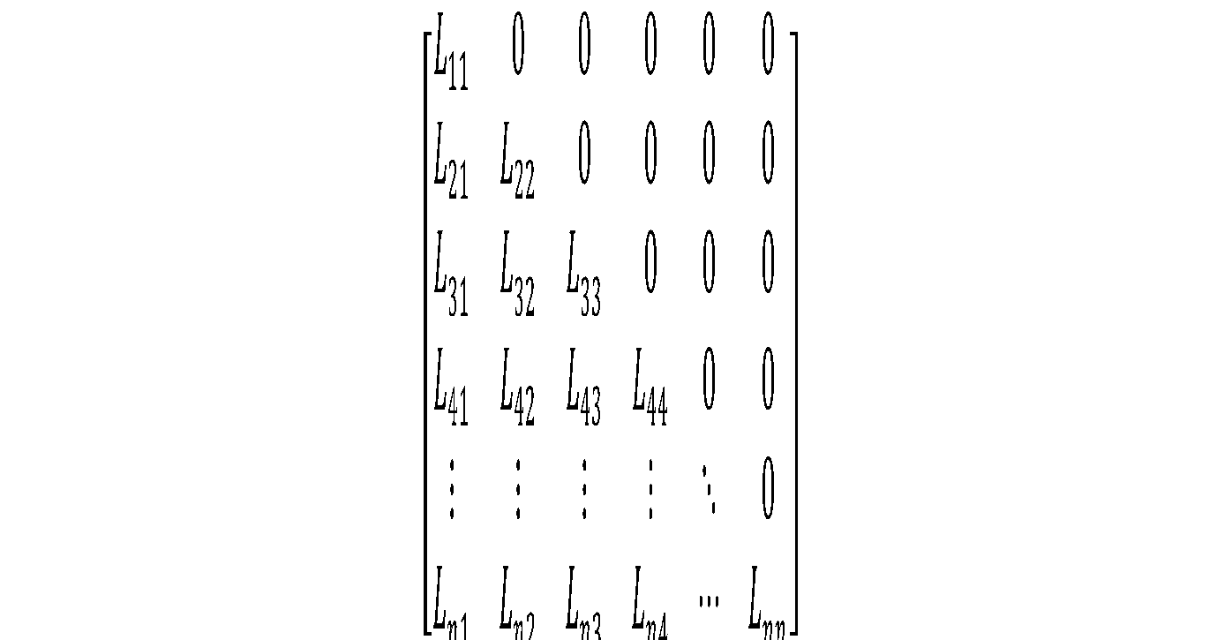
Lower Triangular Matrix
Description:
Square matrix
Elements above the diagonal are zero.

Slide 3
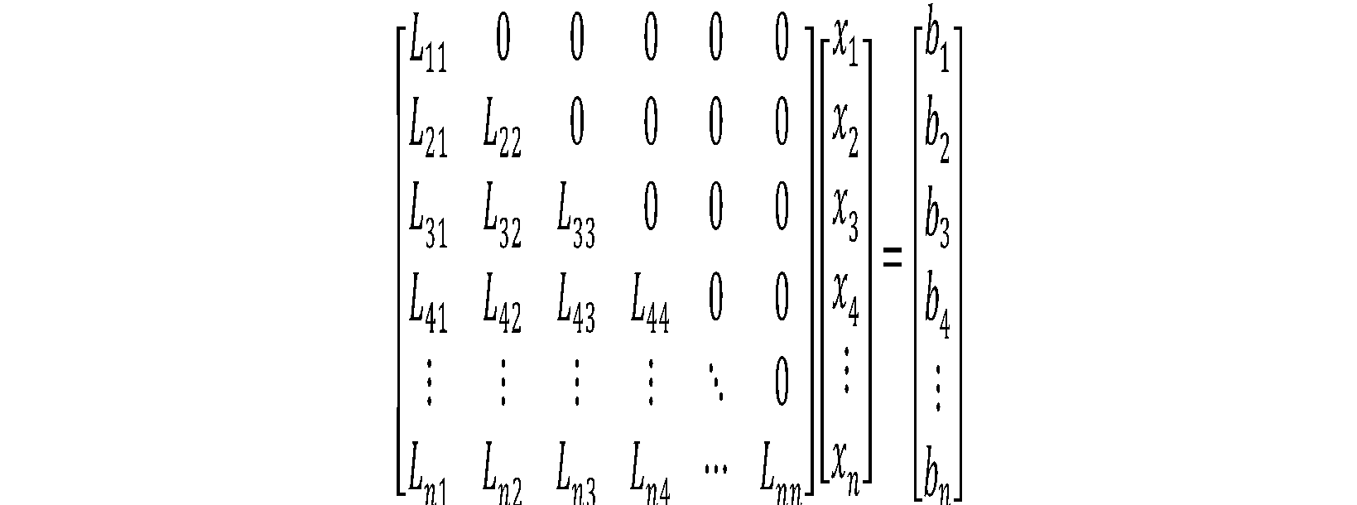
Problem Description
Elements of L matrix provided.
Elements of b vector provided.
To calculate: Elements of x vector.

Slide 4
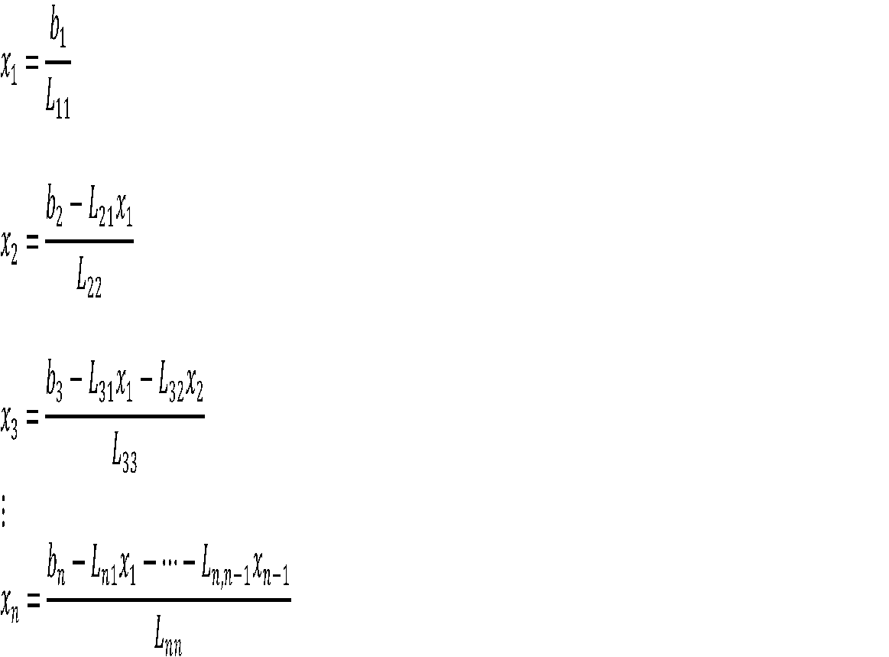
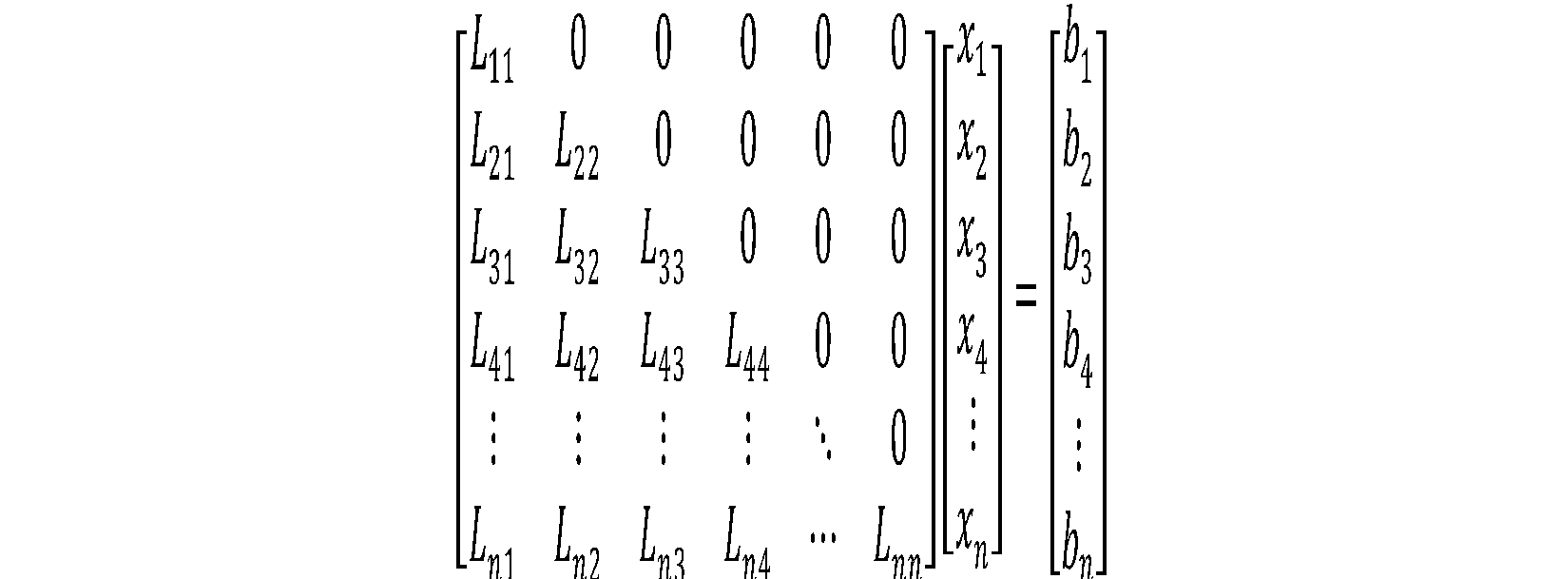
Serial Solution Through Algebraic equations

Slide 5
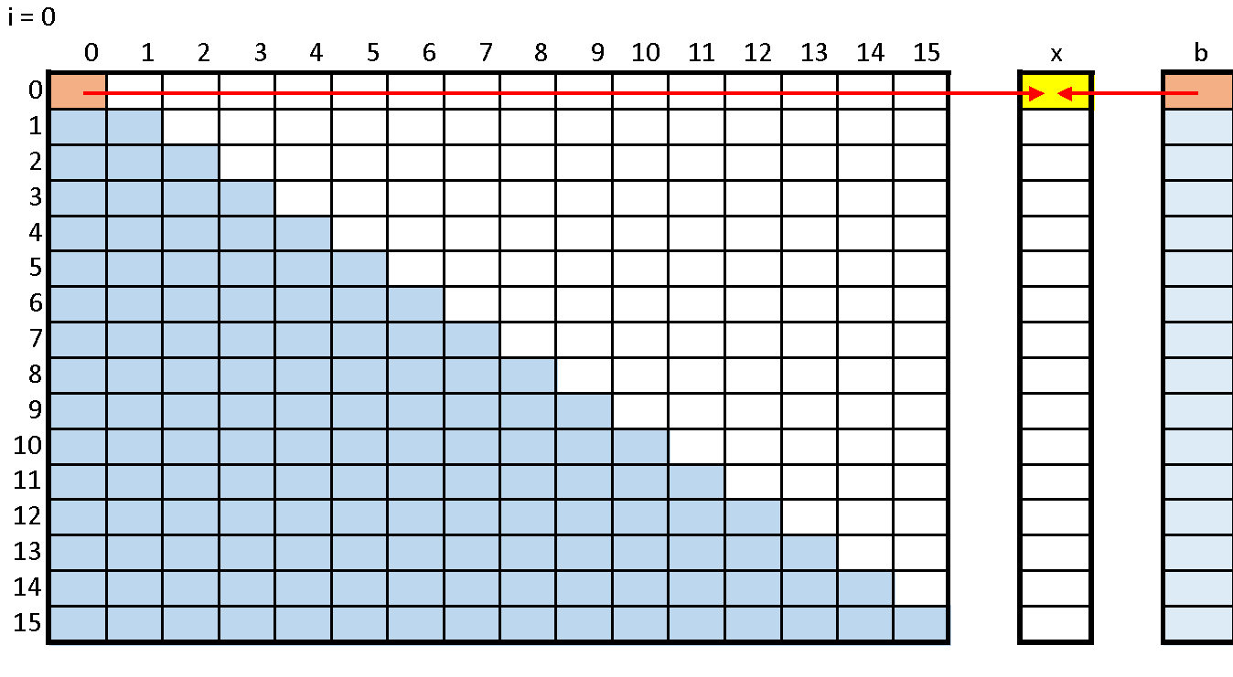
GPU Solver (naïve)
First Iteration

Slide 6
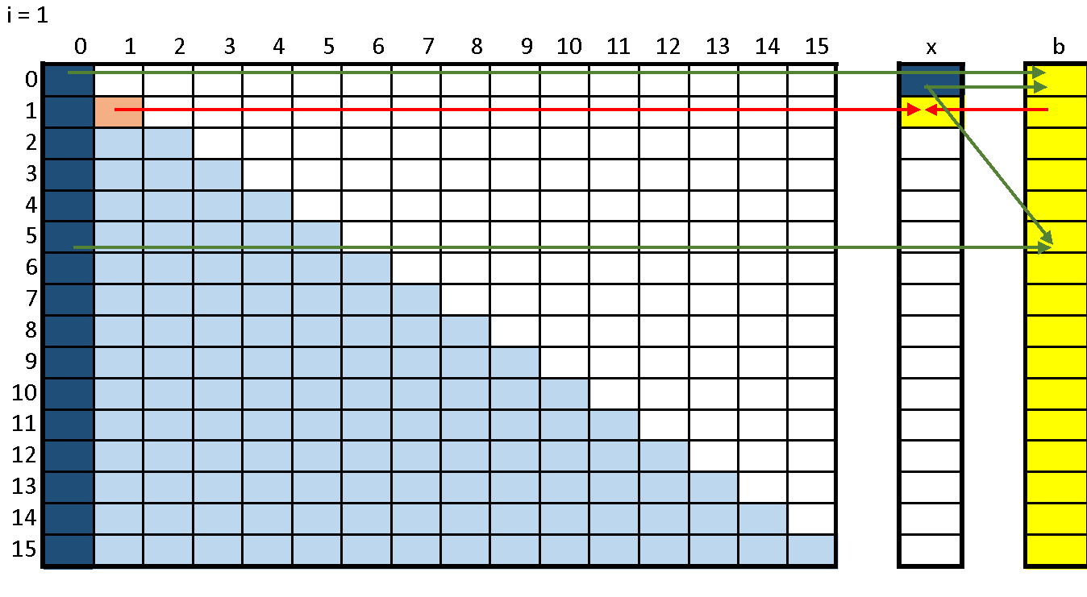
GPU Solver (cont.)
Second Iteration

Slide 7

GPU Solver (cont.)
Third Iteration

Slide 8
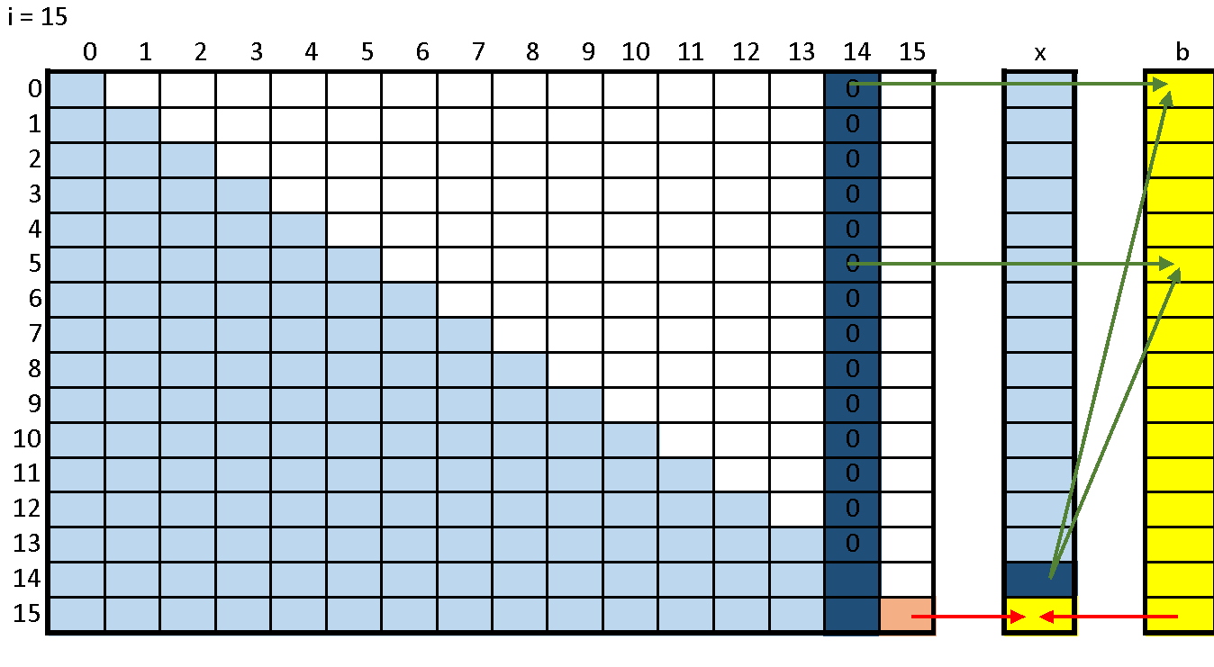
GPU Solver (cont.)
Fifteenth Iteration

Slide 9
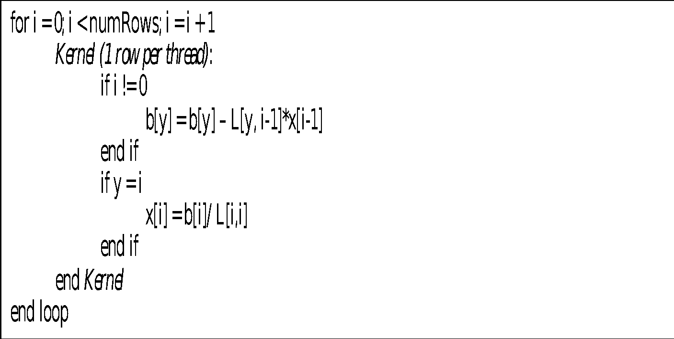
Summary (Pseudo Code)

Slide 10
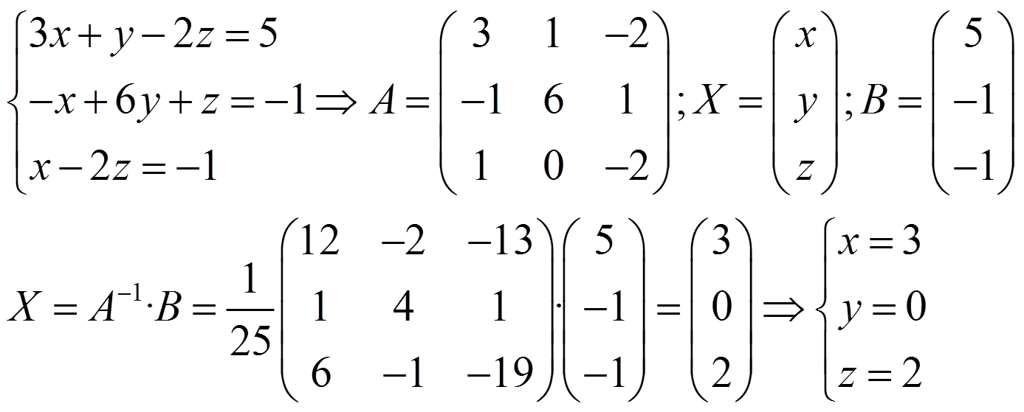
Real Solution

Slide 11
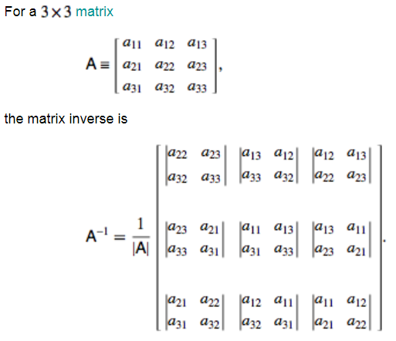
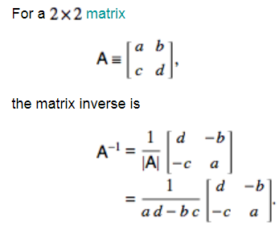
Finding Determinant
A general NxN matrix can be inverted using methods such as the Gauss-Jordan elimination, Gaussian elimination, or LU decomposition.

Slide 12
Problems
Development Environment
Windows vs. Linux ( execution time calculation)
Existing Code Not executing because
cuda_ret = cudaMemcpy(matL_d,&matL_h[0],(matL_h.size())*sizeof(double), cudaMemcpyHostToDevice);
CUDAMEMCPY not working
Copying garbage data
Copying data equals 0
Misplaced locations
CPU and GPU interpret 2D array differently for floats and double.
For Details see link
http://www.trevorsimonton.com/blog/2016/11/16/transfer-2d-array-memory-to-cuda.html

Slide 13
Solution I
Host Code | Kernel
void gpu_simple_solver (int* matL, int* vecX, int* vecB, intnumRows) { const unsigned intnumThreadsPerBlock = N; const unsigned intnumBlocks = (numRows - 1) / numThreadsPerBlock + 1; // Loop Below Executes 8 Times or for each Row of matL for (int i = 0; i <numRows; i++) { gpu_simple_solver_kernel<<<numBlocks, numThreadsPerBlock>>>(matL, vecX, vecB, numRows, i); } } | __global__ void gpu_simple_solver_kernel (int* matL, int* vecX, int* vecB, intnumRows, int i) { intidx = blockIdx.x*blockDim.x + threadIdx.x; if (idx>= numRows) return; //update the B value for every thread by subtracting off the known x (which was calculating last iteration) //multiplied by the corresponding L element if (i != 0) vecB[idx] = vecB[idx] - matL[(idx*numRows + i) - 1] * vecX[i - 1]; if (idx == i) { vecX[i] = vecB[i] / matL[i*numRows + i]; } }

Slide 14
Solution II
Host Code | Kernel
void gpu_simple_solver(int* matL, int* vecX, int* vecB, intnumRows) { const unsigned intnumThreadsPerBlock = N; const unsigned intnumBlocks = 1; gpu_simple_solver_Anjum<<<numBlocks, numThreadsPerBlock>>>(matL, vecX, vecB, numRows); } | __global__ void gpu_simple_solver_Anjum(int* matL, int* vecX, int* vecB, intnumRows) { Int rs_B; Int idx = blockIdx.x*blockDim.x + threadIdx.x; __shared__ intds_X[N]; __shared__ intds_matL[N*N]; if (idx>= numRows) return; rs_B = vecB[idx]; ds_X[threadIdx.x] = vecX[idx]; for (int i = 0; i <numRows; i++) { ds_matL[idx*numRows + i] = matL[(idx*numRows + i)]; } __syncthreads(); for (int j = 0; j <numRows; j++) {if (numRows != 0) {rs_B = rs_B - ds_matL[(idx*numRows + j) - 1];} if (idx == j) {ds_X[j] = rs_B / ds_matL[j*numRows + j]; } } vecX[idx] = ds_X[idx]; }

Slide 15
Solution III
Host Code | Kernel
void gpu_simple_solver(int* matL, int* vecX, int* vecB, intnumRows) { const unsigned intnumThreadsPerBlock = N; const unsigned intnumBlocks = 1; gpu_optimized_solver_Anjum<<<numBlocks, numThreadsPerBlock>>>(matL, vecX, vecB, numRows); } | __global__ void gpu_optimized_solver_Anjum (int* matL, int* vecX, int* vecB, int numRows) {int tot=0; int r_matL=0; __shared__ int ds_X[N]; int idx = blockIdx.x*blockDim.x + threadIdx.x; if (idx >= numRows) return; ds_X[idx]=0; for (int j = 0; j <numRows ; j++) {r_matL=matL[(j*numRows + idx) ]; if (j> 0 && j>idx) { tot= (-1 * (r_matL *ds_X[idx])); atomicAdd (&vecB[j],tot); //vecB[idx]+=tot; // Keepler Performs better on atomics with Global Memory and worst on Shared memory } else if (idx == j) { ds_X[j] = vecB[j] / r_matL ; } } vecX[idx] = ds_X[idx]; }

Slide 16
Performance
Computation Time Comparison in Micro Seconds
Matrix Size ----> | 8x8 | 16x16 | 32x32
Kernel 1 | 17.184 | 33.728 | 77.984
Kernel 2 | 9.2 | 14.2 | 42.8
Kernel 3 |  |  | 33.12
Difference | 7.984 | 19.528 | 35.184
% Age Improve | 46.46% | 57.89% | 45.12%

Slide 17
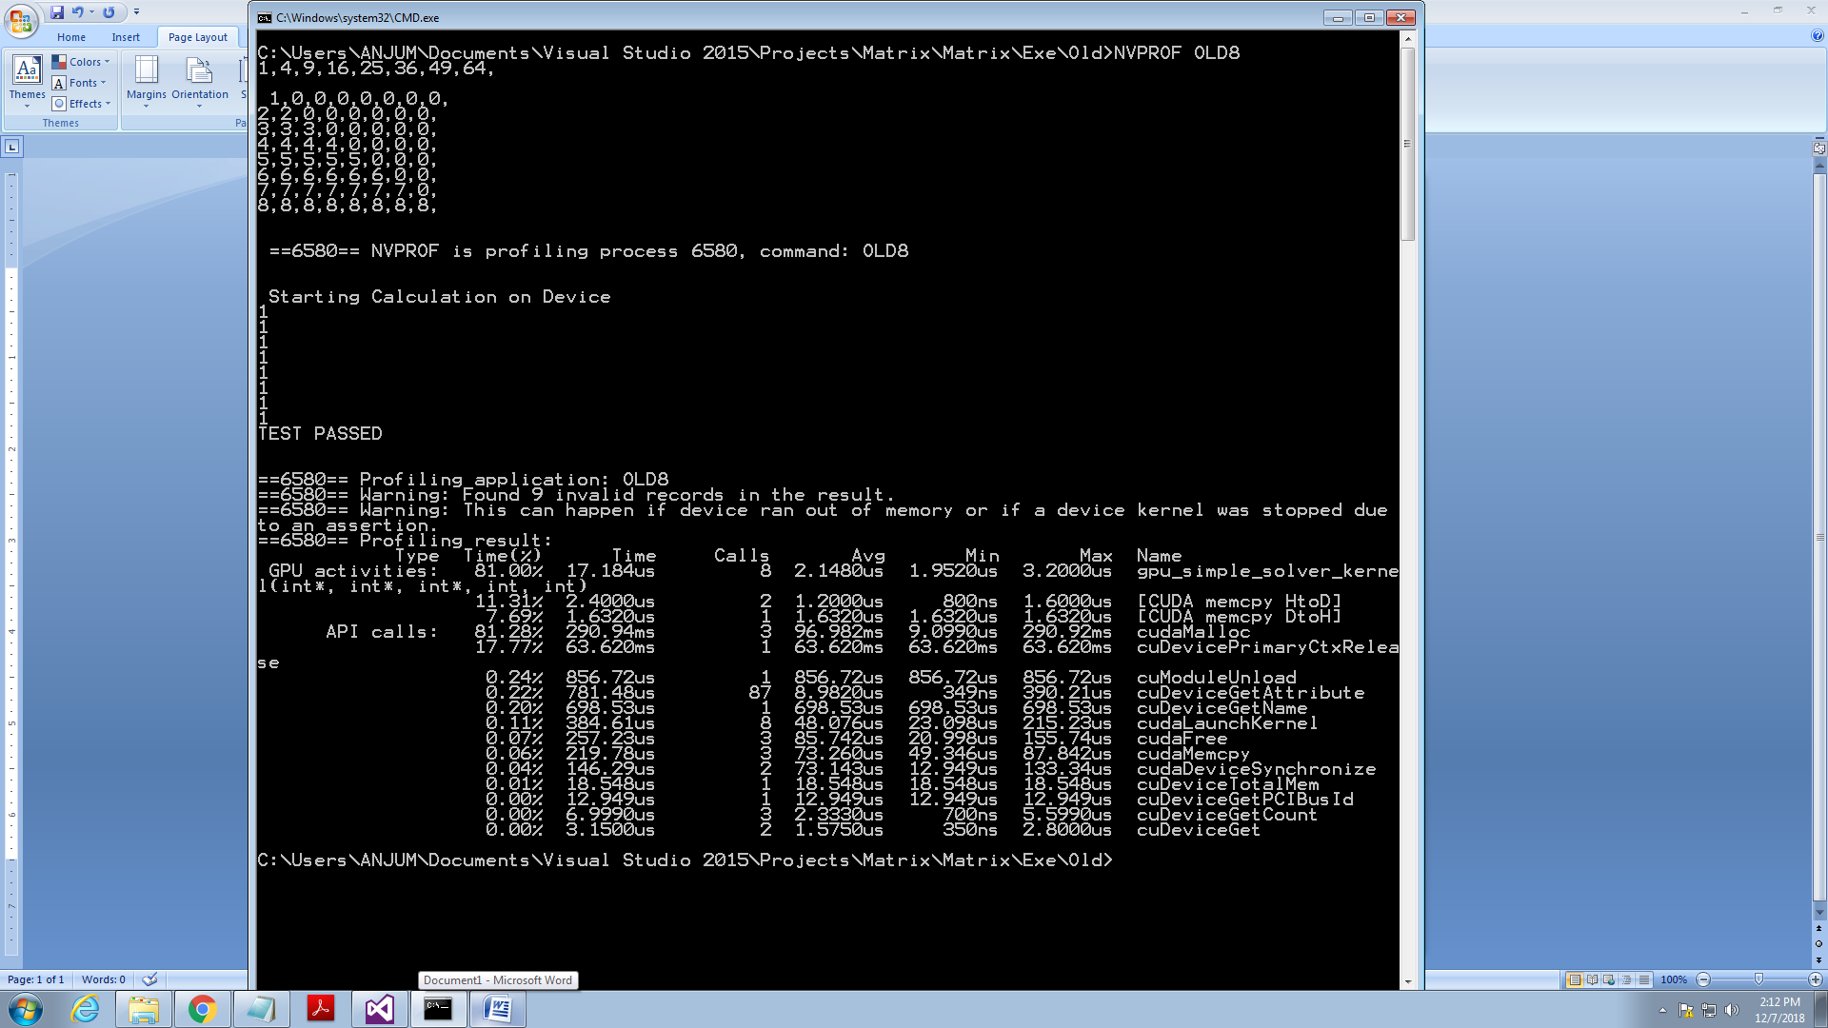
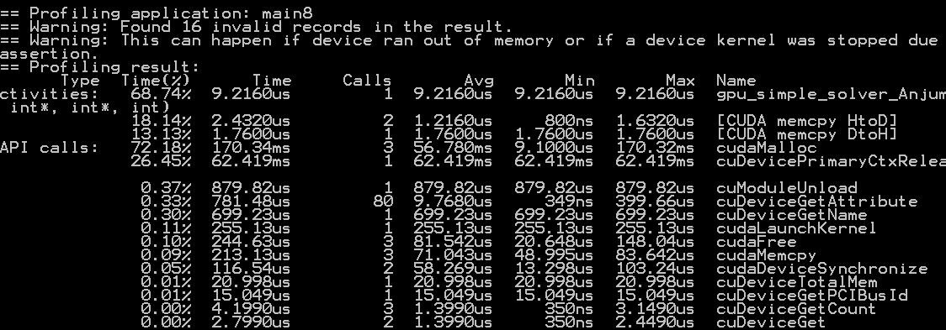
(8 x8 Matrix)
Solution I 8 Calls 17.184 us
Solution II 1 Call 9.2 us <<Return

Slide 18
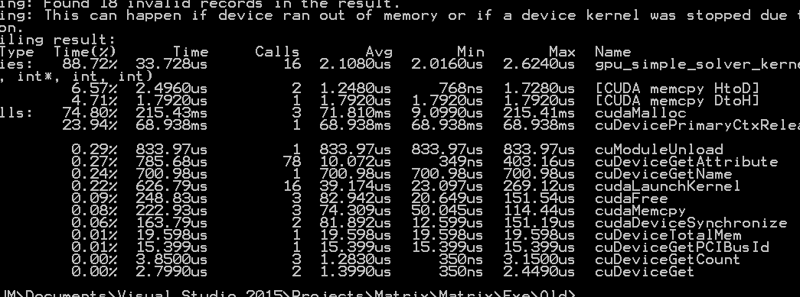
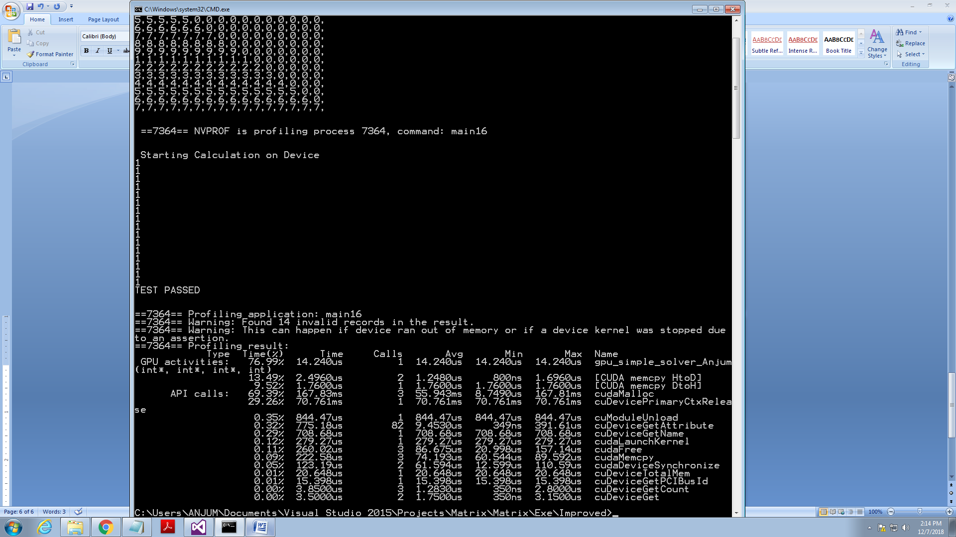
(16 x16 Matrix)
Solution I 8 Calls 33.73
Solution II 1 Call 14.2 <<Return

Slide 19
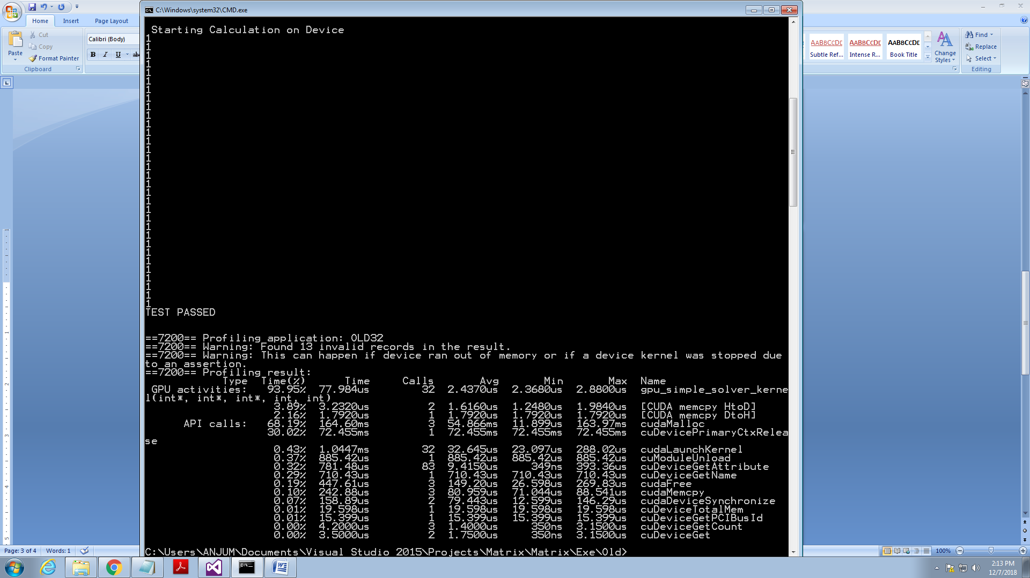
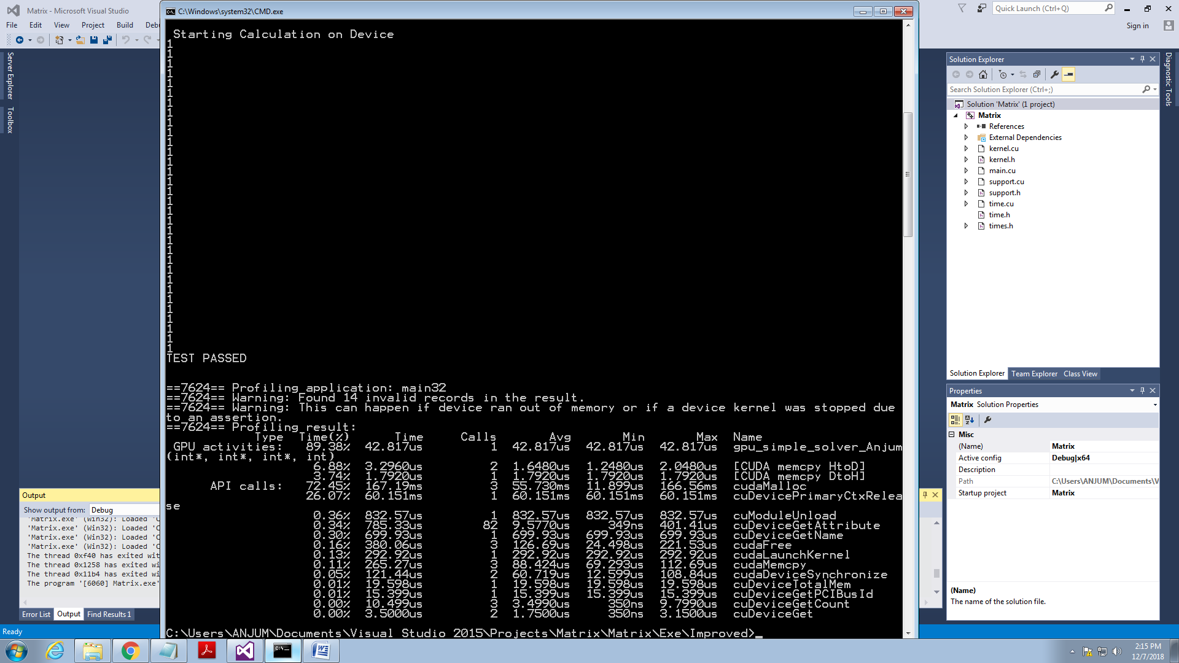
(32 x 32 Matrix)
Solution I 8 Calls 77.984
Solution II 1 Call 42.817 <<Return

Slide 20
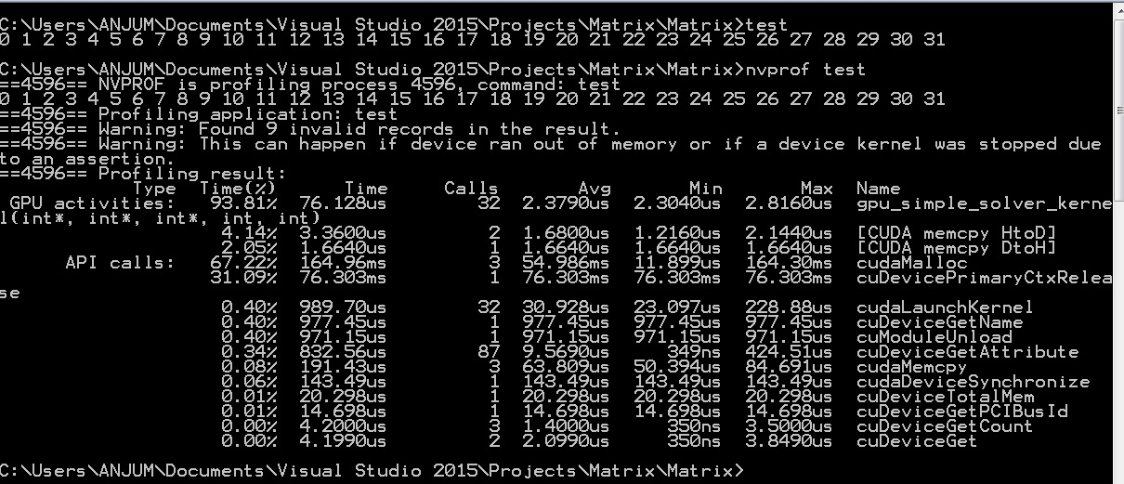
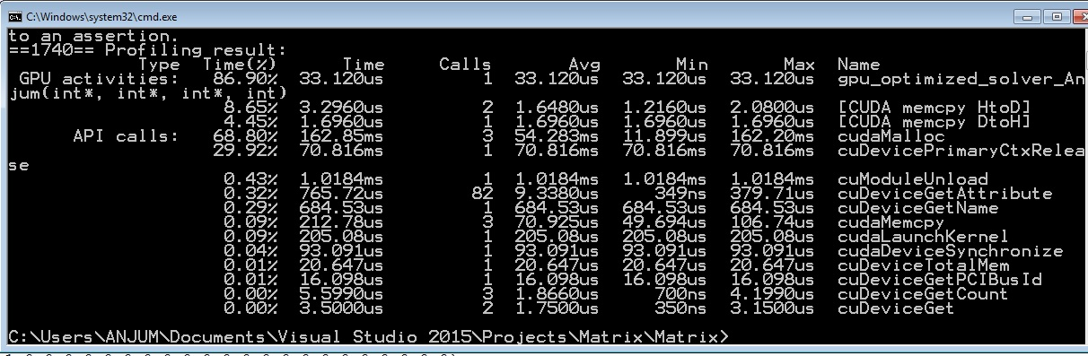
(32 x 32 Matrix)
Solution I 32 Calls 76.13
Solution III 1 Call 33.12 <<Return

Slide 21
Conclusion
The most complex implementation is not always the best
Takes longer to allocate the data on the device than to run CPU implementation
Still slower than other GPU and CPU implementations

