Slide 1

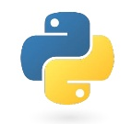
Next Level Python
Tips, tool, and techniques for being highly productive in Python
Notes:
Today, rather than focusing on a particular problem, we’re going to talk about
The goal here is finding ways to get more done when you’re programming

Slide 2
Topics
Prelude
Data structures
Iterators
Functions, Files, & Modules
Exercises
Using an IDE
Debugging
Conda Environments
Exercises

Slide 3
Code snippets, if you want to follow along:
bit.ly/2ScFewN

Slide 4

Topic 0 Prelude

Slide 5

Prelude What is Python?
Invented in the early ‘90s by Guido Van Rossum
CPython Interpreter
Reads your code 📖
Parses it 👀
Checks for syntax errors ✔️
Generates instructions 👉
Steps through instructions ⏭️
BDFL
Notes:
Each instruction corresponds to a C function!
∴ it is a scripting language!

Slide 6
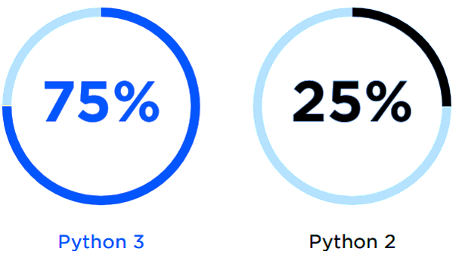
Prelude 2 vs. 3
Python 3 > Python 2
Stick to 3.5+
source: opensource.com
Notes:
Python 3 came out a decade ago
Bit of a mess for a while
Now its 2018, its all better
Use 3!

Slide 7


Prelude Variables
Sounds simple, but worth clarifying
What just happened?
Did we change 1? Or a?
What happened to 1?
Notes:
Answer on next slide

Slide 8
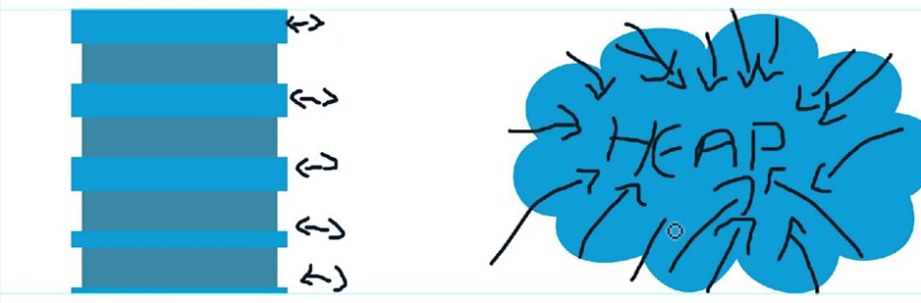
Prelude Variables
Values are objects
objects live on the heap
Names tell you how to find an object
names live on the heap
Stack
Heap
Notes:
Explain the code example
Mention stack overflow

Slide 9
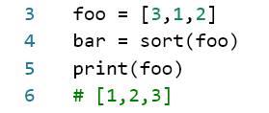
Prelude Variables
What happened to foo?

Slide 10


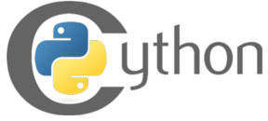
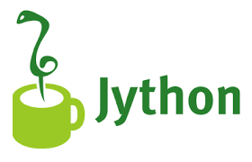



Prelude Beyond CPython
There are other ways of running your Python code:
The best way to get CPython + Scientific libraries

Slide 11
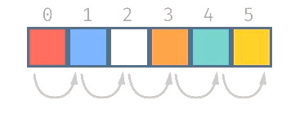
Topic 1 Data Structures
Notes:
Can anyone name a data structure? What do I mean by that?

Slide 12

Topic 1 Data Structures
Lists
Most of us are familiar
Store data in order
Can loop through
Can look up by index
Slow searching
Notes:
Can anyone name a data structure? What do I mean by that?

Slide 13
Data Structures Dictionaries
Store data as key: value pairs
Keys can be:
Numbers
Strings
Tuples of numbers, strings
Values can be: anything!
“Instant” lookup by key!
O(1) even if 1e6 entries!
Slower than lists for looping

Slide 14
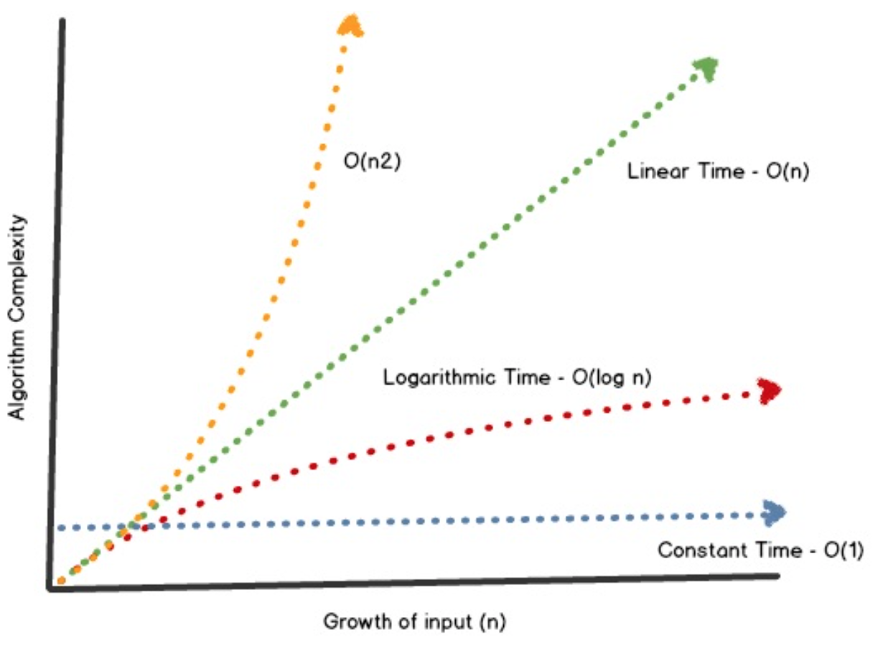
Data Structures Dictionaries
Notes:
Motivating example from student numbers

Slide 15
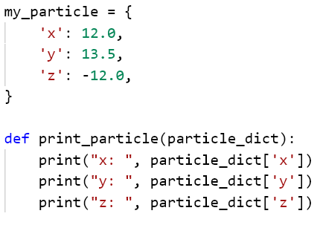
Data Structures Dictionaries
Use cases:
Store properties of something in one place
Example:

Slide 16
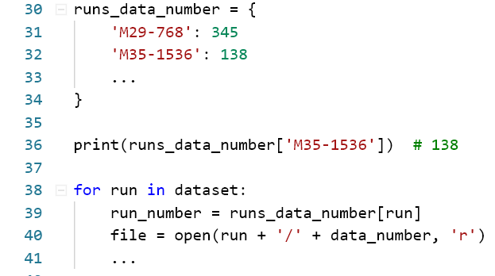
Data Structures Dictionaries
Use cases:
Data you have to access by a name or ID
Catalogs
Filenames for datasets
Example:

Slide 17
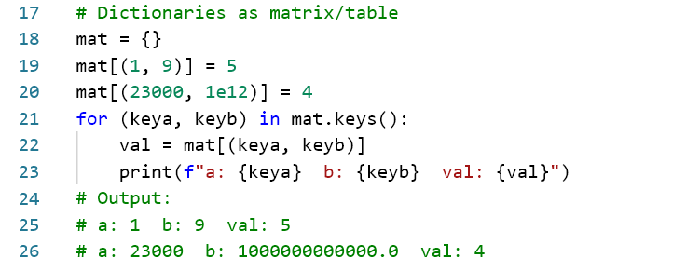
Data Structures Dictionaries – Trick!
You can use tuples as dictionary keys
Use this as a sparse matrix, esp. for non-numerical data!
This would require on the order of 2TB of RAM if you used a list!
Great way to store values that belong at the intersection of two other things, e.g. (computer A, and computer B) have an open connection C

Slide 18
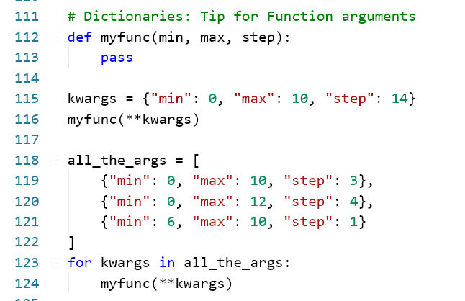
Data Structures Dictionaries – Trick!
You can use dictionaries to hold arguments for functions, apply them later

Slide 19
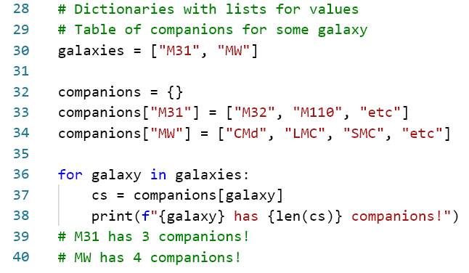
Data Structures Dictionaries – Tip!
You can use lists, and other dictionaries *inside* dictionary values!

Slide 20
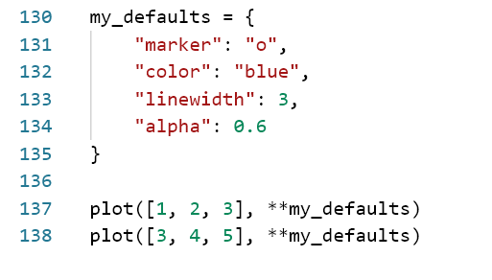
Data Structures Dictionaries – Technique!
If you’re calling some function, e.g. from matplotlib lots of times with slight differences, use a dictionary to hold defaults
Better yet! Make a function!

Slide 21
Data Structures Sets
Sets are like a “bag” of values
Values can be strings, numbers, tuples, etc.
Values are unique.
Adding the same thing twice has no effect
Not ordered
“instant” adding and removing values
“instant” membership testing
Operations for
Testing
Grouping
Differencing
etc.
Notes:
Motivating example from student numbers

Slide 22
Data Structures Sets
Use case:
You have a data set, with some possibly overlapping groups
You want to focus on one group at a time
Solution: Put the group in a set
You can easily isolate just the data in the group
Notes:
Motivating example from student numbers

Slide 23
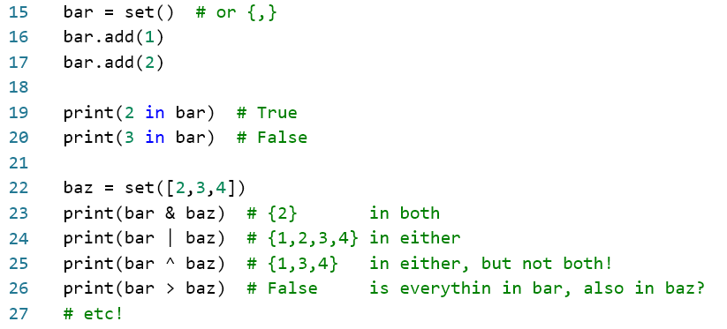
Data Structures Sets
Notes:
Motivating example from student numbers

Slide 24

Topic 2 Iterators

Slide 25
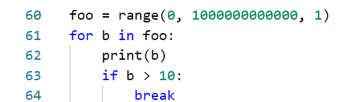
Topic 2 Iterators
Generators create “lazy sequences”, called iterators
This works!
Why doesn’t my computer crash?
Notes:
Talk about green threads/coroutines? Async/await.
Gevent patches all stdlib functions to have yields, multiplexes between them to let you program concurrently in python!
Async/await is the more official way to do this now.

Slide 26
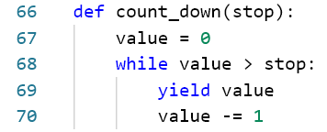
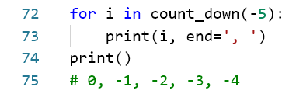
Iterators Behind the scenes
Behind the scenes, they are a function that returns more than one value.
Every time you run the function, you get the next value!
Definition:
Usage:
Notes:
Talk about green threads/coroutines? Async/await.
Gevent patches all stdlib functions to have yields, multiplexes between them to let you program concurrently in python!
Async/await is the more official way to do this now.

Slide 27
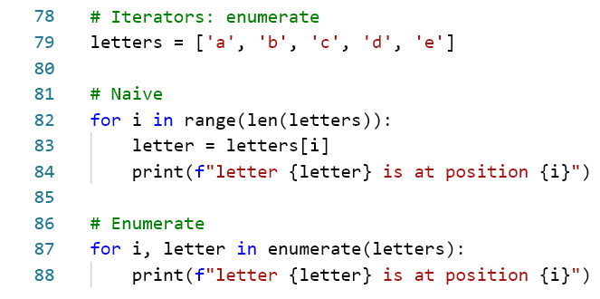
Iterators Useful Iterator Functions
enumerate
Loop through things with indexes
Notes:
Let’s “unpack” this a little! Aside on tuple unpacking

Slide 28
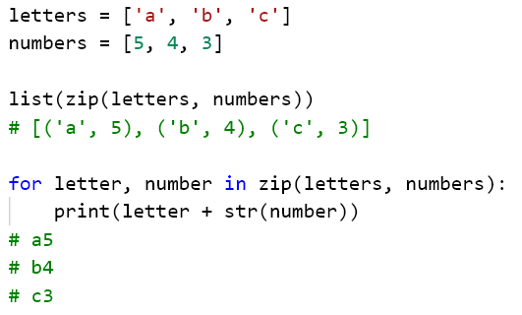
Iterators Useful Iterator Functions
zip
Group items from multiple lists into tuples

Slide 29
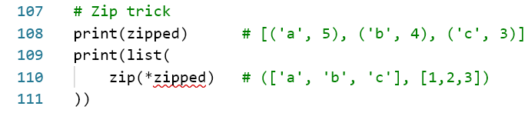
Iterators Useful Iterator Functions
zip
Trick! You can unzip as well, using *

Slide 30
Iterators Useful Iterator Functions
map, filter, etc
Really useful for lists, but if using numpy there are better ways

Slide 31
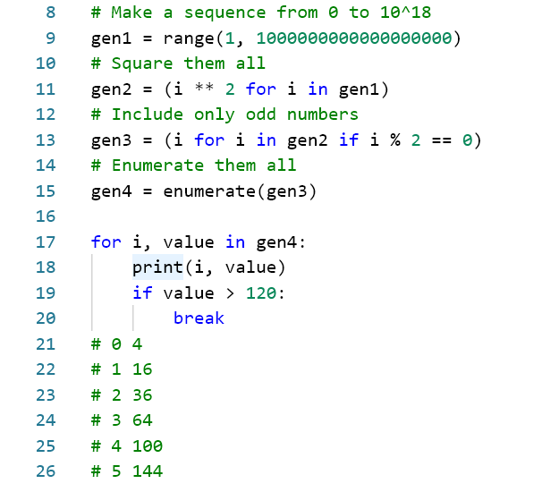
Iterators Generator Expressions
Generator comprehensions by example
Prints:
Notes:
Generator expressions can be handy in a pinch.
This is a contrived example

Slide 32

Topic 3 Functions, Files & Modules
Oh, and packages too

Slide 33
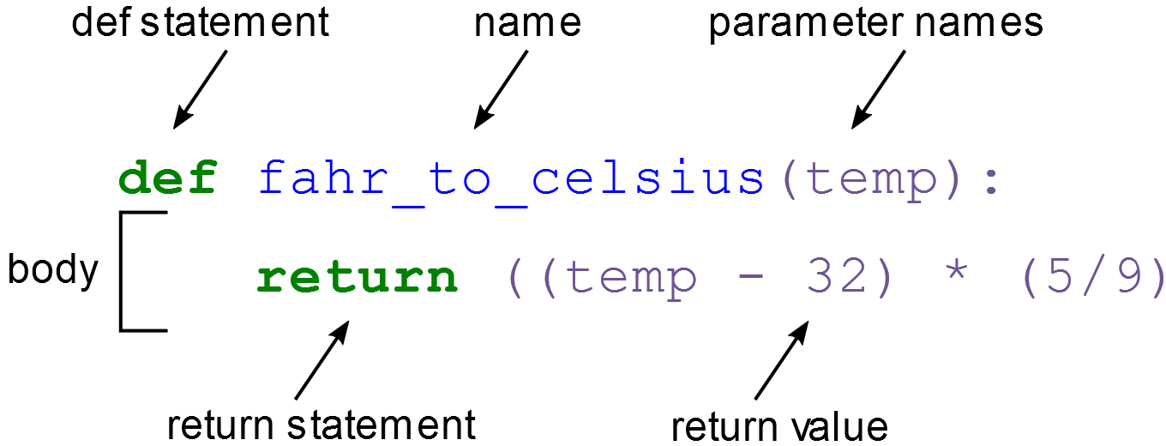
Topic 3 Functions
DRY: Do not Repeat Yourself
Use functions to pull out repeated code, patterns
Safety
Variables inside functions can’t leak out
Easier variable naming
Abstraction
Once you’ve written one type of data analysis, don’t need to worry about the details again
Notes:
Talk about green threads/coroutines?

Slide 34

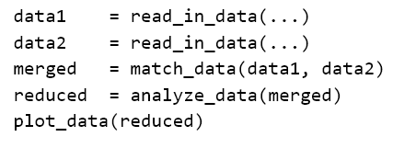
Functions Rules of Thumb
Create a function if:
You write the same thing 2 or more times
You know it will change in the future
It was tricky to get right
It’s a step in a data analysis pipeline

Slide 35
Functions Rules of Thumb
Split up a function if:
It has more than ~10 lines (industry)
It has more than about two loops (science)
It takes more than ~5 parameters
It does two different things, based on a parameter
Prefer two, or three simple functions over one big one

Slide 36
Functions Rules of Thumb
“Magic Functions”
It does different things, based on parameters
Symptoms:
19+ parameters
Some parameters can’t be used with others
matplotlib...
IMO scientists are particularly prone to this
Split it up!

Slide 37
Functions Decorators
@np.vectorize
Put this above your function, and it will work on arrays
Lots of other use cases for decorators, but this is the one I use on a daily basis

Slide 38
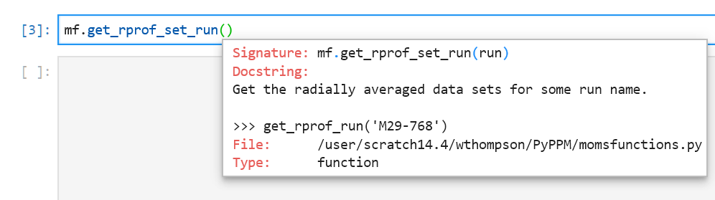
Functions Docstrings
Explain what your function does!

Slide 39
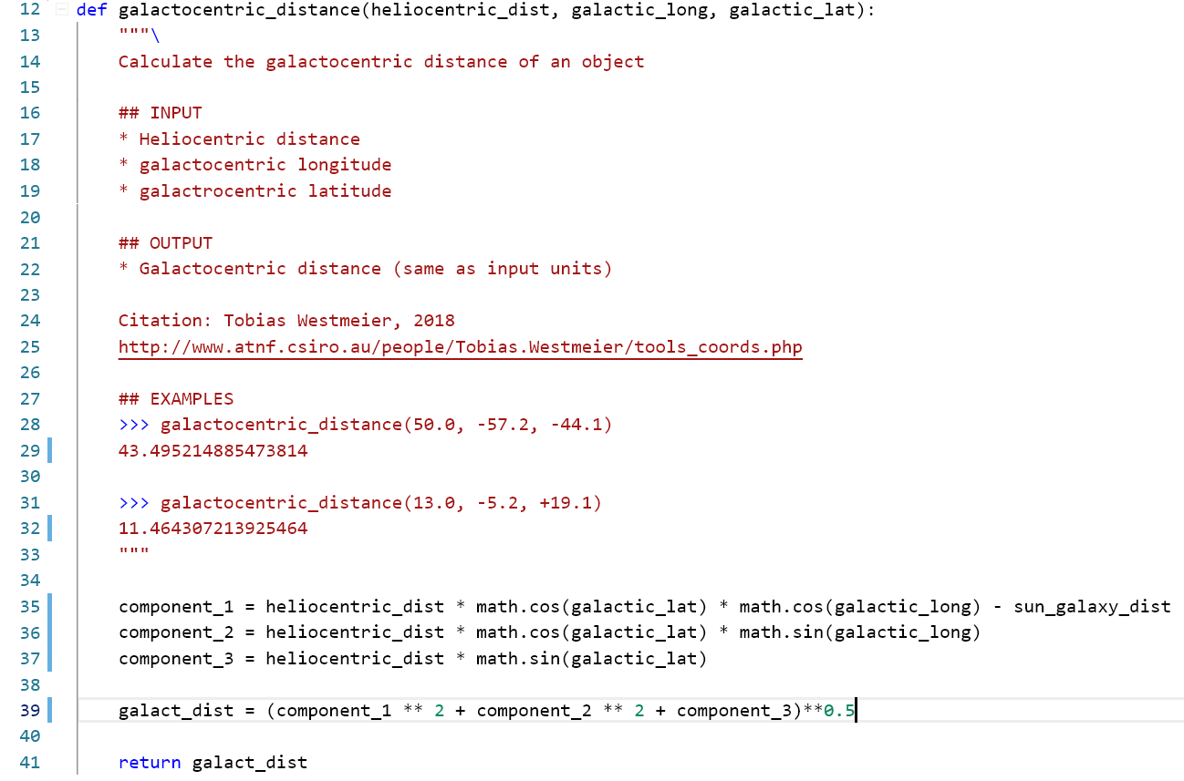
Functions: Docstrings

Slide 40
Functions Doc-tests?
Explain what your function does!

Slide 41
Topic 3 Files & Modules
Make a text file, give it a .py extension
Congrats, you made a module!

Slide 42
Topic 3 Files & Modules
Make a text file, give it a .py extension
Congrats, you made a module!
Any python file is a module that can be imported
Python looks for modules in your current directory, and PYTHONPATH (that’s where e.g. numpy is)
If you want to find where a module is:
Import it, and print(somemodule).__file__

Slide 43
Topic 3 Files & Modules
Importing things should have no side-effects
At the top level, modules should only include:
Constants
Functions
Classes
Bad design: importing the module makes a plot show up

Slide 44
Topic 3 Packages
Put a group of modules in a folder
Add a file named “__init__.py”
Congrats, you have a package!
Now you can group your modules together, e.g. scipy
You could even publish your package to pypi

Slide 45
Exercises
Make a function that:
Takes three arguments (x,y,z)
Returns the distance of the vector
Make a function that:
Takes two points as dictionaries
Returns the distance between them
Put your functions in a module
Document them!
Import your module, and use it!
Extra: Make a function that works over numpy arrays of the vectors (@np.vectorize)
Notes:
Uvic.syzygy.ca
bit.ly/2ScFewN

Slide 46
Topic 4 Using an IDE

Slide 47
IDEs What can an IDE do for you?
Syntax highlighting
Multiple cursors
Integrated terminal
Warnings as you type (and in panel)
Autocomplete
Autoformat
Code outlines
Live code sharing, like Google Docs
Debugging (more on this later)
Version control (another session?)

Slide 48
Topic 5 Debugging

Slide 49
Debugging Reading Stack Traces
http://cs.franklin.edu/~ansaria/traceback.html
Types of Exceptions
IndentationError
SyntaxError
IndexError
ValueError
TypeError
KeyboardInterrupt
buggy-dictionaries.py

Slide 50
Debugging Using a Debugger
Breakpoints
Stepping through
Stepping in & stepping out
Conditional breakpoints
Logpoints
Hitcounts

Slide 51
Topic 6 Conda Environments

Slide 52
Environments
Reproducible science is important
Your code should work the same way
Next year
On someone else’s computer
Installing a new version of a library shouldn’t break your other code

Slide 53
Environments
Most popular environment system is virtualenv
For our use cases, conda is a good choice
Comes built in with Anaconda
Use conda to create a new environment for each project with:
Different packages
Different versions of python

Slide 54
Conda Environments
Create environment.yml
conda env create -f environment.yml
List environments:
conda env list
Activate an environment:
conda activate <env name>

Slide 55
Exercises
Install an IDE
Put in your functions from before
Add a sneaky bug (not a syntax error)
“Switch seats”, and try out the debugger on each others’ code

