Slide 1
Unix and Bash
Software Plumbing #1
Caleb Miller
PAGSA

Slide 2
List of Stuff!
The basics
How to be lazy
Bash scripting
Other tips and tricks
Hopefully useful!

Slide 3
The Basics

Slide 4
Things everyone should know
Navigating
cd
rm
ls
mkdir
man
Getting Fancy
ls -l, ls -a
rm -rf
mkdir -p
More Advanced
ssh
grep
find
sudo vs su
chown/chmod
bashrc and alises
vim and emacs

Slide 5
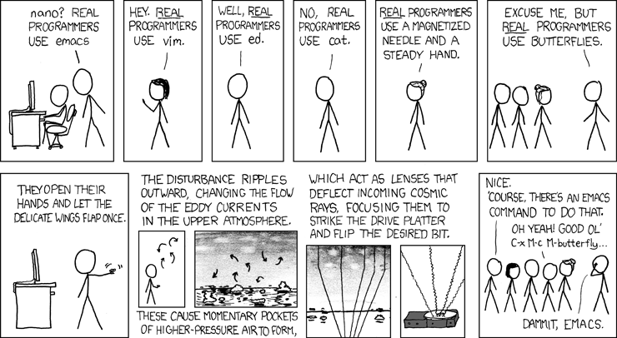

Slide 6
Maximizing Laziness

Slide 7
Aliases
In every home directory there should be a file called .bashrc (ls -a to reveal)
add lines like:
alias la = ‘ls -a’
alias ..= ‘cd ..’
alias …= ‘cd ../..’
alias kek='ssh -Y cmiller@sshcc1.kek.jp'
alias setsw1='source /path1/bashrc; source path2/setup;gb2_proxy_init -g belle'
alias setsw2='source /path3/b2setup release-01-00-04'
alias setall='eval setsw1; eval setsw2'

Slide 8
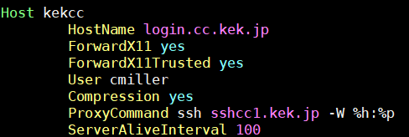
ssh and the power of rsync
The most basic way to copy files between computers is with scp or rsync
scp source target (same for rsync)
Ex.: scp user@remote:copyme.txt /myfiles/
ssh config makes it even easier
In home directory open .ssh/config
add:
rsync kekcc:copyme.txt /myfiles

Slide 9
Bash Scripting

Slide 10
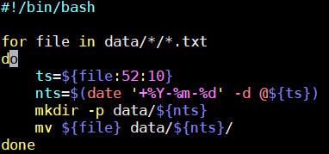
Writing scripts
First make a script file: vim myscript.sh
Add your bash commands directly: rm -rf /*
Run with: sh myscript.sh (runs in a separate shell) or ./myscript.sh (runs in current shell)
May need to use: chmod +x myscript.sh
Main use is for repetitive tasks

Slide 11
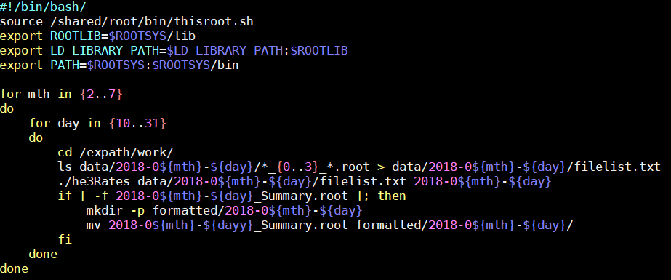
Writing scripts
Data files for example:
He3tubeData_0_1532687635.553153.root
He3tubeData_1_1532710828.128332.root
He3tubeData_2_1532730993.533997.root
He3tubeData_3_1532687361.534825.root
He3tubeData_4_1532733508.711214.root
He3tubeData_5_1532692375.866742.root
He3tubeData_6_1532734610.787894.root
He3tubeData_7_1532712403.241866.root
Can be dangerous!!
Never run as root/su

Slide 12
http://swcarpentry.github.io/shell-novice/

Slide 13
All the tips

Slide 14
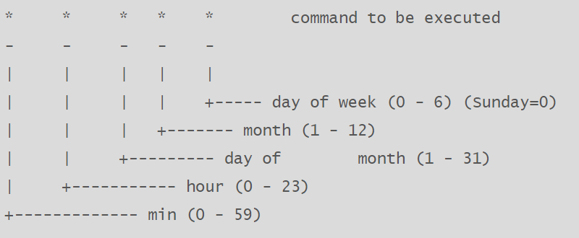
Cron Jobs
crontab -e

