Slide 1
LinkedIn Job Market Demand, Salary & Competition Intelligence
Sector
Team
GitHub
Tableau Dashboards
Human Resources Analytics / Labour Market Intelligence
Section A – Team 14 | Newton School of Technology
SectionA_Team14_JobMarketTrends
Job Demand · Salary Intelligence · Competition Intelligence
Members
Palak, Divya Singh, Arun, Krishna Pramod Dubale, Samarth Sangtani, Sarvesh Kumar
Submitted
29 April, 2026

Slide 2

Job Counts Alone Don't Tell the Full Story
The Problem
Demand
Engagement
A category may have 10,000 postings but zero candidate attention. Recruiters, HR business partners, and workforce planners need richer signals.
Where are jobs concentrated?
Which roles attract candidates?
Business Question: Where is hiring demand concentrated, which roles attract candidates, and where do salary and competition create strategic opportunity?
Salary
Competition
Where is compensation strongest?
Where is hiring hardest?

Slide 3


A Rigorous ETL Pipeline Powers the Analysis
Dataset Scale
120,484 job-level records · 26 analytical columns
Ingest
Clean & Filter
Source
Export CSV
Kaggle: arshkon/linkedin-job-postings
Notebooks
Merge Meta
01_ingestion · 02_cleaning · 03_eda · 04_statistical_analysis · 05_final_load_prep
Feature Engine
Key Features Engineered
demand_score · remote_label · salary_bracket · conversion_rate · days_active
Missing salary was not imputed — treated as a transparency signal, measured as Salary Info %.

Slide 4
Eight KPIs Translate Raw Data into Hiring Intelligence
Total Postings
Avg Views
Market supply and coverage
Listing visibility
Avg Applies
Conversion Rate
Candidate action
Applies ÷ Views — engagement quality
Competition Score
Efficiency Score
Applies ÷ Views — applicant intensity
Applies ÷ Days Active — application speed
Salary Info %
Hard-to-Fill %
Share with disclosed salary — transparency
Weak response relative to active days — hiring friction
All KPIs computed in Python notebooks and visualized across three Tableau dashboards.

Slide 5


Most Postings Are Invisible — A Few Categories Dominate Attention
120K
14.63
10.54
Total Postings
Avg Views
Avg Applies
Across all categories and states
Per posting — moderate visibility
Per posting — competitive but limited
17.52%
29.12%
Conversion Rate
Salary Disclosed
Views converting to applications
Major transparency gap in the market
117,827 of 120,484 postings are low-demand — employers must improve listing quality, not just volume.
Marketing & HR & Recruiting attract the highest engagement despite lower volume. CA, TX, FL dominate geographic demand.

Slide 6
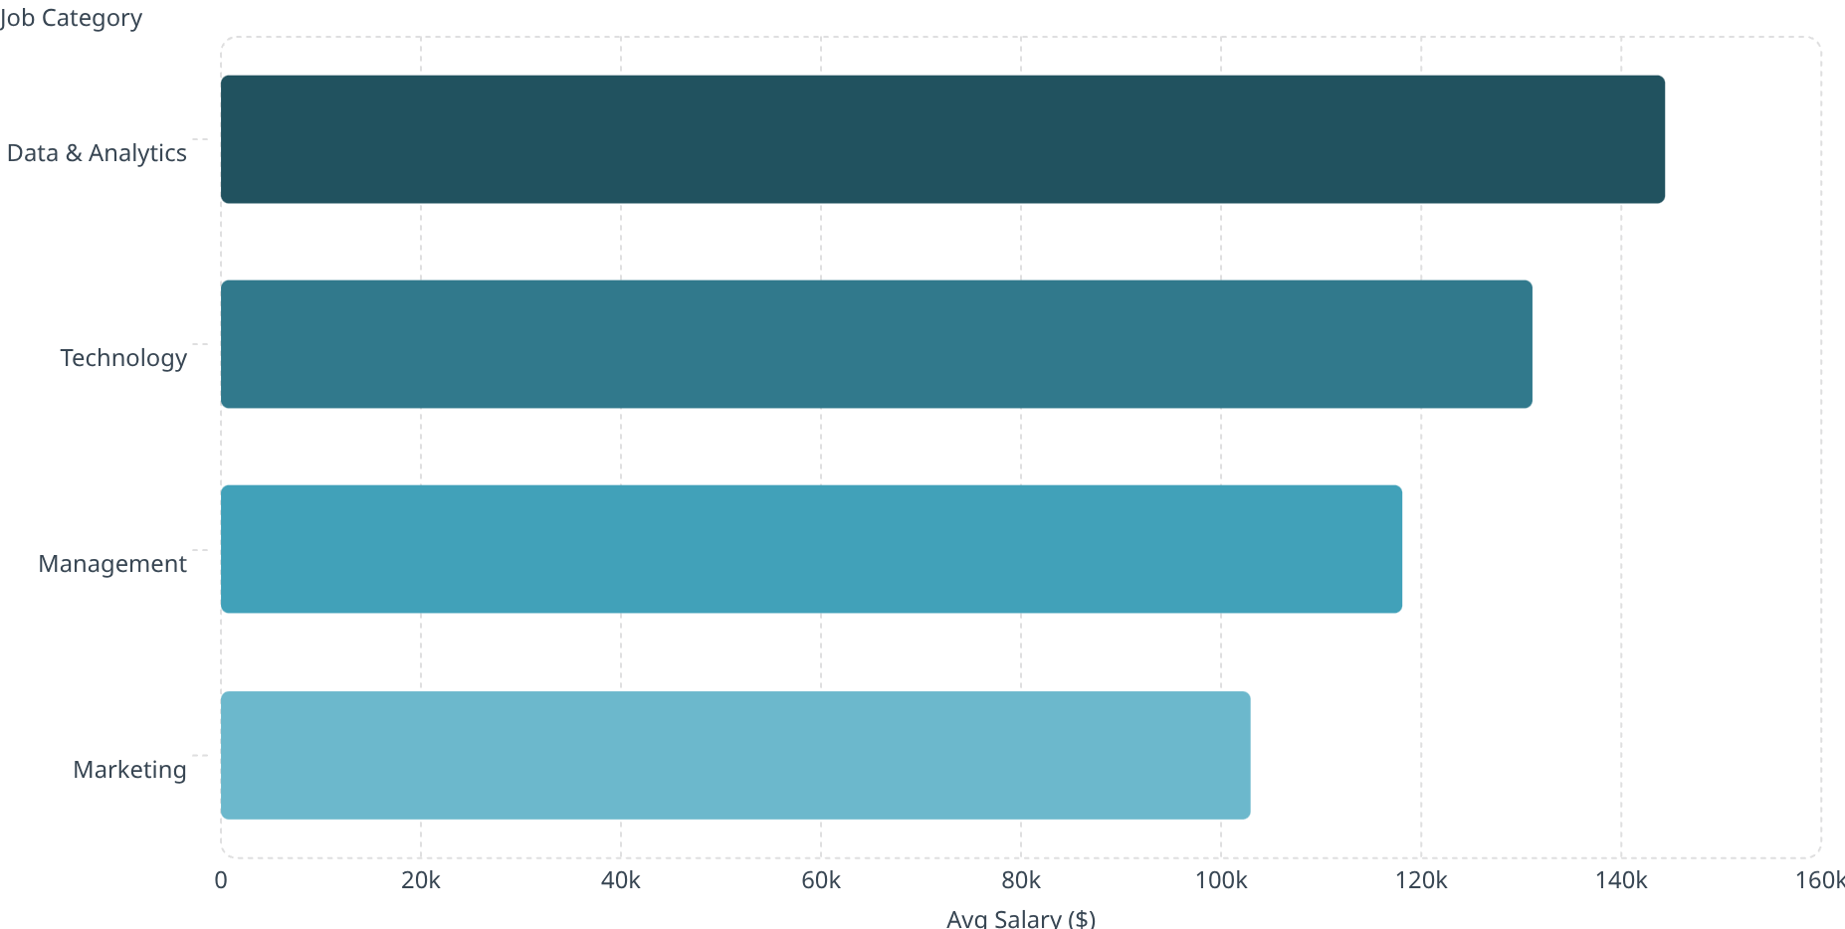
Data & Analytics Leads Pay; Remote Roles Carry a Premium
Statistical Validation
144k
Remote vs On-Site Salary
131k
t-test p-value = 2.6e-196 — highly significant difference
118k
Salary by Category ANOVA
p-value = 0.0 — differences are real, not noise
103k
Efficiency Distribution
Mean = 0.32 applies/day · Median = 0.069 — most roles fill slowly
Libraries: pandas · scipy · statsmodels · matplotlib · seaborn

Slide 7
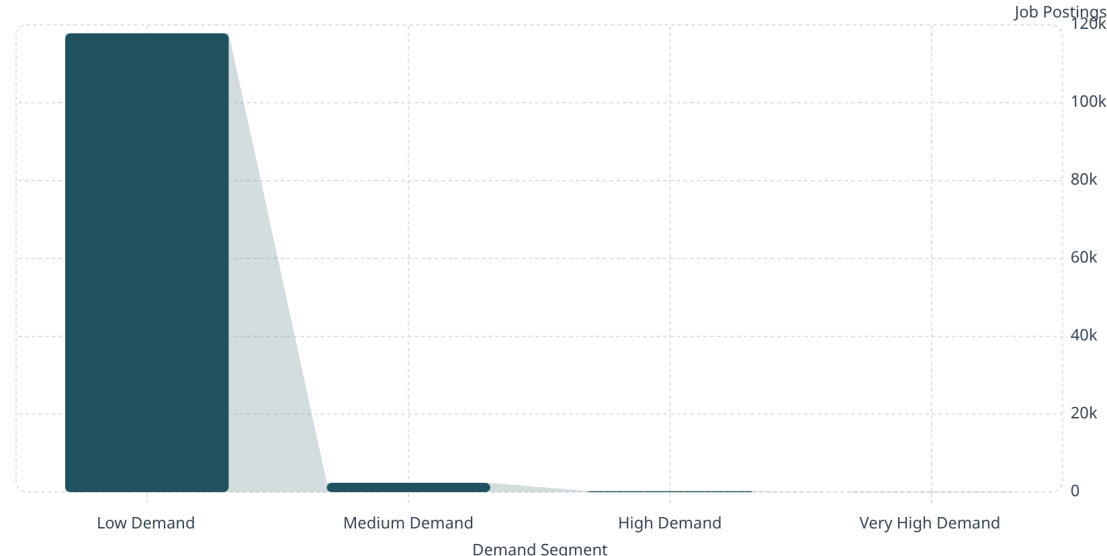
Demand Segmentation Reveals a Highly Skewed Market
0.03%
What This Means
Total conversion rate
118k
High-demand jobs are rare and valuable — study them as best-practice examples for role description, salary framing, and application process design.
Top Demand States
California · Texas · Florida · New York · Illinois
2.39k
235
32
Hiring Activity
Strongly concentrated in April (118,659 postings) — seasonality must be factored into planning.

Slide 8
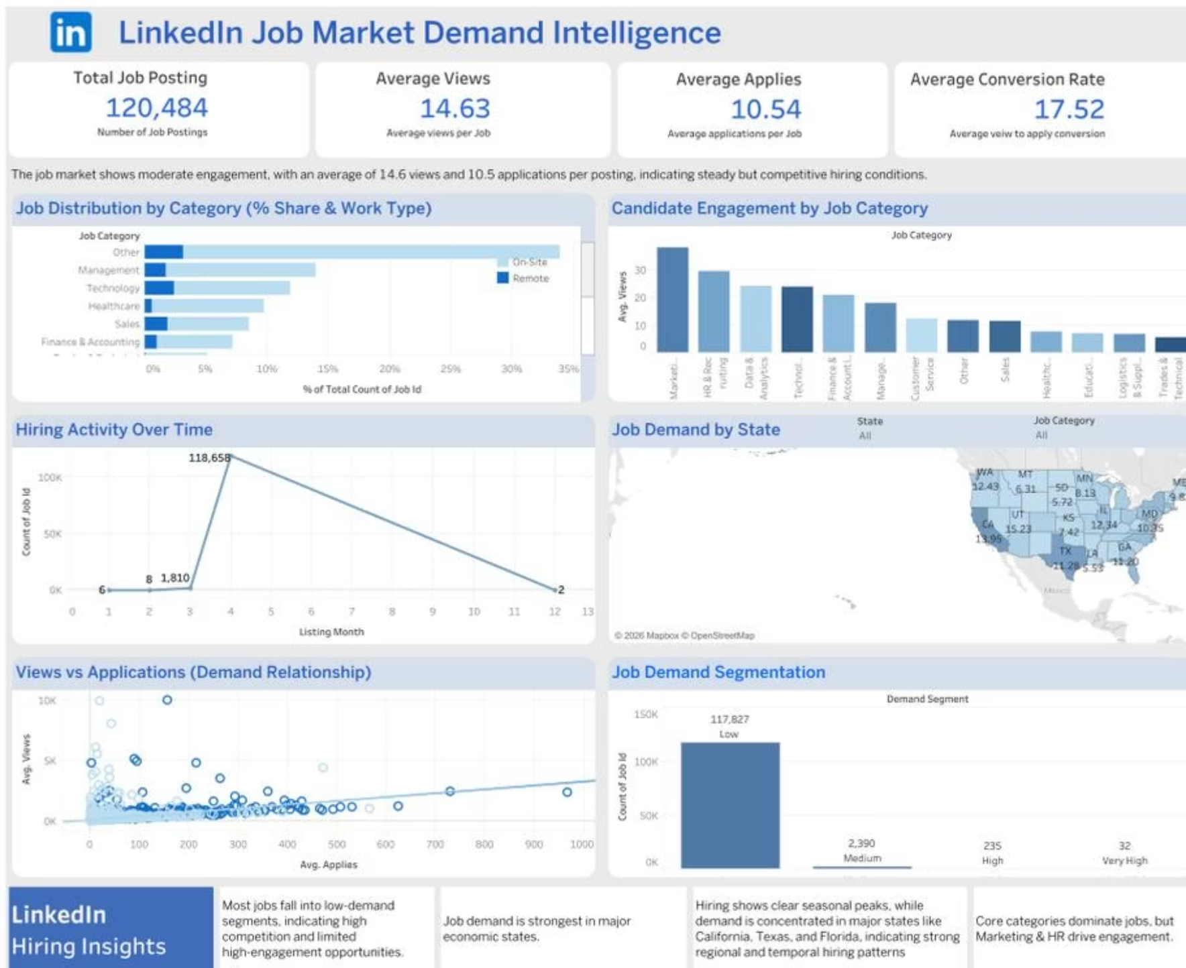
Three Tableau Dashboards Cover Every Decision Layer
Dashboard 1 — Demand Intelligence
Dashboard 2 — Salary Intelligence
Dashboard 3 — Competition Intelligence
KPI cards · State map · Demand segmentation · Hiring activity over time · Views vs Applications scatter
Salary by experience level · Salary bracket distribution · Remote vs on-site salary comparison
Competition score by category · Hard-to-fill indicators · Demand-salary positioning matrix

Slide 9
Five Recommendations to Turn Insights into Hiring Advantage
Mandate Salary Disclosure
1
Only 29.12% disclose salary. Transparency improves candidate fit and reduces screening waste.
Optimize Low-Demand Listings
2
Improve job titles, descriptions, and targeting. A 10% lift in conversion affects thousands of roles.
Benchmark Technical Pay
3
Data & Analytics (~$144K) and Technology (~$131K) need competitive compensation playbooks.
Build Remote Hiring Funnels
4
Remote roles face higher competition — separate funnels with faster screening reduce recruiter backlog.
Leverage High-Engagement Categories
5
Use Marketing and HR & Recruiting for rapid hiring campaigns and fast pipeline creation.

Slide 10

Segmented Intelligence Beats Volume-Based Hiring
Core Conclusion
Future Scope
Skill Dashboard
The job market is uneven: most postings are low-demand, salary transparency is limited, technical roles offer stronger pay, and remote roles combine higher opportunity with higher competition.
Predictive modelling for application probability, hard-to-fill risk, and salary range prediction
Build skill-demand layer using the exploded skills dataset
The recommended action: use segmented hiring intelligence by category · salary · remote status · state · experience level.
Real-Time Refresh
Candidate Tool
Scheduled pipeline updates for near-real-time market intelligence
Recommendation engine using demand, salary, and competition signals

