Slide 1
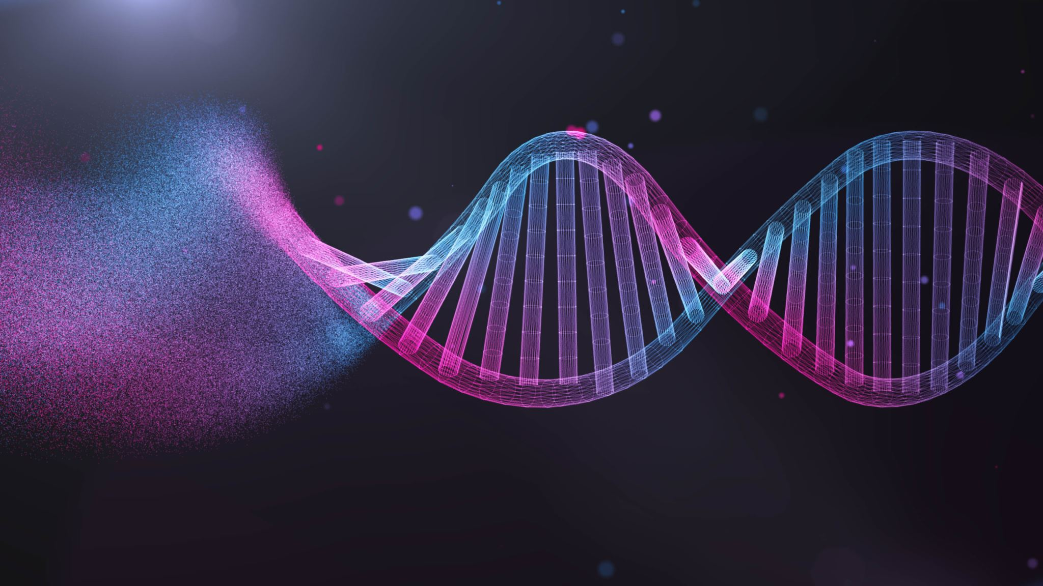

Codon-Helix:
A DNA-Inspired Dual-Stream Triplet-Based Compression Algorithm with Intrinsic Fault Tolerance
Submitted By:
Pallavi Yadav – 22MID0028
Smaranika Dutta – 22MID0270
K. Nikitha – 22MIC0059
Course: Advanced Data Compression Techniques
Slot: E2 + TE2

Slide 2
Introduction
DNA data is growing very fast due to genome sequencing.
Storing, transferring, and analyzing DNA requires huge space.
Normal compression tools (ZIP, GZIP) are not optimized for DNA.
Specialized algorithms can exploit biological patterns to compress better.

Slide 3

What Makes DNA Unique?
DNA has:
Only 4 letters: A, C, G, T
Many repeating sequences
Biological motifs (CpG islands, TATA boxes)
Triplets (codons) forming amino acids
Natural error tolerance
These properties can be used for better compression.

Slide 4
Need for DNA Compression
Reduce storage cost for large genome databases
Speed up data transfer in research labs
Make genome analysis faster
Support cloud storage of genomic sequences
Essential for personalized medicine & medical bioinformatics

Slide 5
Project Objective
This project aims to:
Study different DNA compression algorithms
Compare their performance
Understand their strengths & weaknesses
Introduce a Quantum-DNA Hybrid approach
Improve error tolerance and biological accuracy

Slide 6
Algorithms Compared
We studied four major algorithms:
DNACompress – Pattern & repeat-based
BioCODE – Codon/biological mapping-based
DNABIT Compress – Statistical & adaptive encoding
Quantum-DNA Hybrid – Proposed fault-tolerant model
Each one represents a different generation of DNA compression.

Slide 7
Algorithm 1: DNACompress
How it works:
Finds repeated DNA segments
Replaces repeated patterns with short references
Remaining characters encoded using 2 bits
Pros:
Very simple
Good for repetitive DNA
Cons:
Not good for non-repetitive DNA
No error protection
Medium compression ratio (~2:1)

Slide 8
Algorithm 2: BioCODE
How it works:
Converts codons (3 bases) into amino acids
Uses biological redundancy (64 codons → 20 amino acids)
Tries to detect coding regions (genes)
Pros:
Works well when DNA has many genes
Compression ratio increases for coding DNA
Cons:
Human DNA is mostly non-coding
Fails on random or repetitive sequences

Slide 9
Algorithm 3: DNABIT Compress
How it works:
Uses statistical analysis
Predicts the next base from previous bases
Assigns shorter codes to frequent patterns
Uses run-length encoding for long repeats
Packs bits efficiently
Pros:
Highest compression ratio
Fast processing
Good for large datasets
Cons:
Requires more processing power
Moderate error tolerance

Slide 10
Algorithm 4: Quantum-DNA Hybrid (Proposed)
How it works:
Inspired by quantum superposition (multiple states at once)
Encodes DNA motifs and patterns with special codes
Detects biological regions (TATA box, CpG)
Uses error-correcting repetition codes
Pros:
Very strong error tolerance
Works well even when data is noisy
Balanced compression
Cons:
Slightly slower
Needs more memory

Slide 11
Compression Ratio Results
Average compression ratio:
DNACompress → Low (2–4×)
BioCODE → Medium (2–3×)
DNABIT Compress → High (10–15×)
Quantum-DNA Hybrid → High but stable (7–12×)
Observation:
DNABIT gives best compression; Quantum-DNA gives best balance.

Slide 12
Visual Summary Table
Algorithm | Ratio | Speed | Memory | Error Tolerance
DNACompress | Low | Medium | Low | Very Low
BioCODE | Medium | Medium | Medium | Low
DNABIT | Very High | Very High | Medium | Medium
Quantum-DNA | High | Low | High | Very High

Slide 13

Where Each Algorithm is Best?
DNACompress: Good for repetitive DNA
BioCODE: Good for gene-rich sequences
DNABIT Compress: Best for large-scale genomic storage
Quantum-DNA Hybrid: Best for noisy data and long-term storage

Slide 14
Strengths of Codon-Helix
The proposed Codon-Helix framework features:
Dual-stream processing (pattern + triplet stream)
Codon-based grouping
Motif-aware encoding
Built-in error correction
High resilience and flexibility

Slide 15
Conclusion
DNA compression is essential for genomics and bioinformatics.
DNABIT gives the best compression performance.
Quantum-DNA Hybrid gives best error tolerance.
Codon-Helix offers a balanced, future-oriented approach that combines biological structure and error control.

