Slide 1
Lecture 6: optic flow and the control of locomotion
Translational flow
Rotational flow
Steering
Heading

Slide 2
Translational flow and the control of steering

Slide 3
Translational flow and motion perspective gradient (motion parallax)

Slide 4
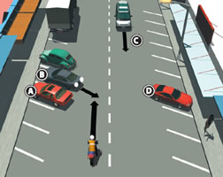
Heading and steering
FOE specifies heading
Steering: changing locomotion path curvature to arrive at a goal. Steering involves detecting heading direction and detecting a target object.
Visual target
Heading
Steering

Slide 5
Two hypotheses for control of steering: Retinal image or optic flow?
Visual information | Retinal image | Optic flow
Theory | Egocentric visual direction: Perceive the the image of the goal relative to the self | Move to cancel the error between heading (FOE, optic flow) and the goal (optic array)
How? | Center the image at the body midline and move forward | Move to place the FOE on target
Heading
Visual target
Steering

Slide 6
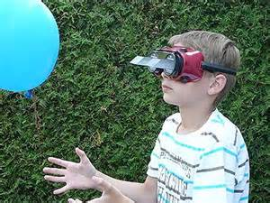
Prism studies
What information do we use to steer? Retinal image or optic flow?
Using prisms, the visual direction (of retinal image) can be dissociated from the direction to a surface (the optic flow direction)
Prisms only perturb visual directions, but not the actual location of surfaces with respect to the POO
Steer using optic flow (Warren & Kay, 2001) but need large visual field (Mon-Williams, 1993, 2008).

Slide 7
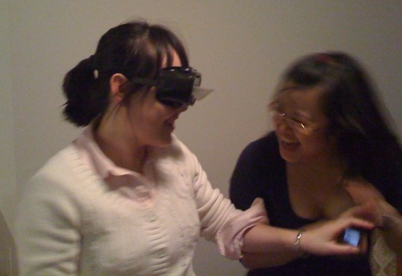
Information for steering: Retinal image or optic flow?
Usually the two information specifies the same thing. How to separate them?
Prisms change the retinal images (visual directions).
But prisms do not change the relations between world surfaces (relative to the observer); or, in optics, the relation between the FOE and VSAs of world surfaces.

Slide 8
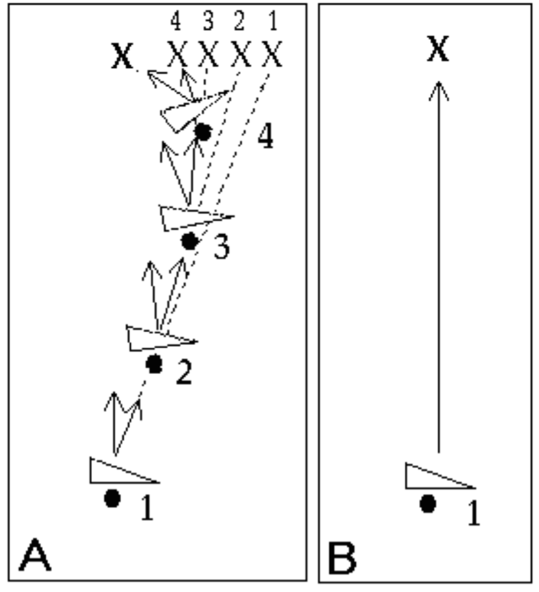
Two predictions for control of steering: Retinal image or optic flow?
Visual direction hypothesis
Optic flow hypothesis

Slide 9
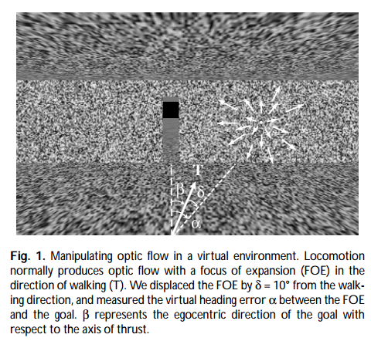
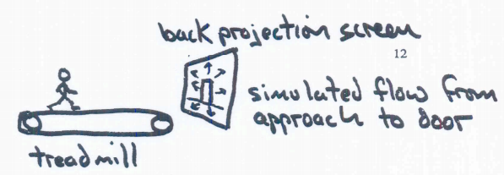
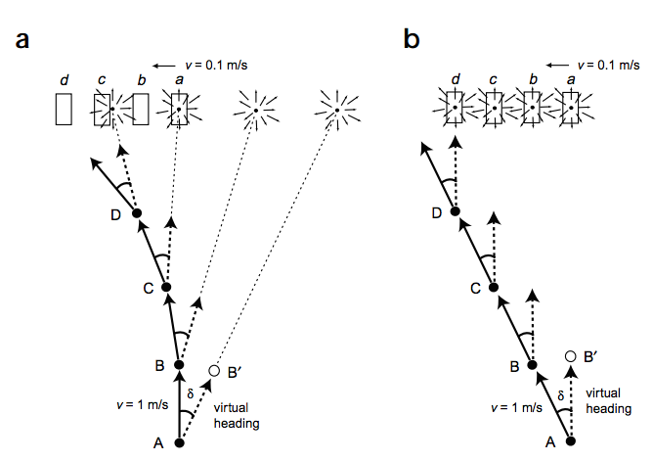
Empirical support: Warren et al 2001

Slide 10
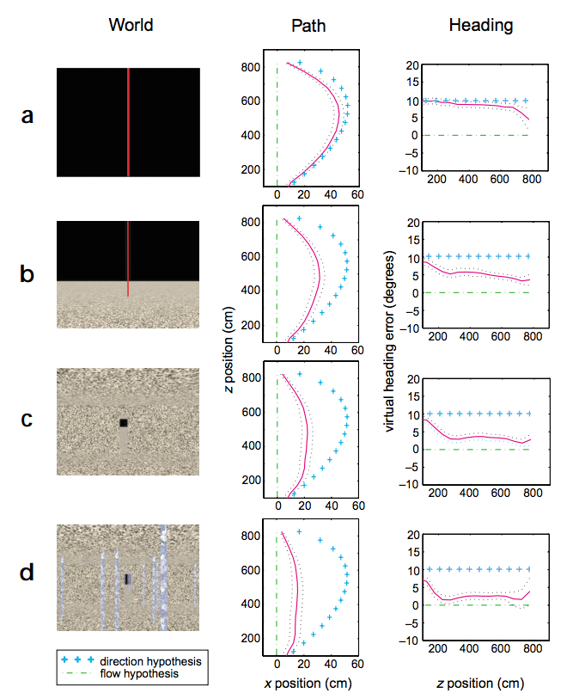
Why do you think there is a sudden drop of path curvature here?
Warren et al, 2001. Results in Experiment 1, VR only.
There were 4 viewing conditions with increasing strength of optic flow.

Slide 11
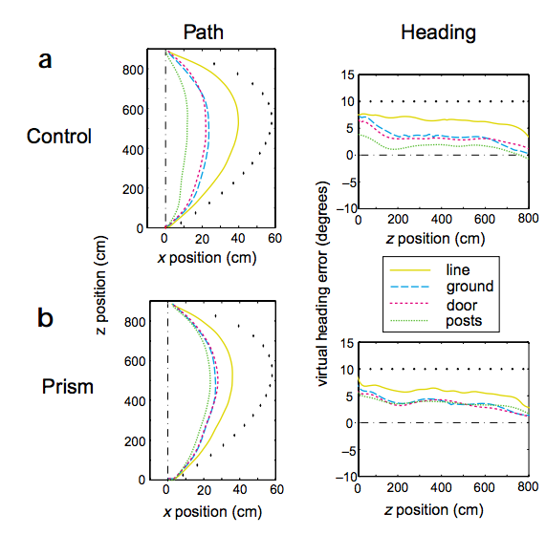
a. VR only
Replicating Experiment 1
b. Prisms + VR
Warren et al, 2001. Results in Experiment 2, prisms +VR.
There were 4 viewing conditions with increasing strength of optic flow.

Slide 12
Control of steering, summary
Using prisms or in VR, the visual direction (of retinal image) can be dissociated from the direction to a surface (the optic flow direction)
Prisms only perturb visual directions, but not the actual location of surfaces with respect to the POO
When there is no optic flow, use retinal image → curved paths
When there is optic flow, use optic flow → straight paths
Steer using optic flow (Warren et al, 2001) but need large visual field (Mon-Williams, 1993, 2008).

Slide 13
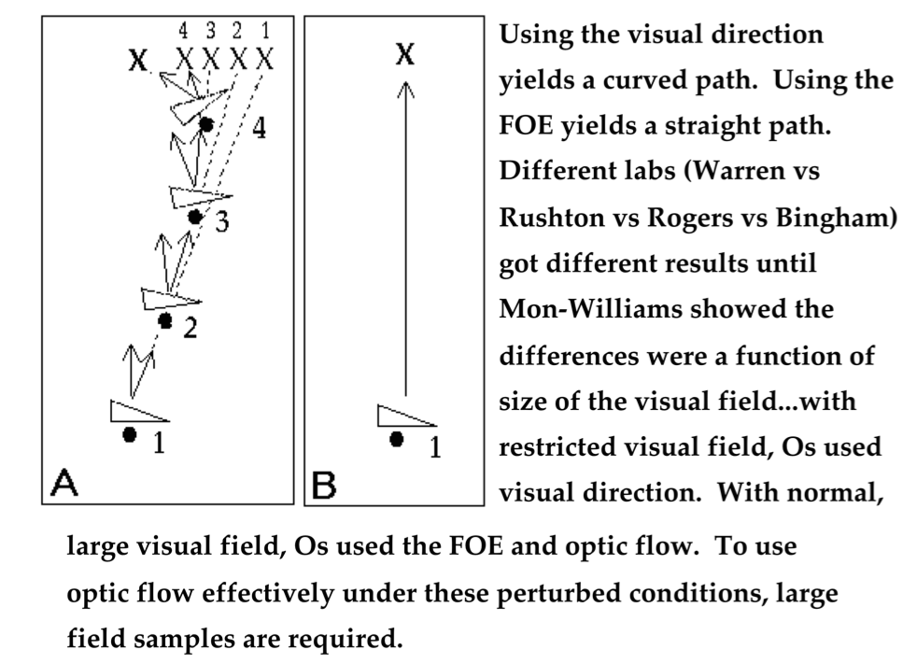

Slide 14
Rotational flow

Slide 15
Rotational flow
Rotational flow does not depend on depth
Rotational flow does not specify depth
Rotational flow

Slide 16
Rotational flow
Rotational flow does not depend on depth
Rotational flow does not specify depth
Translational flow
+
Rotational flow

Slide 17
Rotational flow
Rotational flow does not depend on depth
Rotational flow does not specify depth
Adding rot flow changes the FOE and FOC
Resultant flow

Slide 18
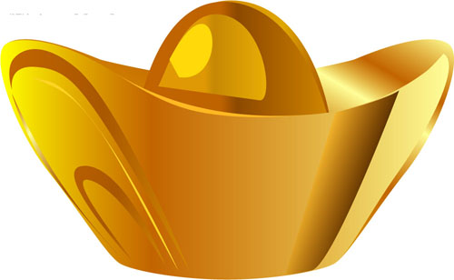
Locomotion with pursuit eye movement: Trans + Rot flow
Eye movement → rotation about POO
Pursuit eye movement: with transition of POO, locomoting observer tracks point in surround

Slide 19
Pure rot flow
POO is somewhere inside the eye… assuming it is at the center of the eyeball
Pure rotation about the POO yields:
Same flow vector at every point in the array
No info about 3D layout

Slide 20
Perceive heading direction

Slide 21
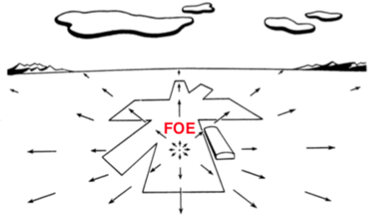
Instantaneous direction of self-motion during translation
Radial outflow
Focus Of Expansion (FOE)

Slide 22
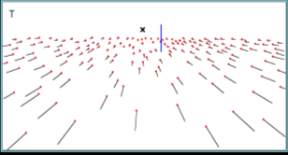
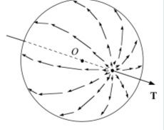
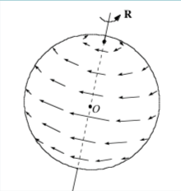
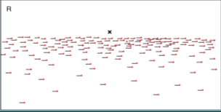
Retinal flow
Flow in the field
Flow projected to the retina
Translation: radial pattern
rotation: solenoidal pattern

Slide 23
Add rot flow to trans flow=??

Slide 24
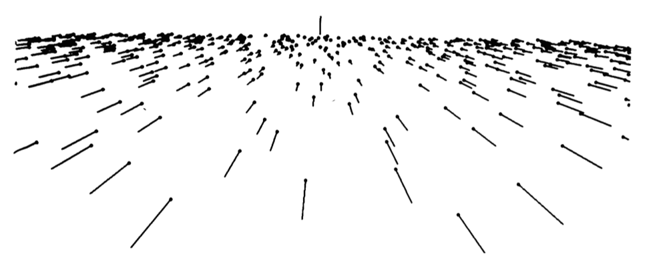
Pure translational flow
From Warren & Hannon, 1990

Slide 25
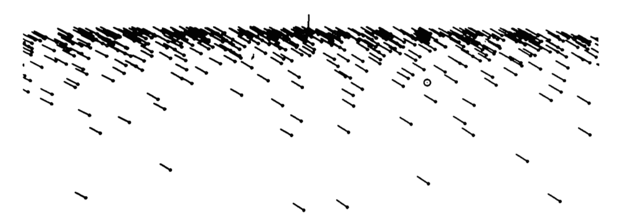
Pure rotational flow
From Warren & Hannon, 1990

Slide 26
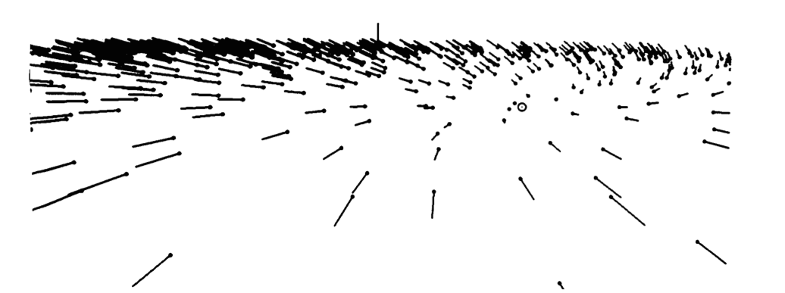
Translational + rotational flow
From Warren & Hannon, 1990

Slide 27
How to recover FOE during pursuit eye movement?
Oculomotor information – the muscle sense of how much the eye has rotated
Can be used to remove rotation vector
Differential flow – subtract neighboring motion parallax flow vectors (especially at depth edge)
Common rot vector drops out and the directions of flow and FOE are recovered
Recovers flow directions, not magnitudes
Trans flow vec: motion parallax
Rot flow vec
Resultant flow vecs for two neighboring points on depth edges

Slide 28
Recovering FOE during pursuit eye movement: Warren & Hannon, 1990
Experiment 1: can we detect heading direction with pursuit eye movement?
Display: Flowing dots on computer screen which simulated optic flow from locomotion over ground (with depth variation);
A target placed at horizon. The target and the simulated heading direction was ±0.5°, ±1°, ±2° or ±3° apart.
Task: judging whether moving to the left of right of the target
Conditions: (1) trans flow only; (2) rot + trans flow by adding a moving fixation point on ground in flow (rot flow generated by oculomotion)
Analysis: find the threshold (75% correct) for perceiving heading direction.

Slide 29
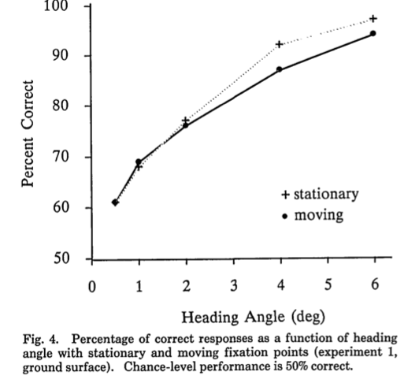
What does this result tell you?
Thresholds ≈ 1.8°
Notes:
Green curve: trans flow only
Orange curve: trans + rot, oculomotor info and motion parallax

Slide 30
Recovering FOE during pursuit eye movement: Warren & Hannon, 1990
Experiment 2: Using what information can we perceive heading? (comparing oculomotor and depth edge/motion parallax)
Conditions: (1) rot + trans flow by adding a fixation point on ground in flow (same as Exp 1, eye moved); (2) rot + trans flow but rot flow is simulated with no actual eye movement
Display, task and analysis: same as Exp 1
Fixate here
Exp 2, condition 2, no oculomotor info

Slide 31
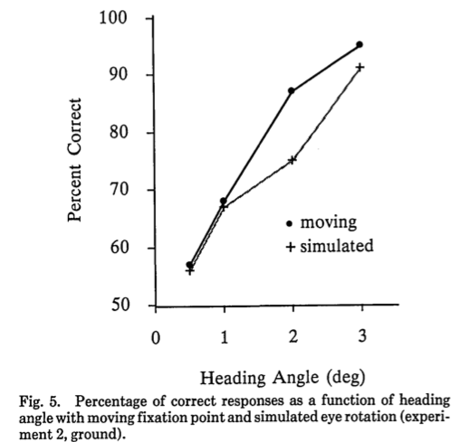
What does this result tell you?
Threshold (moving) = 1.3
No sig. diff
Threshold (sim) = 1.5
Notes:
There is no difference when perceiving heading with rot flow, whether Os moved their eyes or not… so oculomotor info is not required for recovering heading
Orange: motion parallax + oculomotor info
Purple: motion parallax only

Slide 32
Recovering FOE during pursuit eye movement: Warren & Hannon, 1990
Experiment 4: Using what information can we perceive heading? (Is depth edge/parallax necessary when there is no oculomotion?)
Display: radial flow pattern simulated on a wall (no depth variation)
Conditions: (1) rot + trans flow by adding a fixation point on ground in flow (same as Exp 1, eye moved); (2) rot + trans flow but rot flow is simulated with no actual eye movement
Task and analysis: same as Exp 1

Slide 33
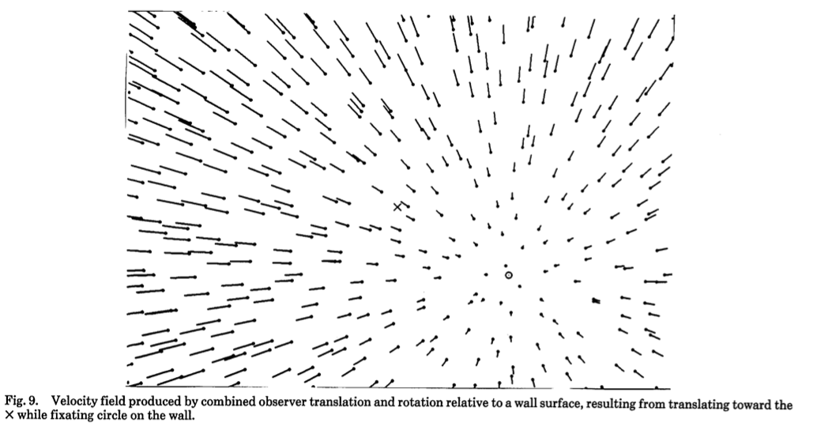
Fixate here

Slide 34
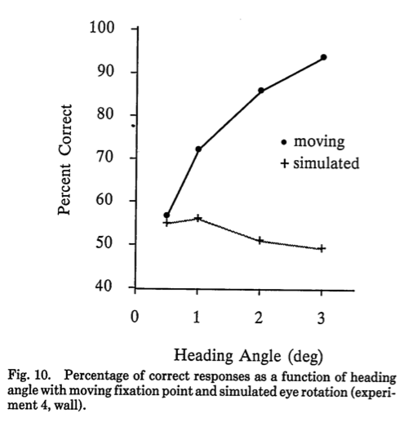
What does this result tell you?
Threshold (moving) = 1.2
Cannot do! Chance level performance
Notes:
Orange: no motion parallax, oculomotor only
Purple: no motion parallax, no oculomotor – can’t perceive heading.

Slide 35
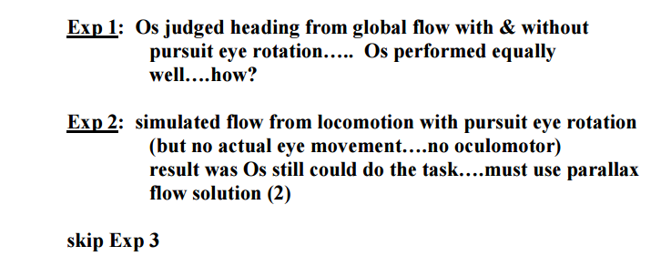
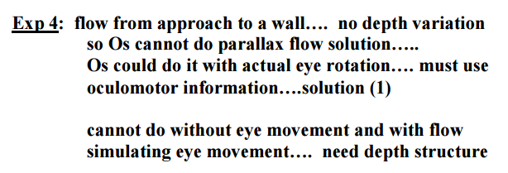
How to recover FOE during pursuit eye movement? Warren & Hannon (1990)

Slide 36
Terms covered
Head and steering
Prism adaptation
Rotational flow, pursuit eye movement
Control of steering (Warren et al, 2001)
Recovering FOE with rotational flow (Warren & Hannon, 1990)

Slide 37
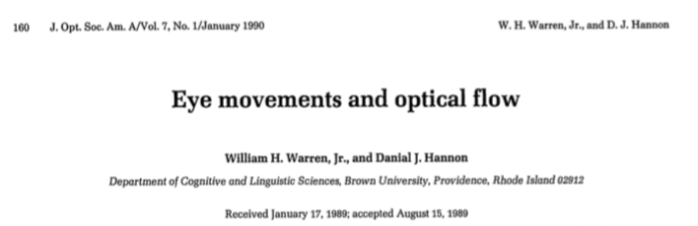
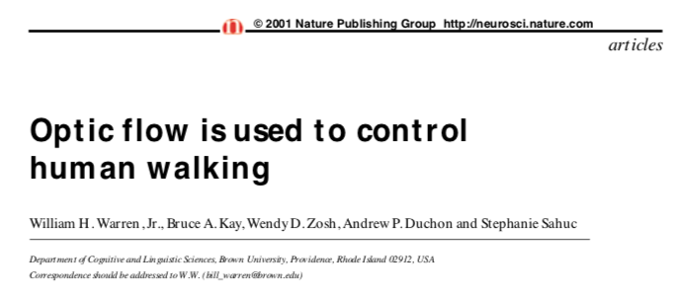
Reading

Slide 38
What’s covered
Translational and rotational flow, pursuit eye movement
Optic flow and the control of locomotion

