Slide 1
Lecture 13: Movement Dynamics

Slide 2
Problems with action control and solutions (Bernstein)
The Degrees of Freedom problem
Context-conditioned variability
Solution: synergy (higher order, coordinate and control)

Slide 3
How may synergy be achieved?
Hypothesis 1: via computation
Engineering approach
Hypothesis 2: dynamics, self-organization

Slide 4
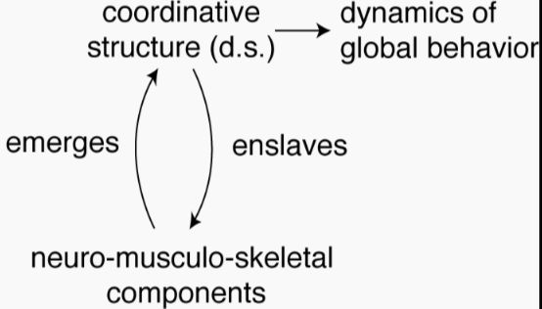
The dynamics hypothesis of action control
In a human movement system:
Components = limbs, muscles etc
Coupling: neural, mechanical
Reduce DF
Energy-saving movement patterns emerge from common underlying dynamics
Solves the problems of motor equivalence, equifinality, CCV etc..
The dynamics of movement
Stable pattern = attractors
Change of movement pattern = bifurcation
The importance of feedback (via perception)

Slide 5

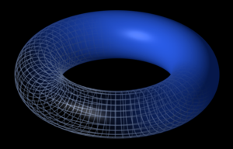
Human movement as a dynamical system
A dynamical system is a formal description of how the state of a system changes over time, depending on its parameter values.
Continuous spatial changes over time
Need feedback to adjust system – online control of behavior
Settles at a pattern
Point attractor
Limit cycle attractor
Limit torus attractor
Chaotic attractor
Critical change of behavior (from one stable state to an other) – bifurcation
E.g. walking and being upright → lying down as a result of tripping and falling

Slide 6

Evidence for online guidance – double step targeting paradigm (Bingham & Zaal, 2004)
Normal reaching to a target
START

Slide 7
Evidence for online guidance – double step targeting paradigm
The target jumps in/closer
START

Slide 8
Evidence for online guidance – double step targeting paradigm
The target jumps away/farther
START

Slide 9
Evidence for online guidance – double step targeting paradigm
When the target jumps closer:
60ms delay!!
If reaches are open-loop, then the reach to the first target need be completed before a second reach aimed at the new target. But hand movement trajectories show that this is not true. Reaching trajectories show it is one reach that is guided online, toward the final target.
Action is NOT pre-planned.

Slide 10
Evidence for online guidance – double step targeting paradigm
Double-step targeting experiments suggested that there was rapid adjustment to change of target locations. The results implied that movement must be controlled online (i.e., closed-loop, via feedback, in this case, visual feedback).
Adaptability and flexibility of human behaviors.
In movement control, variability is good; precision is not good. Variability in movement kinematics can account for sudden changes in the environment.

Slide 11
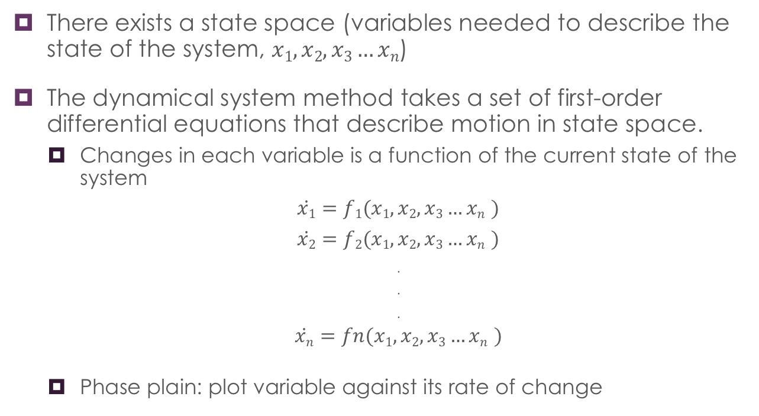
Concepts of dynamical systems theory
There exists a state space (variables needed to describe the state of the system, $x1, x2, x3…xn$)
The dynamical system method takes a set of first-order differential equations that describe motion in state space.
Changes in each variable is a function of the current state of the system
$\dot{x1}=f1(x1, x2, x3…xn$ $)$
$\dot{x2}=f2(x1, x2, x3…xn$ $)$
.
.
.
$\dot{xn}=fn(x1, x2, x3…xn$ $)$
Phase plain: plot variable against its rate of change

Slide 12
Stable states -- attractors
Once the system is at an attractor, it resists perturbation
Point attractor – the system settles at one steady state (one stable point)
Example: a mass spring oscillates and eventually returns to its resting length
Limit cycle attractor – the system settles at a regular pattern
Example: an ideal spring with no energy loss… stretch it… oscillate forever (simple harmonic oscillation) – stable pattern, which is not a point

Slide 13
Change of behavior -- bifurcation
A bifurcation occurs when a small smooth change made to the parameter values (the bifurcation parameters) of a system causes a sudden 'qualitative' or topological change in its behavior.
Qualitative change of behavior
Discontinuous, critical point…
Examples?
Notes:
Ex: system: a child running. State: x – displacement; change of state: x-dot, vel of running. Parameter: wind speed – as wind speeds change running velocity. Suddenly the wind becomes so strong that it makes the child unable to run and fall down. The system bifurcates (from running to lying down) as a result of a parameter change.

Slide 14
Simple dynamical models of movement control

Slide 15
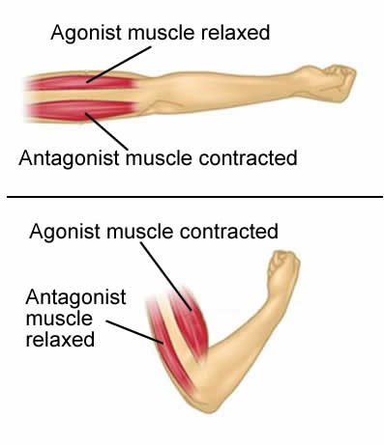
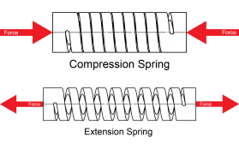
Mass spring models
The joint-muscle system works like damped mass springs.

Slide 16
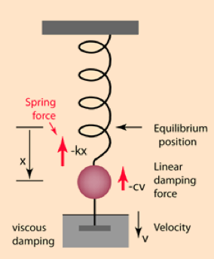
Mass spring with damping
Muscle dynamics in discrete reaching (reach once) = damped mass spring dynamics
The force laws:
Newton: inertia F = m*a
(m: mass of limb; a: acceleration)
Hooke: spring (conservative): F = -k*x
(k: stiffness of muscle; x: muscle length from resting position)
Damping (dissipative): F = -c*v
(c: damping coefficient (intrinsic to the muscle; v: velocity of limb)
Damped harmonic oscillator

Slide 17
Mass spring with damping
Muscle dynamics in discrete reaching (reach once) = damped mass spring dynamics
At equilibrium, a damped mass spring has:
Damped harmonic oscillator

Slide 18

Mass spring without damping
F = m * a
F = -k * x
F = -c * v
For an undamped spring,
at force balance,
F = m * a = -k * x
This is called “simple harmonic oscillation”)
Let m = 1 (for unit mass)
F = a = -k * x
$$\frac{∆F}{∆x}=\frac{∆a}{∆x}=k=\text{stiffness}$$
F =a
ΔF
Δx
x → displacement; v → velocity; a→ acceleration
x
Trajectory form
a
0
v
0
0
0
x
Phase portrait
x

Slide 19
Mass spring without damping
F = m * a
F = -k * x
F = -c * v
For an undamped mass spring,
at force balance,
F = m * a = -k * x
This is called “simple harmonic oscillation”)
Let m = 1 (for unit mass)
F = a = -k * x
$$\frac{∆F}{∆x}=\frac{∆a}{∆x}=k=\text{stiffness}$$
F =a
ΔF
Δx
x → displacement; v → velocity; a→ acceleration
x
The velocity-position relation is the single relation that we use to characterize limb movement. This is the higher-order variable for limb movement.
Trajectory form
v
0
0
Phase portrait
x

Slide 20
Practice!
v
0
v
0
0
0
x
x
Say, the above phase portraits are about 2 oscillatory movements.
Describe and compare them.
Say, the above phase portraits are about 2 oscillatory movements.
Describe and compare them.

Slide 21
Mass spring without damping
Undamped mass spring (harmonic oscillator): not stable. It stays where it is put. If perturbed, it stays where the perturbation leaves it.

Slide 22
Higher-order control (the mass spring model) for single-joint discrete reaching
Damped mass spring (damped harmonic oscillator): stable. The system always settles to a point attractor. The damping term determines how fast the system settles.
As damping becomes heavier
Damped harmonic oscillator:
F = -k * x – c * v = m * a
Point attractor

Slide 23
Higher-order control (the mass spring model) for rhythmic limb movement
Back and forth
Rhythmic movement of a single joint (as leg and arm swings) exhibit limit cycle stability.
The system is a damped harmonic oscillator (= mass spring) but it cycles down or cycles up to a limit cycle attractor.
These are like the damped harmonic oscillator, but settle down to a limit cycle attractor, instead of a point attractor. What is stable is not a parameter but a relationship.
Limit cycle attractor
Perturbation from adding or removing forces

Slide 24
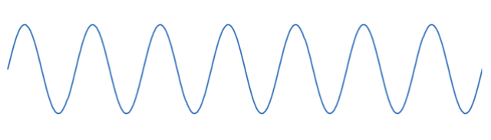
Higher-order control (the mass spring model) for rhythmic limb movement
Perturbation may advance or delay the limb’s phase, but when the limb (oscillator) resets it phase, it exhibits phase advance.
Phase resetting: when the oscillator is knocked off its limit cycle, it returns to it later.
In rhythmic limb movement, when the limb is perturbed and goes off its fixed trajectory form, it will return back to it.
Limit cycle oscillation
Perturbed oscillation
Phase resetting
Phase advance
Perturbation from adding or removing forces

Slide 25
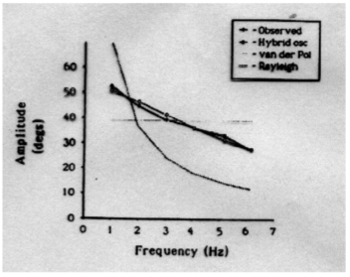
Higher-order control (the mass spring model) for rhythmic limb movement
Rhythmic limb movements (damped harmonic oscillators with limit cycle attractors) can be modeled with:
Hybrid oscillators:
Linear damping
Van der Pol
Rayleigh
Rhythmic limb movements exhibit an inverse frequency-amplitude relationship
The hybrid oscillator model exhibits this relationship

Slide 26
Higher-order control (the mass spring model) for rhythmic limb movement
Rhythmic limb movements (damped harmonic oscillators with limit cycle attractors) can be modeled with:
Phase driven oscillators:
The phase-driven oscillator model predicts phase-resetting (phase advancing)
Higher-order perceptual information (traj form)
Known via perception, visual feedback, closed-loop control.
Perception guided action.

Slide 27
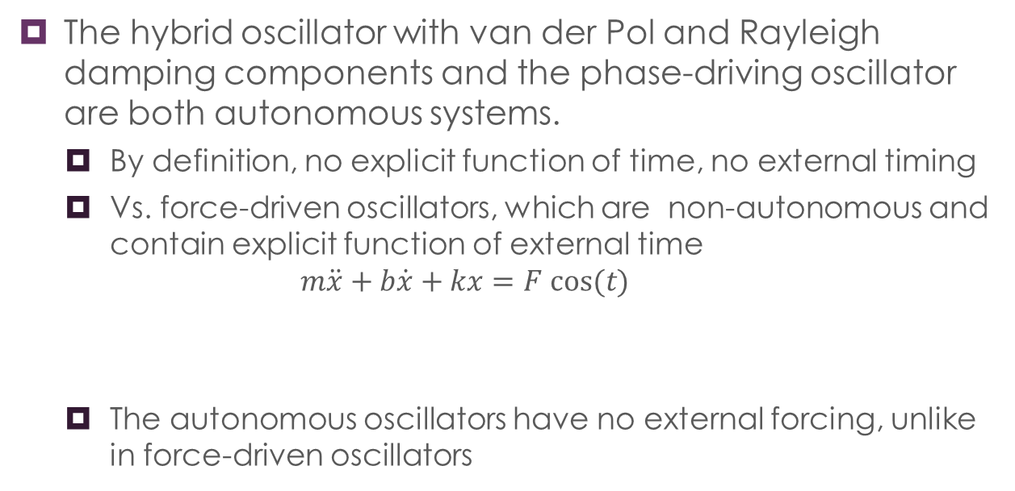
The hybrid oscillator with van der Pol and Rayleigh damping components and the phase-driving oscillator are both autonomous systems.
By definition, no explicit function of time, no external timing
Vs. force-driven oscillators, which are non-autonomous and contain explicit function of external time
$$m\ddot{x}+b\dot{x}+kx=F cos⁡(t)$$
The autonomous oscillators have no external forcing, unlike in force-driven oscillators
Clock in the brain
The forcing imposes order on the system, i.e. controlling how the limbs move

Slide 28
Laws and properties for the control of discrete reaching and rhythmic movement
What kinds of devices can the P/A system assemble themselves into? What dynamic properties do they exhibit?
1. discrete reaching: damped harmonic oscillators with point attractors
2. rhythmic movements: hybrid or phase driven oscillators with limit cycle attractors
Properties of rhythmic movement:
(1) phase resetting
(2) phase advance after resetting
(3) inversed relationship between frequency and amplitude

Slide 29
Summary
Dynamical systems
(Spatiotemporal) change
Forces
Self-organization of systems (can be studied by dynamical systems analysis as a method)
From no order to order with no pre-planned rules
Global enslaves local
Attractors and stabilities
The dynamics of simple human movements
Ballistic reaching – modeled as damped harmonic oscillator (damped mass spring)
Rythmic limb oscillation – modeled as hybrid oscillator or phase-driven oscillator

Slide 30
Reading
Kelso: Contrasting Perspectives on Order and Regulation in Movements
Notes:
Goldfield: Reduction of dimensionality

