Slide 1
Lecture 8: Affordances and higher-order variables
The concept of higher-order variables (smart mechanisms)

Slide 2
From last time
Warren’s work showed that affordances
(1) entail scaling between the actor and the environment (actor-environment fit) and
(2) they are perceptible (S’s in Warren’s studies can look and know whether they could climb the stair or pass the gap without performing the actions).
(3) Furthermore, environmental changes yield changes in the perception of affordances (e.g. raising the ground). Hence you do not only perceive an object, but the whole actor-world unit.

Slide 3
Direct perception?
Eco Psyc → direct perception
Exactly how do we perceive directly (and not via computations)?
The concept of higher order variables (aka smart mechanisms, Runeson, 1977)

Slide 4
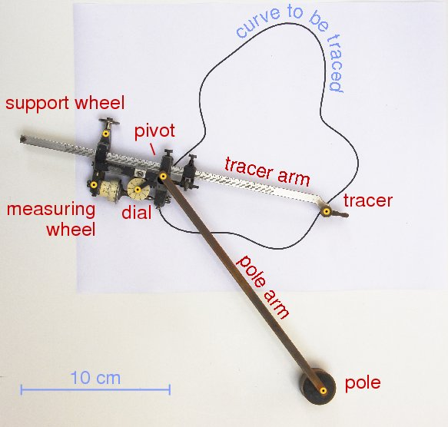
Higher order variables, ex 1
What is the size of this?
How did you get it?
Runison’s example of a planimeter
Whether something is directly measurable (perceptible) depends on the measuring (perceiving) device!

Slide 5
Area is a higher order (2 dimensional) variable. Length is a lower order (1 dimensional) variable.
Using the right device (the planimeter), areas can be measured directly, instead of computed by using lengths.
Whether something is directly measurable/perceptible depends on the measuring device.

Slide 6
Runeson, 1974

Slide 7
Runeson, 1974

Slide 8
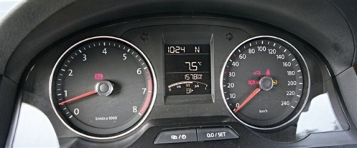
Higher order variable measuring is everywhere in life!!!!
The tachometer measures a higher order variable which is the engine’s revolutions per minute (RPM).
The speedometer measures speed directly, which is a higher order variable (v = d/t). The car does not measure distance and time and then do division!
You cannot measure area or speed with a ruler; neither can you measure length with a planimeter or distance with a speedometer.
To the speedometer, measure speed is direct; to the planimeter, measuring area is direct; to the tachometer, measuring RPM is direct… what is direct depends on the measure device!

Slide 9

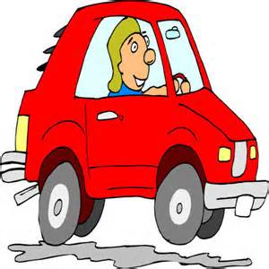
Higher order variables, ex 2
Perceiving time-to-contact

Slide 10
Higher order variables, ex 2
Time-to-contact (TTC) is specified by τ, which is mathematically equivalent to:
TTC – world variable
τ (tau) – optical information that specifies the world variable of TTC
Image and image expansion rate are in the ??

Slide 11
Higher order variables, ex 2
Time-to-contact (TTC) is specified by τ, which mathematically is equal to:
However, τ is visually detected (not computed) as a higher-order variable (Todd, 1981).
It has been shown that the threshold for detecting image expansion rate is higher than that for detecting TTC… i.e., an observer is more sensitive to TTC than to image expansion rate (Regan and Hamstra, 1993).
Note: τ only specifies time (TTC), not velocity or distance of an approaching surface. τ specifies TTC when approaching vel is constant.

Slide 12
Higher order variables, ex 2
Motion of an approaching car or running person… roughly constant vel
But vel is not constant in many cases, for example during free fall
Possible strategy – using “margin values” of τ
τ does not specify TTC but the value of τ can be used to initiate an action

Slide 13
Higher order variables, ex 2
Two situations for using τ
Observer not in control of approach trajectory
use τ to initiate action
Observer in control of approach trajectory
use τ to visually guide action

Slide 14
Perceiving TTC for braking
Why do you need to know your TTC (by detecting τ)?
Braking!
When you are approaching a target, slow down and make soft contact (not crashing)
The control of braking relies on the direct perception of TTC, and the optical info for TTC is τ
TTC is a world property that you are perceiving
τ is an optical invariant, or a piece of info in the optics, using which you perceiving TTC.
Similarly, FOE is an optical invariant (or info) for the perception of heading direction (world property)

Slide 15
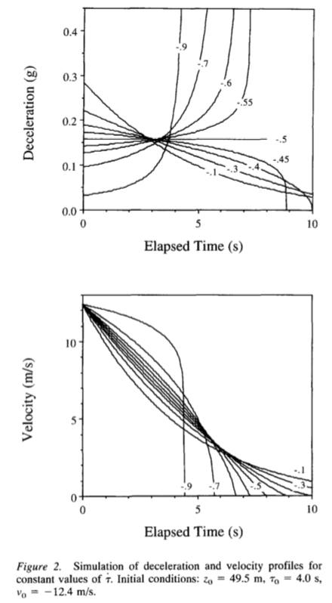
Perceiving TTC for braking
Constant strategy (Yilmaz and Warren, 1995)
Keep (change of tau with time) at -0.5 would yield constant deceleration to stop at a target.
The value of deceleration depended on when braking is initiate along the course of approaching a target.
0 < tau-dot < -0.5: brake fast and move slow;
-0.5 < tau-dot < -1: move fast and brake hard (may crash).
Notes:
Proportional rate control strategy is more flexible and stable than constant tau-dot strategy
Yilmaz n Warren, 1995: Of course, a cautious observer who wanted to approach slowly could use a margin value of -0.3, whereas a risk-taker seeking a faster approach might adopt a margin value of
-0.6. It is clear from Figure 2 that a reasonable braking strategy would be to use a margin value somewhere be- tween -0.4 and -0.5 in order to avoid both infinite decel- erations and a protracted approach.

Slide 16
Perceiving TTC for braking
Proportional Rate Control strategy (Anderson & Bingham, 2010, 2011)
Move so to hold constant
Walk and stop at a target means bring the eyes to the target… use monocular motion info … monocular τ
When τ is large (far from target), τ changes fast
When τ is small (near to target), τ changes slowly
Large means you get to the target quickly, small means you get there slowly.
Notes:
Proportional rate control strategy is more flexible and stable than constant tau-dot strategy

Slide 17
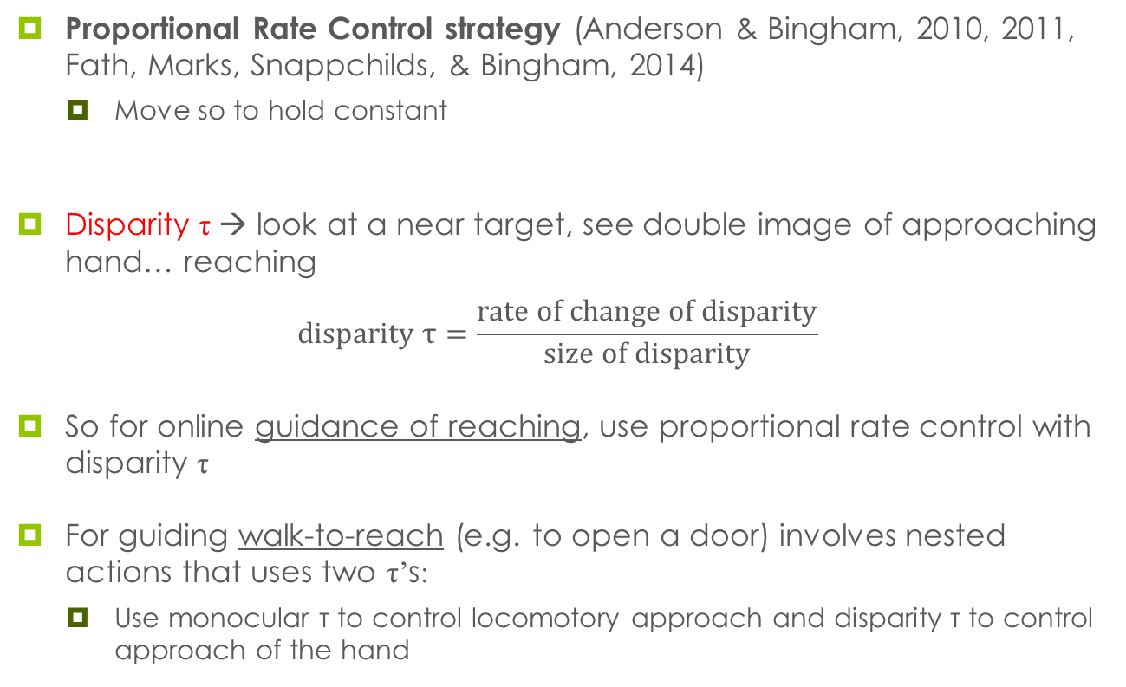
Perceiving TTC for braking
Proportional Rate Control strategy (Anderson & Bingham, 2010, 2011, Fath, Marks, Snappchilds, & Bingham, 2014)
Move so to hold constant
Disparity τ → look at a near target, see double image of approaching hand… reaching
$$\text{disparity} \text{τ}=\frac{\text{rate} \text{of} \text{change} \text{of} \text{disparity}}{\text{size} \text{of} \text{disparity}}$$
So for online guidance of reaching, use proportional rate control with disparity τ
For guiding walk-to-reach (e.g. to open a door) involves nested actions that uses two τ’s:
Use monocular τ to control locomotory approach and disparity τ to control approach of the hand
Notes:
Proportional rate control strategy is more flexible and stable than constant tau-dot strategy

Slide 18
Perceiving TTC for braking
Moral of the story: regardless of the braking strategy, the control of action requires the detection of one optical pattern and/or its change across some time!
→ change of optical pattern with time.
Notes:
Proportional rate control strategy is more flexible and stable than constant tau-dot strategy

Slide 19
Summary
Affordances in everyday life
The concept of higher-order variables
The higher-order optical variable in perceiving TTC
We perceive higher order variables (information) directly and not via mental computation!!!!!!!!!
Notes:
Texture gradient;
Change of gradient
Motion parallax (beta-dot)
Optical velocity
These are all higher order variables

Slide 20
Reading
Runeson (1977): On the possibility of “smart” perceptual mechanisms

Slide 21
Relevant literatures
Todd, J. T. (1981). Visual information about moving objects.. Journal of Experimental Psychology: Human Perception and Performance, 7(4), 795-810.
Yilmaz, E. H., & Warren, W. H. (1995). Visual control of braking: a test of the tau hypothesis. Journal of Experimental Psychology: Human Perception and Performance, 21(5), 996-1014.
Anderson, J., & Bingham, G. P. (2010). A solution to the online guidance problem for targeted reaches: proportional rate control using relative disparity τ. Experimental Brain Research, 205(3), 291-306.
Fath, A., Marks, B. S., Snappchilds, W., & Bingham, G. P. (2014). Information and control strategy to solve the degrees-of-freedom problem for nested locomotion-to-reach.. Experimental Brain Research, 232(12), 3821-3831.

