Slide 1
Lecture 4: Optic flow

Slide 2
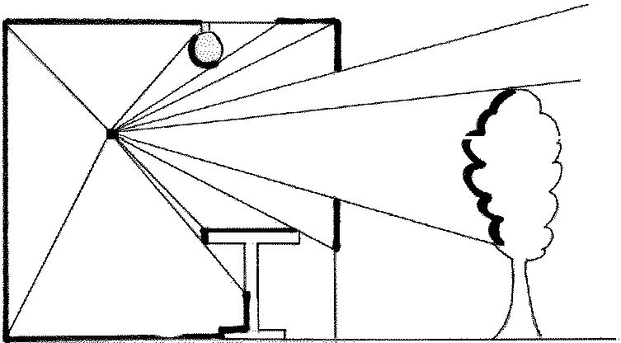
Optic array
The optic array is a nested array of visual solid angles (VSA’s) that are formed by the ambient light converging on the point of observation (POO).
All measures in the optics are angular.
Point of Obs
Notes:
Picking up contrasts, forming angles.

Slide 3
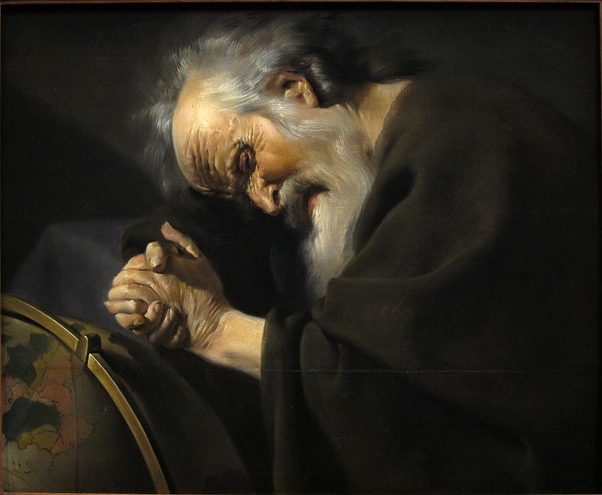
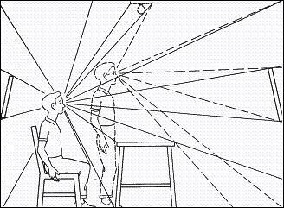
Optic flow
Heraclitus: No man ever steps in the same river twice.
With motion, patterns of light change. The motion and the change of light pattern has one-to-one correspondence (lawful).
The lawful change of optic array wrt a moving POO is called the optic flow.

Slide 4
Mapping between World & Optics
Floor tiles
World:
Observer
Floor (with textures)
Optics:
VSA’s, optic array,
optic flow (when the observer is walking)
To perceive is to detect info in optics to gain knowledge of the world.

Slide 5
Mapping from World to Optics
eye
A
A
b
-b
D = viewing distance

Slide 6


Mapping from World to Optics
$$\frac{∆D}{∆t}=V$$
$$\frac{∆b}{∆t}=v$$
World
Optics
Notes:
World → object approaching
Optics → image expansion
How is image expansion speed related to the approaching speed of the world object?

Slide 7
Mapping from World to Optics
A
b
D = viewing distance
What does this suggest? →
Notes:
What does this suggest?
- Optical patterns are projected by world objects… changes in the world will be reflected lawfully as changes in the detectable optical patterns
- For two objects of similar sizes, the father one moves slower.

Slide 8
Optic flow patterns

Slide 9
Distinguishing self motion from object motion

Slide 10
Changes and regularity
Locomotion => optic flow
Stationary => no optic flow
Outflow specifies approach
Inflow specifies retreat
Translation (motion) yields optic flow; optical invariance (FOE, FOC) specifies properties of motion.
Focus of Contraction
Focus of Expansion
(node, where flow = 0)
Perception and perceptual info are time extended: no sensations, no memory required.

Slide 11
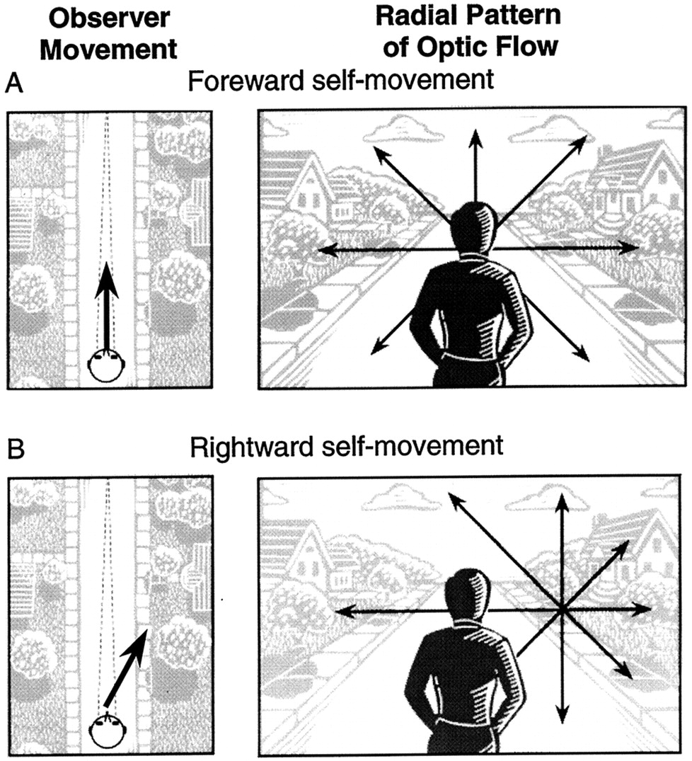
Changes and regularity
FOE specifies heading direction.
Shift of focus from one VSA to another specifies change of direction of heading ( = steering).

Slide 12
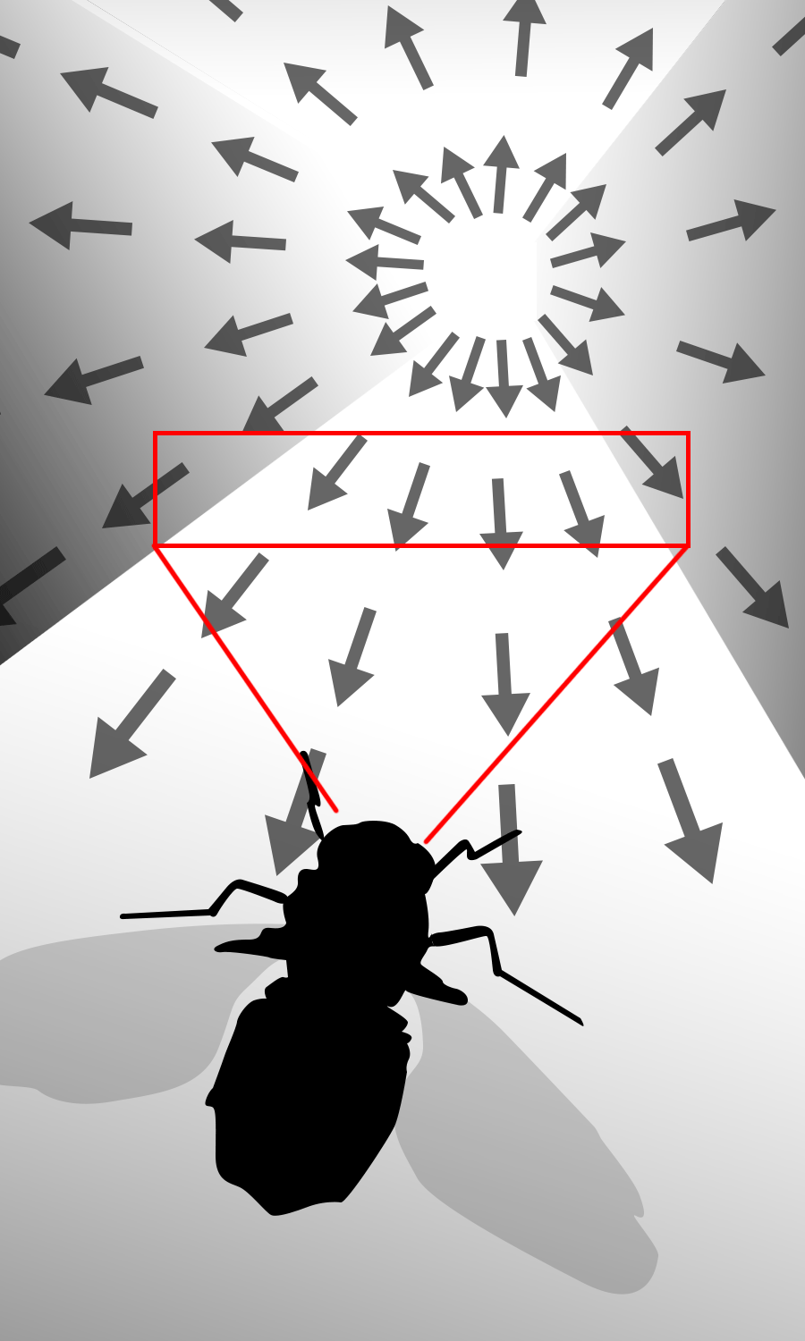
Changes and regularity
FOE specifies heading direction, but the FOE does not have to be in view
The father away from the FOE, the faster the flow speed is (0 flow at the FOE.)
Can detect the FOE by detecting the flow patterns. The more the optic array is sampled, the better the perceived 3D structure. (Looking though a slit vs. IMAX. )

Slide 13
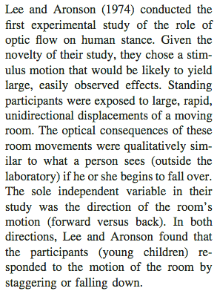
The “hanging room” demo
Acoustic flow?

Slide 14
The case of occlusion
Occlusion: light pattern corresponding to the surface of the ball goes out of existence in the optics. But, is (the surface of) the ball going out of existence in the world?
When surfaces in the world:
Going out of sight:
Deletion of optical texture at an edge.
Reversible (coming into sight, with accretion of optical texture at an edge).
Going out of existence:
Melting, evaporating, exploding, burning, crushing…
Irreversible.

Slide 16
How about retreating from an obstacle?
How about retreating from an aperture?

Slide 17
Perception is spatial-temporal
Michotte (1946): The perception of causality

Slide 18
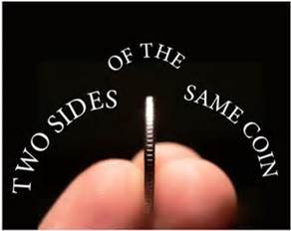
Four pillars of ecological approach
Perception can only be understood in relation to environment (A-E mutuality)
Animal is adapted to regularities of the econiche that support perception/action
Physical and informational regularities, ecological constrains
Perception is evolved to guide actions (functional)
Adapt to information that supports successful action
Semantics (= meaning) grounded in action
Perception/action coupling
Information as specificity
Higher-order spatiotemporal patterns of stimulation
Specific to behaviorally-relevant properties, within eco context of constraints
Perception as the detection of information by an attuned perceptual system
Implicit mapping from information to behaviorally-relevant properties
Attunement in evolution and learning

Slide 19
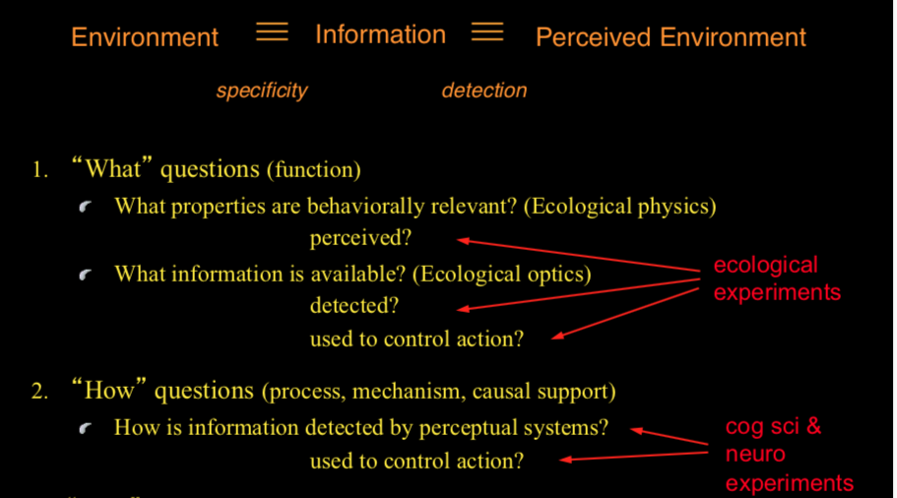

Slide 20
Concepts & Terminologies of this class
Radiant vs. ambient light; optic array, optic flow, visual solid angle, invariance, FOE/FOC, global flow/ local flow, heading, steering.
World-optics relations
Occlusion, deletion/accretion

Slide 21
Relevant Readings
Gibson “Theory of direct visual perception” –will be sent to you electronically.

Slide 22
Homework 2
Type out answers in full sentences.

