Slide 1
Lecture 16: Concluding Remarks

Slide 2
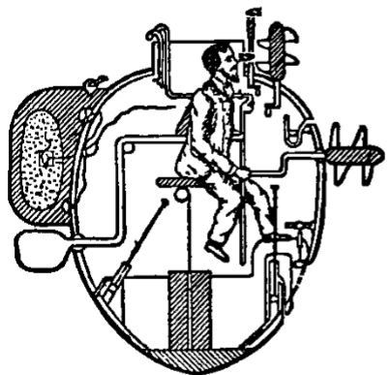
How do we know the world? – the constructive approach
Submarine model of the mind
The observer is in contact with an internal representation of the world (periscope image), not the world itself.
The observer controls an internal model of the body (knobs and levers) not the body itself.
We know the world by building, understanding and controlling a mental model of it. – constructivism

Slide 3
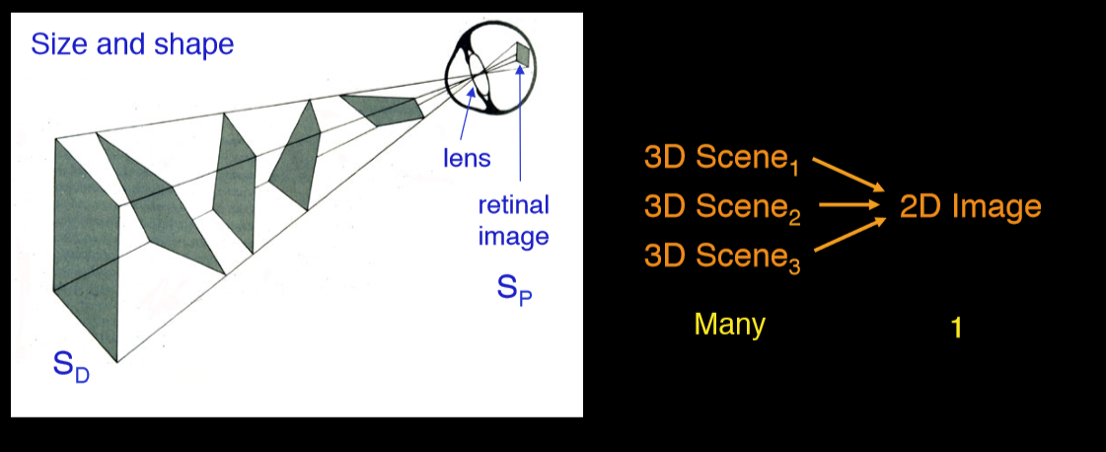
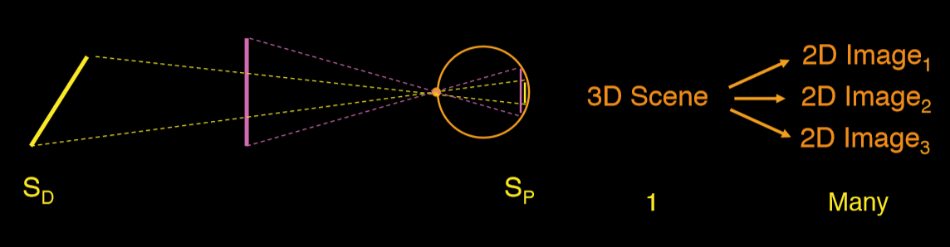
The problems of perception
3D world → 2D retinal images (where vision begins) → 3D percept… HOW?
The problem of ambiguity: many –to- one mapping
The problem of constancy: one- to- many mapping

Slide 4
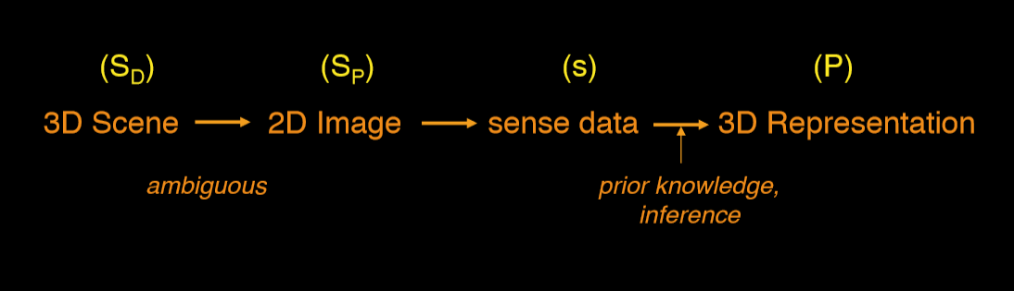
The constructive solution (Holmholtz, Rock, Gregory)
Perception as the construction of an internal representation of the external world, from static image-based input.
Goal of perception is to recover a Euclidean description of the world (S_{D})
Indirect, inferential or representational view
Three key features: nonspecificity, inference, representationalism

Slide 5
The constructive solution (Holmholtz, Rock, Gregory)
Mind only in contact with sensory data
More impoverished, more dissimilar to real world
Must “go beyond the info given”… “unconscious inference”
Inference involves assumptions, biases, experiences, memory, prior knowledge etc..
Impoverished info (non-specific)

Slide 6
The representational fallacy: who interprets the representation in your head?
Hume’s problem: how do representations get connected to the world?

Slide 7
How do we know the world? – the computational view
The computational view offers a specific and explicit account of how to construct (which is majorly improved from fuzzy psychological theories).
The computational view formulated vision as “inverse optics”
Marr (1982) Vision
Bottom-up sequence of processing steps from image to object representation
How to recover physical surface properties from image?
Computational level, algorithmic level (software), implementation level (hardware)

Slide 8
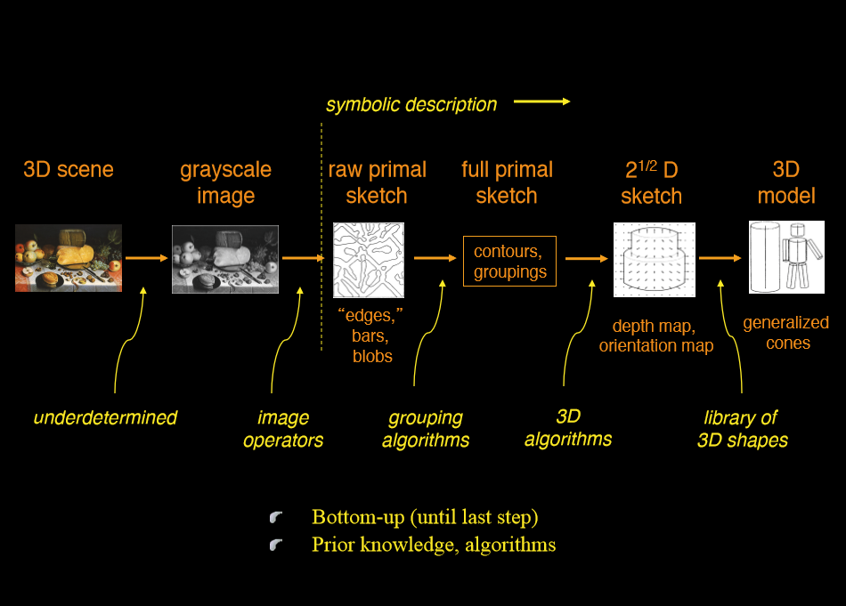

Slide 9
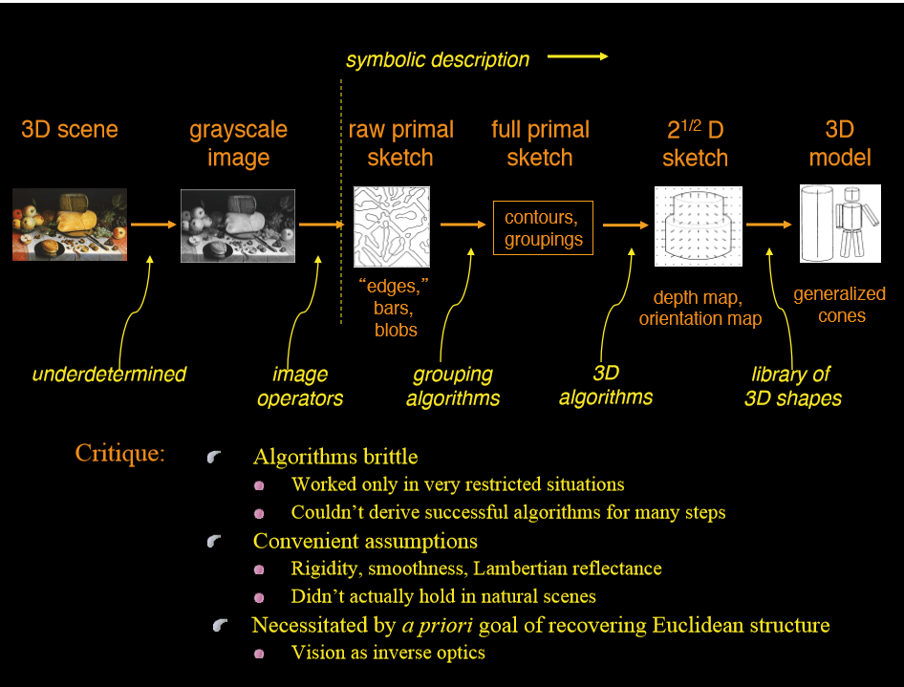

Slide 10
The constructivist approach is founded on the idea that cognition is representational
Actor-environment dualism
Environment as physical
Mind as a formal system of operations on representations
Perception as a process of inferring internal representation of external world from impoverished input
The mind is in direct contact with internal representations, not with external world.

Slide 11
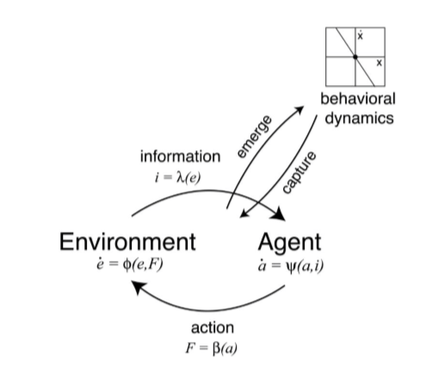
How do we know the world? – the ecological approach
Actor-environment (A-E) as one unit
Must analyze the whole system (hence the term “ecological”)
Direct perception
Specificity
Non-inferential
Non-representational
Perception uses information, which exists in the A-E system

Slide 12
A-E mutuality
Analyze the whole ecosystem
Animal and econiche co-evolved, are complementary
Animal is adapted to regularities of the econiche that support successful perceiving and acting
Physical and informational regularities
Econiche is adapted to animal
Niche construction

Slide 13
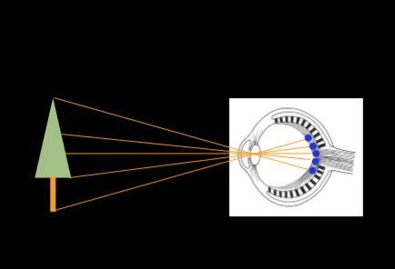
Constructive
Ecological
Distal stimulus
Goal: reconstruct the Euclidean or Newtonian structure of the world
An environment for an animal
Behaviorally relevant description at an ecological scale (affordances)
Proximal stimulus
Retinal image
Elementarism
Information
Optic array and optic flow (spatial-temporal change in the optics)
Higher-order variables as info that specifies complex properties
Notes:
Elementarism: world as a set of points in space. Retinal image as mosaic of punctate, static stimuli. Each point produces sensation or signal and the brain reassembles them.

Slide 14
Ecological approach to perception: central arguments
Perception/action can only be understood in relation to environment
Animal is adapted to regularities of the econiche that support P/A
Physical and informational regularities, within ecological constrains (e.g. passive dynamics)
Perception evolved to guide action (perception is for action)
Adapt to info that supports successful action
To perceive is active (action is for perception)
Move to generate optic flow
Information as specificity
Higher-order spatio-temporal patterns of stimulation
Specific to behaviorally relevant properties, within eco context of constraint
Perception as the detection of info by an attuned perceptual system
Implicit mapping from info to behaviorally relevant properties (e.g. motor control and coordination)
Attunement in evolution and learning: adapt to info

Slide 15
Optic array
Optic flow
Higher-order variables
Invariant
Information
The visual system detects info from the optics to perceive world properties and guide actions.
Affordances
Motor control
Bernstein’s problem and solution
Movement dynamics
Self-organization and system dynamics
Calibration

Slide 16
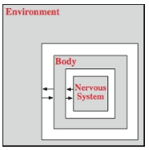
Information exchange
Cognition exists in the brain-body-environment system

Slide 17
Radical embodied cognition: Ecological psychology
Info = higher order relations in the optic flow that do not change in the context of moving world objects and specifies a world property (e.g. Tau is optic information that specifies time-to-contact)
How does cognition happen?
How do individuals perceive and know the world?
Complete rejection of mental representations.
Complete rejection of brain’s dominance.
What is perception for? | Action; perceiving action possibilities; P/A are inseparable.
Basis of P/A: How is P/A modeled? | Animals actively seek and pick up info that directly specifies affordances.
Roles of the body and environment in modeling P/A. | Monism – the body/environment is part of the perception, e.g. changing floor height changed perceived passibility (Warren & Whang, 1987) . Use of control laws (higher-order; embodied).
Scale/unit of analysis | Higher-order control and coordination, the system as a whole, not the constituting elements.

Slide 18
Question:
Why do researchers embracing the idea of (radical) embodied cognition not use MRI scanning as a research method?
Notes:
Evolution of system thru time is important – MRI is lack of temporal sensitivity
Emphasis on the observable change of the whole state (e.g. behaviors) not the processing within the brain.

Slide 19
Question:
Studies have shown that when you are holding a glass of warm water, you feel the one you are talking to is warm; if you are holding a glass of icy water, you feel the one you are talking to is less warm. Similarly, if you are thinking of the future, your body tends to lean forward.
Is this embodied cognition (at least in the Gibsonian sense)? Why or why not?

Slide 20



Cognition is still based on representation and mental models… still similarity based and involves the causal chain.
However, the formation of mental models are affected by not only the brain, but also the body and the environment.
By including the body and environment, it forms a better world model.
How friendly is the person with whom you are interacting?

Slide 21
Reading
Warren (2006), The dynamics of perception and action. P358--368
[Optional] Wilson & Golonka (2013), Embodied cognition is not what you think it is.
available at: https://www.frontiersin.org/articles/10.3389/fpsyg.2013.00058/full

