Slide 1
Lecture 12: Computational and dynamical theories of motor control

Slide 2
Problems with action control and solutions
The Degrees of Freedom problem: too many things to control
Solution: synergy (coordination, low-level automatism)

Slide 3
Problems with action control and solutions
The Context Conditioned Variability problem: neural commands do not uniquely determine movement
Solution 1: synergy
Solution 2: feedback, or closed-loop control – perception is needed to know the state of the action system (e.g. position of a joint)

Slide 4
Synergy and what needs to be considered
DF: number of varying parts of control
Context-conditioned variability: adaptive to sudden changes in action contexts
Equifanality: achieve one goal from different initial conditions
Motor equivalence: many movements all achieve the same goal

Slide 5
How may synergy be achieved?
Hypothesis 1: via computation
Engineering approach
Hypothesis 2: dynamics, self-organization

Slide 6
Computational theories leading toward synergy
Reflex chains
Closed-loop models
Open-loop models and motor program
Inverse models
Forward models

Slide 7
1. Reflex chains
C. S. Sherrington, 1910
Reflex chains:
Complex movements assembled from reflexes
S→ R chains: stimulus – reflex – stimulus –reflex
Each reflex serves as the next stimulus
Problems：
Non-adaptive
Serial processing
Determining the initial state based on future goal

Slide 8
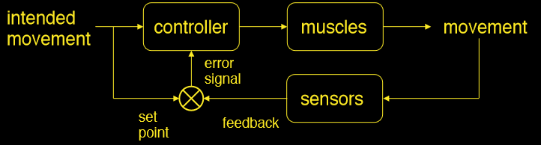
2. Closed-loop models
Wiener, 1949
Advantages:
Closed-loop, error correction
Adapt to changes
Account for equifinality
Problems:
Time lag – slow
Time lag – errors blow up, system explodes
Assumes all movements require afferent feedback

Slide 9
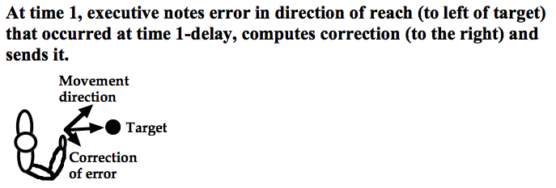
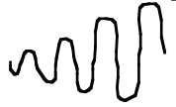
Online guidance and closed-loop control cannot be done by a central executive in the brain!
Due to the time lag, the correction is always behind movement, therefore always inadequate.
error
time
The system blows up!

Slide 10

3. Open-loop models
Brown, 1911
Motor program = neural representation of detailed movement plans
Pre-planned, pre-structured set of neural commands to active muscles
Account for ballistic movements without afference
Problems:
Adaptiveness
Generalization – need a motor program for every movement

Slide 11
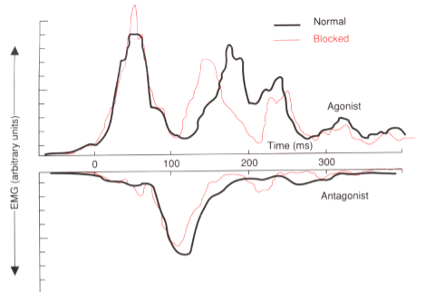
Motor program theories were popular.
Evidence supporting the motor program hypothesis: more complex movements have longer RTs
RT to move a finger = 150 ms; RT to move a finger and reach-to-grasp an object = 195 ms (Henry & Rogers, 1960)
1-syllable word = 518 ms to start speaking; 2-syllable word = 553 ms to start (Klapp, Anderson & Berrian, 1973)
Taking longer time to “program” more complex movements
Evidence supporting the motor program hypothesis: perturbation without feedback did not change muscle activation
Unexpectedly block arm movement and no feedback… no change of EMG patters
Muscle activation is pre-planned

Slide 12
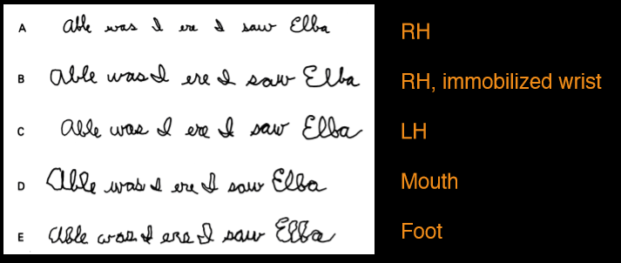
Motor program cannot be muscle-specific (Raibert, 1979)
Various limbs perform the same movement in the same patterns
An abstract motor program

Slide 13
4. Inverse model
Inverse model
of musculo-skeletal mechanics
Motor commands
Desired movement
Knowing the desired movement, work backwards and determine necessary motor commands, given the current state and contextual variability.
Inverse kinematics inverse dynamics

Slide 14
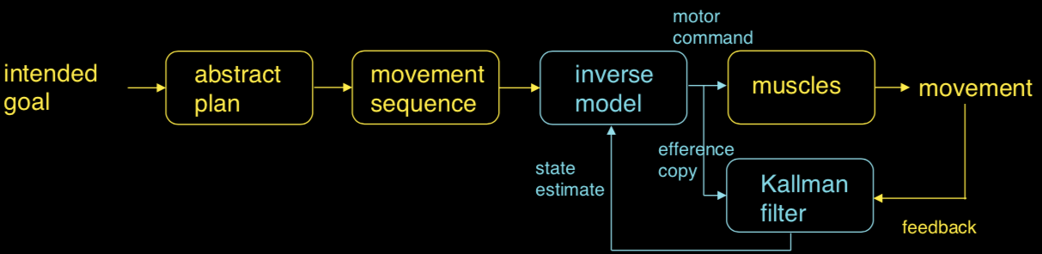
Inverse model
The inverse model determines motor commands (to achieve an intended movement) based on an estimate of the current state.
State estimate is done via Kallman filter
Use efference copy of motor command to predict state
Use the difference between predicted and actual feedback to correct state estimate
Problem: CCV – motor commands for an intended goal depend on the current state of the system

Slide 15
Forward model
Forward model of musculo-skeletal mechanics
Motor commands
Movement
With motor commands, predict resulting movement, given current state of the musculo-skeletal system
based on Newton’s laws

Slide 16
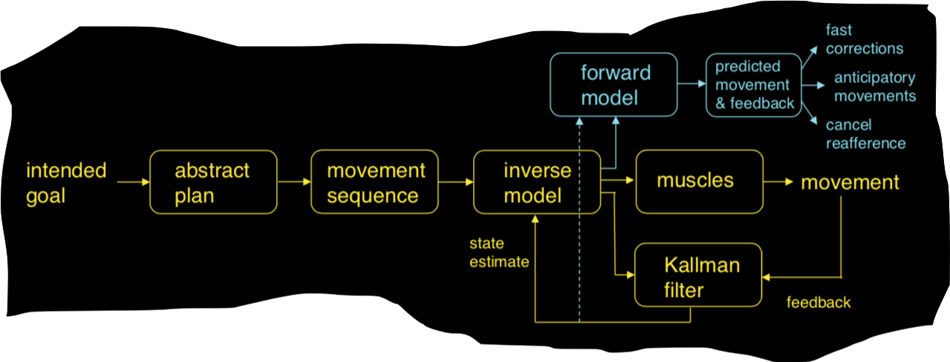
The forward model (e.g. Wolpert, 1995) predicts movement and sensory feedback for motor commands, based on an estimate of the current state of the musculo-skeletal system
Fast correct of movement using Kallman filter without needing real sensory feedback
Enable coordination of anticipatory movements
Problem: feedback delay – need to compensate for time delays to avoid instability

Slide 17
All these are computational models.
Not embodied, not emergent
Some are widely used in robotics
All these models assume there exist a central controller that makes plans and processes signals

Slide 18
Critique of the computational approach
Kelso, J. A. S. (1984): where does the spatiotemporal organization in behavior come from?
For motor programs or some sort of a priori plan
Implying centralized control, brain dominant, body in empty space (akin to the “air theory” in perception)
How to translate discrete, time-independent, symbolic programs into continuous, time-dependent, physical body
All about muscles… ignores non-muscular forces
Patterns (regularity) in movement don’t imply that they are prescribed by a plan
Kinematics as a consequence of dynamics (laws of physics)
Where do motor programs or internal models come from?

Slide 19
The dynamics perspective
Where does the spatiotemporal organization in behavior come from?
Emerges a posteriori from dynamics of the system
Action systems are dynamical systems (implying changes and forces governed by the laws of physics)
Control is emergent (non-representational, not within the brain)
The “ground theory” of motor control
Movements are governed by physical forces and environmental constrains (geometrical, kinematical and dynamical)
Exploit non-muscular forces and coordination tendencies
Kinematic details may be a consequence of underlying dynamics (vs. planned)
Self-organization… how much of the organization in behavior can we get “for free” (without assuming prior knowledge)?

Slide 20
Non-linear dynamics in action control
The body is a physical ( = real, concrete and substantial) system with its own dynamics:
System of pendulums (=limbs) and springs (= muscles and tendons), subject to the gravitational field
The oscillatory processes have intrinsic coordination tendencies
The system takes advantage of the intrinsic dynamics to solve the DF problem and simplify control

Slide 21
Non-linear dynamics in action control
Entrainment
Coupled oscillators become synchronized
Self-organization
Reduces DFs
(synchronizing metronomes: https://www.youtube.com/watch?v=DD7YDyF6dUk&feature=related)
Coordination (of actions) as an example of entrainment
Inter-limb coordination
Gait patterns
Multiple actions (e.g. walking while typing on the phone)

Slide 22
Where does the organization in behavior come from?
Coordination between the limbs
Coordination between agent and environment
(1) via computation
(2) self-organization

Slide 23
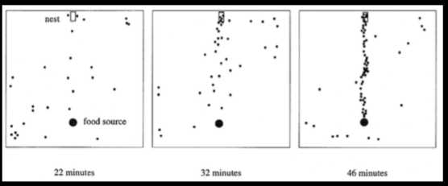
Self-organization in biological systems
Ant trail formation
Bird swarming
Synchronization
Emergent behavior
Reduce DF of system
Fish schooling
Notes:
Begin with many components of DF (each fish or each bird) , each moving freely… coupling, DFs freely interact… nonlinear positive feedback (global pattern enslaves local movement, reinforces global structure… emergent global spatiotemporal structure/pattern

Slide 24
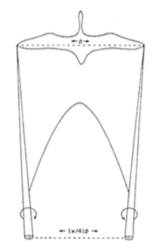
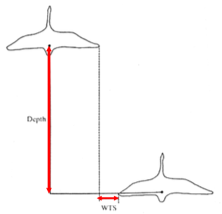
Flocking
Nobody “programs” the group of birds. How is this pattern formed?
Rolling vortex cylinders
51% energy saving

Slide 25
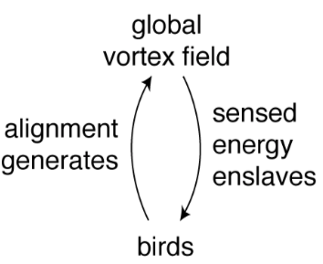
Flocking
Components = birds
Coupling by airflow (aerodynamics)
Begin with an open system… energy dissipates… forms aerodynamic field
Chance alignment of birds…generates vortex field… reduces energy expenditure
Feedback: sensing energy expenditure
Global field enslaves individual birds
Alignment reinforces global field
Emergent pattern: V-formation

Slide 26
Question: how does this bird flocking example illustrate the idea of embodiment?
What is embodiment?

Slide 27
READING:
Kelso “Self-organization of behavior: The basic picture”
(Pgs 1—14)
Only if you are interested:
Kelso “How nature handles complexity”
Wolpert “Computational approaches to motor control”

