Slide 1
Lecture 2: Ecological Realism and Gibson’s insights
Main claims of ecological psychology

Slide 2
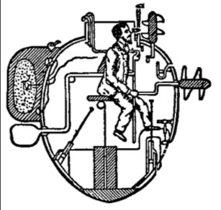
The constructive approacj
Dualism (Rene Descartes)
Agent-environment dualism: a physical environment vs a mental representation
Perception → inferring mental representation of external world from impoverished sensory input
(Perceiver/actor is in contact with the representation not the real world)
Representation = reality? (David Hume, John Searl)

Slide 3
Counter examples against constructivism

Slide 4
What do you see?
Functionally speaking, do you see light? Do you see intensity or intensity contrast? Do you see colors? Or do you see objects/events in the world?
Similarly, in hearing… do you hear sounds? Or do you hear activities that make the sounds (e.g. hand clapping, glass smashing)?

Slide 5
What we see vs. how we see
Do you necessarily “see things”, when the retinal cells are stimulated?
What is the difference between sensation and perception?
Does light results in perception after it shines on the retina?

Slide 6
The Ganzfeld Experiment, Wolfgang Metzger
Sense illumination, but perceive nothing.

Slide 8


Slide 9
What we see vs. how we see
Do you necessarily “see things”, when the retinal cells are stimulated?
What is the difference between sensation and perception?
Does light results in perception after it shines on the retina?
Can you perceive something when there is no light reflected from it?
(VEP videos)

Slide 10
What we see vs. how we see
Do you necessarily “see things”, when the retinal cells are stimulated?
What is the difference between sensation and perception?
Does light results in perception after it shines on the retina?
Can you perceive something when there is no light reflected from it?
Are images projected on the retina similar to the actual world objects? (similarity-based representations)

Slide 11
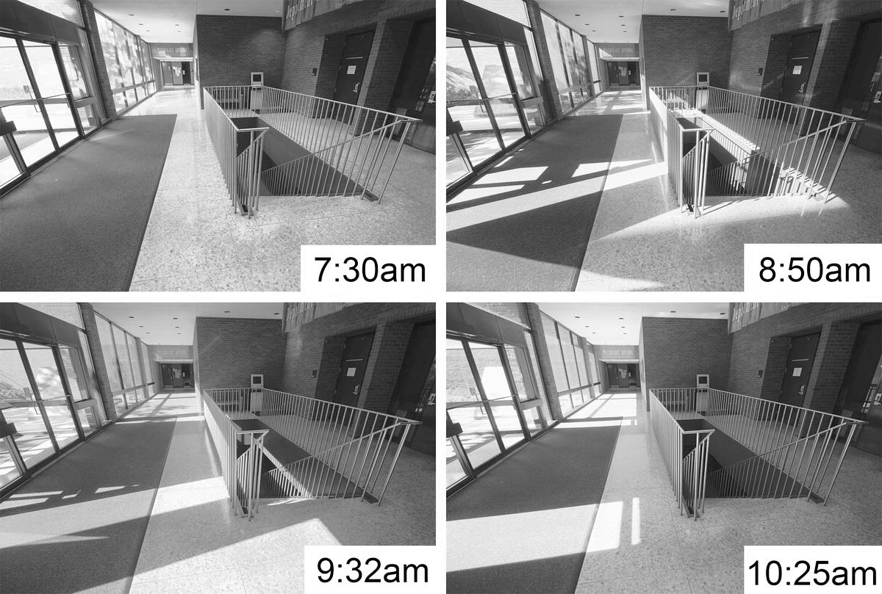

Slide 12
We do not have a world model, that looks like the world itself, on our retinas or in our minds. We do not understand the world by “looking at” its representations in our minds.
But how?
Notes:
If you see the world and then build a world model in your mind. Are you part of the world? Are you part of your mental world model?
Suppose you are in the world. Then you look out – you don’t see you.
Then you build a world model, how do you know where to place yourself in the mental world model?

Slide 13
Realism: things exist whether we experience them or not
Realism and the Scottish Enlightenment. Thomas Reid. 18th century
Reality exists independently of observers or perceptual experiences
Observers live in the world. Observers, world objects and light (as medium) form one unitary system. All elements in the system move, interact and change with time.
What is the status of the system? How do we come to know the status of the system? What is the information that specifies the status of the system?
Central inquiries of a realistic approach to perception
Notes:
Reid believed that common sense (in a special philosophical sense of sensus communis) is, or at least should be, at the foundation of all philosophical inquiry.^{[3]} He disagreed with Hume, who asserted that we can never know what an external world consists of as our knowledge is limited to the ideas in the mind, and George Berkeley, who asserted that the external world is merely ideas in the mind. By contrast, Reid claimed that the foundations upon which our sensus communis are built justify our belief that there is an external world.

Slide 14
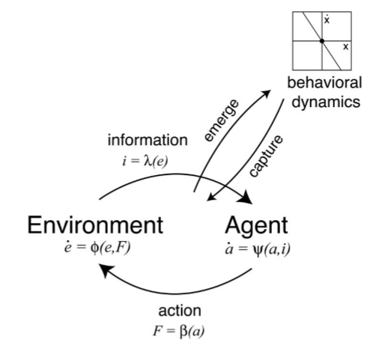
The unitary system of Perception/Action
The P/A system constitutes: observers, surfaces/objects and light as medium
The system changes over time ( = evolves)
Observers look to acquire info to know (= perceive) the current status of the system
How? – by picking up optical info, which is in patterns of light
Different statuses of the system send out different optical info; different optical info specifies different statuses of the system
Warren, 2006

Slide 15
The ecological approach
$$Environment ≡Information ≡Perceived environment$$
Environment contains information and information specifies environmental properties
Observers detect information to perceive environment
Agent-environment unity (or mutuality) -- must analyze the whole ecosystem to understand perception, hence termed ecological
Perception is direct:
specificity, non-inferential and non-representational

Slide 16
Agent-environment mutuality
Analyze the whole ecosystem
If treating agent and environment as independent, then you get incommensurate descriptions of them (nonspecificity)
In nature, animal and econiche co-evolved, and are complementary
Animal is adapted to regularities of econiche that support successful perceiving and acting
Takes advantages of the physical and informational regularities and ecological constraints in the environment
Econiche is also adapted to animal
Niche construction
Commensurate descriptions of agent and environment

Slide 17
The ecological approach is specific
“The fallacy is to assume that because inputs convey no knowledge they can somehow be made to yield knowledge by “processing” them.”
--Gibson, 1979, p253

Slide 18
The ecological approach is specific
Environment for agents (where perception and action happen)
Information from optic array/ optic flow (info is of higher order and spatiotemporal)
Properties of environmental objects that are action-relevant
generate
specifies
Governed by the laws of physics
Notes:
The laws of physics = natural = determinististic = 1:1 correspondence
If you throw a basketball (filled fully with air) on to the ground with a certain a mount of force at a certain angle, it definitely bounces in a predicted way, which is a different way from if you throw a tennis ball with the same force and angle on to the same ground.
This is an event governed by natural laws. If you detect the optical info of this process, you perceive the events without having to compute.

Slide 19
The ecological approach is non-inferential
Perception relies on information, not inference.
We make inference only if information is not enough. Info ▼, inference ▲
The perceptual system is attuned to detecting information (the perceptual system is evolved to suit detecting info from a particular environment)
To better perceive, the observer should acquire more information
Inference and prior knowledge are not necessary
Notes:
Attunement: developed in evolution and learning. The perceptual systems adapt to specific info that yields successful action within ecological constraints (e.g. for prays, horses, antelopes etc, they have to detect predators who may come from all directions, so to escape. So they develop wide visual field size to cover large areas around them. Similarly, predators need to see prays running in front of them with good depth perception, so their visual fields have large overlaps for better depth perception.
The perceptual system is attuned to the environment (the ecology, the tasks etc), not to retinal or neural stimulation.

Slide 20
The ecological approach is non-representational
Getting a representation of the world into your head doesn’t solve the problem of perception
If not representation, then what？
Perception as a relation between agent and environment
Perceive to gain access to the behaviorally relevant properties of the environment – perception/action

Slide 21
On realism
Perception -- to gain direct awareness of behaviorally relevant properties
Perception-action coupling
Successfully action is the criterion for veridical perception
Empirically, measuring the effectiveness of perception using actions (not, say, verbal accounts)
Can’t perceive, if there is no information
(do not use inference to ”fill in the blank”)

Slide 22
Summary: Computational vs. Ecological Approach to Perception
What do we see?
Constructivist/computational: proximal stimuli (retinal images, neural impulses etc)
Eco approach: physical world
How do we see?
Eco approach: Info from structured light → perception
Direct perception, from structured light as info to perception
The eyes pick up and the brain measures info
Computational approach: distal stimuli→ proximal stimuli → sensation → perception
Perception is indirect and mediated by sensation
The eyes detect stimuli, the brain constructs/computes representations

Slide 23
Four pillars of ecological approach
Perception can only be understood in relation to environment
Animal is adapted to regularities of the econiche that support perception/action
Physical and informational regularities, ecological constrains
Perception is evolved to guide actions
Adapt to information that supports successful action
Semantics (= meaning) grounded in action
Information as specificity
Higher-order spatiotemporal patterns of stimulation
Specific to behaviorally-relevant properties, within eco context of constraints
Perception as the detection of information by an attuned perceptual system
Implicit mapping from information to behaviorally-relevant properties
Attunement in evolution and learning

Slide 24
Reading
Gibson, 1979, Chapter 1

