Slide 1
pufS, trngS, AND HARDWARE ENTROPY
Parker langa & bryan wheeler

Slide 2
Tests
Approx Entropy Test
Cum Sums
Discrete Fourier Transform Spectral
Frequency Test
Linear Complexity test
Maurer’s Universal Statistical Test
Overlapping Template Matching Test
Random Binary Matrix Rank Test
Runs Test
Serial Test

Slide 3
Objective – bitstream analysis
For each of the provided bitstreams run the NIST C code suite to determine which of the 5 required tests the bitstream fails.
Write a few sentences explaining why the bitstream fails each test and how attackers could use the information from this failed test to predict or characterize the pseudorandom number.
  It is alright if you aren’t entirely how an attack could utilize this information. The goal is to think critically about risks associated with RNGs, so it is better to describe your thought process then provide an answer with no explanation.

Slide 4
Objective – python analysis
Each test will have an accompanying Python script that generates a number known to fail that test. Analyze the Python script (and, if helpful, the number it generates) to determine why the output is flawed.
Write a few sentences explaining why the Python code is flawed and how attackers could exploit the weaknesses in the generated pseudorandom number to predict or characterize output.
  It is alright if you aren’t entirely how an attack could utilize this information. The goal is to think critically about risks associated with RNGs, so it is better to describe your thought process then provide an answer with no explanation.

Slide 5
Required

Slide 6
Frequency test
This test identifies the number of zeros and the number of ones in a given bitstream
A non-random number will not have roughly the same number of zeros and ones
Flawed generator: Markov Chain
  Markov chain = mathematical matrix model that moves between multiple states as a function of time
  Combined with a linear congruential generator (LCG) to generate semi-random transition choices that determine next state of Markov Chain matrix

Slide 7
Runs Test
This test counts the instances of consecutive ones (one runs) and consecutive zeros (zero runs)
A non-random number will have a bitstream that is oscillating (switching values) too quickly
Graph the number of runs per each run length and calculate graph’s p-value. A random result requires a p-value over 0.01
Flawed generator: 32-bit XORShift
  Shifts a 32-bit seed-based value multiple times by differing quantities

Slide 8
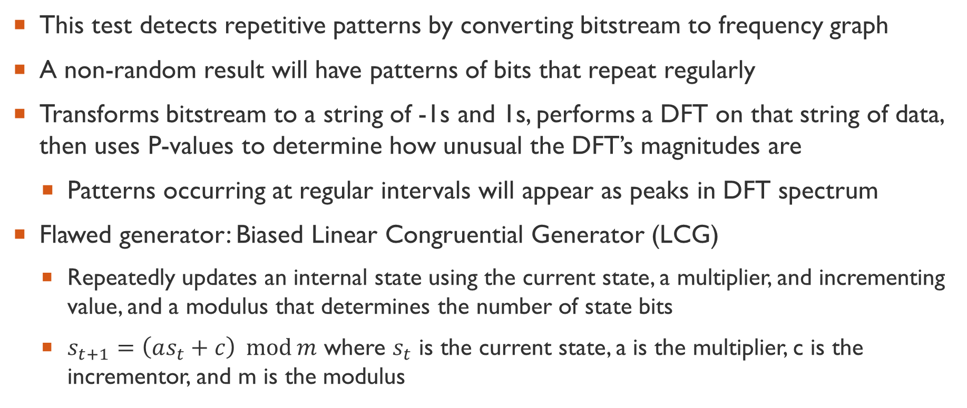
Discrete Fourier Transform Spectral test
This test detects repetitive patterns by converting bitstream to frequency graph
A non-random result will have patterns of bits that repeat regularly
Transforms bitstream to a string of -1s and 1s, performs a DFT on that string of data, then uses P-values to determine how unusual the DFT’s magnitudes are
  Patterns occurring at regular intervals will appear as peaks in DFT spectrum
Flawed generator: Biased Linear Congruential Generator (LCG)
  Repeatedly updates an internal state using the current state, a multiplier, and incrementing value, and a modulus that determines the number of state bits
  $s_{t+1}=\left(as_{t}+c\right) \operatorname{mod}{m}$ where $s_{t}$ is the current state, a is the multiplier, c is the incrementor, and m is the modulus

Slide 9
Linear Complexity test
This tests determine the length of an LFSR required to characterize a random number
A non-random result will have an LFSR that is too short which implies high-level repetition in the bitstream
Flawed generator: Fibonacci XOR LFSR
  Shifts a seed value and generates new bits by XORing previous values

Slide 10
Serial Test
This test determines the frequency of all possible overlapping patterns
There are expected to be reoccurring patterns, especially of short bit lengths, but they should occur at expected frequencies (checked using P-values)
  Directly counts patterns unlike the DFT test
A non-random result should have sufficiently large p-values
Flawed generator: modular-exponentiation (MODEXP) generator
  The modulus is taken of fixed based that is raised to a seed power

Slide 11
Optional

Slide 12
Random Binary Matrix Test
This test determines if there are dependencies between bit substrings
A non-random number will have linear dependencies between fixed length substrings
Substrings of the random number are used to assemble a matrix, and the bottom rows of the resulting matrix must not be dependent on the rows above them
Flawed generator: LCG

Slide 13
Overlapping/Periodic Template Matching Test
This test determines number of potentially overlapping, occurrences of a specific string
  Overlapping occurrences means two occurrences of a string can use overlapping bits (e.g. 101 occurs twice in 10101 but the middle 1 is shared)
  The number of expected occurrences is dependent on the pattern length
A non-random number must have a statistically expected number of pattern occurrences
Flawed generator: IBM’s RANDU (multiplicative LCG)

Slide 14
Maurer’s Universal Statistical Test
This test analyzed the number of bits between matching patterns to determine if a sequence can be compressed
  Measures how quickly blocks repeat, similar to the serial test but without overlapping windows
A non-random number will be significantly compressible so can be represented by fewer bits than is currently presented
Flawed generator: LCG

Slide 15
Approximate Entropy Test
This tests determines the frequency of overlapping m-bit patterns and compares them to the frequency of overlapping patterns of adjacent lengths (m+1)
A non-random number will have m-bit and m+1-bit pattern frequency comparisons that fall outside of an expected result
Flawed generator: Markov chain

Slide 16
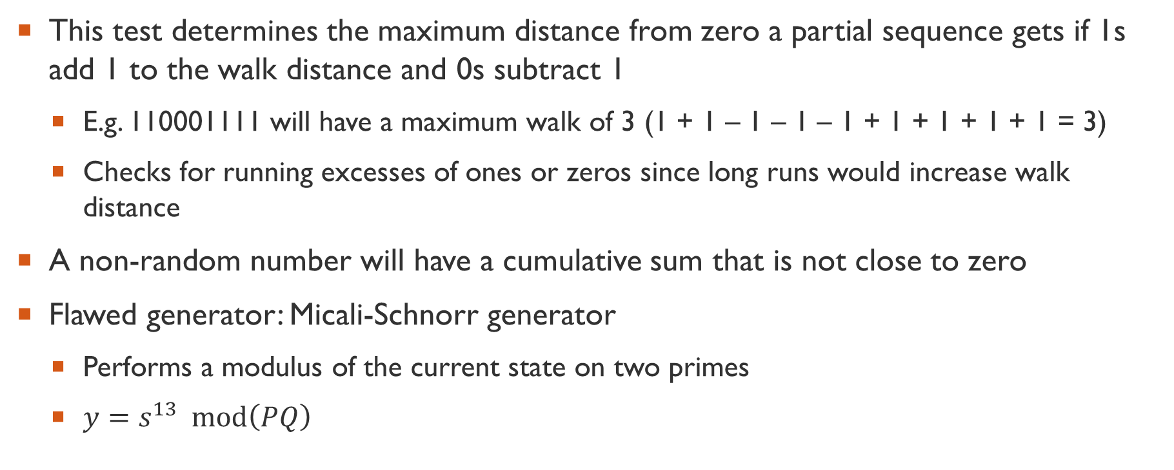
Cumulative Sum Test
This test determines the maximum distance from zero a partial sequence gets if 1s add 1 to the walk distance and 0s subtract 1
  E.g. 110001111 will have a maximum walk of 3 (1 + 1 – 1 – 1 – 1 + 1 + 1 + 1 + 1 = 3)
  Checks for running excesses of ones or zeros since long runs would increase walk distance
A non-random number will have a cumulative sum that is not close to zero
Flawed generator: Micali-Schnorr generator
  Performs a modulus of the current state on two primes
  $y=s^{13} \operatorname{mod}\left(PQ\right)$

Slide 17
Random Excursions Test
This test determines the frequency of particular walk levels (cumulative sum results between each sum of zero)
A non-random number will have frequencies of specific walk levels that fall outside the expectations for random numbers
Flawed generator: 32-bit XORShift

