Slide 1

STOCK PREDICT AI
PRESENTED BY
PAMBALA SAHASRA

Slide 2
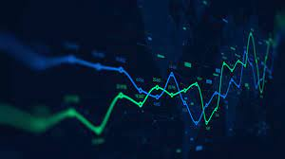
Introduction to Stock Predict AI
Stock Predict AI is an advanced artificial intelligence system designed to forecast stock market trends.
It leverages machine learning algorithms to analyze vast amounts of financial data.
The goal is to help investors make informed decisions based on predictive insights.
Notes:
Image source: https://www.slidemake.com

Slide 3
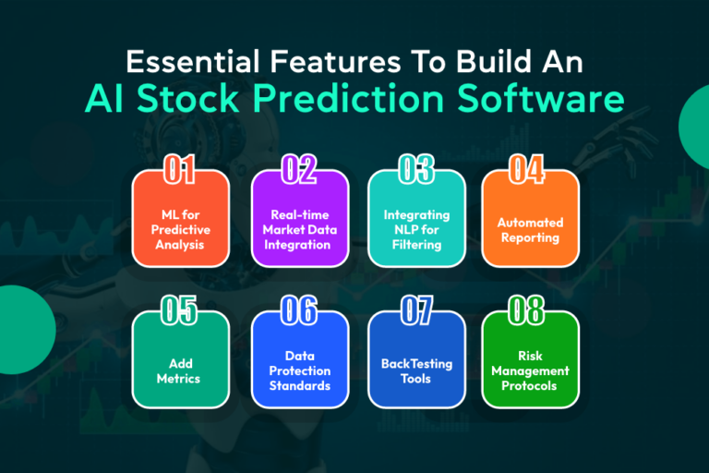
Importance of Stock Prediction
Accurate stock prediction enhances investment strategies and risk management.
It can provide a competitive edge in fast-moving financial markets.
Reliable forecasts can contribute to increased profitability for traders and institutions.
Notes:
Image source: https://devtechnosys.com

Slide 4

Core Technologies Behind Stock Predict AI
The system employs deep learning models such as neural networks to identify complex patterns.
It integrates natural language processing to analyze news and social media sentiment.
Time series analysis techniques are used to model historical stock data effectively.
Notes:
Image source: https://peerdh.com

Slide 5
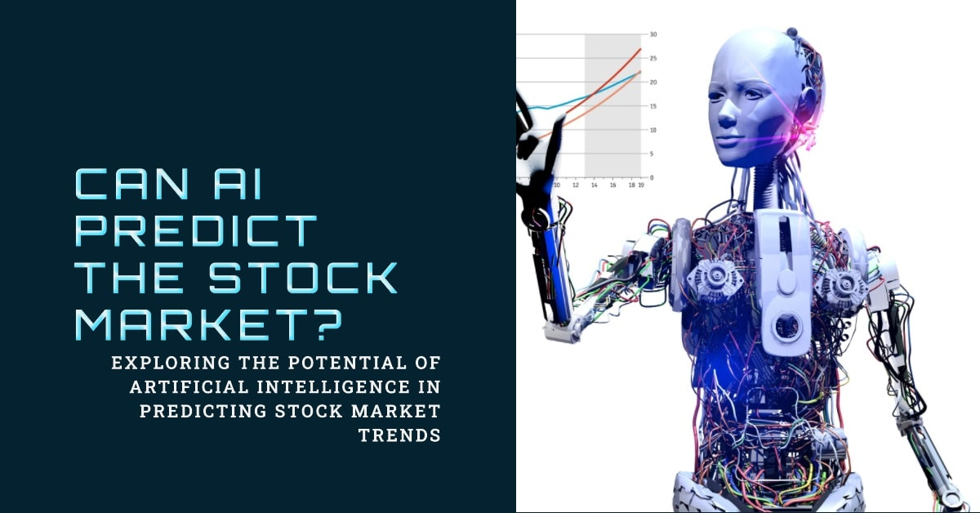
Data Sources Utilized
Financial statements, market data, and historical prices form the core datasets.
Real-time news feeds and social media platforms provide current market sentiment.
Alternative data like economic indicators and geopolitical events are also incorporated.
Notes:
Image source: https://reports.finbrain.tech

Slide 6
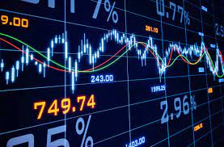
Machine Learning Models Employed
Supervised learning models like regression and classification are foundational.
Ensemble methods combine multiple models to improve prediction accuracy.
Reinforcement learning is explored for developing adaptive trading strategies.
Notes:
Image source: https://miro.medium.com

Slide 7
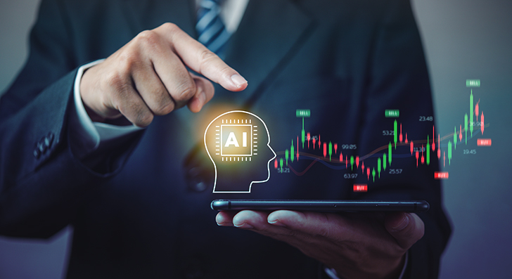
Benefits of Using Stock Predict AI
It offers faster analysis compared to traditional manual methods.
The system can identify emerging trends before they become apparent.
Users gain data-driven insights that support strategic investment decisions.
Notes:
Image source: https://www.damcogroup.com

Slide 8
Challenges and Limitations
Market unpredictability and sudden events can reduce model accuracy.
Overfitting to historical data may lead to misleading predictions.
Data quality and real-time processing demands pose ongoing technical challenges.
Notes:
Image source: https://www.slidemake.com

Slide 9
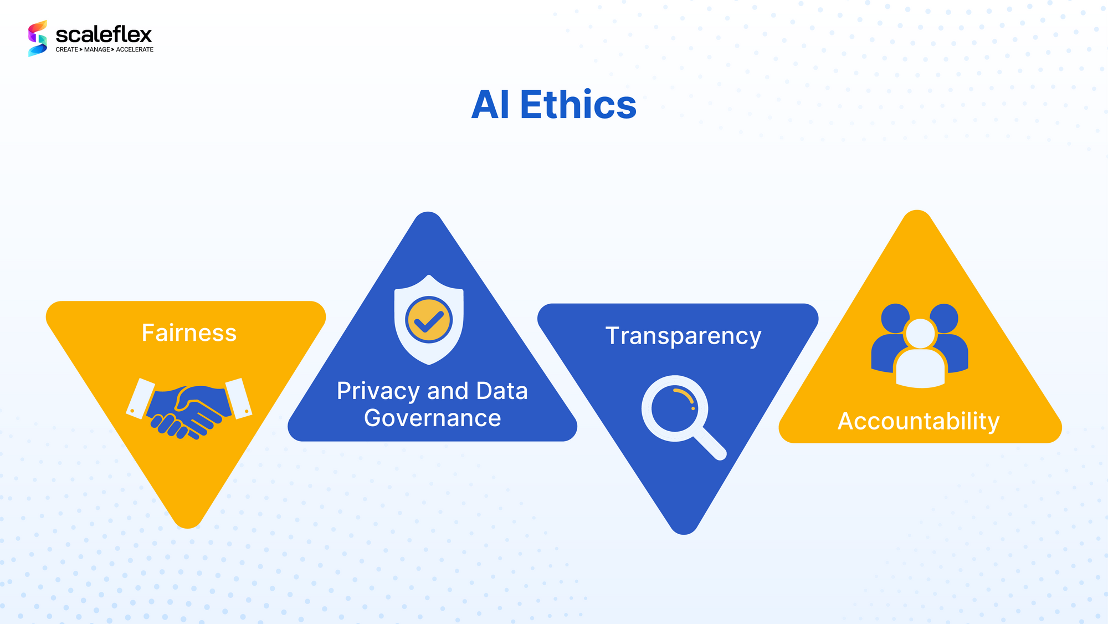
Ethical and Regulatory Considerations
Ensuring transparency in AI decision-making processes is crucial.
There are risks associated with over-reliance on automated predictions.
Compliance with financial regulations and data privacy laws is mandatory.
Notes:
Image source: https://blog.scaleflex.com

Slide 10
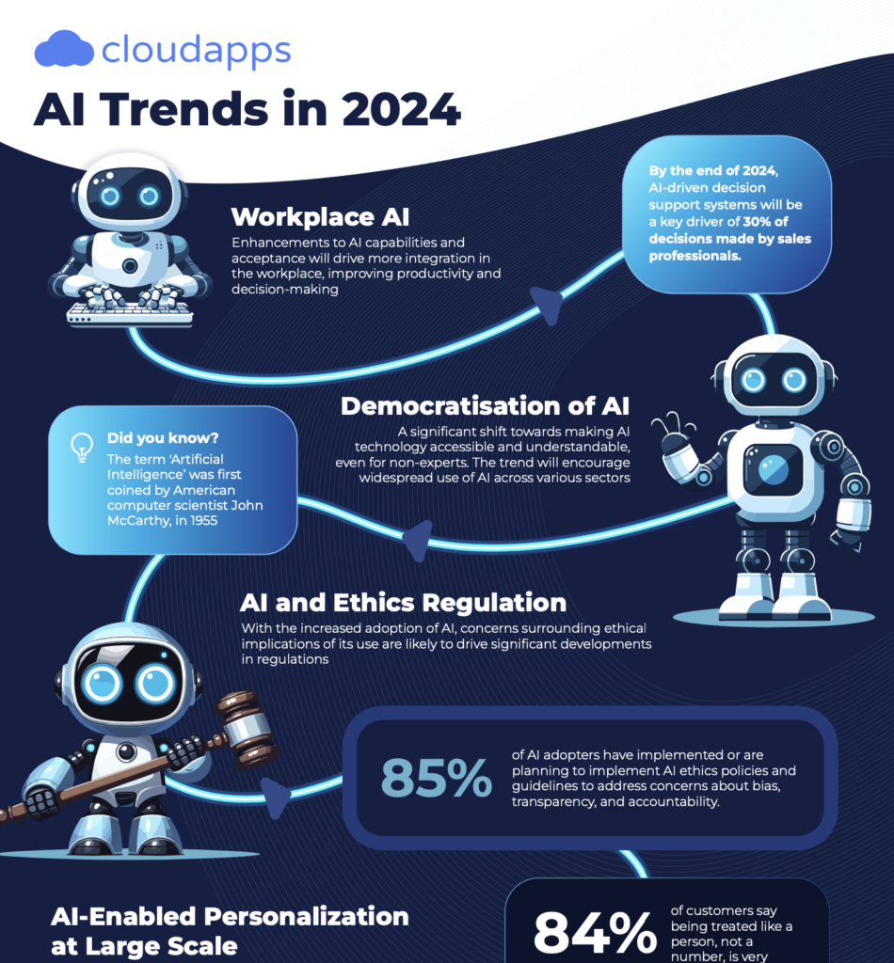
Future Trends in Stock Predict AI
Integration of more sophisticated AI techniques like generative models is anticipated.
Increased use of alternative and unstructured data sources will enhance predictions.
Collaboration between human traders and AI systems will become more prevalent.
Notes:
Image source: https://www.cloudapps.com

Slide 11
Conclusion and Outlook
Stock Predict AI represents a significant advancement in financial technology.
Continuous improvements will lead to more accurate and reliable forecasts.
Its adoption is expected to grow as the system becomes more accessible and robust.
Notes:
Image source: https://reports.finbrain.tech

