Slide 1
Ecomeristem
Phenology

Slide 2
deltaT = Ta - Tb; TT = TT + deltaT;
if (STOCK_AVAILABLE) {
tempDD = DD + deltaT + plastodelay; boolCrossedPlasto = tempDD - plasto;
plastoVisu = plastoVisu - plastodelay;
liguloVisu = liguloVisu - plastodelay;
if (boolCrossedPlasto >= 0) {
EDD = plasto - DD;
DD = tempDD - plasto;
phenoStage = phenoStage + 1;
}
else {
EDD = deltaT + plastodelay;
DD = tempDD;
}
}
else {
plastoVisu = plastoVisu + EDD;
liguloVisu = liguloVisu + EDD;
}
sla = FSLA - SLAp * log(phenoStage);
Thermal Time

Slide 3
INITIAL
FLO
==
phenostage_to_end_filling
ENDFILLING
VEGETATIVE
== nb_leaf_pi + 1 + nb_leaf_max_after_pi + phenostage_pre_flo_to_flo
== nb_leaf_stem_elong
and
< nb_leaf_pi
==
phenostage_to_maturity
== nb_leaf_pi
ELONG
== nb_leaf_pi
PI
== nb_leaf_pi + 1 +
nb_leaf_max_after_pi
PREFLO
MATURITY
Plant
Test phenoStage

Slide 4
Culm
(peduncle & panicle)
MATURITY
Plant
ENDFILLING
INITIAL
FLO
plant@PI
Culm is mainstem
VEGETATIVE
phenostage ==
nb_leaf_pi + 1 + nb_leaf_max_after_pi + phenostage_pre_flo_to_flo
plant@ELONG
nb_lig > 0
ELONG
plant@PI
PI
culm_phenostage == nb_leaf_pi + nb_leaf_max_after_pi + 1
PREFLO
culm_phenostage ==
phenostage_at_pi + coeff_pi_lag
and
nb_phytomer >= 3

Slide 5
INITIAL
INITIAL
VEGETATIVE
culm@ELONG
or
culm@PI
At lig time
VEGETATIVE
REALIZATION
len >= predim
and
plant is growing
inter_len >= inter_predim
LIG
MATURITY
Internode
Leaf

Slide 6
Plant
Culm
( VEGETATIVE
or ELONG
or PI
or PRE_FLO )
and
stock > 0
and
bool_crossed_plasto >= 0
( VEGETATIVE
or ELONG
or PI )
and
NEW_PHYTOMER_AVAILABLE
and
nb_phytomers < nb_max_phytomers
NEW_PHYTOMER_AVAILABLE
CREATE_PHYTOMER
Phytomers creation

Slide 7
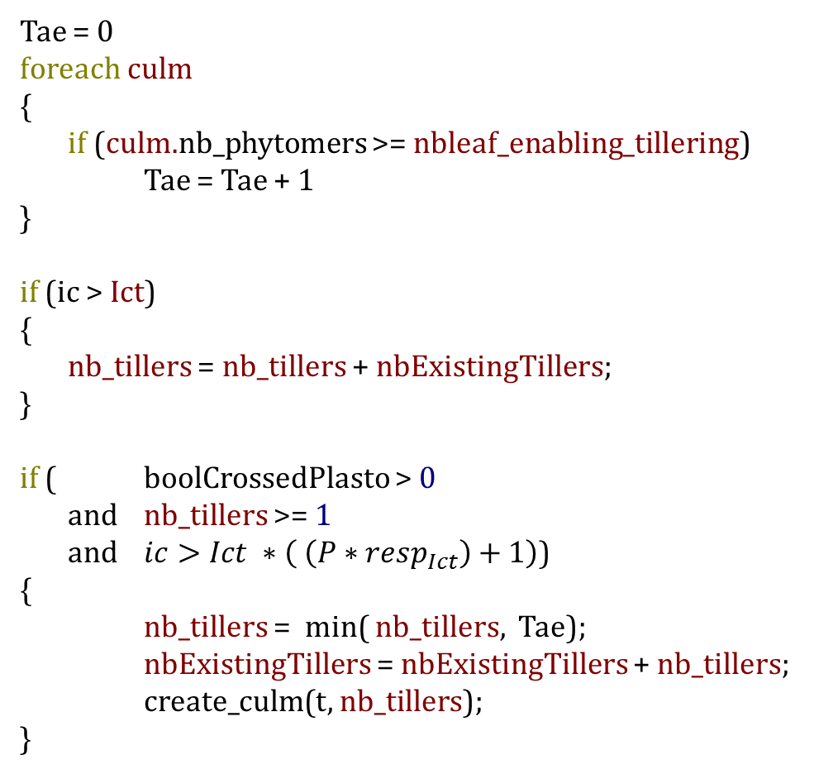
Tae = 0
foreach culm
{
if (culm.nb_phytomers >= nbleaf_enabling_tillering)
Tae = Tae + 1
}
if (ic > Ict)
{
nb_tillers = nb_tillers + nbExistingTillers;
}
if ( boolCrossedPlasto > 0
and nb_tillers >= 1
and $ic>Ict ∗\left( \left(P∗resp_{Ict}\right)+1\right)$)
{
nb_tillers = min( nb_tillers, Tae);
nbExistingTillers = nbExistingTillers + nb_tillers;
create_culm(t, nb_tillers);
}
Tillering

