Slide 1
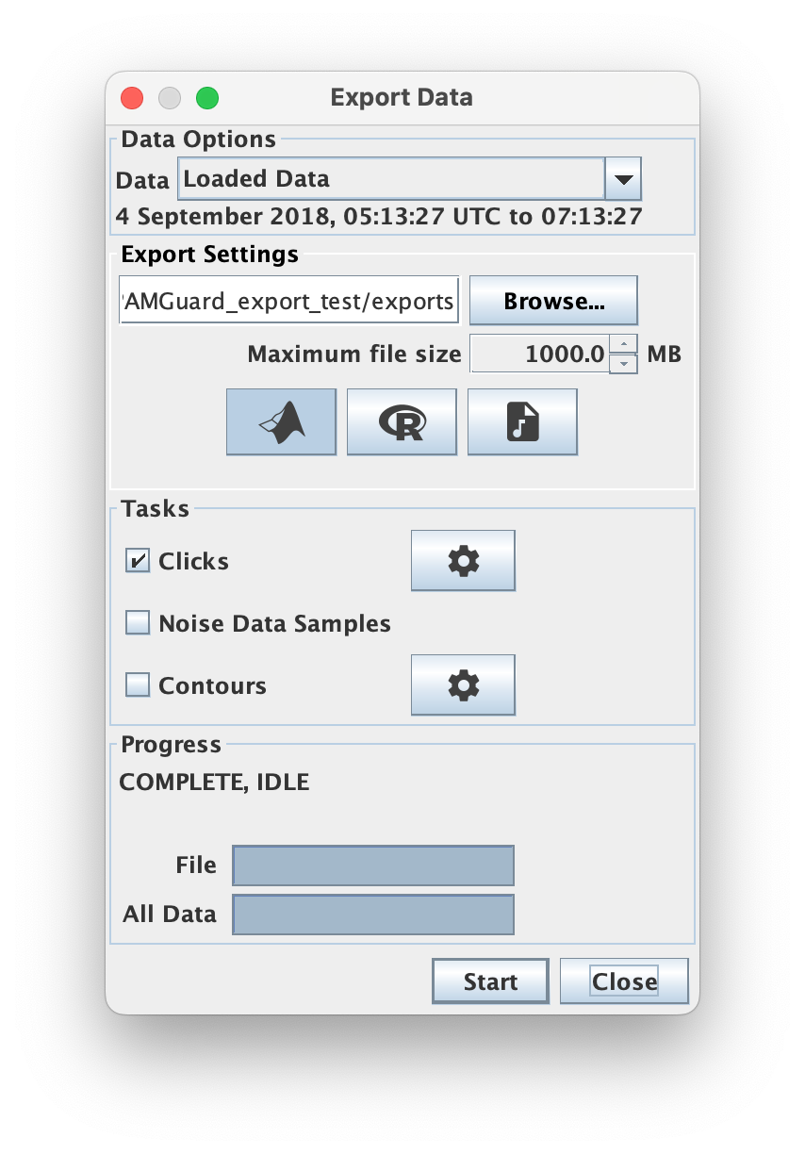
Select which part of the dataset to export.
Select a folder to save the exported data to.
Select which data format to export to.
Set the maximum allowed file size
Select which data types to export.
Data specific settings for filtering e.g., selecting on classified clicks
Shows the progress in exporting data.

