Slide 1
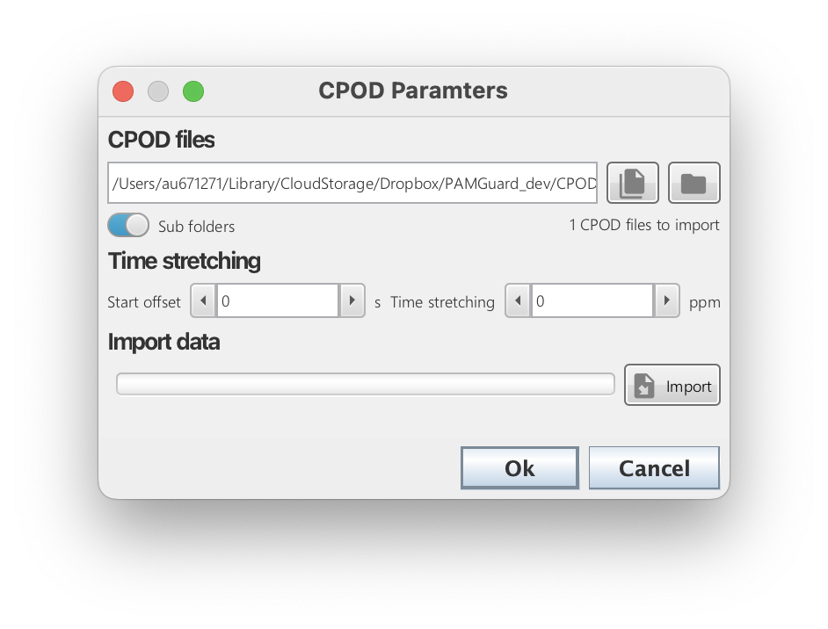
Select individual files e.g. CP1, CP3, FP1 and/or FP3 files
Select a folder of files. All CPOD/FPOD files in the folder will be importer
Compensate for time drift if the drift is known
Start importing CPOD/FPOD data.

