Slide 1
PAMGuard Batch processing
Mew plugin module. Available for testing.
Runs same configuration on multiple datasets.
Automatically sets wav file folder, output binary, and database
Does it’s best to restart after a crash / windows restart

Slide 2
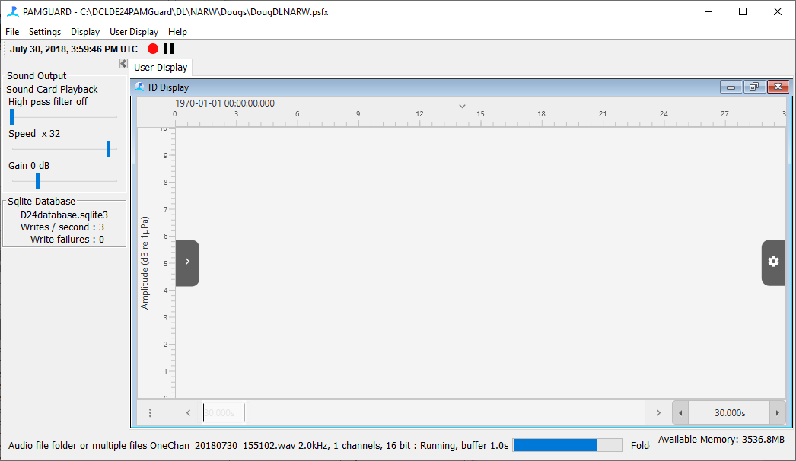


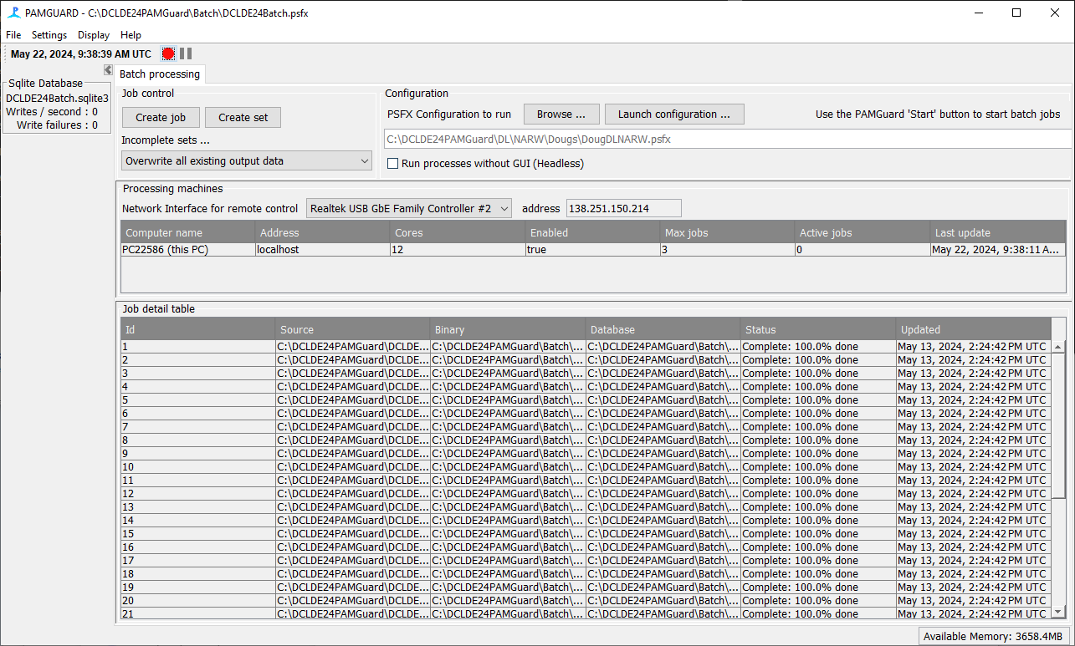
Batch Control System
Multiple Batch Processes
PSFX to setup batch processor
PSFX to run on the data
Database 1
Job 1
Binary Store 1
Job 2
Database 2
Binary Store 2
Database of batch job status’s
Database 3
Job 3, etc …
Binary Store 3

Slide 3
Next Steps
Offline tasks, e.g. click reclassification (tricky, but working on it).
Multiple computers (Possibly too complex to be worth it ?)
Outstanding questions
How to include different calibration values for each dataset (i.e. small configuration changes for each set)
How to handle repetitive processes that require human action (e.g. Tethys export)

Slide 4
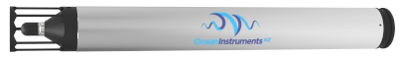
Raw Audio Data sampled at 384kHz
Automatic Click Detector
1ms clips of Transient Detections
Lossless Compression
SUD File Storage
Decimate to 96kHz
Recording 96kHz data

Slide 5
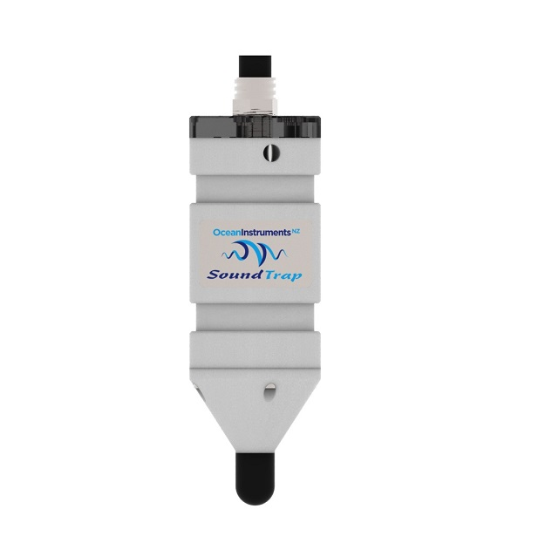
Raw Audio Data sampled at 576kHz
Automatic Click Detector
1ms clips of Transient Detections
Lossless Compression
SUD File Storage
Decimate to 96kHz
Recording 96kHz data

