Slide 1
3/30 meeting

Slide 2
PARAMETER
Duty cycle : 20%
Padding ratio : 20%
Minimum cycle time (no edff) : 0.8
Minimum cycle time (with edff) : no

Slide 3
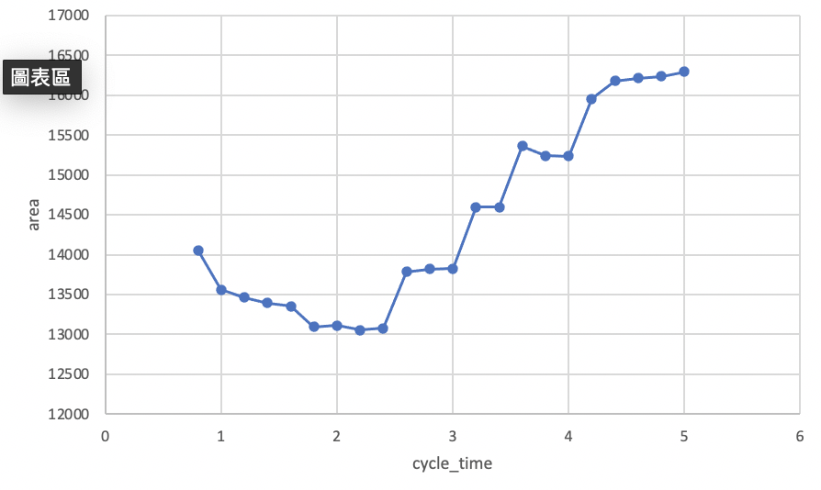
Analysis : T vs A
T : 0.8 ~ 5.0
7 structures
Min T : 0.8s
Min A : 13095
Min A*T : 11243

Slide 4
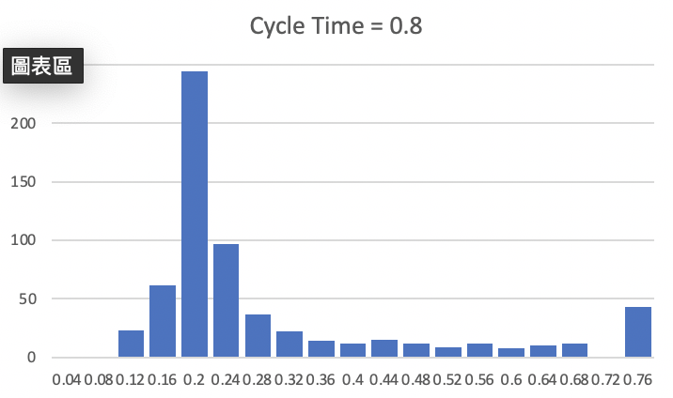
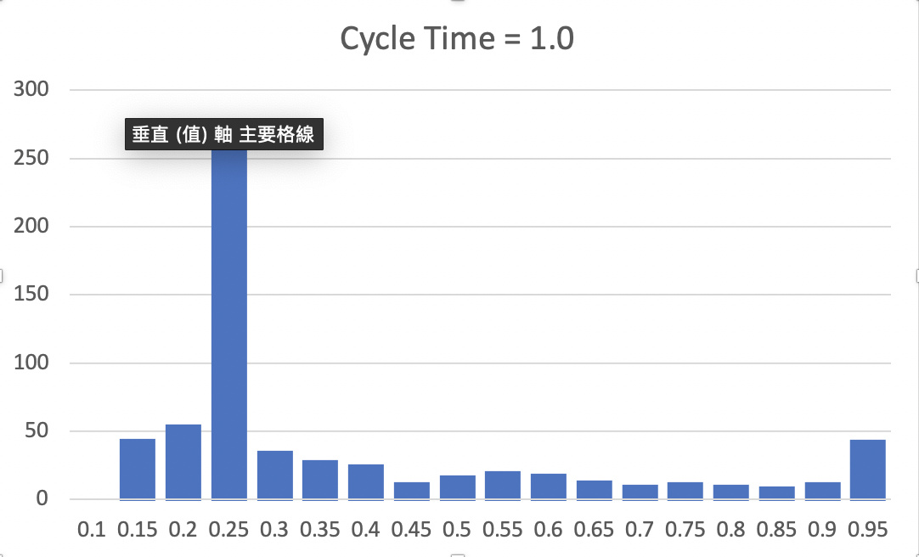
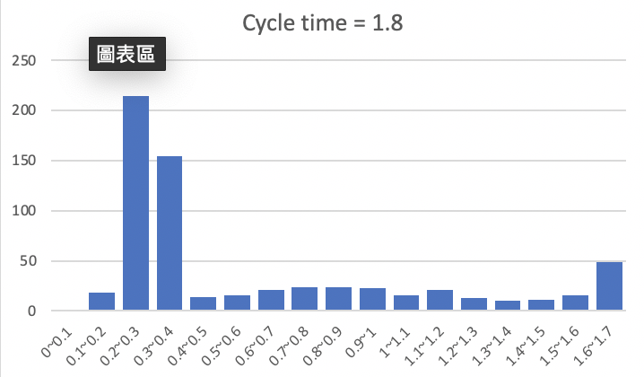
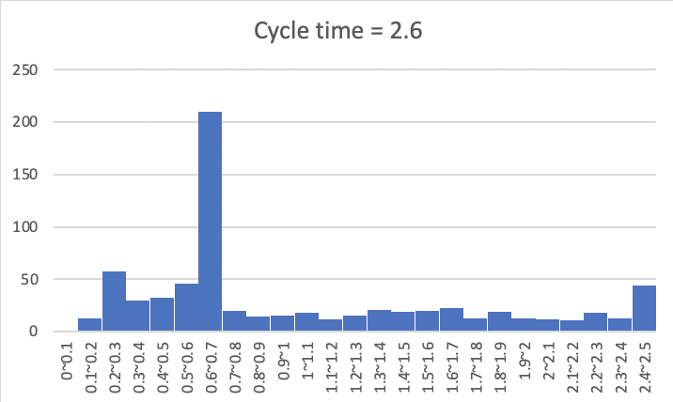
Analysis : slack time distribution (critical)

Slide 5
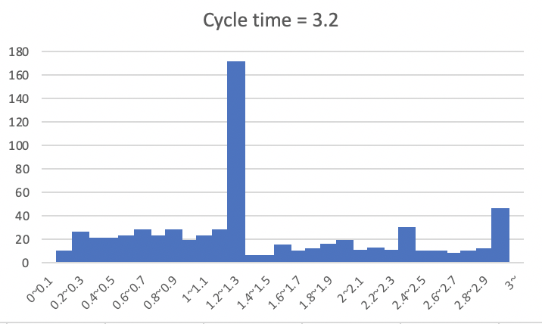
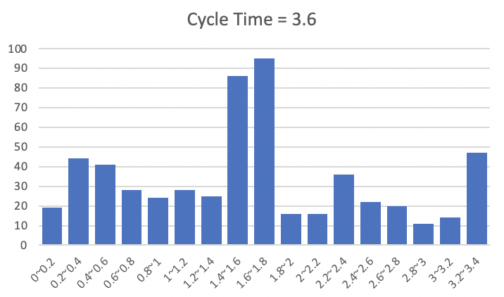
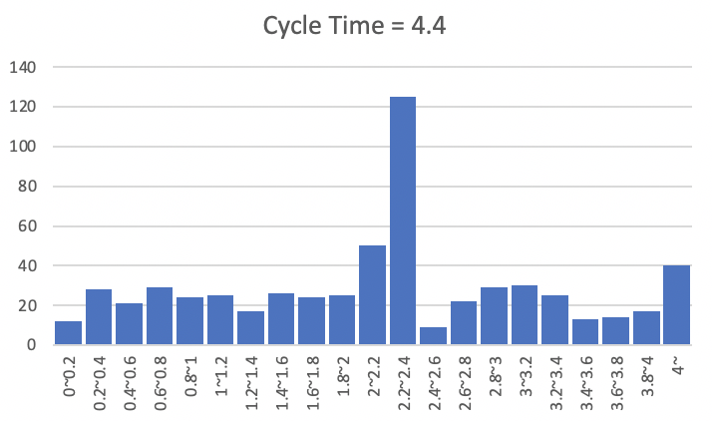
Analysis : slack time distribution (critical)

