Slide 1
5/26 meeting

Slide 2
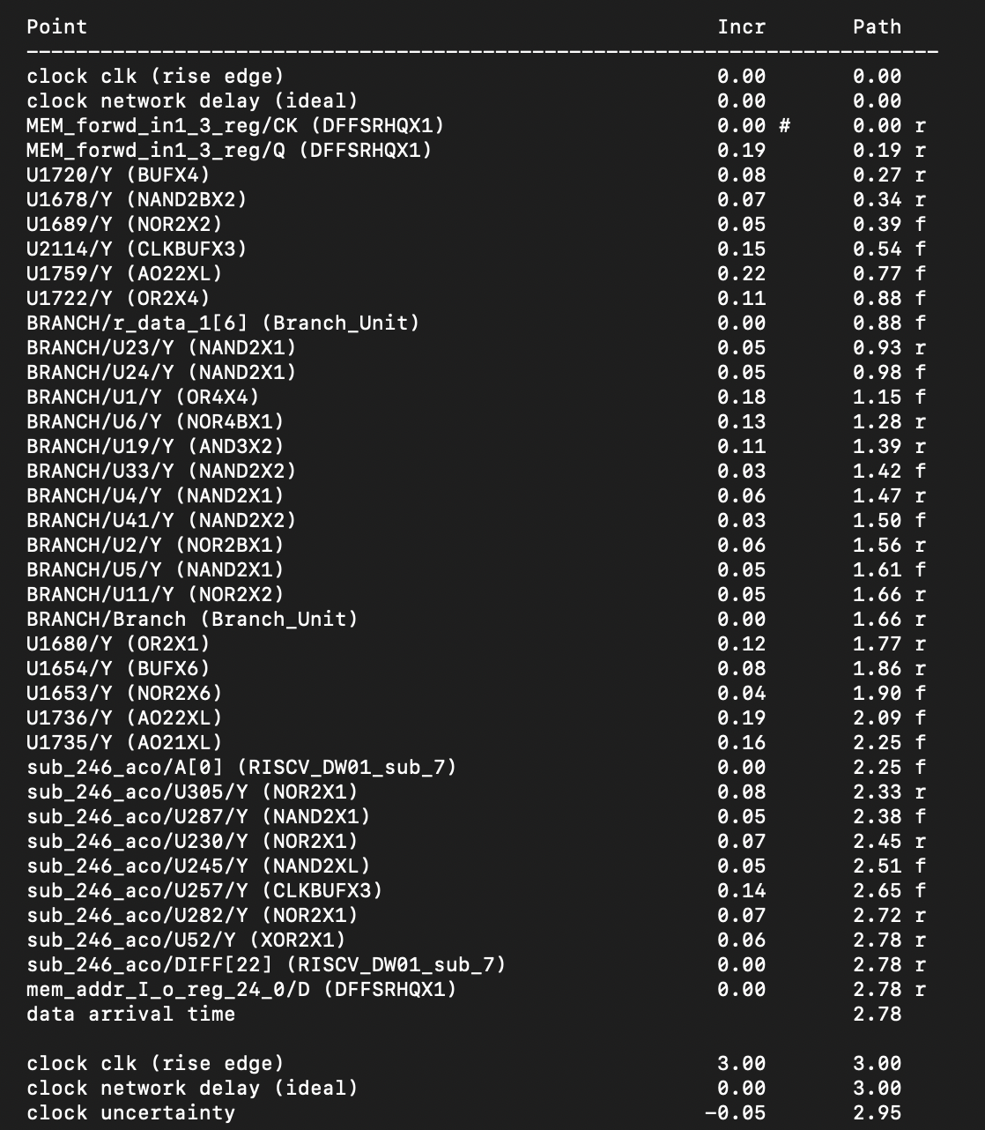
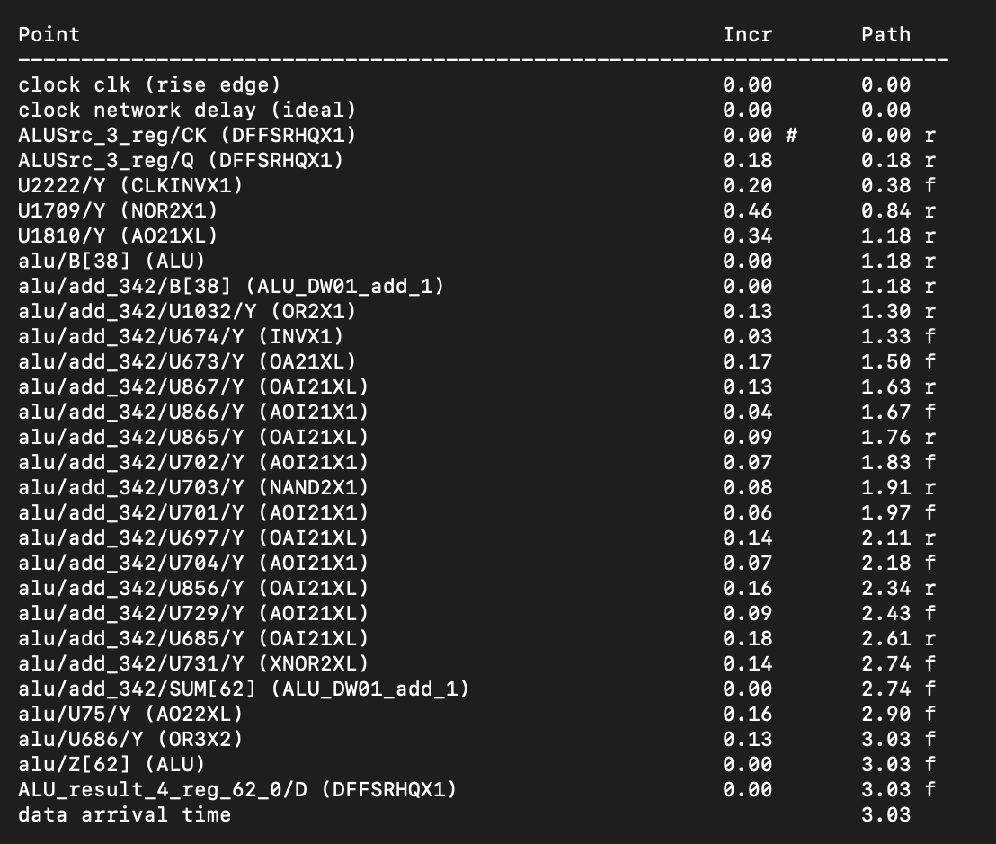
Critical Path

Slide 3
Critical Path
Instruction Fetch
Instruction Decode
Execute(ALU) : Forwarding + Subtraction / Forwarding + Branch
Memory
Write back to register

Slide 4
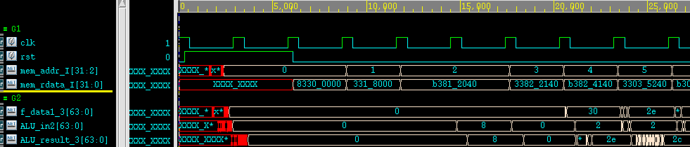
Design Benchmark
Load data
A sequence of subtraction
Branch

Slide 5
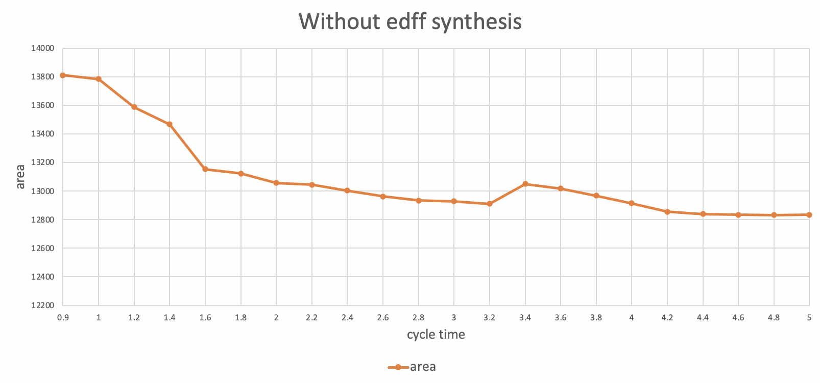
Choose cycle time

Slide 6
Experiment : test for benchmark
Synthesis Cycle Time | Pattern 1 limit | Pattern 2 limit | Pattern 3 limit | Benchmark limit
3.2 ns | 2.6 ns | 2.8 ns | 2.2 ns | 3.0 ns
3.0 ns | 2.8 ns | 2.8 ns | 2.8 ns | 2.8 ns
2.8 ns | 2.5 ns | 2.6 ns | 2.3 ns | 2.7 ns
2.6 ns | 2.4 ns | 2.4 ns | 2.2 ns | 2.5 ns

Slide 7
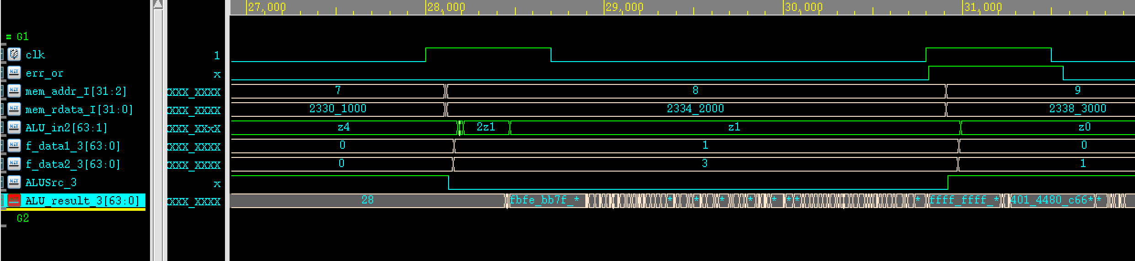
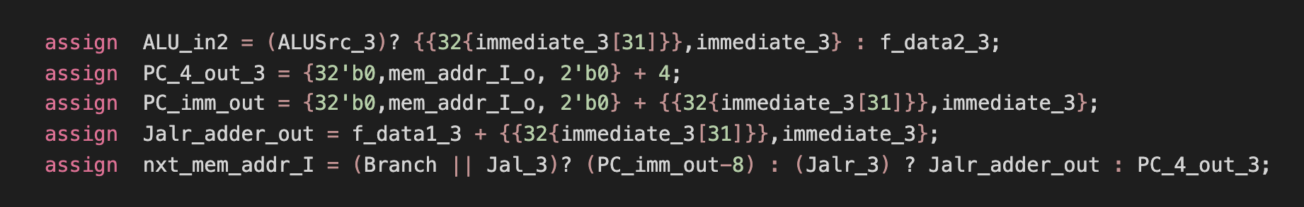
Problem : ALU_in2會有z出現

Slide 8
Problem : ALU_in2會有z出現
Only occur in certain synthesis

