Slide 1
5/6 meeting

Slide 2
Analyze the processor with EDFF
Can’t replace the flip-flop related to data memory.
The number of EDFF may be around 100~200(586).
Pattern 1 : general
Pattern 2 : load, several ALU operation, store
Pattern 3 : load , one ALU operation, store

Slide 3
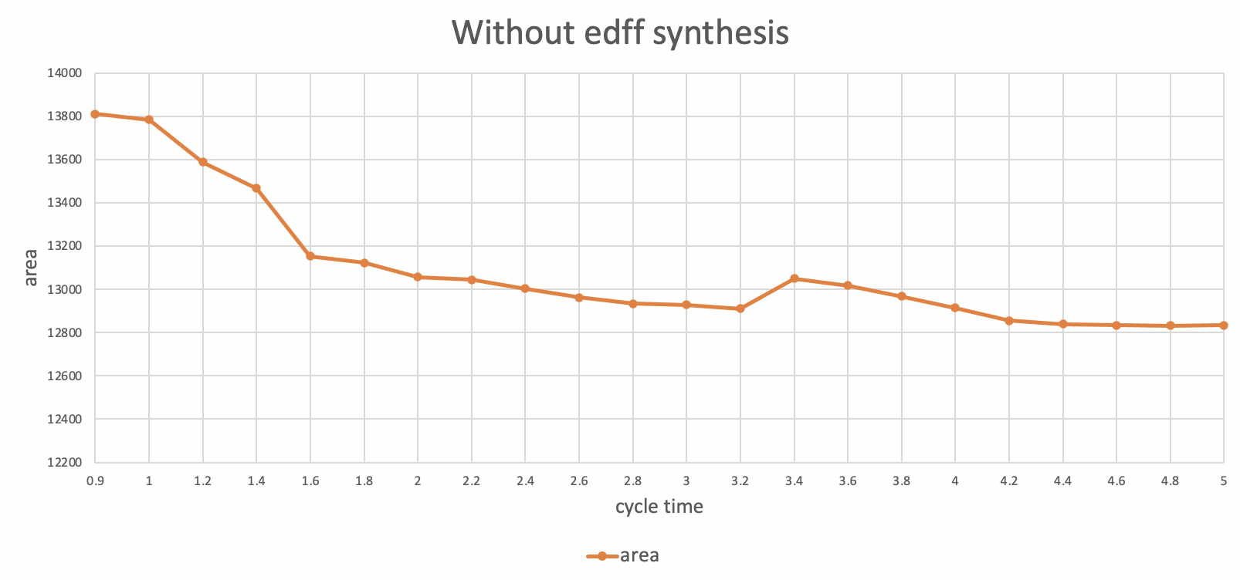
Choose proper cycle time to add EDFF

Slide 4
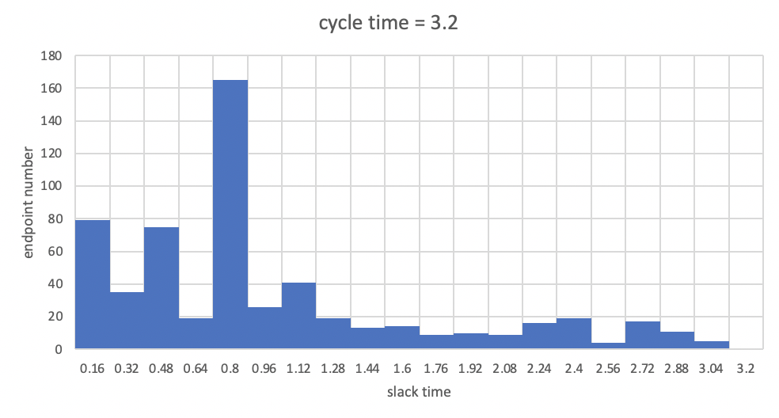
Experiment : CT=3.2 ns
Padding ratio | Padding length | Pattern-1 poff/limit | Pattern-2 poff/limit | Pattern-3 poff/limit | EDFF number
NONE | NONE | 1.3 ns | 1.5 ns | 2.9 ns | 0
20% | 20% | failed | failed | failed | 258
15% | 20% | 2.1/1.3(5) | 1.9/1.6(4) | 2.9 | 154
15% | 25% | 2.1/1.3(3) | 2/1.8(5) | 2.9 | 154
15% | 30% | 2.1/1.3(6) | 1.9/1.6(4) | 2.9 | 154

Slide 5
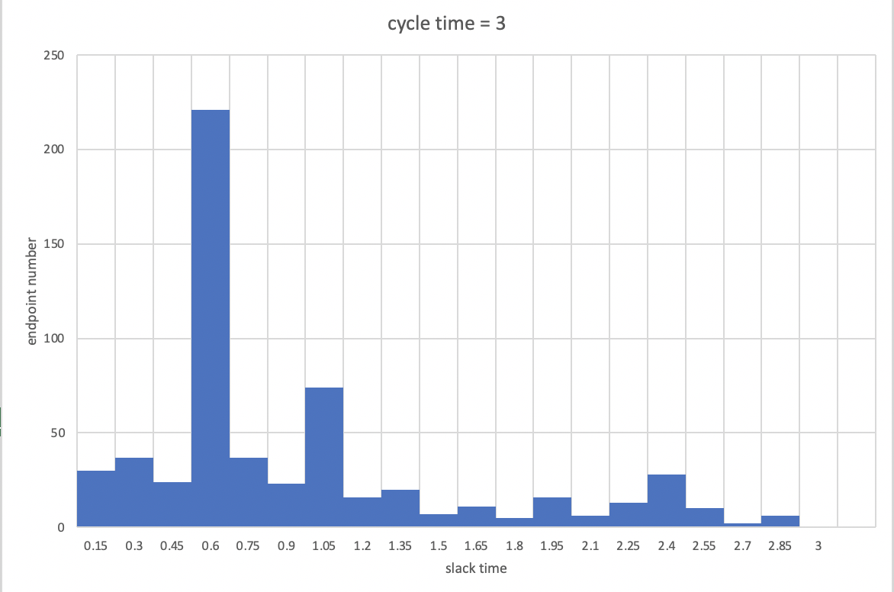
Experiment : CT=3.0 ns
Padding ratio | Padding length | Pattern-1 poff/limit | Pattern-2 poff/limit | Pattern-3 poff/limit | EDFF number
NONE | NONE | 1.6 ns | 1.3 ns | 2.8 ns | 0
15% | 20% | 1.8/1.6(1) | 1.6/1.5(8) | 2.8 | 62
15% | 25% | 1.9/1.6(2) | 1.8/1.6(8) | 2.8 | 62
15% | 30% | 1.9/1.6(1) | 1.6/1.5(8) | 2.8 | 62

Slide 6
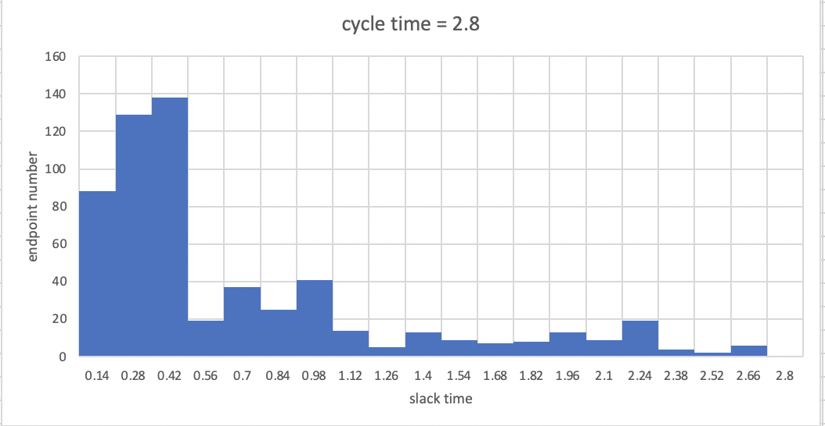
Experiment : CT=2.8 ns
Padding ratio | Padding length | Pattern-1 poff/limit | Pattern-2 poff/limit | Pattern-3 poff/limit | EDFF number
NONE | NONE | 1.7 ns | 1.4 ns | 2.6 ns | 0
10% | 10% | failed | failed | failed | 161
8% | 20% | 1.8/1.7(1) | 1.6/1.4(5) | 2.6 | 108
8% | 25% | 1.9/1.7(1) | 1.8/1.6(3) | 2.6 | 108
8% | 30% | 1.9/1.7(1) | 1.6/1.4(4) | 2.6 | 108

Slide 7
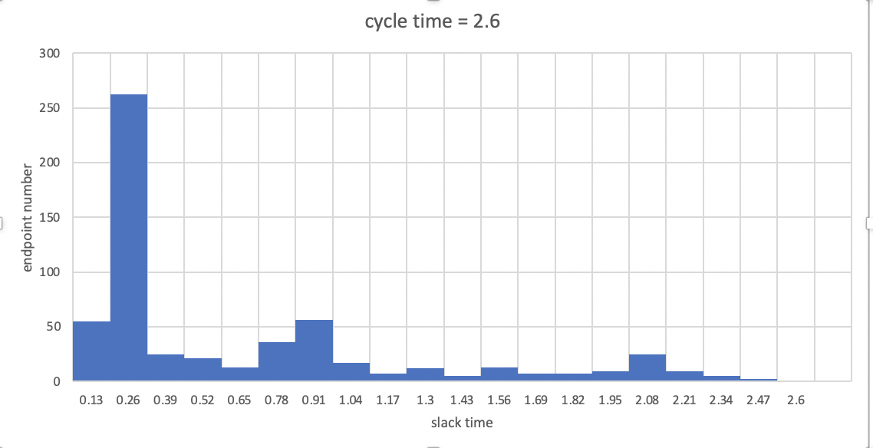
Experiment : CT=2.6 ns
Padding ratio | Padding length | Pattern-1 poff/limit | Pattern-2 poff/limit | Pattern-3 poff/limit | EDFF number
7% | 20% | failed | failed | failed | 61
6% | 20% | failed | failed | failed | 61

Slide 8
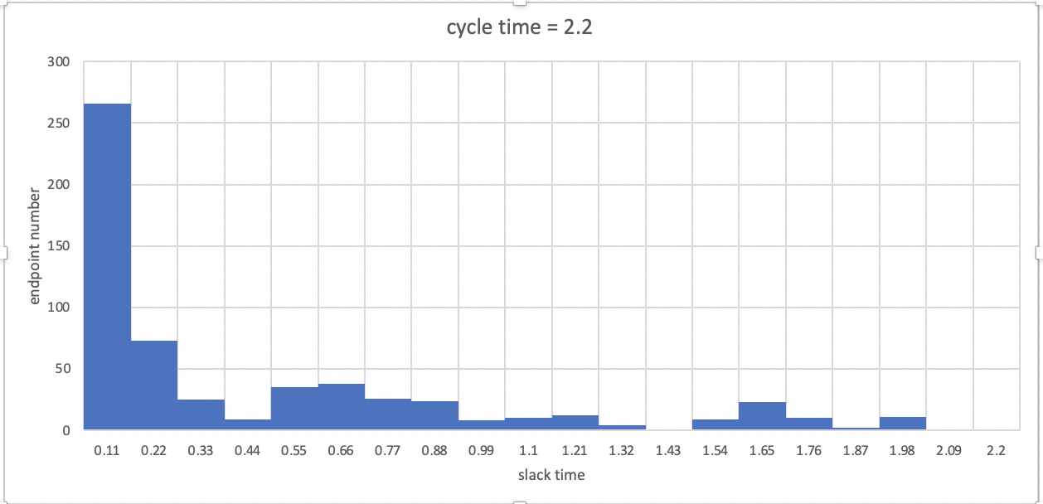
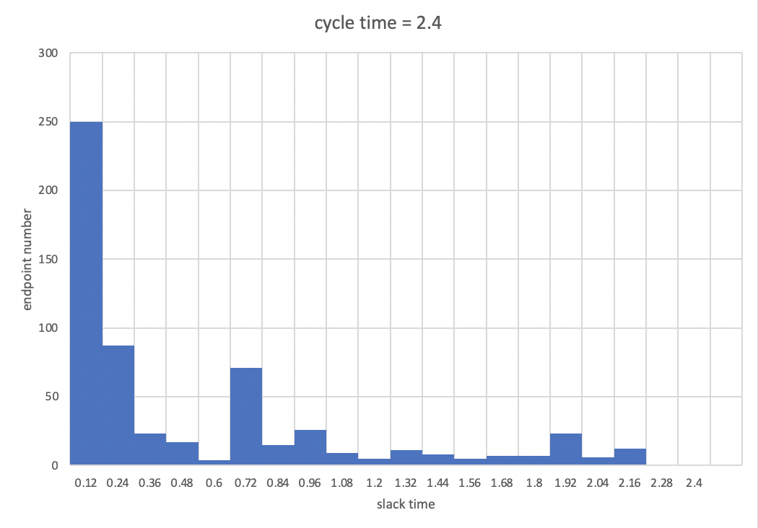
Analysis : slack time distribution

Slide 9
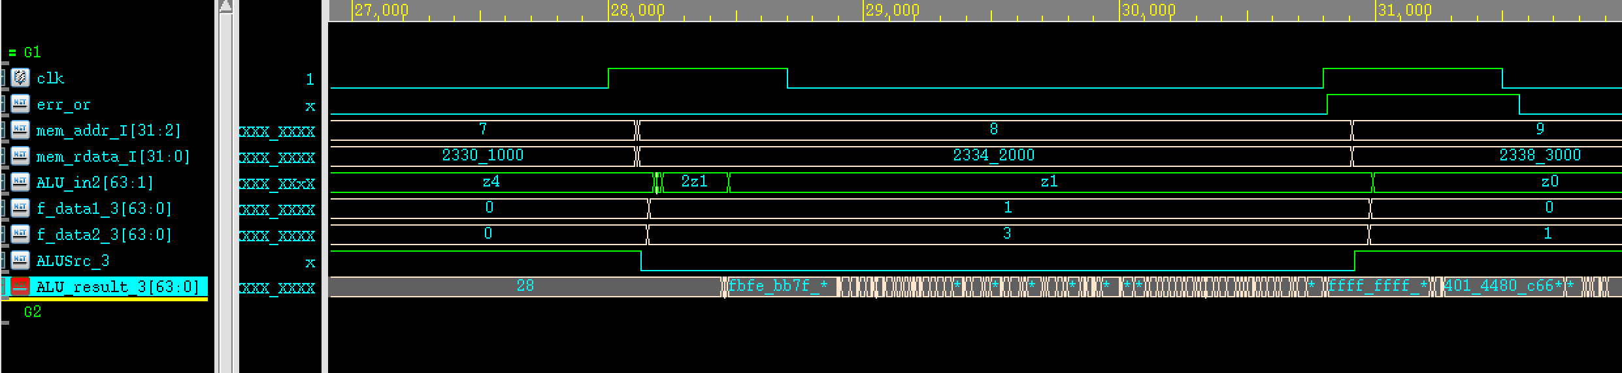
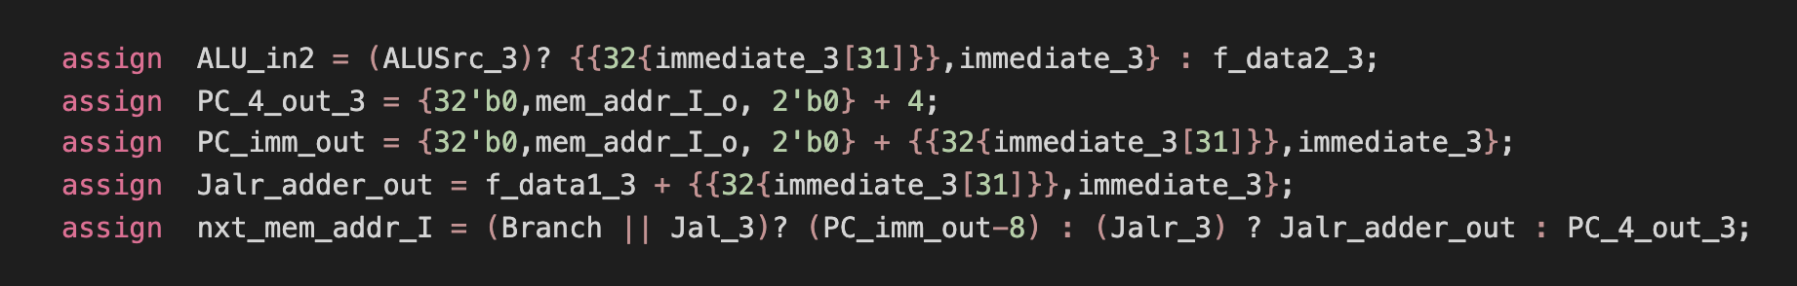
Problem : ALU_in2會有z出現

