Slide 1
6/16 meeting

Slide 2
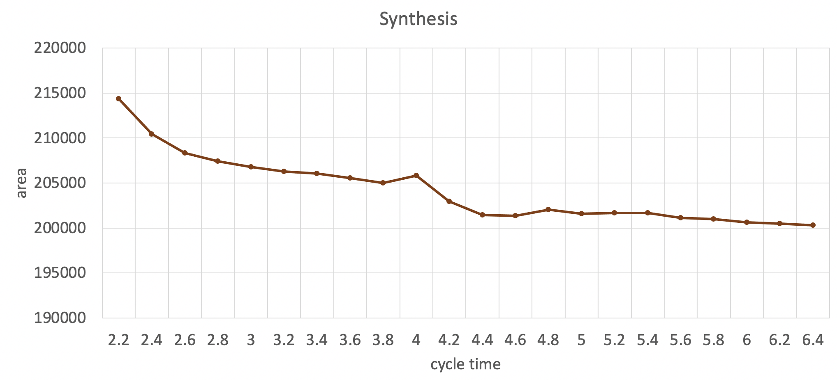
Area vs Cycle time

Slide 3
Flow
Select cycle time to synthesis.
report_timing : critical path
report_timing –path end : all endpoint slack time
report_resources : check cell architecture
Collect then information and design
Gate-level simulation

Slide 4
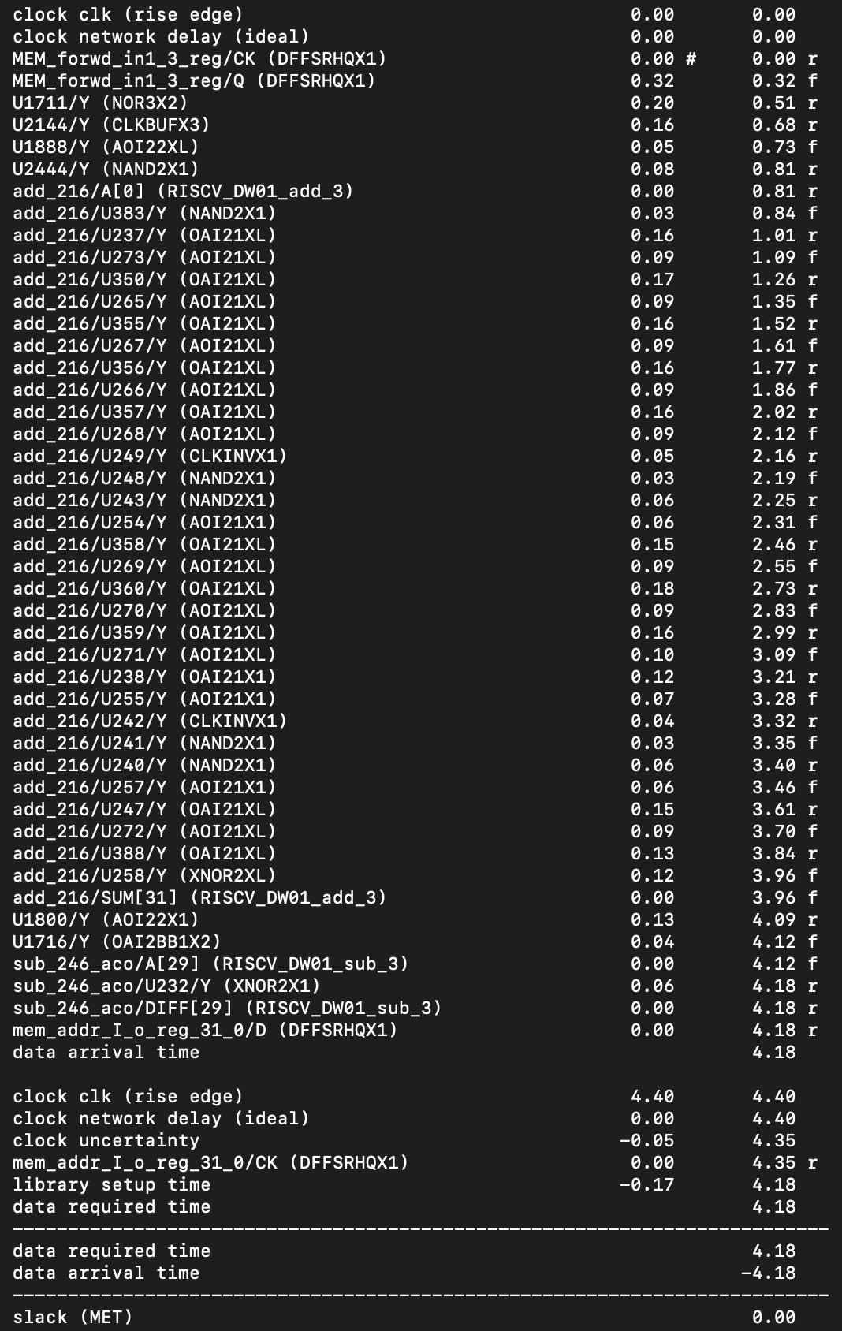
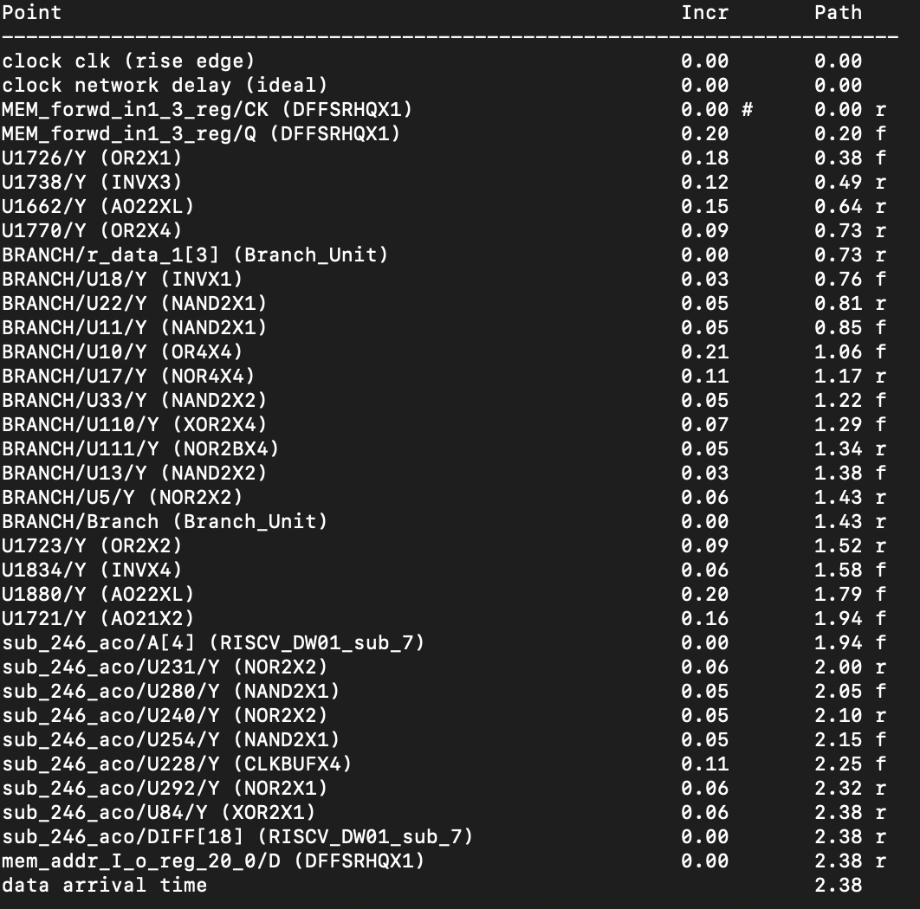
report_timing

Slide 5
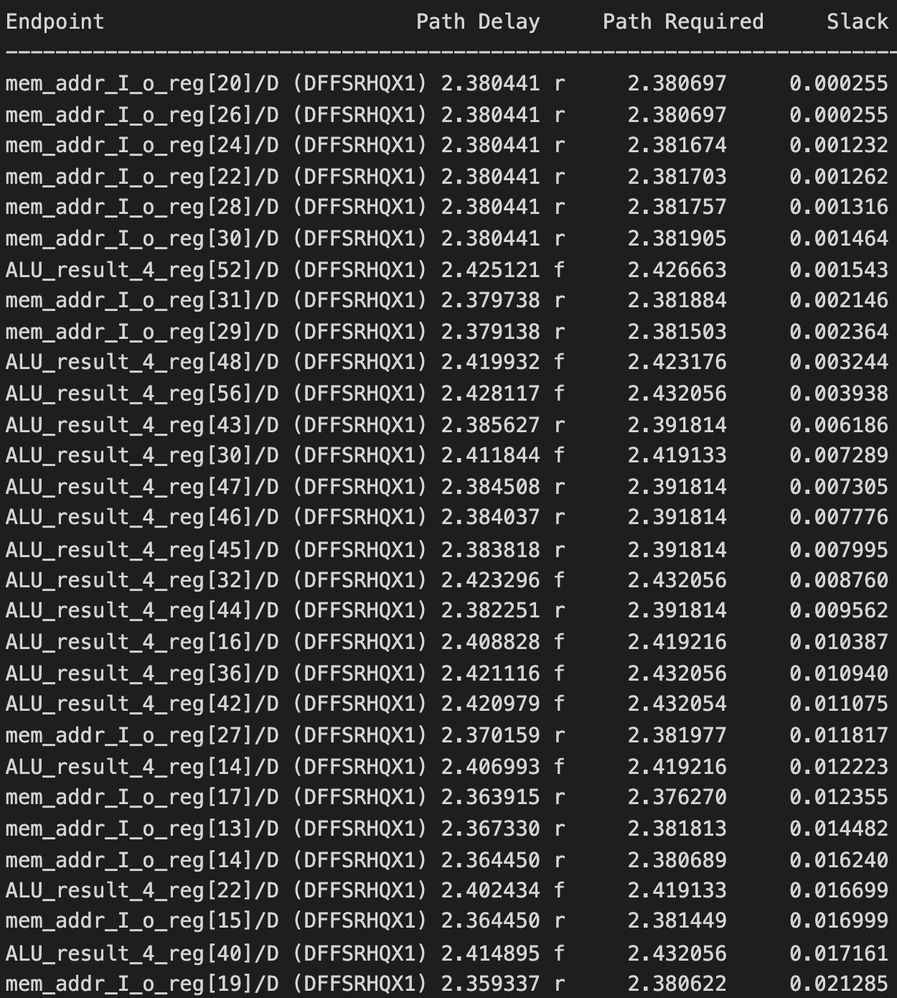
report_timing –path end

Slide 6
Related instructions
add, sub, srl, sll…
beq, bne
load, store…

Slide 7
Five stage pipeline
Instruction Fetch : IF
Instruction Decode : ID
Execute(ALU) : EX
Memory : MEM
Write back to register : WB

Slide 8
Instruction flow
Load data
Occur load-use hazard : MEM forwarding
Occur data hazard : WB forwarding
Run over every instruction
Make ALU path longer
Take control of next instruction address (branch)

Slide 9
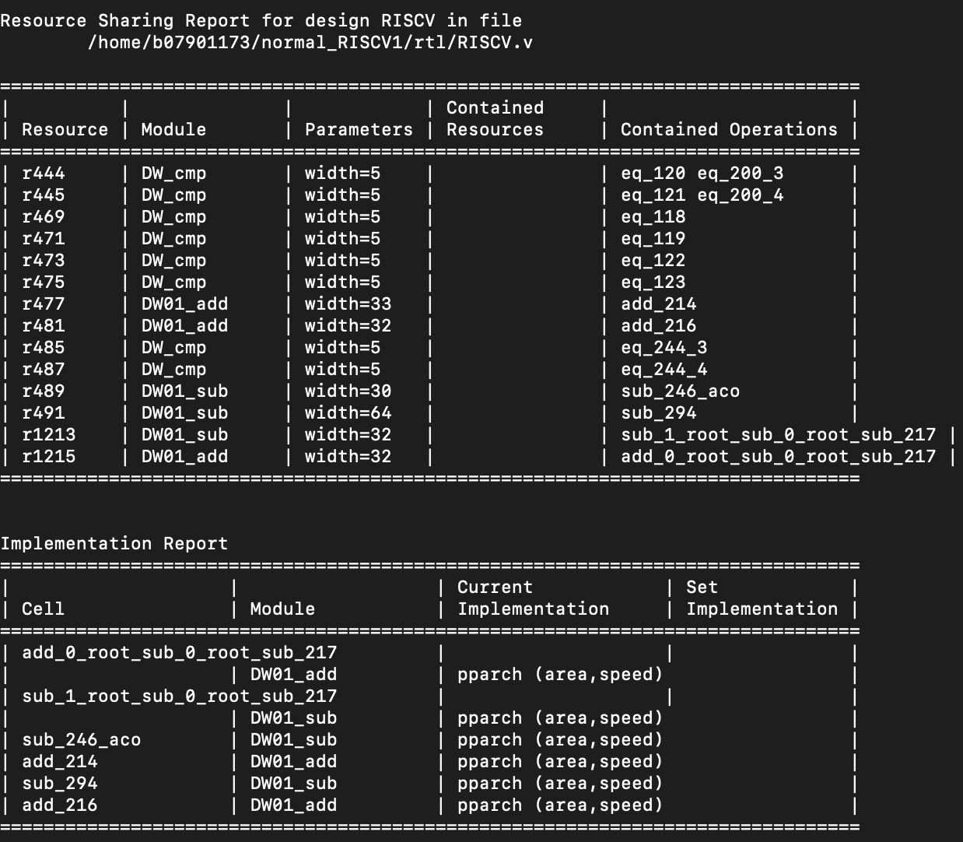
Check cell: report_resources

Slide 10
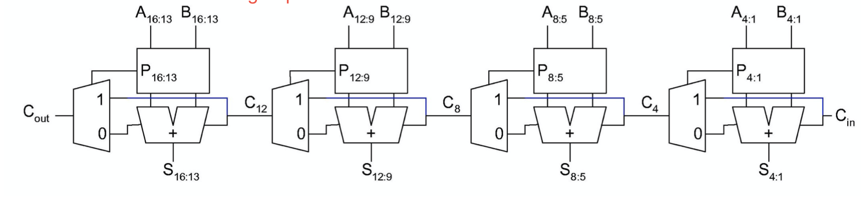
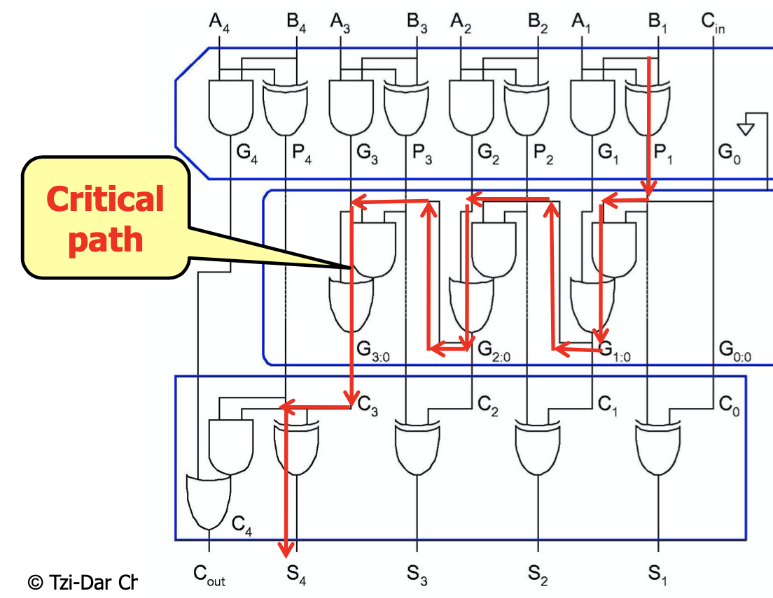
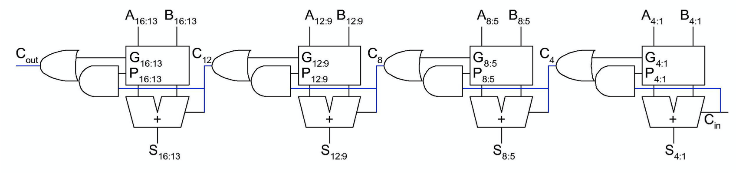
Check cell
DW01_add : pparch -> delay-optimized flexible parallel-prefix
DW01_sub : pparch -> delay-optimized flexible parallel-prefix

Slide 11
Test
Synthesis Cycle Time | Pattern 1 limit | Pattern 2 limit | Pattern 3 limit | Benchmark limit | Arrival time
2.2 ns | 2.1 ns | 2.2 ns | 2.2 ns | 2.2 ns | 1.98 ns
2.6 ns | 2.4 ns | 2.4 ns | 2.2 ns | 2.5 ns | 2.38 ns
3.8 ns | 3.1 ns | 3.1 ns | 3 ns | 3.6 ns | 3.58 ns
4.4 ns | 3.4 ns | 3.3 ns | 3.3 ns | 4.1 ns | 4.18 ns

Slide 12
Why cannot occur tight bound?
Some case wouldn’t occur.
-> There are some address which we won’t arrive.
-> Instruction address is 32 bits, but memory contains 256 words, which only uses 10 bits
Not exactly know the architecture of computing cell.
More details I didn’t notice.

