Slide 1
High Accuracy Image Classifier Inference on PYNQ-Z2
Team8
b07901073吳秉軒 r11943012曾維雋 r11943043潘奕亘
Graduate Institute of Electronics Engineering
National Taiwan University
Dec 29th, 2022

Slide 2
Outline
Goal
Training setting
Immigrate to QNN, onnx
Model selection
Software issue
FINN implementation
Conclusion
Reference

Slide 3
Outline
Goal
Training setting
Immigrate to QNN, onnx
Model selection
Software issue
FINN implementation
Conclusion
Reference

Slide 4
Goal
Image classifier on cifar10 using ResNet
Implement 2 version:
1. Lightweight ResNet based on baseline accuracy (~85%)
2. Maximize the utilization of resources on PYNQ-Z2 (or KV260) to approach best performance (~90%)
Design a methodology of tuning model’s parameter
(Option) Finish an End-to-end image classifier application accelerated with FPGA

Slide 5
Training set
Start from ResNet18
Preprocessing
RandomCrop
RandomHorizontalFlip
Normalize
Optimizer: SGD
Learning rate: 0.1, momentum: 0.9, weight decay: 5*10⁻⁴
Scheduler: CosineAnnealingLR
Epoch: 200
Batch size: 128

Slide 6
Immigrate to QNN
Using layer from QNN library
QuantIdentity for input and shortcut
Conv2d -> QuantConv2d
Set bit width for each layer’s parameters
Export with FINNManager
onnx file

Slide 7
Outline
Goal
Training setting
Immigrate to QNN, onnx
Model selection
Lightweight model
Max-utilized model
Software issue
FINN implementation
Conclusion
Reference

Slide 8
Model selection
Parameter setting
Layer
Channel
Bit width
Design 2 versions
Light-weight model (~85%)
Max-utilized model (~90%)

Slide 9
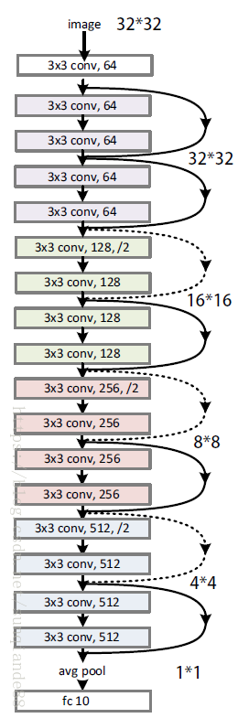
Original model
Model: Resnet18-4w4a
Accuracy: 92.54%
Total parameter: 11,164,352
Layer | Num of Param
Conv0 | 1,728
Group1 | 147,456
Group2 | 524,288
Group3 | 2,097,152
Group4 | 8,388,608
Fully-connected | 5,120

Slide 10
Observation
Last block of ResNet18
Take about 75% of model’s parameters
Duplicand of ResNet block
2 for each ResNet block in ResNet18
ResNet8
Remove last block & 1 duplicand
Little impact on accuracy
92.54% -> 90.11%
Large impact on resources (onnx file)
~44000kB -> ~4900kB

Slide 11
Observation
Search on channel & bit width
Channel: 8~64
Bit width: 4~8
Conclusion
Suitable number of layer (for a specific accuracy)
Adjust channel and bit width
Impact: channel > bit width

Slide 12
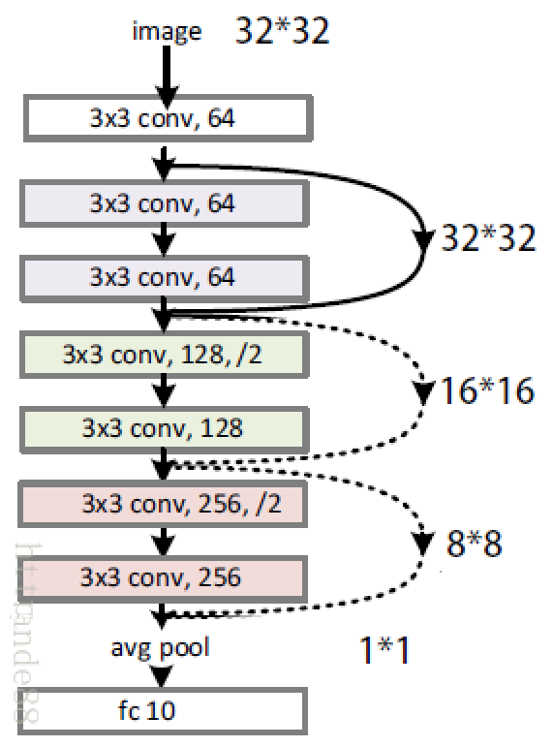
Light-weight model
Model: Resnet8-6w6a
Accuracy: 84.51% (↓8.03%)
Total parameter: 77,360 (↓ 99%)
16
16, /2
16*16
Layer | Num of Param | Decreased %
Conv0 | 432 | 75%
Group1 | 4,608 | 97%
Group2 | 14,336 | 97%
Group3 | 57,344 | 97%
Group4 | 0 | 100%
Fully-connected | 640 | 87%
16
32
8*8
32
64
4*4
64

Slide 13
Max-utilized model
Maximize the utilization to get higher accuracy (~90%)
Truncate the model to fit in the PYNQ-Z2
Reduce layer
Reduce channel
Maximize the resource
Slightly increase channels
Slightly increase bit width
Approach ideal accuracy

Slide 14
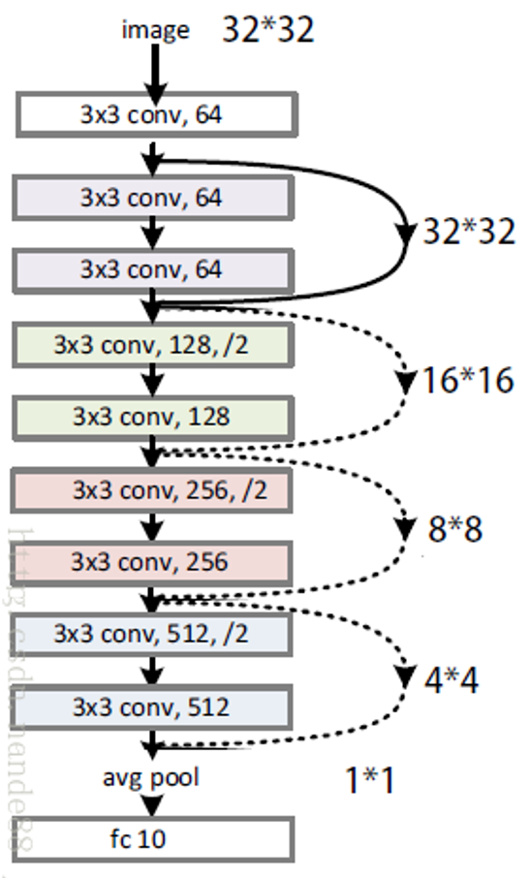
Resnet10
Model: Resnet10-4w4a
Accuracy: 91.57%
Total parameter: 4,897,472
Layer | Num of Param
Conv0 | 1,728
Group1 | 73,728
Group2 | 229,376
Group3 | 917,504
Group4 | 3,670,016
Fully-connected | 5,120

Slide 15
Resnet8
Model: Resnet8-4w4a
Accuracy: 89.98%
Total parameter: 1,224,896 (↓ 75%)
Layer | Num of Param
Conv0 | 1,728
Group1 | 73,728
Group2 | 229,376
Group3 | 917,504
Fully-connected | 2,560

Slide 16
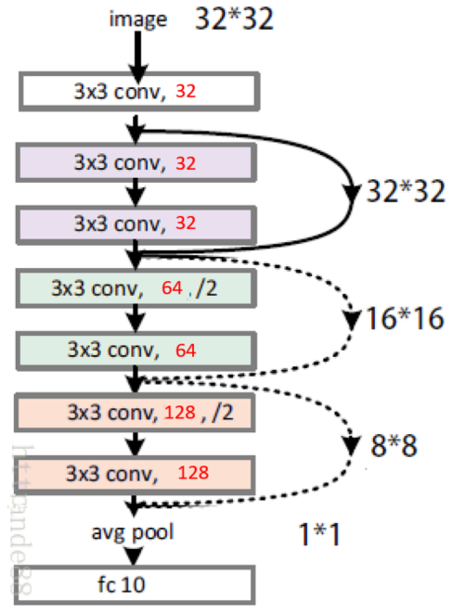
Reduce half of the channel
Model: Resnet8-4w4a
Accuracy: 87.63%
Total parameter: 307,296 (↓ 75%)
Layer | Num of Param | Decreased %
Conv0 | 864 | 50%
Group1 | 18,432 | 75%
Group2 | 57,344 | 75%
Group3 | 229,376 | 75%
Fully-connected | 1280 | 50%

Slide 17
Increase channel
Model: Resnet8-4w4a
Best accuracy
Increase number of channel of the last group
Accuracy: 88.5% (↑0.87%)
Version | Conv0 | Group1 | Group2 | Group3 | FC | Acc %
Base | 32 | 32 | 64 | 128 | 10 | 87.63
First group | 48 | 48 | 64 | 128 | 10 | 88.09
Middle group | 32 | 32 | 96 | 128 | 10 | 87.85
Last group | 32 | 32 | 64 | 144 | 10 | 88.5

Slide 18
Increase bit width
Model: Resnet8-5w5a
Best accuracy
5 bits for all layers
Accuracy: 89.33% (↑1.7%)
Version | Conv0 | Group1 | Group2 | Group3 | FC | Acc %
All 4b | 4 | 4 | 4 | 4 | 4 | 87.63
First + last | 5 | 4 | 4 | 4 | 5 | 88.23
Middle | 4 | 5 | 5 | 5 | 4 | 88.15
All 5b | 5 | 5 | 5 | 5 | 5 | 89.33

Slide 19
Software issue
onnx generation
Should use QuantIdentity for shortcut
Should put model on CPU before export
onnx size
Only represent resource of parameter
Synthesize result also involve architecture

Slide 20
Outline
Goal
Training setting
Immigrate to QNN, onnx
Model selection
Software issue
FINN implementation
Transform
Issue
Result
Conclusion
Reference

Slide 21
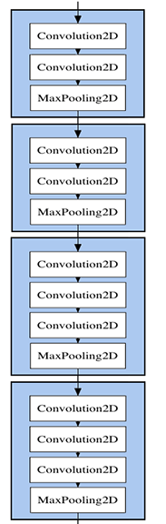
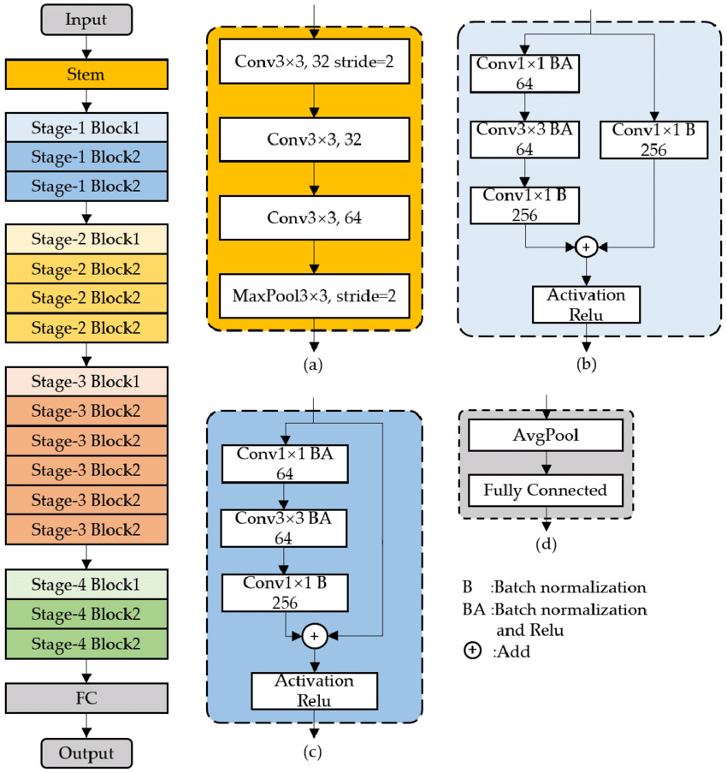
Difference of Architecture
VGG
Convolution
Max pooling
ResNet
Convolution
Max pooling
Short-cut path
Average pooling

Slide 22
FINN Transform
Input ONNX
Tidy Up
Streamlined
Dataflow
Folded
Hardware Generation
ResNet-dependent flow
Tackle with the operations of Resnet
Quantized Neural Network
Accelerate the transform flow
More flexible for testing

Slide 23
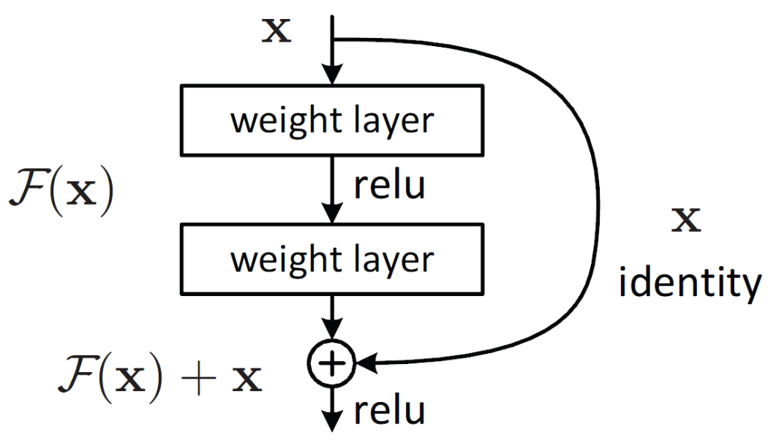
FINN Transform
Input ONNX
Tidy Up
Streamlined
Dataflow
Folded
Hardware Generation
Linear streamline
Similar to VGG’s flow
Non-linear streamline
Short-cut path
MoveLinearPastEltwiseAdd()

Slide 24
FINN Transform
Input ONNX
Tidy Up
Streamlined
Dataflow
Folded
Hardware Generation
BNN
InferBinaryMatrixVectorActivation()
InferQuantizedMatrixVectorActivation()
QNN
InferQuantizedMatrixVectorActivation()

Slide 25
FINN Transform
Input ONNX
Tidy Up
Streamlined
Dataflow
Folded
Hardware Generation
Folded parameter setting
Configure PE, SIMD and FIFO
There are some constraints
SIMD must divide IFMChannels
MatrixVectorActivaton requires SIMD >= MW/1024
FIFO depth doesn’t have big effect on resource utilization

Slide 26
FINN Issue
Input ONNX
Tidy Up
Streamlined
Dataflow
Folded
Hardware Generation
Assertion error
Signed output requires actval < 0
Solution
AbsorbSignBiasIntoMultiThreshold()
Add it to the beginning of Streamlined
Absorb signed int bias into MultiThreshold and re-evaluate the output type.
Notes:
There is a transformation missing at the beginning of the streamlining block, which is the absorb. AbsorbSignBiasIntoMultiThreshold() transformation. This transformation would normally set the out_bias attributes accordingly.

Slide 27
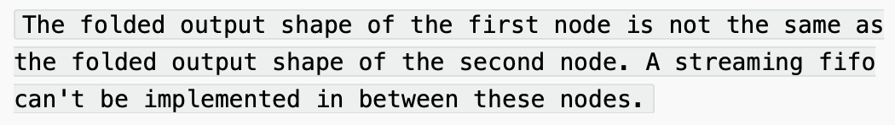
FINN Issue
Input ONNX
Tidy Up
Streamlined
Dataflow
Folded
Hardware Generation
Folded output shape is not consistent
Fpgadataflow.InsertDWC()
Fpgadataflow.InsertFIFO()
Eliminate these commands
DWC(data width converter) may cause error.

Slide 28
Implementation Result
High accuracy version (ResNet10, 90.11%)
Layer | W bit | Shape | Channel
Conv0 | 4 | 32x32 | 3
Conv1_0 | 4 | 32x32 | 64
Conv1_1 | 4 | 16x16 | 64
Conv1_2 | 4 | 32x32 | 64
Conv2_0 | 4 | 16x16 | 64
Conv2_1 | 4 | 16x16 | 128
Conv2_2 | 4 | 8x8 | 64
Conv3_0 | 4 | 16x16 | 128
Conv3_1 | 4 | 4x4 | 256
Conv3_2 | 4 | 8x8 | 128
Element | ResNet10 |  | PYNQ-Z2
LUT | 64463 | 121% | 53200
LUTRAM | 6630 | 38% | 17400
FF (slice) | 96921 | 91% | 106400
BRAM | 178 | 127% | 140
BUFG | 1 | 3% | 32

Slide 29
Implementation Result
High accuracy version (ResNet8, 89.33%)
Layer | W bit | Shape | Channel
Conv0 | 5 | 32x32 | 3
Conv1_0 | 5 | 32x32 | 32
Conv1_1 | 5 | 32x32 | 32
Conv2_0 | 5 | 32x32 | 32
Conv2_1 | 5 | 16x16 | 64
Conv2_2 | 5 | 32x32 | 32
Conv3_0 | 5 | 16x16 | 64
Conv3_1 | 5 | 8x8 | 128
Conv3_2 | 5 | 16x16 | 64
Element | ResNet8 |  | PYNQ-Z2
LUT | 40593 | 76% | 53200
LUTRAM | 3150 | 18% | 17400
FF (slice) | 63355 | 60% | 106400
BRAM | 76 | 54% | 140
BUFG | 1 | 3% | 32

Slide 30
Implementation Result
Lightweight version (ResNet10, 84.51%)
Layer | W bit | Shape | Channel
Conv0 | 6 | 32x32 | 3
Conv1_0 | 6 | 32x32 | 16
Conv1_1 | 6 | 16x16 | 16
Conv1_2 | 6 | 32x32 | 64
Conv2_0 | 6 | 16x16 | 16
Conv2_1 | 6 | 8x8 | 32
Conv2_2 | 6 | 16x16 | 16
Conv3_0 | 6 | 8x8 | 32
Conv3_1 | 6 | 4x4 | 64
Conv3_2 | 6 | 8x8 | 32
Element | ResNet8 |  | PYNQ-Z2
LUT | 35617 | 67% | 53200
LUTRAM | 2707 | 15% | 17400
FF (slice) | 46435 | 44% | 106400
BRAM | 29 | 21% | 140
BUFG | 1 | 3% | 32

Slide 31
Conclusion
Model truncation
Critical layer: last convolution layer
Impact: channel > bit width
Parameter suggestion (for PYNQ-Z2)
Layer: ~10
Bit width: 4-6 bits
FINN implementation
Model-dependent transform
At most 80% HW utilization
Performance | Accuracy | Lightweight
LUT | 76% | 67%
LUTRAM | 18% | 15%
FF (slice) | 60% | 44%
BRAM | 54% | 21%
BUFG | 3% | 3%
Accuracy | 89.33% | 84.51%

Slide 32
Reference
https://github.com/Xilinx/brevitas
https://xilinx.github.io/finn/
https://finn.readthedocs.io/en/latest/source_code/finn.transformation.fpgadataflow.html

