Slide 1

COVID-19 Challenge
Telepresence Robot
Chongdan Pan

Slide 2
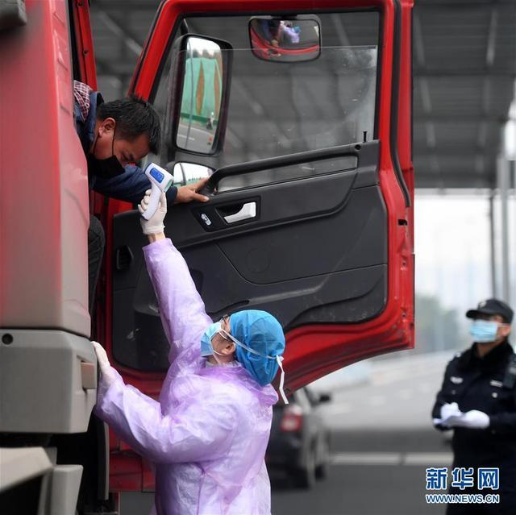
Problem Description
Chinese COVID-19 Outbreak Control Methods
To prevents interaction between virus carriers and normal people, temperature measuring stations is set in all gates of all housing estates in China.
Effective but High Cost
However, such methods require many volunteers to keep stationed at gates for hours, which costs a lot of time, labor force and increases the possibility that the volunteers get infected.
Evidence
My uncle stations at the east gate of my housing estate for from 12:00 to 17:00 every 3 days to measure the temperature of comers. There are also many news about these volunteers everywhere.
https://baijiahao.baidu.com/s?id=1657513147214514829&wfr=spider&for=pc
2

Slide 3
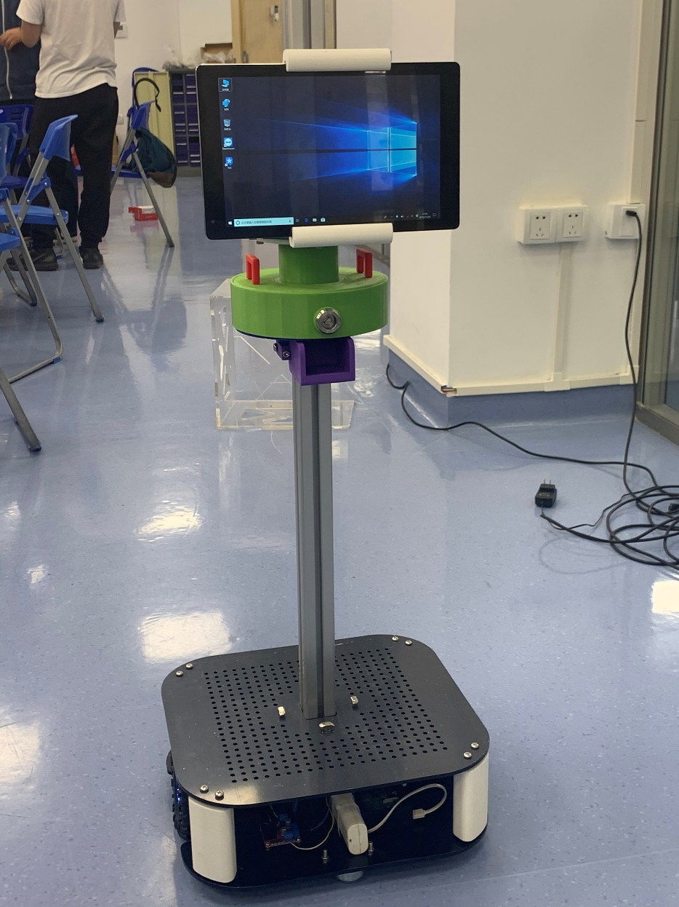
Needs & Ideas
Needs
A safer and more cost-effective way to monitor the temperature of people who come in and out of housing estates
Ideas: Telepresence Robot
My team from JI have developed a healthcare telepresence robot under budget of 3500 RMB, which can provide remote care for people. Caregivers can control the robot to move, make video call and deliver pills to the disabled even when he is far away.
The volunteer can be replaced by such robot to monitor the temperature of comers.
3

Slide 4
Solution: Temperature measuring telepresence robot
Higher efficiency
Compared to human, the robot can measure more comers’ temperature at once. It can work longer and better, especially at night.
Lower Cost
The temperature measuring telepresence robot doesn’t need to move around and deliver pills, so the robot will cheaper, which will cost less than 1500 RMB.
Safer
With telepresence robot, the volunteers don’t need to go out to monitor the situation at risk of getting infected.
4

