Slide 1
CUSTOMER SHOPPING BEHAVIOR
Customer shopping behavior points to a retention opportunity
A data-led read on demand, discount response, subscription adoption, and practical growth levers.

Slide 2
THE BASE
3,900 purchases reveal a large but under-monetized base
3,900
$59.76
3.75
37
purchases across 18 fields and 25 products
average purchase amount
average review rating
ratings imputed during cleaning
The customer base is broad, but subscription adoption is still the clearest growth gap.

Slide 3
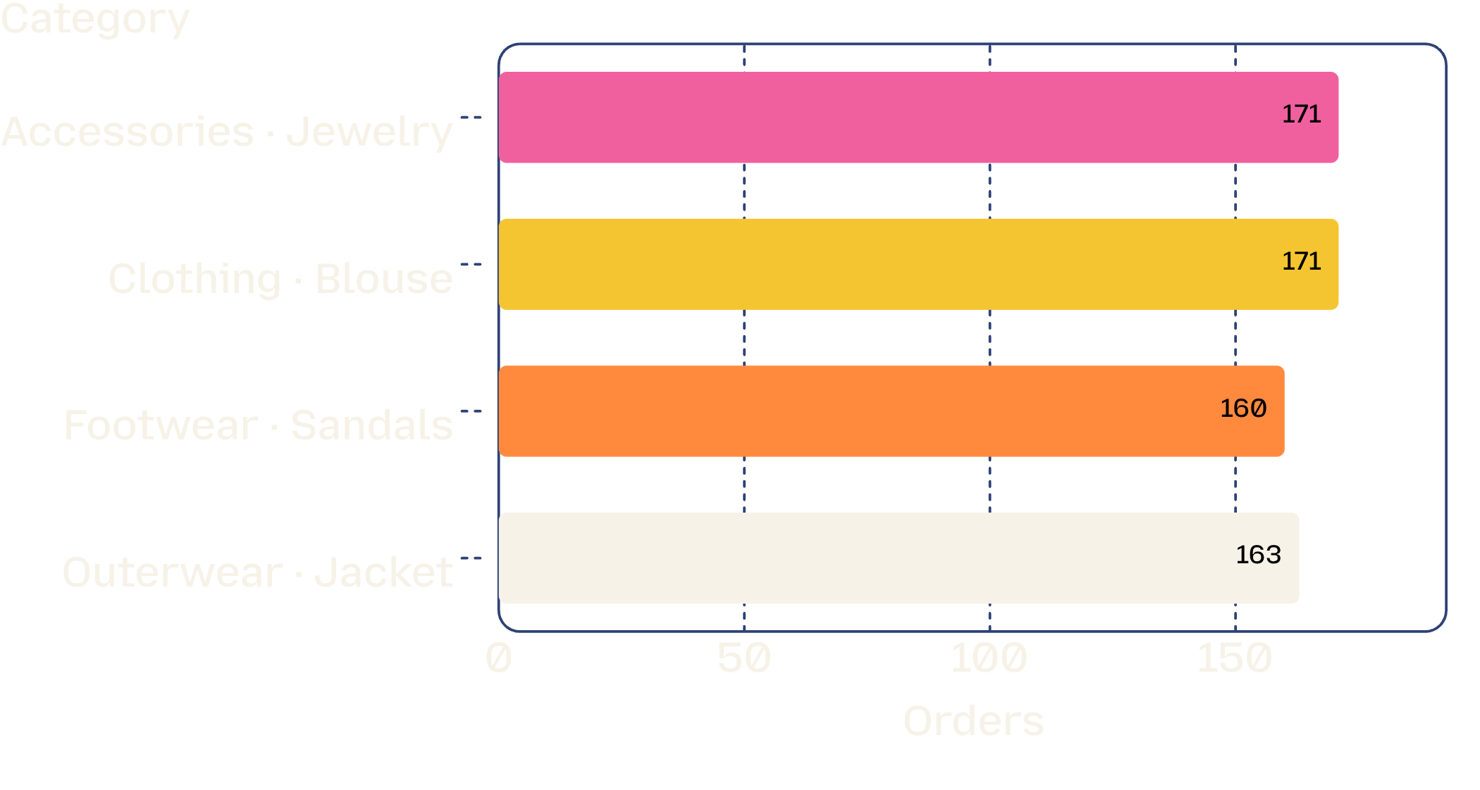
PRODUCT HIERARCHY
Clothing leads demand, with a clear product hierarchy
Clothing leads the dashboard's revenue and sales views.
Category leaders: Jewelry, Blouse, Sandals, and Jacket.
Use category leaders as the entry points for merchandising and campaign planning.

Slide 4
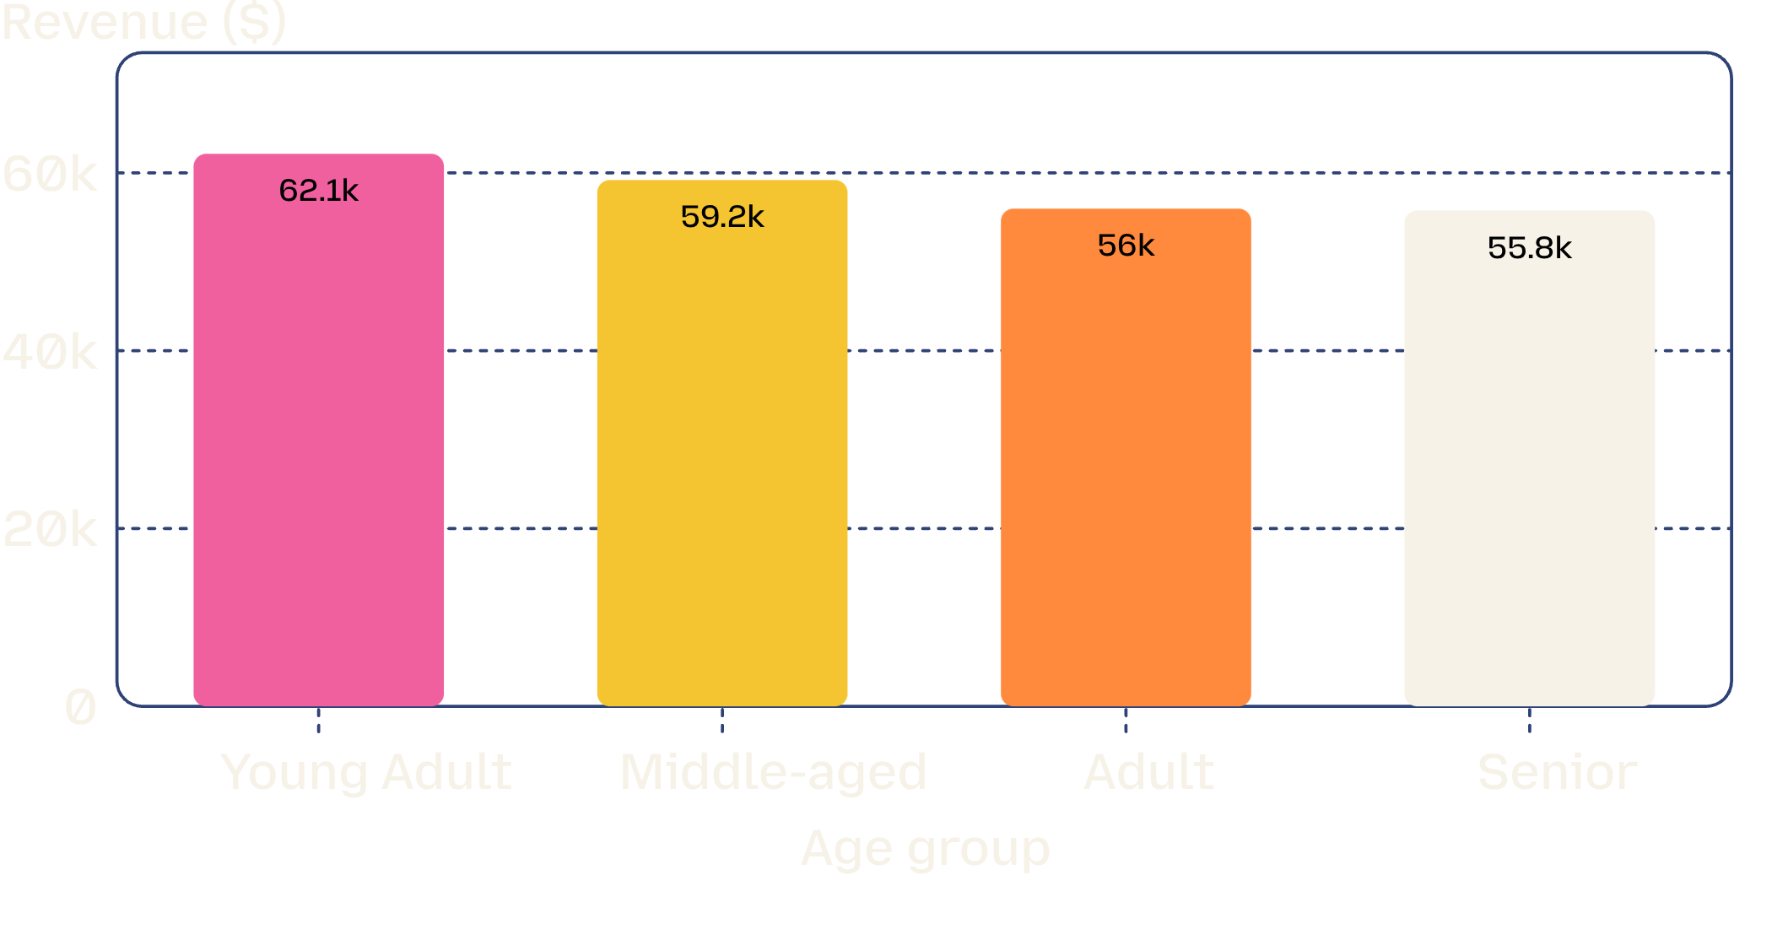
REVENUE COHORTS
Young adults and male shoppers drive more revenue
$157,890
male customer revenue
Female customer revenue: $75,191
Prioritize growth campaigns around the highest-revenue cohorts, then tailor creative and offers by segment.

Slide 5
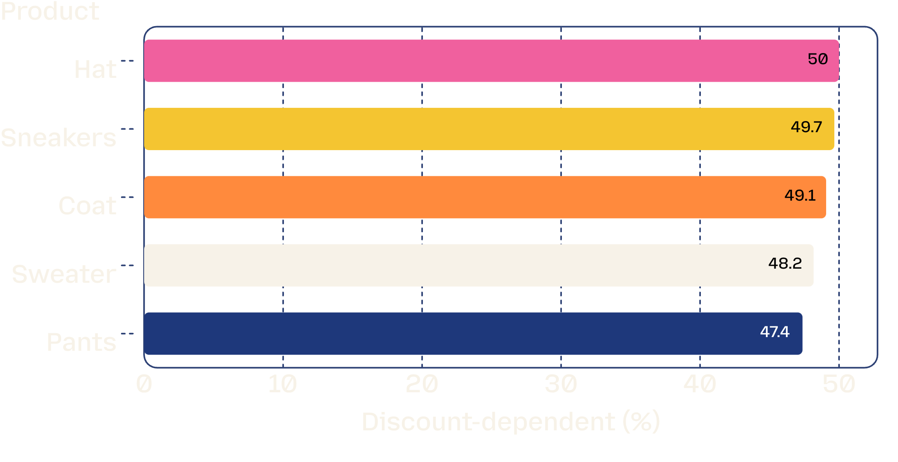
DISCOUNT ECONOMICS
Discounts attract high spend, but some products may be over-dependent
839
customers used discounts while spending above the average purchase amount.
Decision: protect margin by testing targeted offers instead of broad discounting.

Slide 6
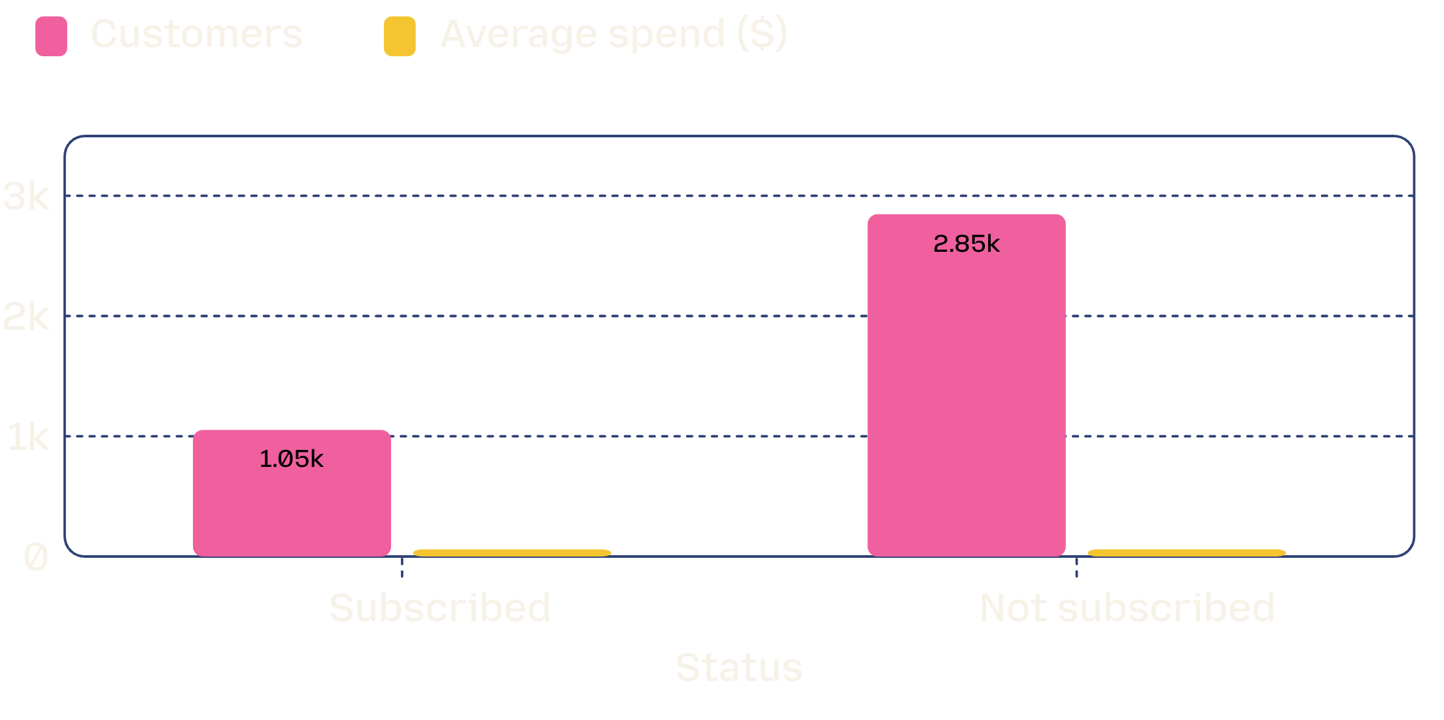
SUBSCRIPTION GAP
The subscription gap is large, and spend is nearly flat
1,794
more non-subscribers than subscribers
Repeat buyers: 958 subscribed; 2,518 did not.
Subscription value is not yet translating into a meaningful basket-size lift.

Slide 7



PRACTICAL LEVERS
Experience and product signals offer practical levers
Shipping
Top-rated products
Merchandising move
$60.48
Gloves 3.86 · Sandals 3.84 · Boots 3.82
Feature highly rated products in campaigns and test express-shipping messaging with high-value cohorts.
Express average purchase amount versus $58.46 for Standard shipping.
Hat 3.80 · Skirt 3.78

Slide 8

FROM ANALYSIS TO GROWTH
Five actions can turn the analysis into growth
1
Boost subscriptions: Clarify exclusive benefits and test offers against repeat buyers.
2
Build loyalty: Reward the 3,116-customer Loyal segment and move Returning customers upward.
3
Review discount policy: Target discount-dependent products and monitor margin impact.
4
Position the winners: Put top-rated and category-leading products at the center of campaigns.
5
Target the highest-value cohorts: Focus age, gender, and shipping messages where revenue is strongest.

