Slide 1


Eco-Scan AI
Pandya Rishi Kanaiyalal
Parmar Kuldeepkumar Pravinbhai
Sagar Chouhan
College Name – Government Engineering College, Palanpur

Slide 2

Project Objectives
To detect waste items using image recognition.
To classify waste into categories such as Plastic, Paper, Glass, Metal, Organic and E-Waste.
To provide proper disposal and recycling guidance.
To spread awareness about sustainable waste management.
To use Artificial Intelligence for supporting environmental sustainability.

Slide 3
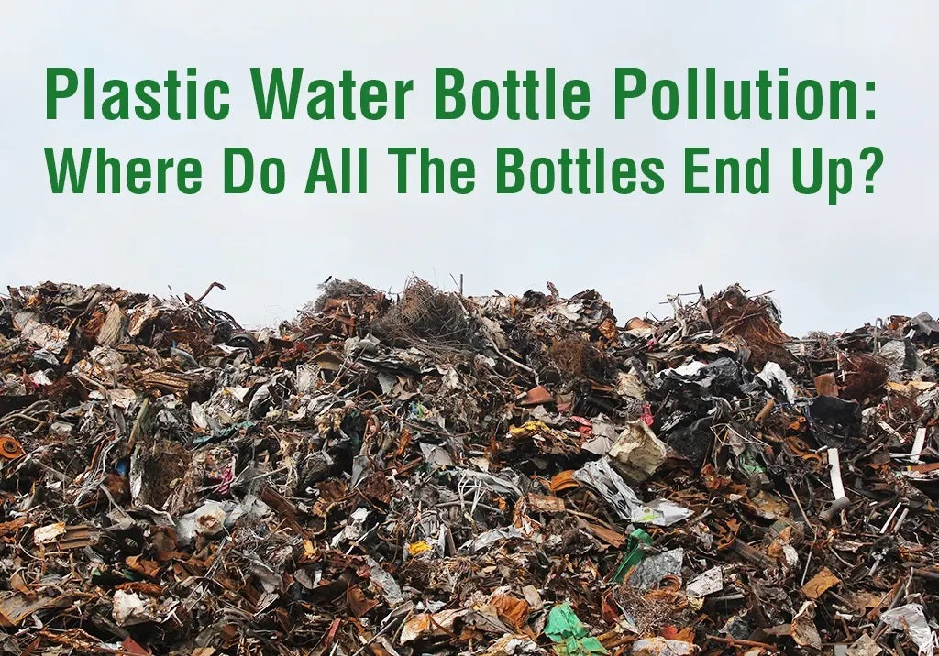
Problem Statement
Improper waste disposal is one of the major environmental challenges today. Many people are unaware of the correct method of disposing different types of waste. As a result, recyclable materials often end up in landfills, causing pollution and resource wastage.
The aim of this project is to develop an AI-based solution that helps users identify waste items and provides proper recycling and disposal recommendations.

Slide 4
Project Overview - Introduction
Eco-Scan AI is an Artificial Intelligence based waste detection and recycling assistant developed to support sustainable waste management. The system uses Computer Vision and a Convolutional Neural Network (CNN) model to identify different types of waste from uploaded images.
Users can upload an image of a waste item through a simple Streamlit web application. The trained model analyzes the image, predicts the waste category, and provides suitable recycling or disposal guidance. The project aims to encourage responsible waste management practices and create awareness about environmental sustainability through the use of AI technology.

Slide 5
End Users
The proposed system can be used by a wide range of users who want to improve waste segregation and recycling practices.
Students and educational institutions for learning about waste management.
Households for proper disposal of daily waste items.
Recycling centers for quick waste categorization.
Environmental organizations conducting awareness programs.
Municipal bodies promoting sustainable waste management.
General public interested in eco-friendly practices.
The system is designed with a simple interface so that users of all age groups can easily use it.

Slide 6
Wow Factors in Project
Wow Factors
Uses Artificial Intelligence for automatic waste identification.
Provides instant waste classification from uploaded images.
Recommends appropriate recycling or disposal methods.
Helps users understand correct waste segregation practices.
Simple and user-friendly Streamlit-based interface.
Supports environmental sustainability and green initiatives.
Can be further enhanced for real-time waste detection applications.
The project combines technology and environmental awareness to solve a real-world problem in a practical way.

Slide 7
Modelling/Block Diagram/Flow of Project
Project Flow
The working process of Eco-Scan AI follows a simple and structured flow.
User Uploads Image of Waste Product
Image Preprocessing
CNN Model Analysis
Waste Category Prediction
Recycling Information Retrieval
Display Result and Recycling Tip
The uploaded image is first preprocessed and resized according to the model requirements. The trained CNN model then extracts image features and predicts the waste category. Based on the prediction, the system retrieves relevant recycling information and displays the category, disposal method, and recycling tips to the user.

Slide 8
Technology Stack
Programming Language
Python
Machine Learning Framework
TensorFlow
Keras
Web Application Framework
Streamlit
Supporting Libraries
NumPy
Pillow (PIL)
Project Domains
Artificial Intelligence
Computer Vision
Sustainability
Green Skills
These technologies were selected because they provide an efficient environment for building image classification applications.

Slide 9
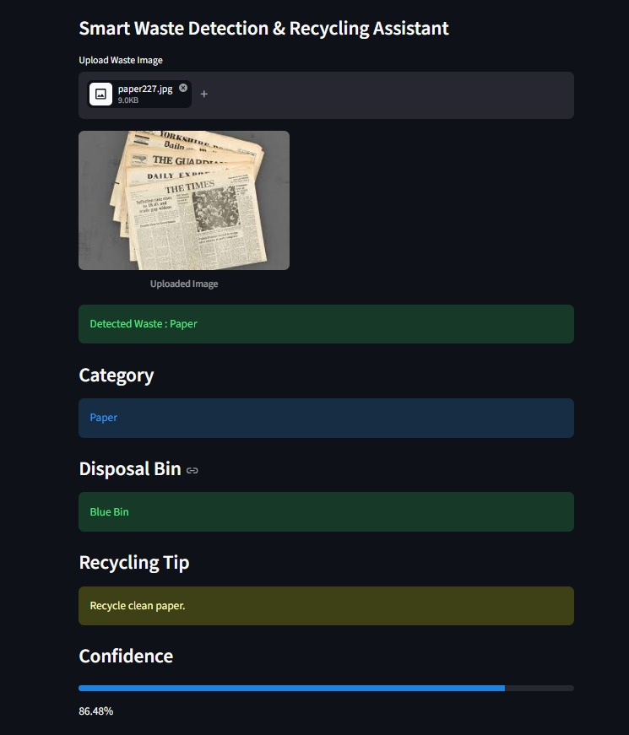
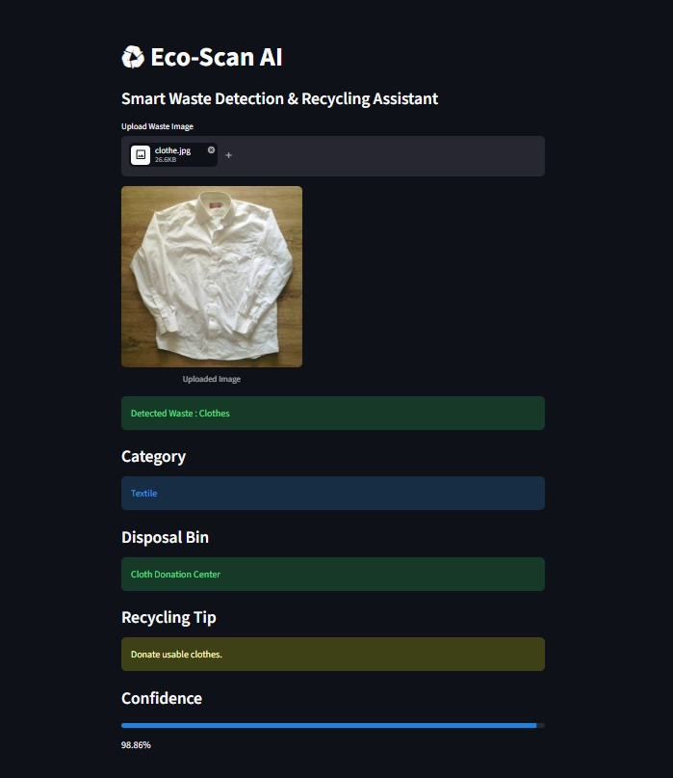
Result/Outcomes

Slide 10
Result/Outcomes
The Eco-Scan AI application was successfully developed and tested using different waste images. The trained CNN model was able to identify waste categories and provide appropriate disposal and recycling recommendations through the Streamlit web interface.
Key Outcomes
Successfully classified different types of waste using image recognition.
Provided suitable disposal bin recommendations.
Displayed recycling tips for users.
Developed a simple and user-friendly Streamlit application.
Promoted awareness about proper waste segregation and recycling.
Sample Results
Paper Waste
Predicted Category: Paper
Disposal Bin: Blue Bin
Confidence: 86.48%
Textile Waste
Predicted Category: Clothes (Textile)
Disposal Method: Cloth Donation Center
Confidence: 98.86%

Slide 11
Conclusion
Eco-Scan AI demonstrates how Artificial Intelligence and Computer Vision can be applied to address environmental challenges. The system helps users identify waste items, understand proper disposal methods, and encourage responsible recycling practices.
The project not only showcases the practical use of machine learning but also supports the goal of creating a cleaner and more sustainable environment. Through this project, we explored the use of AI for solving real-world problems related to waste management and sustainability

Slide 12
Future Perspective
Although the current system successfully classifies waste through uploaded images, there are several opportunities for future enhancement like
Development of a mobile application for wider accessibility.
Integration of real-time camera-based waste detection.
Support for additional waste categories and larger datasets.
Integration with IoT-enabled smart waste bins.
Multi-language support for users from different regions.
Cloud-based deployment for large-scale usage.
These improvements can make the system more efficient, scalable, and useful for practical implementation in smart cities and environmental projects.

Slide 13
Thank You
Github link
https://github.com/PANDYA-RISHI2005/Edunet_Internship_capstone_project
Video (google drive link)
https://drive.google.com/file/d/1alaFDsMyod0vxBIcMU9A8aqgwpPnFyqi/view?usp=drivesdk

