Slide 1
IBM Bluemix and Watson

Slide 2

Bluemix
A cloud platform as a service (PaaS)
Based on Cloud Foundry – a cloud computing platform
Linux based environment
App development, deployment and delivery (DevOps)

Slide 3
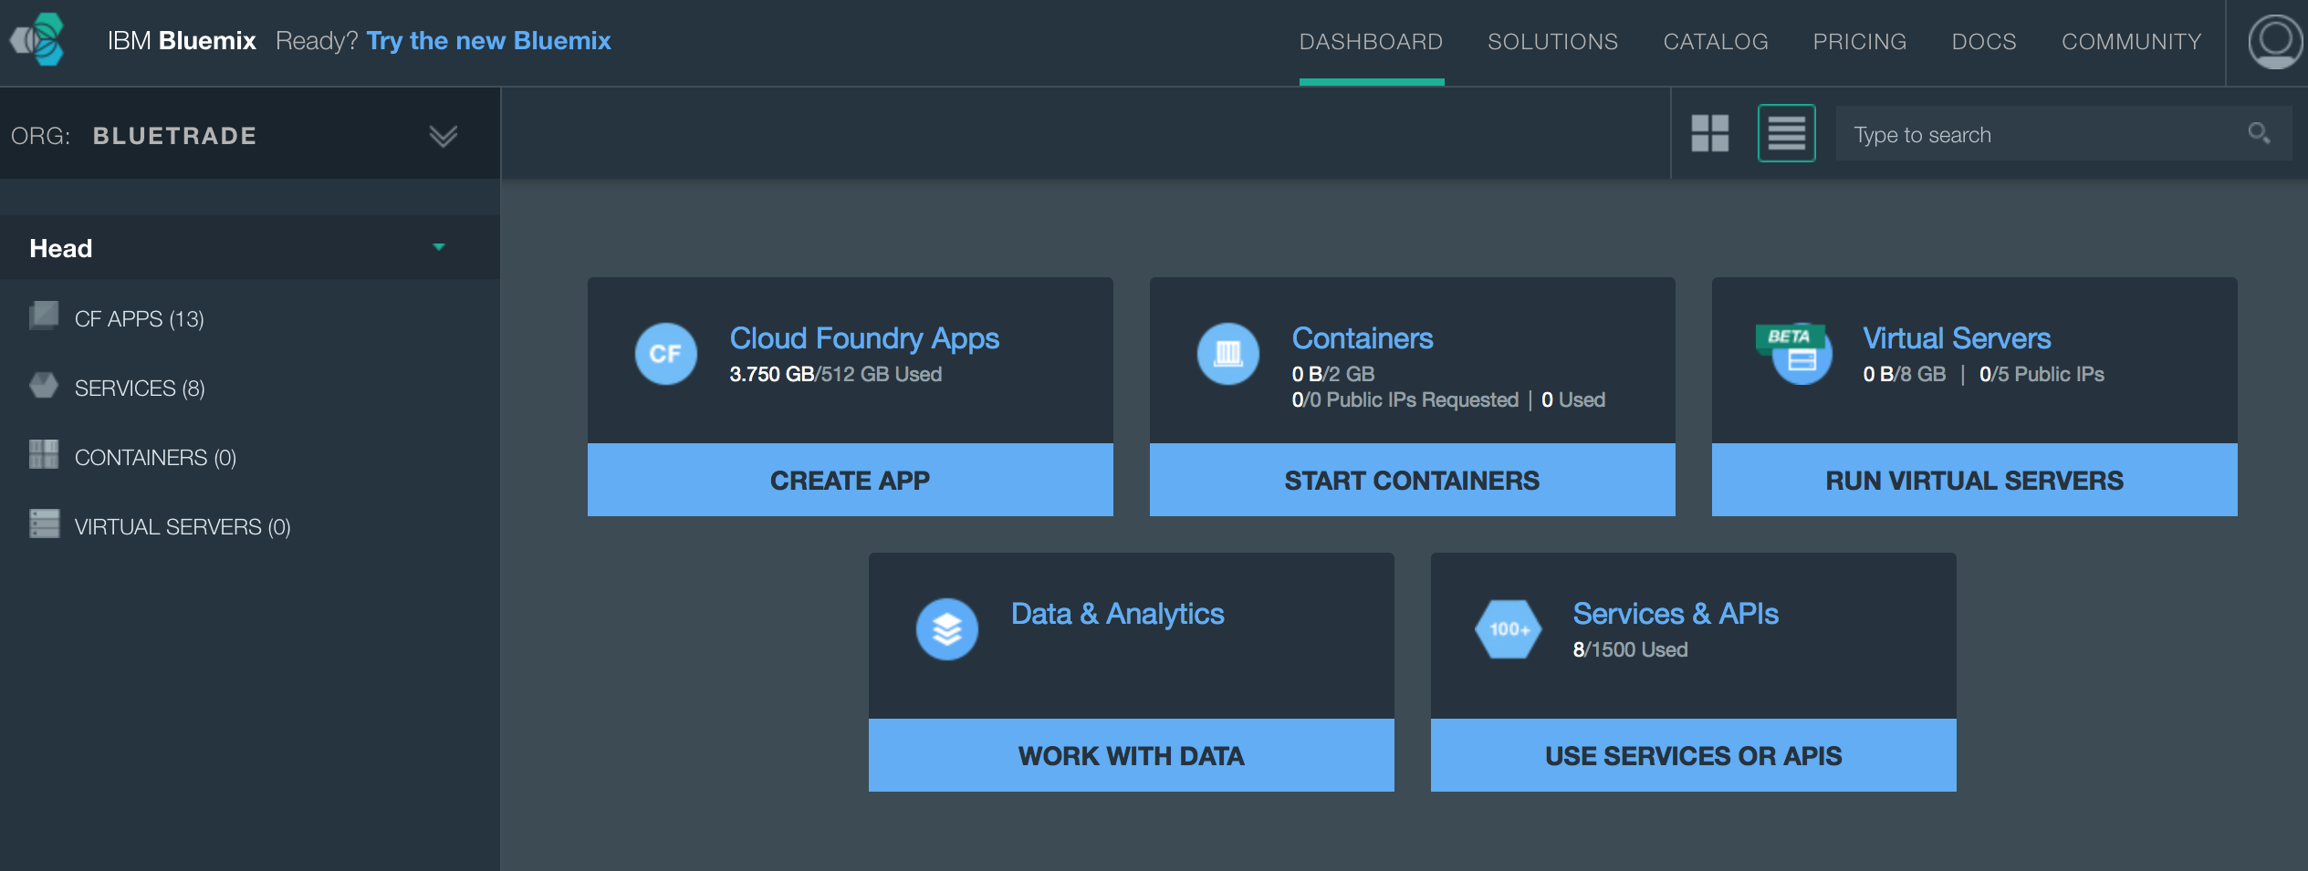
Bluemix
Organization
Space

Slide 4
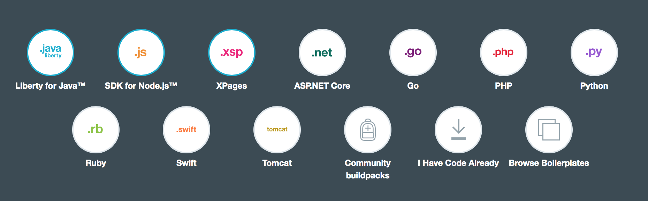
Supported Languages and Buildpacks
Support for custom buildpacks

Slide 5

Cloud Foundry
A Linux based cloud environment
Provides:
Access to bluemix server
Command-line interface (CLI)
Eclipse plugin
SSH access

Slide 6
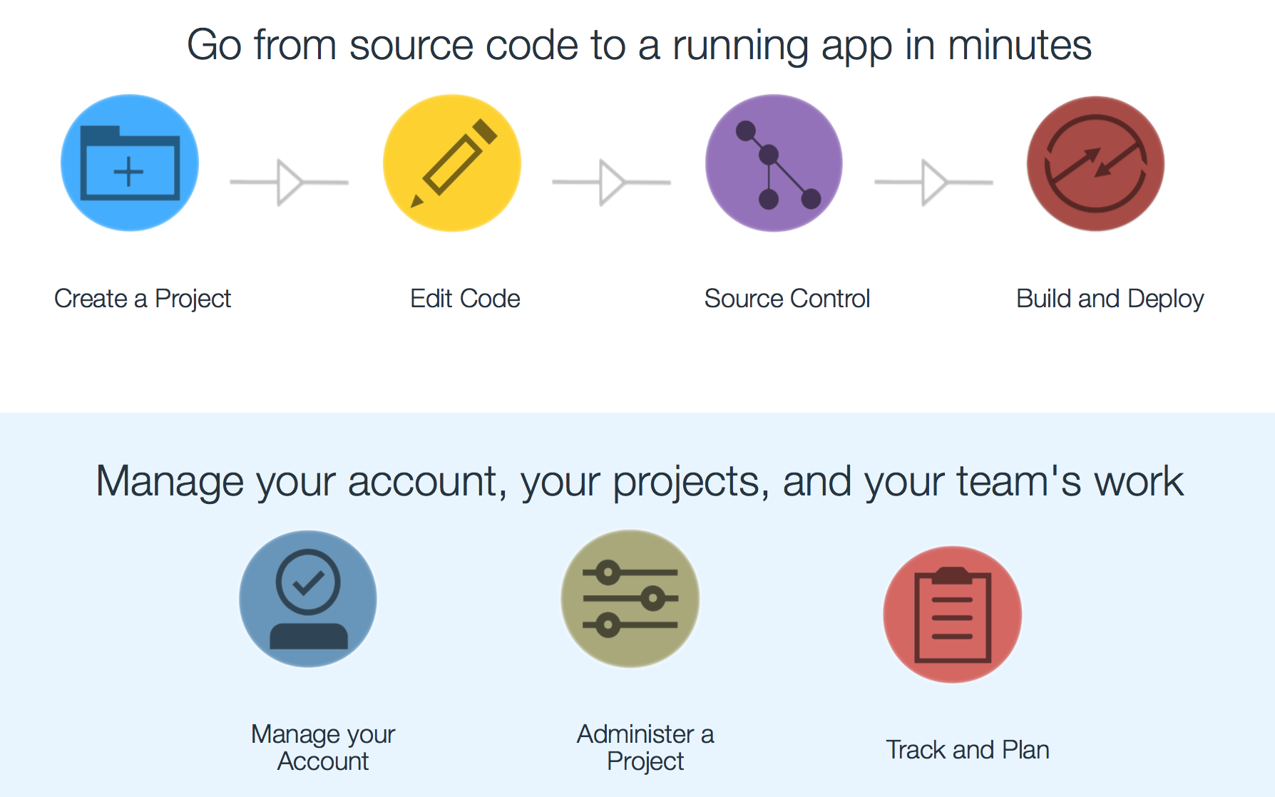
Bluemix DevOps Services

Slide 7
Bluemix DevOps Services
Track & Plan service
Planning for project and team-work
source control
A Web IDE for managing source control
Source control through Git, Jazz SCM, or GitHub
Delivery Pipeline
Automated builds and deployments through the Delivery Pipeline service

Slide 8
Deploying an App with manifest.yml
An example:
To be used with CLI
---
applications:
- name: HogwartsHouses
memory: 512M
disk_quota: 512M
path: .
buildpack: "http://github.com/virtualstaticvoid/heroku-buildpack-r.git"
command: R -f "./startApp.R"
timeout: 180
env:
env_type: production

Slide 9

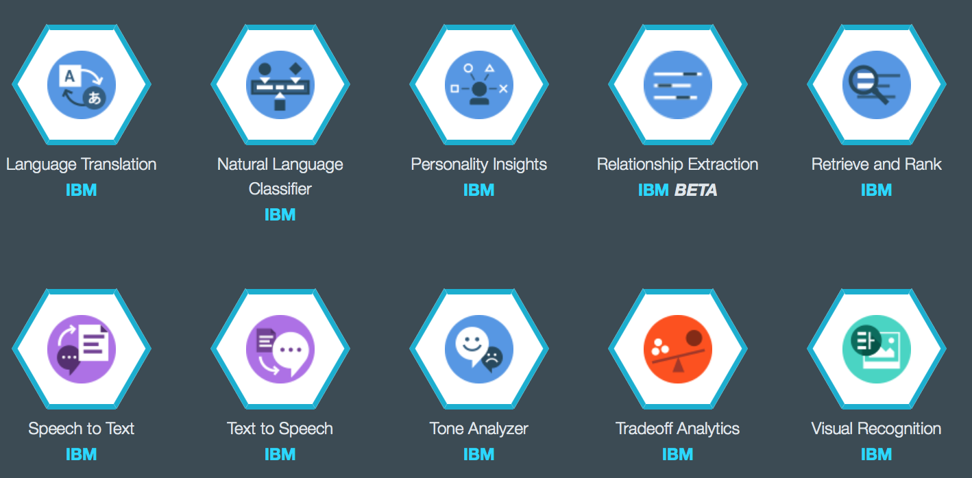
Watson Services
100+ services
RESTful API for each of them
Documentation and support

Slide 10
Use Case – App with Watson Service
Create an app in Bluemix and modify
Create a service in Bluemix
Train and ready the NLC
Deploy the app
Ex. | Class
… | …
… | …
Train.csv

Slide 11
Create an NLC Service
Services & APIs >> Natural Language Classifier >> (Assign a service name) >> Create
Go to the service credentials page and copy them

Slide 12
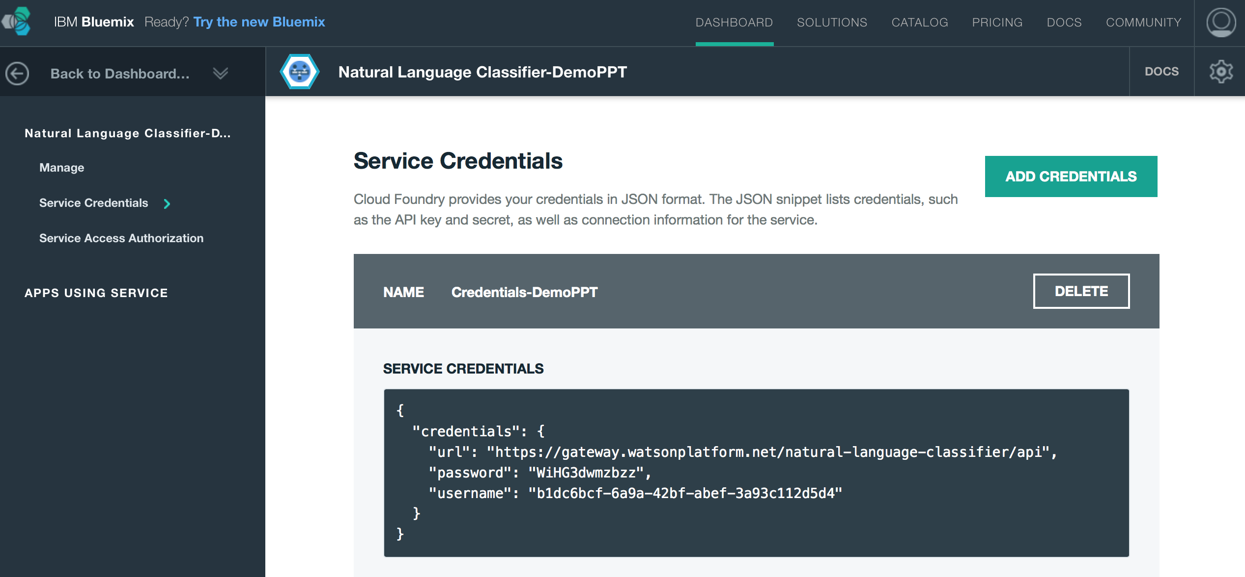
Watson Service Credentials

Slide 13
Use Case – Hogwarts’ Houses Classification
Query | Class
I have courage | Gryffindor
I am brave | Gryffindor
I am a good friend | Hufflepuff
Hard working | Hufflepuff
Smart and intelligent | Ravenclaw
Artistic interests | Ravenclaw
I am hungry for power | Slytherin
I enjoy killing people | Slytherin
… | …

Slide 14
Create and Train a Language Classifier
Create and train with the curl command:
Replace the ‘username’ and ‘password’ with the service credentials and give the classifier a name at ‘My Classifier’
curl -u "{username}":"{password}" -F training_data=@train.csv -F training_metadata="{\"language\":\"en\",\"name\":\"My Classifier\"}" "https://gateway.watsonplatform.net/natural-language-classifier/api/v1/classifiers"

Slide 15
Create and Train a Language Classifier
Response when training:
{
"classifier_id" : "e295e0x75-nlc-190",
"name" : "My Classifier",
"language" : "en",
"created" : "2016-07-14T06:33:25.655Z",
"url" : "https://gateway.watsonplatform.net/natural-language-classifier/api/v1/classifiers/e295e0x75-nlc-190",
"status" : "Training",
"status_description" : "The classifier instance is in its training phase, not yet ready to accept classify requests"
}

Slide 16
Create and Train a Language Classifier
Status check:
Replace the ‘username’ and ‘password’ with the service credentials and ‘classifier_id’ with your classifier ID
curl -u "{username}":"{password}“ "https://gateway.watsonplatform.net/natural-language-classifier/api/v1/classifiers/{classifier_id}"

Slide 17
Create and Train a Language Classifier
Response when ready:
{
"classifier_id" : " e295e0x75-nlc-190",
"name" : "My Classifier",
"language" : "en",
"created" : "2016-07-06T12:37:39.339Z",
"url" : "https://gateway.watsonplatform.net/natural-language-classifier/api/v1/classifiers/e295e0x75-nlc-190",
"status" : "Available",
"status_description" : "The classifier instance is now available and is ready to take classifier requests."
}

Slide 18
Use Case – App Usage
User
App UI
NLC
User characteristics
e.g. I am brave.
User input
e.g. brave
Class
e.g. Gryffindor

Slide 19
Project Link
App is running at:
https://hogwartshouses.eu-gb.mybluemix.net/
Git repo for the project:
https://github.com/RAW21/HogwartsHouses.git

Slide 20
Thank you!
Bhaumik Pandya

