Slide 1
Bankruptcy Prediction

Slide 2
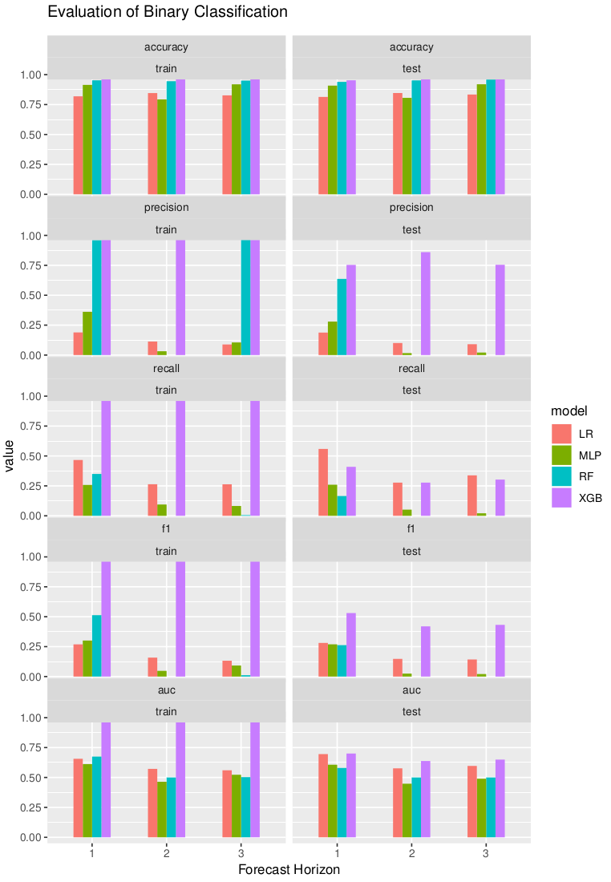
Model Training and Evaluation Binary Classification

Slide 3
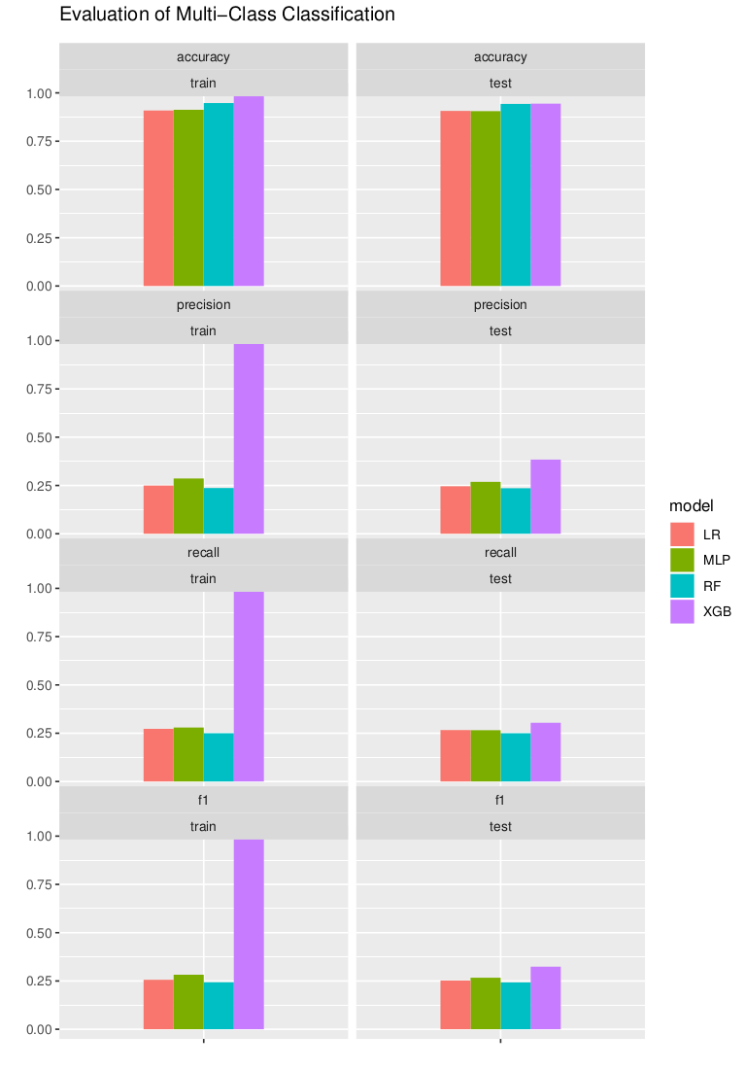
Model Training and Evaluation Multi Class Classification

Slide 4
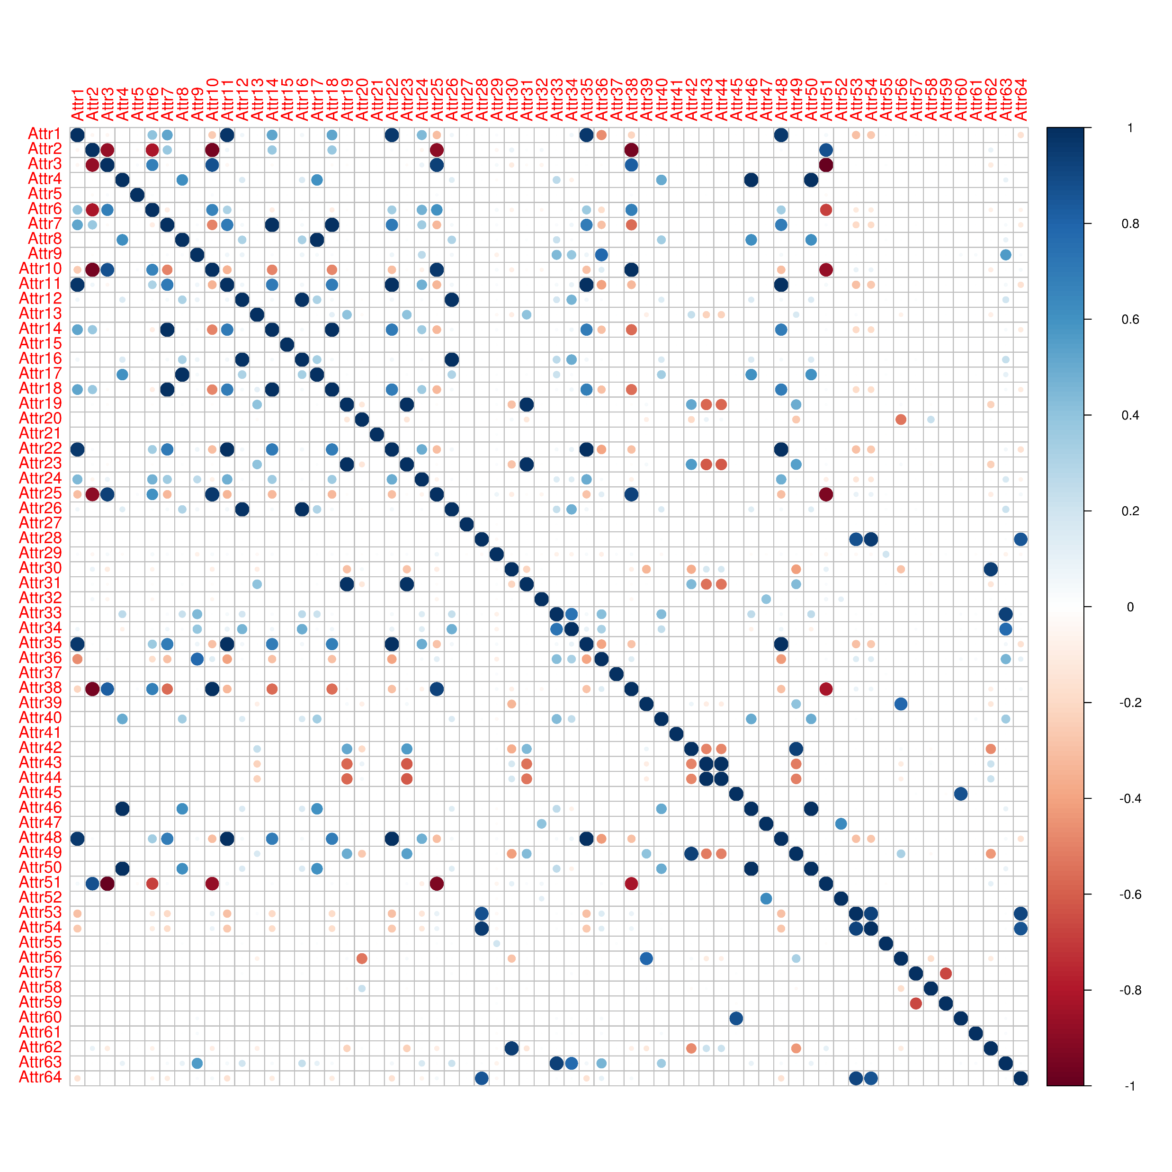
Correlation among features

Slide 5
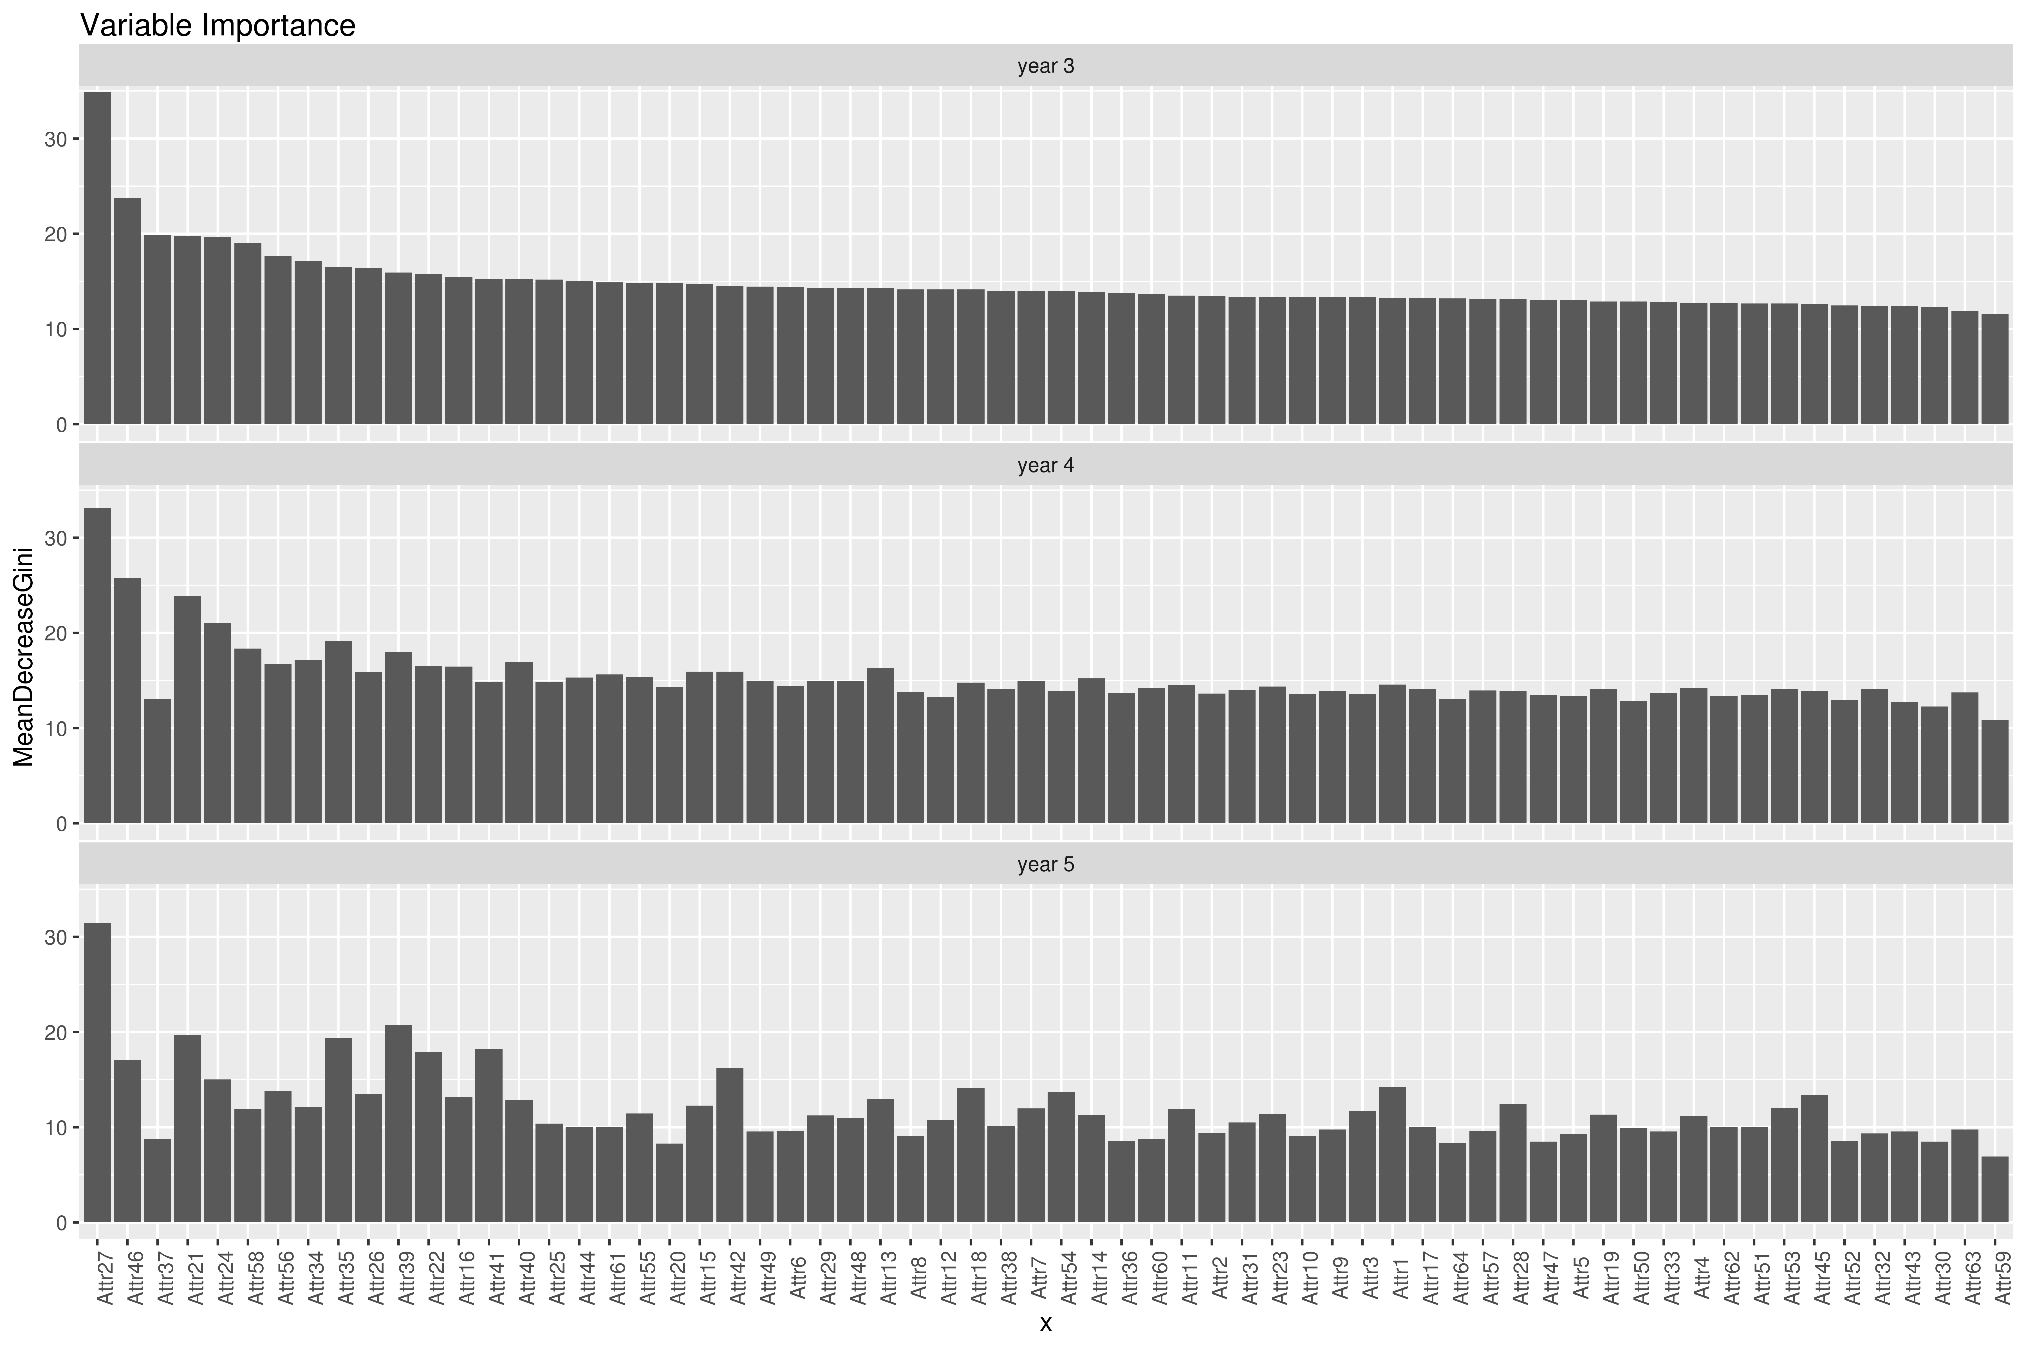
Variable Importance with Random Forest

Slide 6

Thank You!
Bhaumik Pandya
Bhaumik.pandya21@gmail.com

