Slide 1
CYBERPUNK CTF FORENSIC & SECURITY TOOLKIT
Submitted in the partial fulfillment for the award of the degree of
BACHELOR OF ENGINEERING
IN
Computer Science and Engineering
With specialization in
Cyber Security
Name: Pankaj
University Roll No: 24BCY70020
Under the Supervision of:
Mr. Abhishek Thakur
Department of AIT-CSE
DISCOVER . LEARN . EMPOWER

Slide 2
Introduction to Project
• What is Digital Forensics: The process of uncovering and interpreting electronic data.
• Mission: Elevating forensic efficiency through immersive UX.
• Target: CTF players, security professionals, and academic researchers.

Slide 3
Problem Formulation
• CLI Fragmentation: Over 20+ specialized tools operating in isolation.
• Data Leakage: Risks associated with manual handling of sensitive wordlists and extracted data.
• Cognitive Fatigue: Lack of visual hierarchy in standard security terminal outputs.

Slide 4
Objectives of the Work
1. Unified Interface: Centralizing 15+ industry-standard CLI tools.
2. Real-time Feedback: Streaming tool outputs directly to the portal.
3. Persistence: Ensuring an audit trail for every investigation session.
4. Aesthetic Engagement: Using Cyberpunk UI to enhance task focus.

Slide 5
Methodology: Four-Tier Stack
• View: React.js SPA with modular forensic components.
• Middleware: Express server managing file streams and process spawning.
• Engine: Node.js Child Process module for native tool calls.
• Persistence: SQLite database for results and metadata.

Slide 6
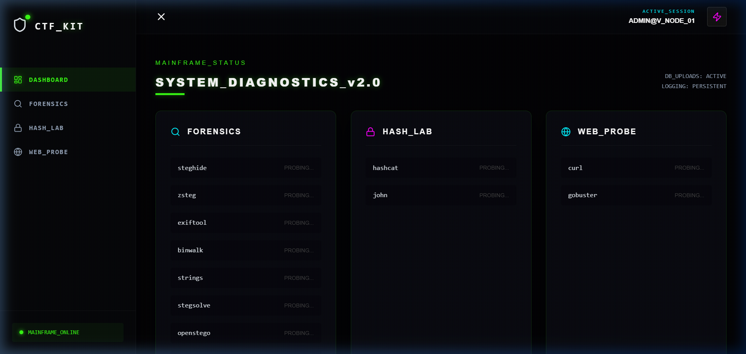
Result: Command Dashboard

Slide 7
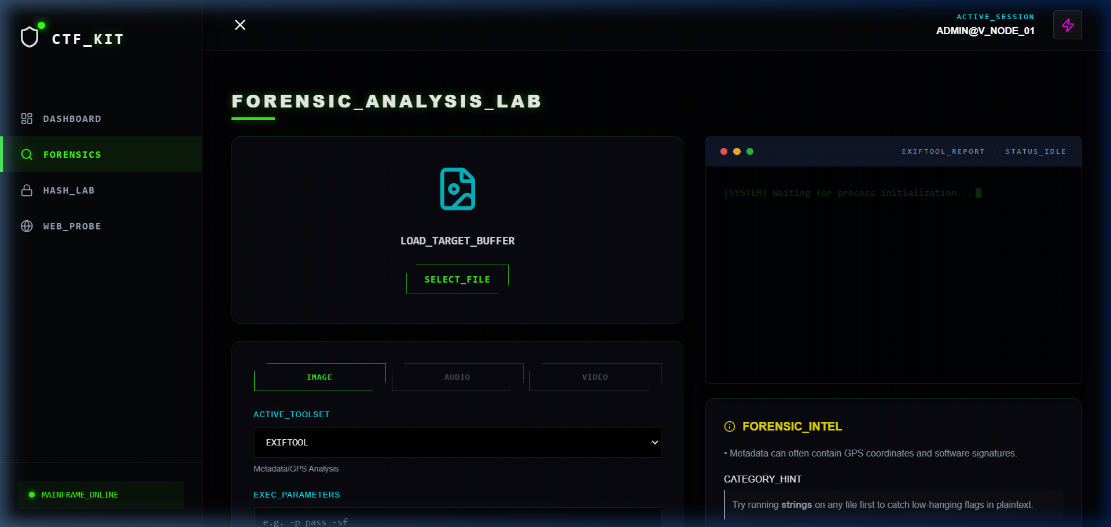
Result: Steganography Lab

Slide 8
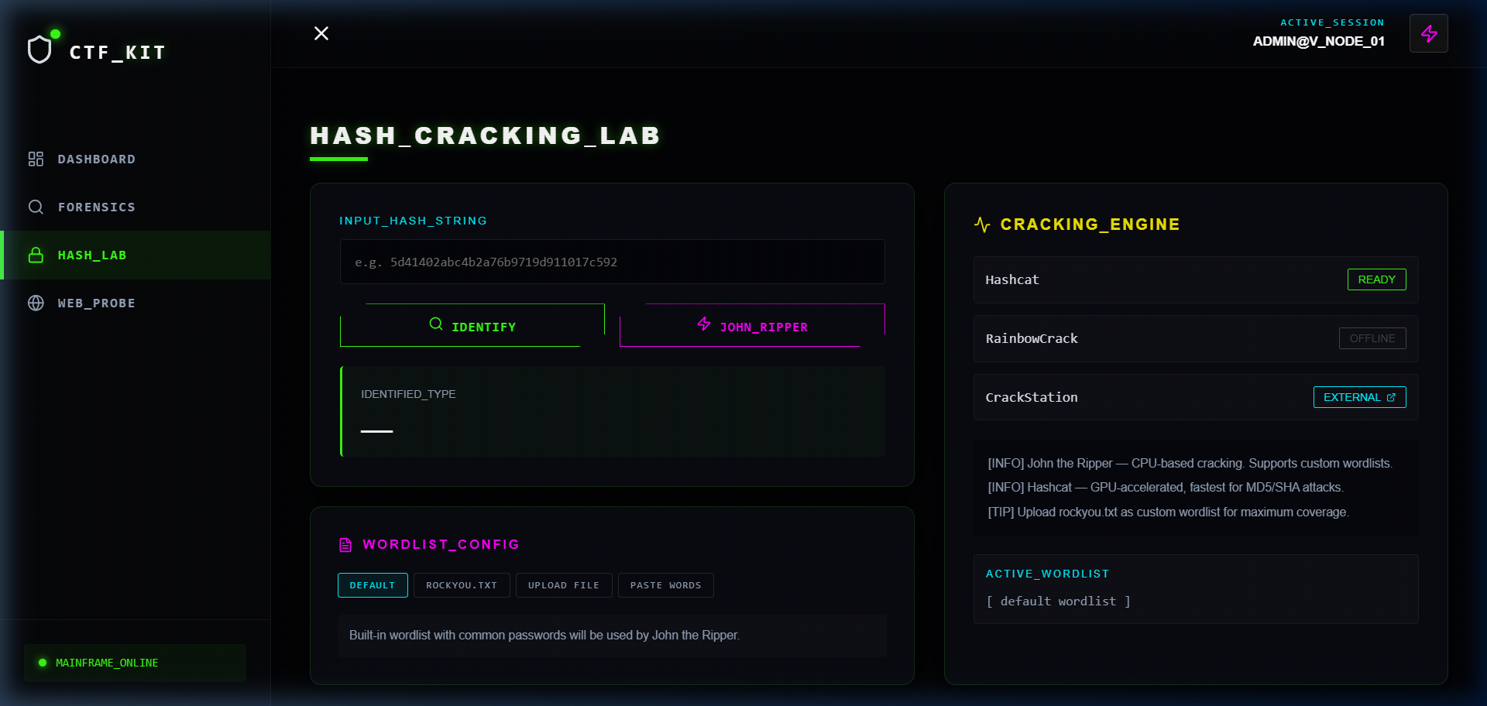
Result: Forensic Cracker

Slide 9
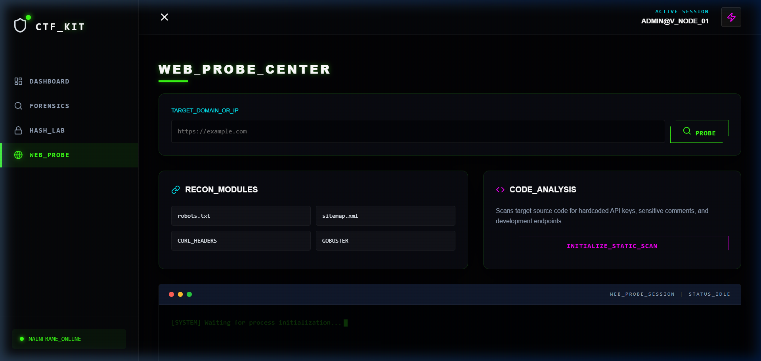
Result: Web Reconnaissance

Slide 10
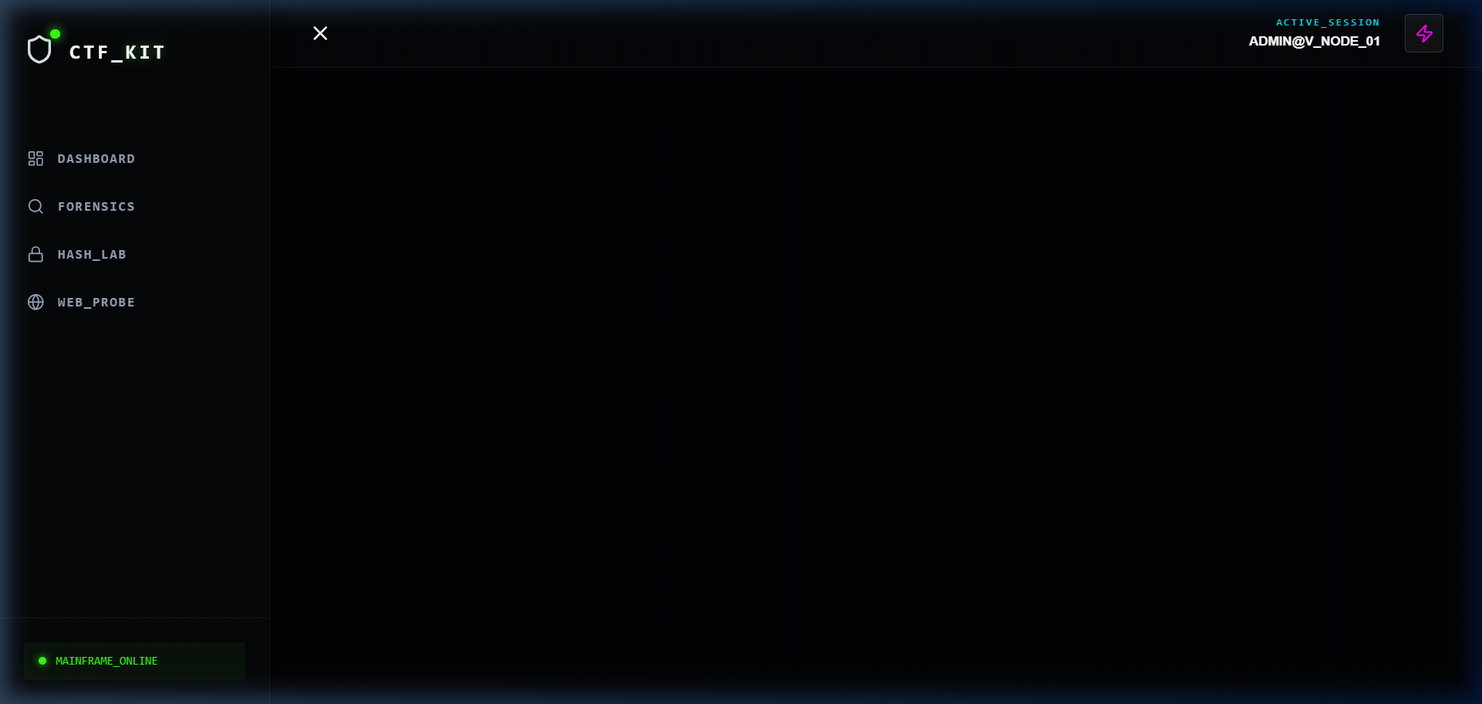
Result: Audit Trail History

Slide 11
Conclusion
• Successfully integrated fragmented CLI tools into a cohesive portal.
• Achieved 100% observability of forensic results via SQLite logging.
• Unified Cyberpunk UI significantly improved user immersion.

Slide 12
Future Scope
• Distributed cracking using Cloud infrastructure.
• Enhanced AI-driven forensics for anomaly detection.
• Real-time multi-agent collaborative investigation rooms.

Slide 13
References
1. Node.js Official Documentation (https://nodejs.org)
2. React.js Design Guidelines (https://react.dev)
3. Hashcat Tool Suite (https://hashcat.net)
4. John the Ripper (https://www.openwall.com/john/)

Slide 14
THANK YOU

