Slide 1
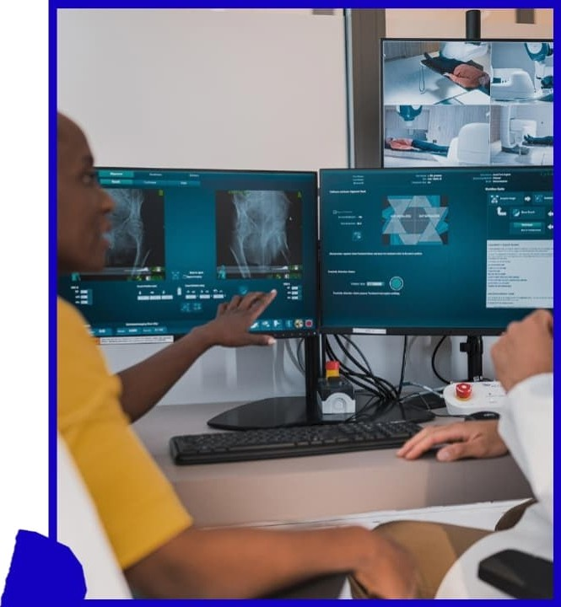

Automated Detection of Knee Osteoarthritis Severity from X-ray Images
MaYank Panoar Saumbh
Mohd. Imaad
2022 S3114 ZO22UCV926 2022UCA94I

Slide 2








Introduction to Knee Dsteoarthritis
Knee osteoarthritis (OA) is a chronic degenerative joint disease characterized by the breakdown of cartilage and underlying bone in the knee joint, resultlng in pain, stiffness, and reduced mobility.
It is one ot the leading causes of disability worldwide (nearly 5•/, translating to 350 million people), especially among the elderly population, significantly impacting the quality of life.
Early and accurate diagnosis of OA sever“ity plays a cr‘iticaI role in managing the disease progression and planning appropriate treatment strategies.
Medical imaging, particularly X-ray imaging, remains me most commonly used diagnostic tool for evaluating knee OA.
Radiographic assessments help determine the sever'ay of OA by analyzing joint space narrowing, osteophyte formation, and other structural changes.
Traditional manual evaluation of knee X-rays by radiologists is time-consuming, subjective, and prone to inter-observer variability, which may lead to inconsistent diagnoses.

Slide 3


.4dxancentcnts in 4I and Deep Lcvning
. Recent.advances in’Al and”DLhave revolutionized’medičalimage analysis:
.CNNs.aÙÎomailčaIIy. exiiact hlèrarćhicaİ features from raw Images.
’ Focus on classVÿÏng knee ÒA severhy..using.deep leamińg archhectures.
@ .’ Fòur models:’ EÎfičientNetB5; DenseNet; İnceptionV3,:and MoLÎlleMï are evatuałed..
. ÉÏtÏcieńtNeiBŚ.offers:parameier efÎiciency and štrong qenera'Iizáfiton.
@ DenșeNeț faclliiates eftectrve:graòIèm’tIow,and feat jure reuse.-.
@ ,’inceptionV 3 provides muiti-scaie feature extraction.:

Slide 4





Integration of a novel ensemble learning technique that effectively combines model outputs to Improve prediction accuracy.
Development and comparative evaluation of multiple deep learning models tailored for knee OA sever”zy classification using X-ray images.
Comprehensive performance analysis using precision, recall, F1-score, and confusion matrices to demonstrate the efficacy of the proposed approach.
Detailed exploration of model training strategies including data preprocessing, augmentation, and class balancing to address challenges inherent in medical image datasets.
Research Gontributioni

Slide 5








Existing Literature on Dsteovthritis Detection
"":L.*.T”D '.".'ORI
The application of artifklalintellfqence(AI) and deep learning(DL) techniques to medical imaging has
significantly advanced the diagnosis and severity classification of knee osteoarthritis (OA).
Early works focused on traditional machine learning algorithms relying on handcrafted features extracted from X-ray images.
These methods often struggled with generalization and required extensive domain expertise.
Kumar et al. demonstrated the use of classical machine Maming techniques for predicting knee OA severity.
Achievlng promising results but constrained by the limitations of feature engineering and dataset scale.
Their work laid the foundation for further adoption of deep learning methods which can automatically learn
discriminatlve features from raw Images.

Slide 6









Transformation of OA Detection Paradigms
The surge in deep convolutionai neural networks (CNNs) has transformed OA detection paradigms.
Johnson et al. implemented a deep learning framework that leveraged CNN architectures to automate OA diagnosis from radiographic Images.
Their study showcased improved accuracy and consistency compared to traditional radlologlst evaluations.
Sadhukhan explored deep CNNs for medical image classification, highlighting model architecture design and training strategies.
Joshi et al. contributed to early detection of OA severity using Al-based analysis of X-ray Images.
Their work involved training deep models capable of identifying subtle panerns associated with in'ziaI stages of cartilage degradation.
Their findings underscored the necessity of robust preprocessing and augmentation techniques to enhance model robustness.

Slide 7








Comprehensive Revieu's and Challenges
Comprehensive reviews summarize the evolution of Al methods for OA detection, comparing traditional machine learning approaches with modern deep learning frameworks.
Deep learning models like DenseNet, EfficientNet, and Incepdon have achieved state-of-the-art performance.
Challenges remain in dataset heterogeneity and model interpretability.
Patil addressed the impact of data augmentation on improving neural network performance in knee OA detection.
Augmentation techniques mitigate overFitting and enhance generalization, especially critical in medical datasets with limited samples.
Recent advancements in AI research illustrate the growing role of artificial intelligence in OA diagnosis.
Jain and Gupta encourage leveraging ensemble techniques to combine multiple models for Improved prediction accuracy.

Slide 8

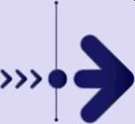
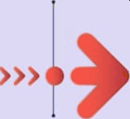
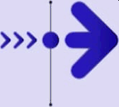


Dataset (li cri icit
Utilization of Knee Osteoarthritis Dataset with Severity from Kaggie
Trainingset: 5,778
images
Test set: 1,656 images
Total of 8,260 images Eategorized by severity levels of osteoarthritis (OA)
Validation set: 826 images

Slide 9

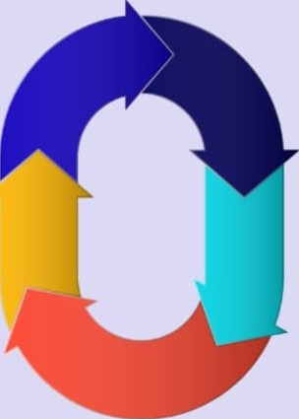

I.lass Distribution and t?ltvactcristics
Class distribution shows five distinct
classes of OA severity
‘Healthy* class contains the highest number of images (2,286)
Data augmentation and class balancing
strategies are necessary
'Severe* class has the fewest images (173)
lmbalanced class distribution presents challenges for model training

Slide 10


Image Preprocessing Techniques
B. Image Characteristics

Slide 11



PreprocessÒg and Data Augmentaäon Methods
iv. pREpRocsssi G AND DATA AUGMENTATION

Slide 12


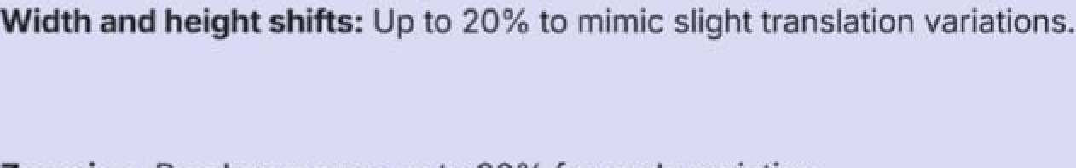

Augmentation Techniques Used
B. Data Augmentation

Slide 13



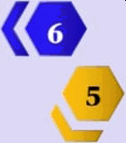
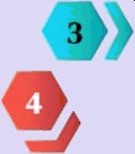

Model Architectwe Overview
V. MODEL ARCHITECTURE AND TRAINING
Efff‹5egtNetB?/, DenseNet, IneeptIorA'3, az›d
Mot›BeNet used ft›cclaadfI‹mlon

Slide 14
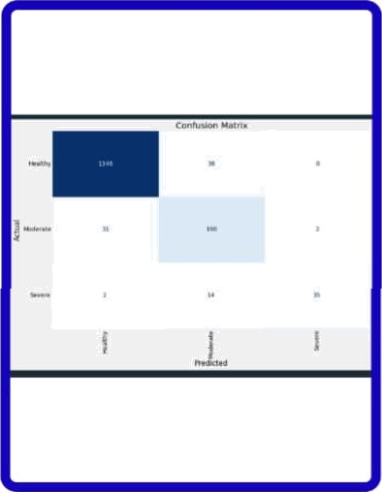







DenseNetl2l Model Detaüs
””DenseNet”” connects each layer to every other layer ìn a feed- forward manner, mitigating vanishing gradients and encouraging feature reuse.
”*Backbone:** DenseNet (pre-trained on ImageNet) ””Input Size:*” 224 x 224 x 3
**Custom Head Layers:”” GMP layer, Batch Normalization, Dense layer
(256 units, ReLU activation) with L1 and L2 regulari ation, Dropout (rate
= 0.4), Softmax output layer
*”Optimizer:** Adamax
”*Loss Function:”” Categorical Crossentropy ””Test Accuracy:”” 94.87%

Slide 15
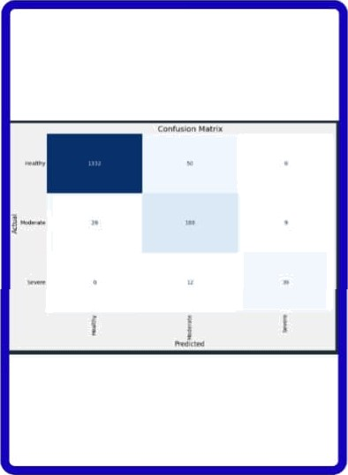








EfficientNetB5 Model Details
EfficientNetB5 is part of the EfficientNet family proposed by Tan and Le, which utilizes a compound scaling technique to uniformly scale depth, width, and resolution.
EfficientNetB5 offers a favorable trade-off between accuracy and computational efficiency.
Backbone: Pre-trained EfficientNetB5 (ImageNet weights) Input Size: 224 x 224 x 3
Architecture Additions: Global Max Pooling (GMP) layer, Fully Connected (Dense) layer with ReLU activation, Batch Normalization layer, 9egufarization: L2 on weights (0.016), LV on bias and activity (0.006), Dropout layer (rate = 0.4), Final Softmax output layer for 5- class classification
Optimizer: Adamax (learning rate = 0.001) Loss Function: Categorical Crossentropy Test Accuracy Achieved: 94.14”7‹

Slide 16
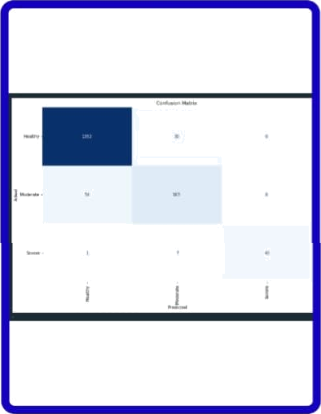










InceptionV3 Model Details
InceptionV3 uses a multi-path architecture that captures features at multiple scales via parallel convolutions of different kernel sizes.
Backbone: lnceptionV3 (pre-trained on ImageNet) Input Size: 224 x 224 x 3
Custom Layers: GMP, Batch Normalization, Dense layer with 256 units, ReLU activation
Regularization: L2 on weights (Iambda=0.016), L1 on bias and activity
(Iambda=0.006)
Dropout (rate = 0.4) Softmax output layer
Optimizer: Adamax (learning rate = 0.001)
Loss Function: Categorical Crossentropy Test Accuracy: 94.08%

Slide 17
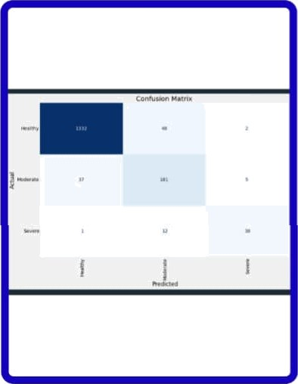







MobileNetV2 Model Detaüs
D. MobîleNetV2 Model
MobileNet is optimized for real-time inference on edge devices.
Backbone: MobileNet (pre-trained on ImageNet) Input Size: 224 x 224 x 3
Architecture Additions: GMP, Dense(256 units) + ReLU, Batch- Normalization (momentum = 0.99, epsilon = 0.001), Regularization: L2 on weights (0.016), L1 on bias and activity (0.006), Dropout (rate = 0.4), Softmax output tayer
Optimizer: Adamax (learning rate = 0.001) Loss Function: Categorical Crossentropy Test Accuracy: 93.65%

Slide 18

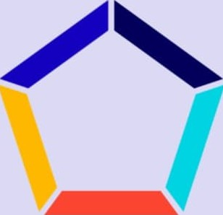

Ensemble Model I.oitstrliction
Architecture Design:
Inputs: Standardized 224 x 224 x 3 image input
Final Prediction: Class with the highest average probability across models
Componems: Fine-tuned versions of: EfficientNetB5, OenseNet121, InceptionV3, MobileNetV2
Ensembling Strategy: P ensemble = 1/4 Z Pi where Pi is the softmax probability
vector from the i-th model.

Slide 19
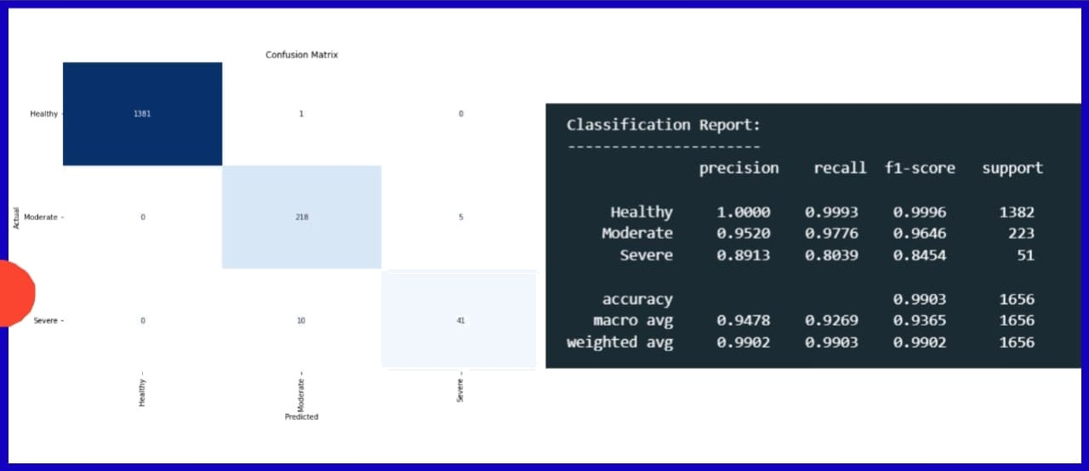
Ensemble Modeì Construction

Slide 20





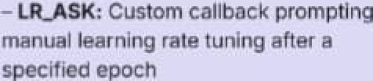





Training Strategy and Results
3łalnțng Ö+astten: 20:epochg
based.an. .validation

Slide 21




To assess the performance of our deep learning models on knee osteoarthr'8is sevent’y classPication, we employed a comprehensive set of evaluation metrics including Accuracy, Precision, Recall, F1-Score, and Confusion Matrix.
These metrics were computed on the test dataset comprising 1,656 images across five severity classes: Healthy, Doubtful, Minimal, Moderate, and Severe.
The ensemble model was further compared agalnst the individual models to quantify improvement in multi-class discrimination performance.
tlvatuation Metrics and Ilesults

Slide 22


Stimmvy of Nlodcl Results

Slide 23








Confusion Matrix Analysis
C. Confusion Matrix: Ensemble Model
The confusion matrix of the enaambtsmoa , which
achieved the highesttestaccuracy of 90.083t.
Diagonal dominance In the matrix indicates •xcaIIent
prediction fidellty across all mentioned classes.
Only te out of 1,858 test images reflect a highly robu6t model.
Heahhy:1381true positlvae, 1faIse positive, 0 false negatives.
Moderate: 0 falcs positives, 218 Due positives, 5
felse negaaves.
Seyere: 0 false positives, 10 false negatives, 41bue

Slide 24

Class-Wise Performance Metrics
Dataset Bias: The dataset Is sourced from a single source (Kaggle), which may not represent global popu
lation diversity.
ImageResolution Constraints: All images were resized to 224x224, potendally omitting fine-grained details. e Relabellng Ambiguity: Relabeling inherently involves some subjectivity, though we followed radiological
guidelines.

Slide 25


Key contributions of tms u'ork
o Extensive preprocessing and augmentation: Enhanced image quality and dataset balance to mitigate class inn balance and overf'ctlng.
0 Model architecture optimization: Fine-tuning of pre trained CNN backbones with tailored classification heads and regularizatlon strategies.
Ensemble learning: Successfully combined complemen tary strengths of multiple arch”aectures through soft voting, resutting in significant performance gains.
Robust evaluation: Utilized multiple metrics (accuracy, precision, recall, F1-score) and confusion matrices to comprehensively assess model reliability and class-wise performance.

Slide 26
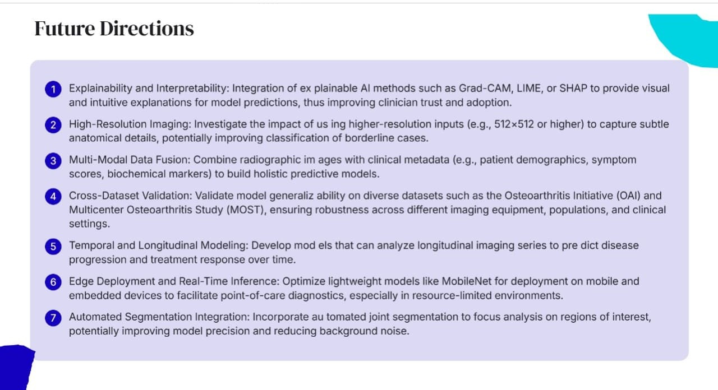

Slide 27


Fin& Thoughts
0 In conclusion, this research underscores the transformative potential of deep learning to revolutlonize knee osteoarthritis diagnosis by providing accurate, fast, and interpretable severity classification. By continuing to address current limitations and exploring advanced modeling and deployment strategies, future systems can better support clinicians, improve patient outcomes, and faciI‘itate large-scale epidemiological studies.

Slide 28


Acknowledgement
We would like to express our sincere gratitude to Dr. Gaurav Singal (Assistant Professor, Department of CSE,
NSUT Delhi) , for their continuou• euldanceand support throughout the project.
Their expert advice and feedback were invaluable in refining the methodology and experimental setup. And peer support whose comments and suggestions during the review process were instrumental in improving the quality of the paper.
We also wish to acknowledge the ongoing efforts of the medical research community and healthcare professionals who continue to work towards improving the diagnosis and treat mem of knee osteoarthritis, which serves as the motivation for this study.

