Slide 1

Data Collection Using Signup form with advanced CSS and JS
BRINDAVAN
INSTITUTE OF TECHNOLOGY & SCIENCE (BITS-KNL)
(Approved by AICTE & Affiliated to JNTUA) NH-7, PEDDATEKUR, KURNOOL,518218
An Industrial Training Review
Submitted By
M. Karthikeya Naidu 21439-CM-035

Slide 2
Contents:
Abstract
Introduction
Role of E-commerce Webpage in present generation
Working of E-commerce webpage
Result
Conclusion

Slide 3
Abstract
This document details the creation of a basic Data-collection website using HTML , CSS and javascript which is aimed at providing a user-friendly interface with an attractive interface for collecting data of a user with a signup form it’s like a google form." The project includes a signup form, login form ,data collection page.
The signup page contain input fields such as name, email, and some other with enhance the visual appeal and usability of the webpage.
It is a responsive website where it fit’s every device . Irrespective of size of display.

Slide 4
Introduction
The rapid growth of the internet has revolutionized the way businesses operate, leading to the rise of online data collection as a crucial tool for understanding customer behavior and preferences. An online signup form enables businesses to gather valuable user data efficiently and securely, operating 24/7, and providing customers with a seamless experience. Creating an effective data collection signup form requires a combination of robust structure and appealing design, which can be achieved using HTML and CSS.
This document introduces the creation of a user-friendly data collection signup form for "DataEase" using HTML for structure and CSS for styling to enhance visual appeal and usability.
The signup form is designed to provide a seamless and intuitive experience for users. It includes a well-organized layout, fields for user information (such as name, email, and contact number), and a submit button for easy data submission. Additionally, the form incorporates validation features to ensure accurate data collection and a confirmation message to inform users of successful submission.

Slide 5
Role of Data-collection Webpage in present generation
In the present generation, online data collection forms play a crucial role by revolutionizing how businesses gather and utilize customer information. They provide the convenience of 24/7 access for users to submit their details, allowing businesses to collect valuable data from anywhere at any time. Data collection forms enable businesses to reach a global audience, breaking geographical barriers and expanding their database.
They also support digital marketing strategies, offering tools for personalized communications, customer engagement, and data analytics. By streamlining the data collection process, these forms enhance overall user experience, drive informed decision-making, and foster a competitive business environment, making them indispensable in today's digital age.
Enables businesses to reach a global audience, supports digital marketing strategies, and drives informed decision-making by streamlining the data collection process and enhancing customer engagement.

Slide 6
Working of E-Commerce Webpage :
User Interface:
Includes fields for personal information (e.g., name, email).
Uses dropdown menus and checkboxes for preferences.
Submit button sends data for processing.
Data Validation:
Ensures accurate and complete data entry.
Provides error messages for corrections.
Automated Confirmations::
Sends confirmation messages upon successful submission.
Notifications on error submition.
Responsive Design::
Works seamlessly on desktops, tablets, and smartphones.
Enhances user experience and accessibility.

Slide 7
Conclusion
Concluding a data collection signup form can depend on various factors including the purpose of the conclusion and the stage of development or operation of the form.
If the data collection initiative itself is concluding, this would involve winding down operations, settling any outstanding data processing tasks, communicating with users about the conclusion, and securely handling or archiving the collected data.
In some cases, a data collection signup form may need to be temporarily closed for maintenance, updates, or other reasons. The conclusion in this case would involve notifying users of the temporary closure and providing an expected reopening date if possible.

Slide 8
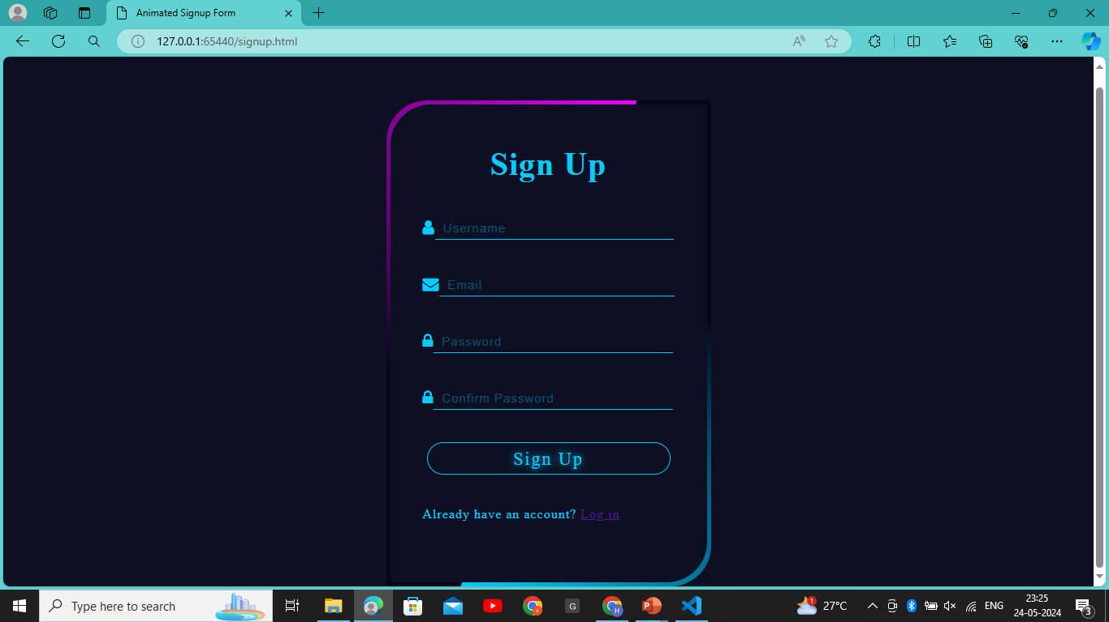
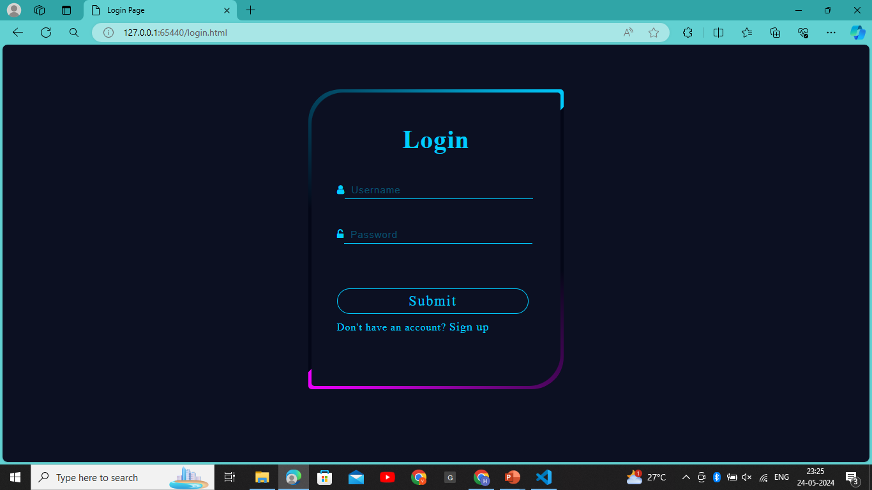
Result

