Slide 1
The Impact of Shipping Connectivity and Deviation Costs on Port Resilience: Empirical Evidence from the Red Sea Crisis
Oral Presentation for
The 5th Annual Conference on Port and Shipping Economic Systems Engineering
The 3rd Conference on Transport and Supply Chain Resilience and Digital Transformation
Zhenyuan PAN¹*, Qiwei SHAN¹
Supervisor: Dr. Yi XIAO (FBM, BNBU)
¹ Faculty of Business and Management (FBM), Beijing Normal–Hong Kong Baptist University (BNBU), Zhuhai, China
* Presenting author: s230001081@mail.uic.edu.cn

Slide 2
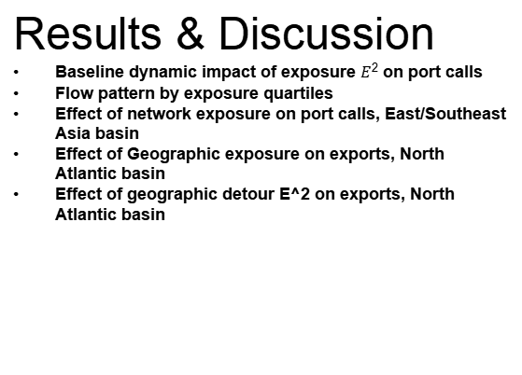
CONTENT
01
Introduction
Red Sea shock: Suez → Cape detours
From detours to exposure— which matters more?
02
Literature Review
Trade Networks
Port Resilience
Red Sea Shock Event
03
Method
Data Sources & Variable Construction
IMF PortWatch | Daily Port Activity & Trade Estimates (Core dataset)
UNCTAD | PLSCI (port-level connectivity)
Ports metadata & Natural Earth
Marine Regions—IHO Sea Areas shapefile
Main regression
Half Life
04
Results & Discussion
Baseline dynamic impact of exposure $E^{2}$ on port calls
Flow pattern by exposure quartiles
Effect of network exposure on port calls, East/Southeast Asia basin
Effect of Geographic exposure on exports, North Atlantic basin
Effect of geographic detour E^2 on exports, North Atlantic basin
05
Conclusion
06
References

Slide 3
1
Introduction
Red Sea shock: Suez → Cape detours
From detours to exposure— which matters more?

Slide 4
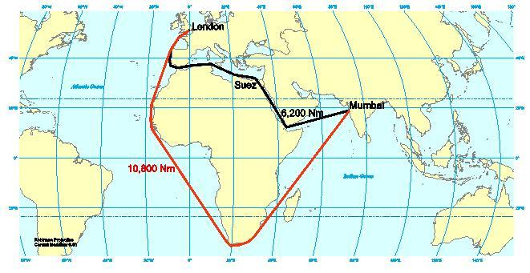


Introduction
Red Sea shock: Suez → Cape detours
Detouring via the Cape (Asia–Europe) typically adds ~10–14 days of transit
Detour cost: Port exposure E
$$E_{geo}$$
Δkm (Suez→Cape)
High E_gro: Asia–Europe trunk; Shanghai–Piraeus
Low E_gro: Trans-Pacific; Shanghai–Los Angeles
$$E_{net}$$
PLSCI (2019–2023)
Figure 1: Mumbai to London – the Suez Canal versus the Cape of Good Hope (Feyrer, 2009)
High E_net: Global/regional hubs; Singapore
Low E_net: Remote ports reliant on transshipment;

Slide 5

Introduction
From detours to exposure— which matters more?
Objective: Identify port resilience; compare two exposure dimensions
Do ports with lower pre-shock connectivity/ exposure suffer larger drops? does connectivity cushion impacts?
RQ1
RQ2
Which explains heterogeneity better: trade/network exposure ($E_{net}$) or geographic detour ($E_{geo}$)?
RQ3
How fast is recovery? Report a port-level half-life metric τᵢ

Slide 6
2
Literature Review
Trade Networks
Port Resilience
Red Sea Shock Event
Research gap and contribution

Slide 7
Literature Review——Trade Networks.
A port-centric syllogism: Shipping matters
Vulnerability and Connectivity of Trade Networks
Ports matter in shipping
Port risk scales up to macro risk
Why Study “Vulnerability × Connectivity”?
Framework | Keywords | Papers
Global trade's dependence on maritime networks | Maritime trade; network effects; transport efficiency vs. fragility; import-basket dependence | (Xu et al., 2020)
 |  | (Wu et al., 2024)
 |  | (Korniyenko et al., 2017)
Structural vulnerability of shipping networks | Small-world/scale-free structure; core–hub concentration; node-degree centralization; connectivity & robustness | (Xu et al., 2020)
 |  | (Wang et al., 2016)
 |  | (Wang et al., 2022)
Systemic risk amplification via ports | Port disruptions; marine chokepoints; rerouting costs; supply-chain interruption; macro exposure | (Achurra-Gonzalez et al., 2019)
 |  | (Pratson, 2023)
 |  | (Verschuur & Hall, 2024)
Empirical & simulation evidence | Static/dynamic resilience; cascading failures; disruption simulations; recovery assessment; review synthesis | (Bai et al., 2023)
 |  | (Korniyenko et al., 2017)
 |  | (Faure & Ducruet, 2025)
Importance & Dependence: Global trade relies heavily on maritime networks, which are both a source of efficiency and a conduit for shock propagation (Bernhofen et al., 2016; Feyrer, 2021).
Chokepoint risk: Highly connected systems typically raise efficiency, but when critical chokepoints are disrupted, concentration at those nodes amplifies shock transmission and slows recovery (Carvalho et al., 2021；Acemoglu et al, 2012).
Sensitivity: Complex-network and simulation studies show that the global container-shipping network is highly sensitive to several maritime chokepoints (Malacca, Suez, Panama) (Verschuur et al., 2022).

Slide 8
Literature Review——Port Resilience
Define resilience (APRR)
Importance in ports (time-as-cost; TTR)
Port Resilience: Concept, Importance, and Systemic Risk
System-critical nodes & exposure
Definition (APRR), time as cost, critical ports, spillovers
Weak resilience → network amplification → macro losses
Concept & mechanism: Port resilience = ability to anticipate, prepare, respond, and recover while maintaining core functions (Lau et al., 2024).
Importance: Time is trade cost: daily delays cut trade; faster recovery curbs losses (Djankov et al., 2010; Hummels & Schaur, 2013; Feyrer, 2021).
Risk profiling: Coupled port–supply-chain models reveal system-critical ports; outages spill across regions; scenarios quantify at-risk trade (Verschuur et al., 2022; Verschuur et al., 2023).
Cost of weak resilience: Local port shocks propagate and amplify through production networks, generating macro losses (Carvalho et al., 2021; Acemoglu et al., 2012).
Framework | Keywords | Papers
Port resilience: definition & mechanisms | APRR; multi-dimensional; governance & digitalization | (Tsoulfas, 2025); (Gharehgozli et al., 2017); (John et al., 2016)
Why resilience matters for trade | costs; time; trade elasticity | (Clark et al., 2004); (Blonigen & Wilson, 2008)
Risk profiling & systemic nodes | critical ports/sea-lanes; targeted vs. random failure; disruption simulation | (Verschuur et al., 2022); (Wu et al., 2018); (He et al., 2022)
Consequences of weak resilience | network amplification; multi-hazard risk; economic losses & mitigation | (Rose et al., 2018); (Verschuur et al., 2023); (Zhang & Lam, 2015)

Slide 9
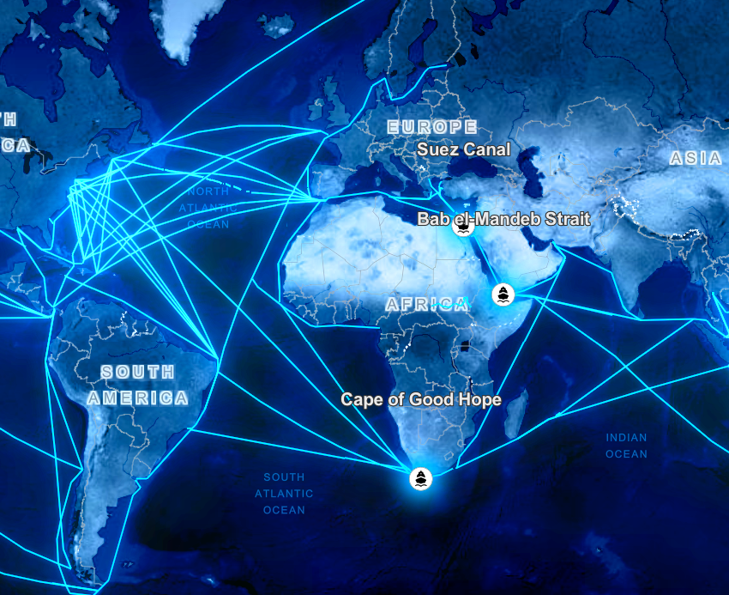
Literature Review——Red Sea Shock Event
1. Event profile
2. Rerouting Costs & rates.
In late-2023, Houthi attacks (after the 19 Nov seizure of Galaxy Leader) led major liners to suspend Red Sea/Suez routes; a US-led escort began on 18 Dec, but risk still triggered large-scale rerouting ((U.S. Department of Defense, 2023; A. P. Moller–Maersk, 2023; United Nations Security Council, 2024).).
Ships detoured via the Cape of Good Hope, adding roughly 10–14 days; Suez-routed trade fell by about half (Jan–Feb 2024), Bab-el-Mandeb transits dropped ~70% by end-Q1, while Cape oil/product flows rose ~50% vs 2023 averages.
Longer routes and higher security risk increased sailing time, insurance, and freight rates; regional shipping activity declined.
Figure 2: Esri, Vantor, Earthstar Geographics, and the GIS User Community | Esri, TomTom, FAO, NOAA, USGS
Source: International Monetary Fund (2024).

Slide 10
Literature Review——Red Sea Shock Event
1. Event profile
1. (Dunn & Leibovici, 2024): Houthi attacks in the Red Sea caused a ~70% drop in Bab-el-Mandeb/Suez traffic. This drove global shipping costs to more than double in a few months. global port-export volumes fell over 7% year-on-year by early Feb 2024.
2. (Merk, 2024): The Red Sea–Suez route normally carries ~14% of global trade (30% of container trade) Transit via the Cape adds ~10–14 days and about $1 million in fuel cost per Asia–Europe voyage
3. (Notteboom et al., 2024) Early impacts included vessel re-routing and blanked sailings, shifts in major shipping networks, and sharp increases in insurance and freight rates. full impacts will only be clear once stability returns
4. (Kamali et al., 2024): Concurrently, port call activity fell by 5–7% in regions like sub-Saharan Africa, Europe, and the Middle East.
5. Supply Chain Resilience and Policy (2024): Inventory-rich firms managed to cushion short-term shocks, and global supply chains absorbed ~2 weeks of extra transit by Spring 2024 (clearing backlogs within two months) according to McKinsey

Slide 11
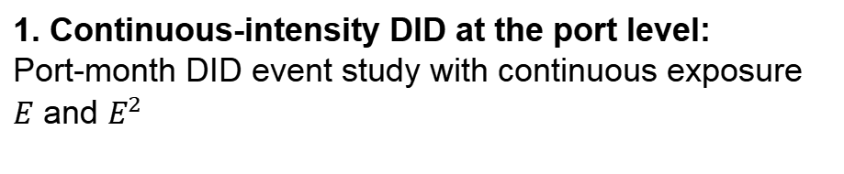
Literature Review--Identification design
Contribution:
1. Continuous-intensity DID at the port level:
Port-month DID event study with continuous exposure $E$ and $E^{2}$
Actionability & portability
Literature Review
Geopolitical setting
Binary / Descriptive shock designs
(Kamali et al., 2024); (Dunn & Leibovici, 2024); (Wang, Fang, Yu, Hu, & Gong, 2024)
1. Event profile
Resilience metrics
Quasi-experimental distance shocks
(Feyrer, 2021); (Hugot & Umana Dajud, 2016)
Exposure measurement
Macro VAR / GE simulations
(Attinasi et al., 2024); (Carrière-Swallow et al., 2022); (Pratson, 2023); (González & Costa de Arguibel, 2025); (Hamano & Vermeulen, 2020)
Identification design

Slide 12
Literature Review--Exposure measurement
Contribution:
1. Composite exposure index E(network + geography)
2. Non-linear exposure–response (thresholds)
3. Misclassification under single-indicator specs
Actionability & portability
Geopolitical setting
Literature Review
1. Event profile
Resilience metrics
Pure distance-based exposure
(Feyrer, 2021)
Exposure measurement
Single connectivity indices (LSCI / PLSCI)
(Xu et al., 2020); (Verschuur et al., 2022); (UNCTAD, 2023, 2024); (Wang, Dou, & Haralambides, 2022)
Identification design
Route-share proxies (“share through Suez”)
(World Bank, 2024);

Slide 13
Literature Review--Resilience metrics
Contribution:
1. Dynamic path-based resilience metrics (Peak, Time-to-Recovery)
2. Standardised, comparable output metrics (z-imp, etc.)
Actionability & portability
Geopolitical setting
Literature Review
1. Event profile
Resilience metrics
Static resilience scores / capability indices
(Bai et al., 2023); (Asariotis et al., 2021);
(Zhang et al., 2023);
Flow-based drops (throughput, calls, trade)
(Wang et al., 2024); (Bai et al., 2022); (UNCTAD, 2023, 2024);
Exposure measurement
Price- / cost-based indicators
(Mechai & Wicaksono, 2024); (Bai et al., 2024);
Identification design

Slide 14
Literature Review--Geopolitical setting
Contribution:
1. Hazard-agnostic port resilience framework
2. Embedding ports into great-power competition & chokepoint politics
3. Cross-region / bloc differences in resilience
Actionability & portability
Geopolitical setting
Literature Review
1. Event profile
Natural hazards & climate-related port disruptions
(Verschuur et al., 2020); (Verschuur, 2023); (González, 2025)
Resilience metrics
Pandemic / macro shocks to ports and shipping
Wu et al., 2024); (Faure, 2025); (UNCTAD, 2023, 2024); (Wang, Dou, & Haralambides, 2022)
Exposure measurement
Identification design
Red Sea as “supply chain shock”
(Kamali et al., 2024); (Wang et al., 2024)

Slide 15
Literature Review--Actionability & portability
Contribution:
1. Reproducible data-to-figure workflow (“toolkit”)
2. Portable scenario & early-warning framework
3. Dashboard-style metrics for port managers
Actionability & portability
1. Event profile
Geopolitical setting
Literature Review
Qualitative policy checklists
(UNCTAD, 2024); (World Bank, 2025);
Resilience metrics
Exposure measurement
Model-based scenarios locked in papers
(PortWatch RAP、WB Data Lab notebooks)
Identification design

Slide 16
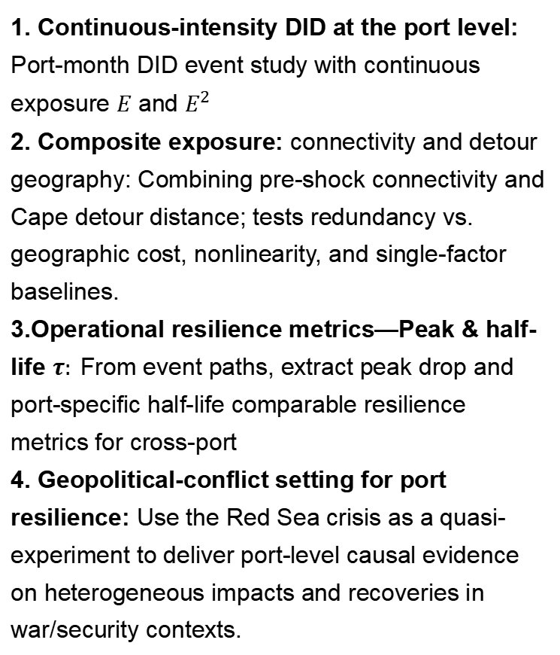
Literature Review——Conculsion: Research Gap and Contribution
Research Gap
Contribution
1. Identification design: mostly use binary DID, case studies, or descriptive event studies;
2. Exposure measurement: Typically isolates either distance or connectivity; few test nonlinearity, or quantify misclassification under single-indicator specs.
3. Resilience metrics: Existing scorecards/capability indices are static ; we lack output-based, comparable measures of realized resilience paths (e.g., peak loss, time-to-recovery).
4. Geopolitical setting: Port-resilience studies skew toward natural hazards/macroeconomic shocks;
5. Actionability & portability: lack of reusable resilience measurement and scenario simulation/early warning tools.
1. Continuous-intensity DID at the port level: Port-month DID event study with continuous exposure $E$ and $E^{2}$
2. Composite exposure: connectivity and detour geography: Combining pre-shock connectivity and Cape detour distance; tests redundancy vs. geographic cost, nonlinearity, and single-factor baselines.
3.Operational resilience metrics—Peak & half-life $τ:$From event paths, extract peak drop and port-specific half-life comparable resilience metrics for cross-port
4. Geopolitical-conflict setting for port resilience: Use the Red Sea crisis as a quasi-experiment to deliver port-level causal evidence on heterogeneous impacts and recoveries in war/security contexts.

Slide 17
3
Method
Data Sources & Variable Construction
IMF PortWatch | Daily Port Activity & Trade Estimates (Core dataset)
UNCTAD | PLSCI (port-level connectivity)
Ports metadata & Natural Earth
Marine Regions—IHO Sea Areas shapefile
Main regression
Half Life

Slide 18
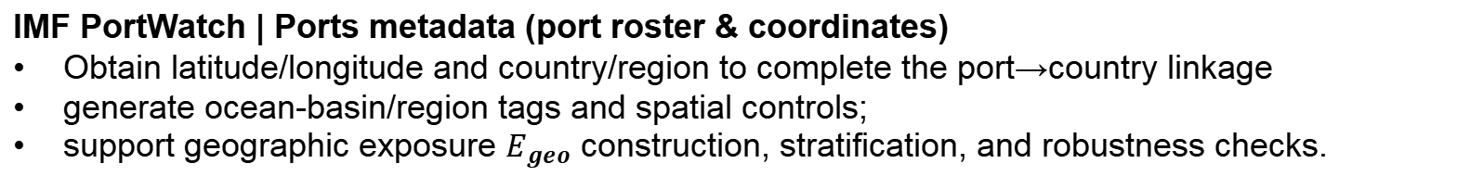
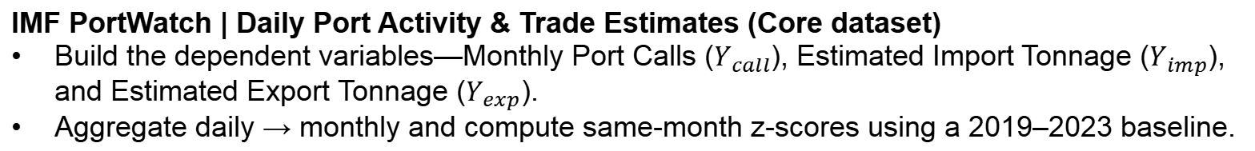
Data Sources & Variable Construction
Data & Purpose (Brief)
IMF PortWatch | Daily Port Activity & Trade Estimates (Core dataset)
Build the dependent variables—Monthly Port Calls ($Y_{call}$), Estimated Import Tonnage ($Y_{imp}$), and Estimated Export Tonnage ($Y_{exp}$).
Aggregate daily → monthly and compute same-month z-scores using a 2019–2023 baseline.
IMF PortWatch | Ports metadata (port roster & coordinates)
Obtain latitude/longitude and country/region to complete the port→country linkage
generate ocean-basin/region tags and spatial controls;
support geographic exposure $E_{geo}$ construction, stratification, and robustness checks.
UNCTAD | PLSCI (port-level connectivity)
Compute and standardize to construct network connectivity exposure E_net
Natural Earth (coastlines/boundaries/representative points)
generate ocean-basin/region tags

Slide 19
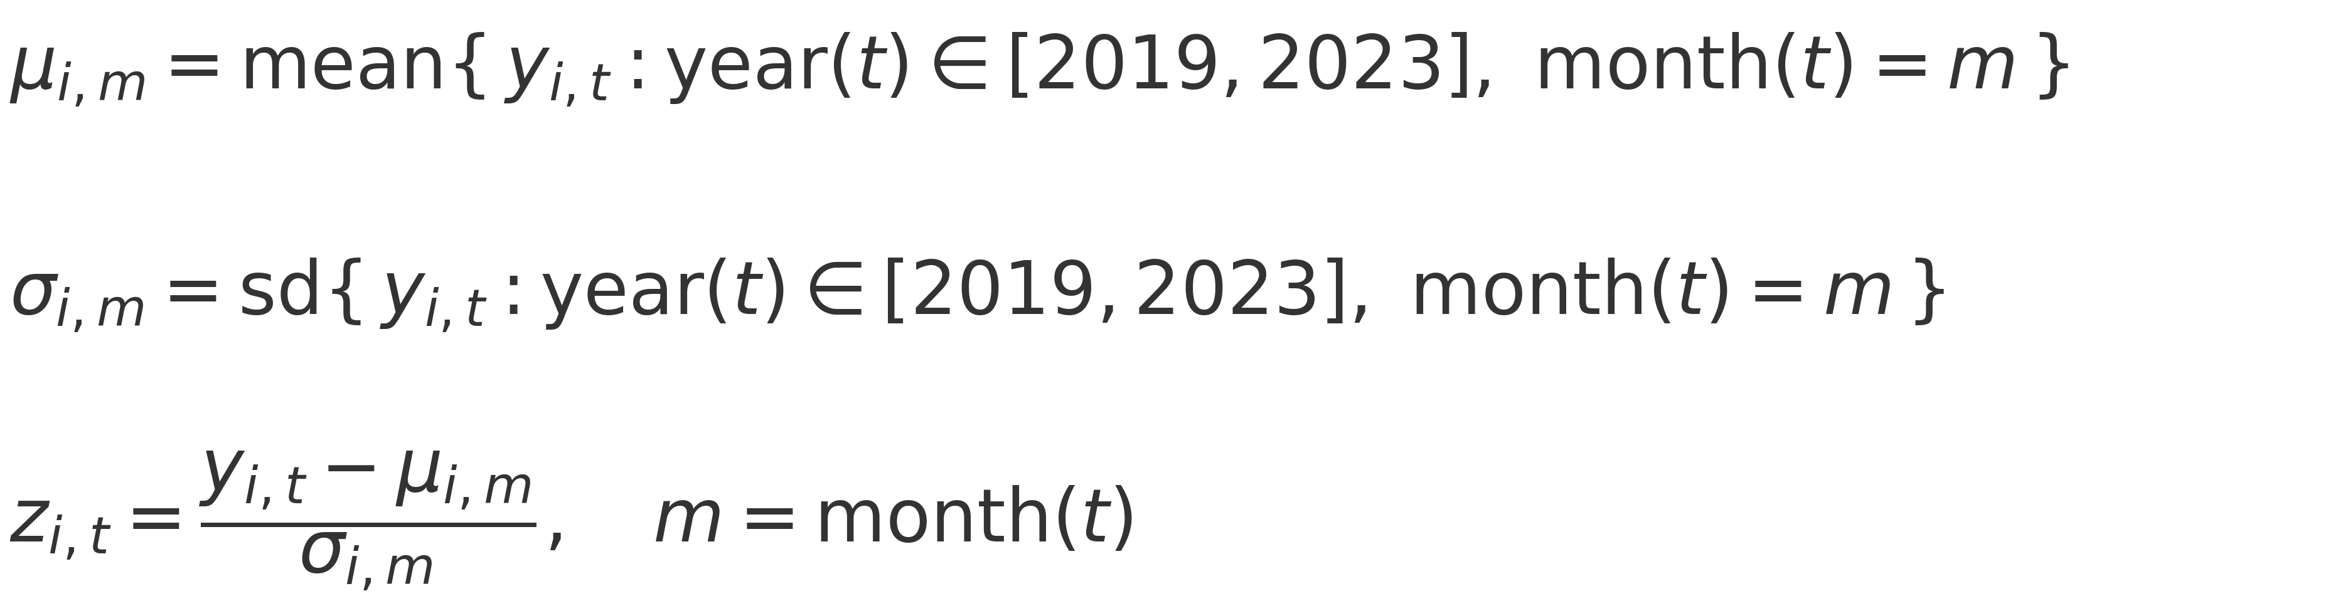
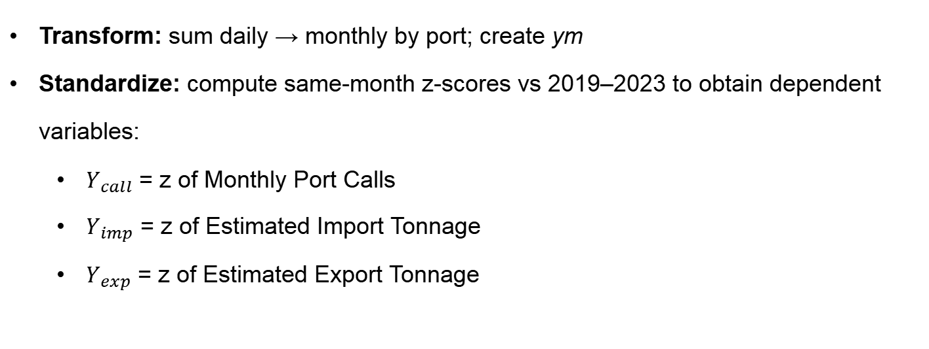
Data Sources & Variable Construction
IMF PortWatch | Daily Port Activity & Trade Estimates (Core dataset)
IMF PortWatch | Daily Port Activity & Trade Estimates (Core dataset)
Build the dependent variables—Monthly Port Calls ($Y_{call}$), Estimated Import Tonnage ($Y_{imp}$), and Estimated Export Tonnage ($Y_{exp}$).
Aggregate daily → monthly and compute same-month z-scores using a 2019–2023 baseline.
Transform: sum daily → monthly by port; create ym
Standardize: compute same-month z-scores vs 2019–2023 to obtain dependent variables:
  $Y_{call}$ = z of Monthly Port Calls
  $Y_{imp}$ = z of Estimated Import Tonnage
  $Y_{exp}$ = z of Estimated Export Tonnage

Slide 20
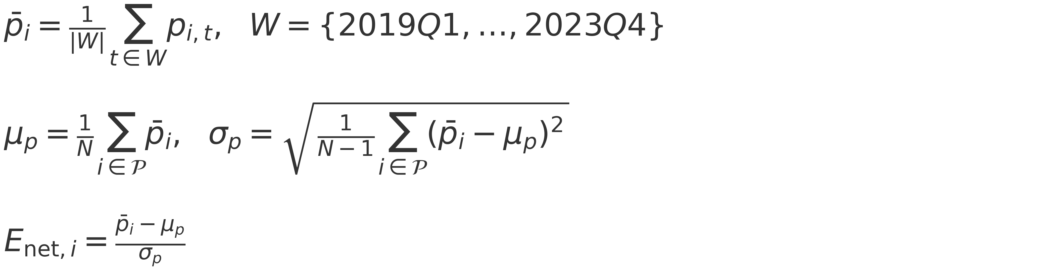
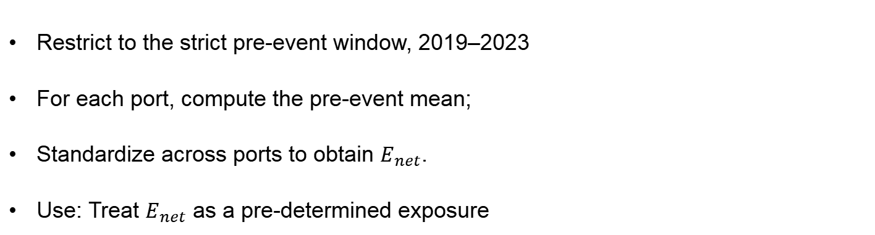
Data Sources & Variable Construction
UNCTAD | PLSCI (port-level connectivity)
UNCTAD | PLSCI (port-level connectivity)
Compute and standardize to construct network connectivity exposure $E_{net}$
Network Exposure
This is a port-level, quarterly index (0–100) that measures each port’s liner-shipping connectivity—its embeddedness in global mainlines.
Restrict to the strict pre-event window, 2019–2023
For each port, compute the pre-event mean;
Standardize across ports to obtain $E_{net}$.
Use: Treat $E_{net}$ as a pre-determined exposure

Slide 21
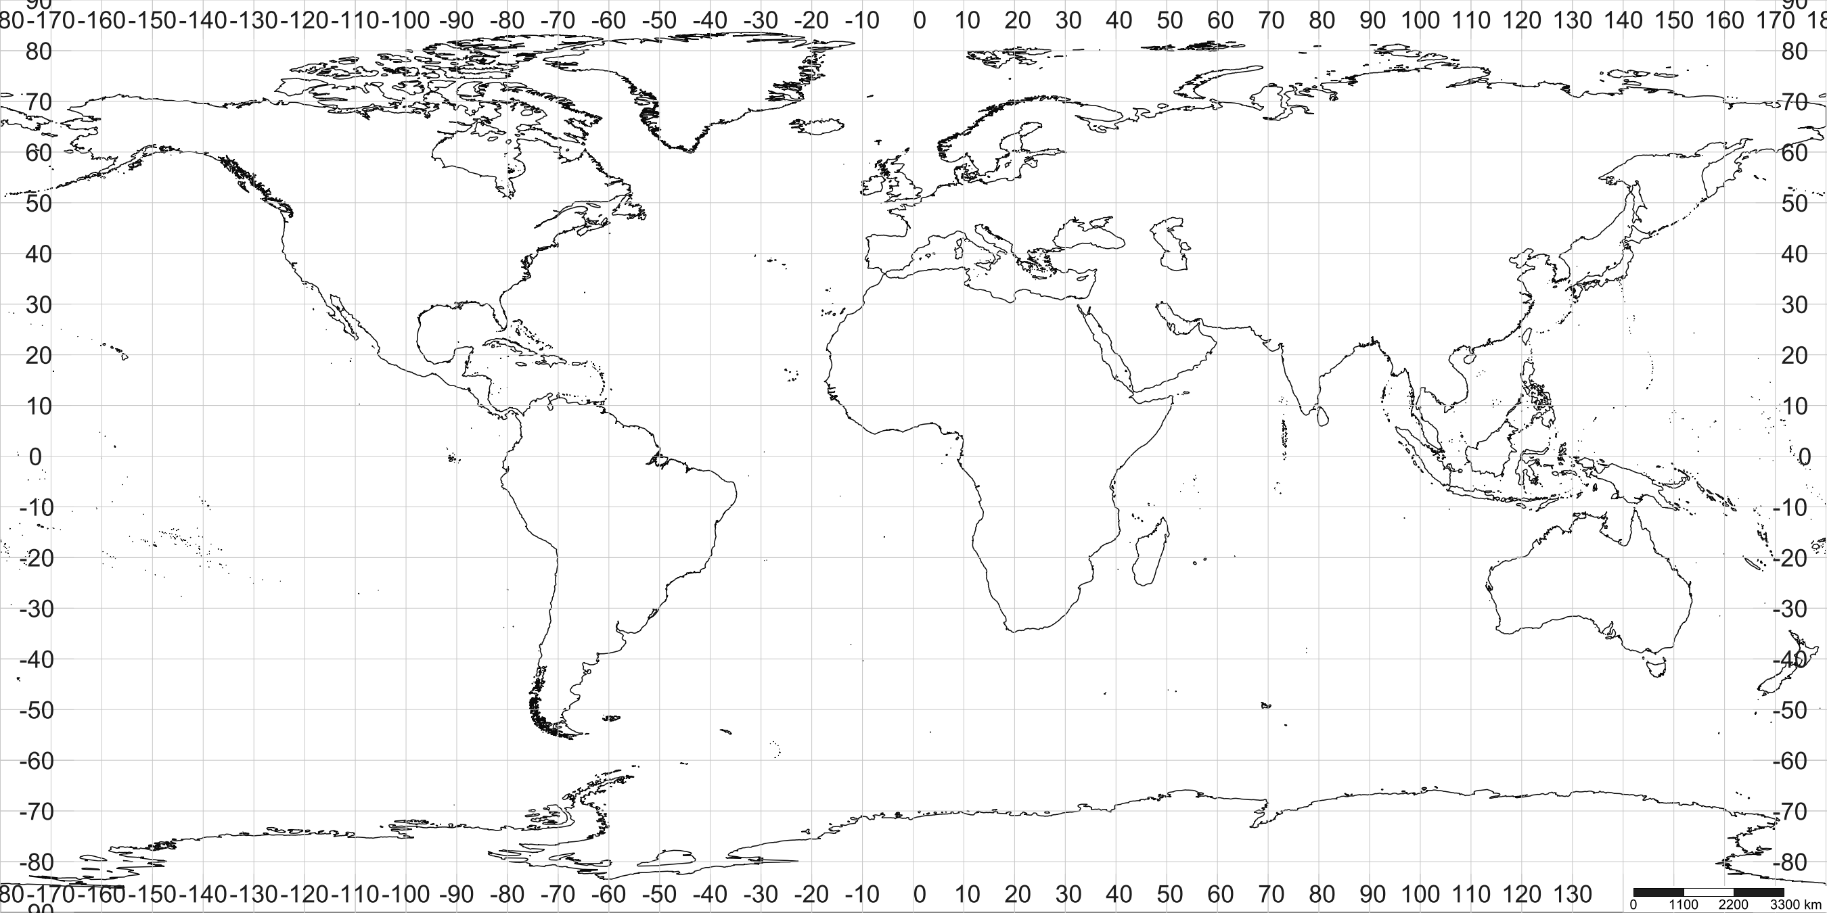

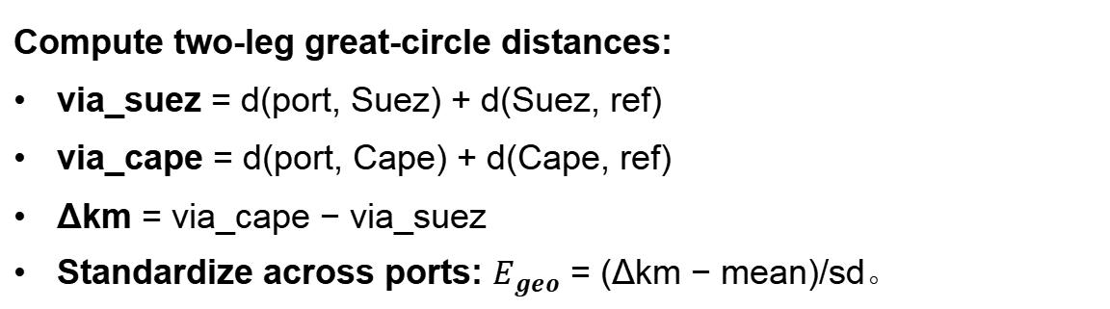
Data Sources & Variable Construction
Ports metadata & Natural Earth
IMF PortWatch | Ports metadata (port roster & coordinates)
Natural Earth (coastlines/boundaries/representative points)
Geography Exposure
d(Suez, ref)
Data from portwatch_ports:
Suez lat = 30.003，lon = 32.580
Cape lat = −34.356，lon = 18.474
ref point (European/Mediterranean)
lat = 36.818，lon = 10.165
R
d(port, Suez)
d(Cape, ref)
S
P
d(port, Cape)
Compute two-leg great-circle distances:
via_suez = d(port, Suez) + d(Suez, ref)
via_cape = d(port, Cape) + d(Cape, ref)
Δkm = via_cape − via_suez
Standardize across ports: $E_{geo}$ = (Δkm − mean)/sd。
c
Figure 3. Geographic deviation for port i: $∆{km}_{i}=d(P, C)+d(C, R)−\left[d(P, S)+d(S, R)\right]$

Slide 22
Data Sources & Variable Construction
Marine Regions—IHO Sea Areas shapefile
Natural Earth (coastlines/boundaries/representative points)
Marine Regions—IHO Sea Areas shapefile
It is a dataset containing the boundaries of the world’s oceans and seas, with polygons representing various seas and basins according to the IHO S-23 standard.
Content: The dataset contains the boundary data for each sea
Point-in-Polygon Matching: We used the geoinpoly command to match the latitude and longitude of each port to the sea polygons, determining which basin each port belongs to.
Standardization and Quality Control: After matching, I created a mapping of each port to its corresponding basin, handling unmatched ports with a fallback method (such as using the nearest basin).

Slide 23

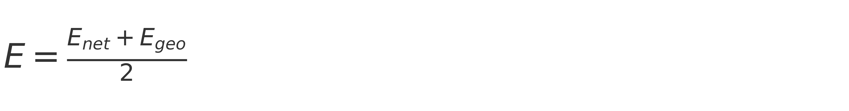
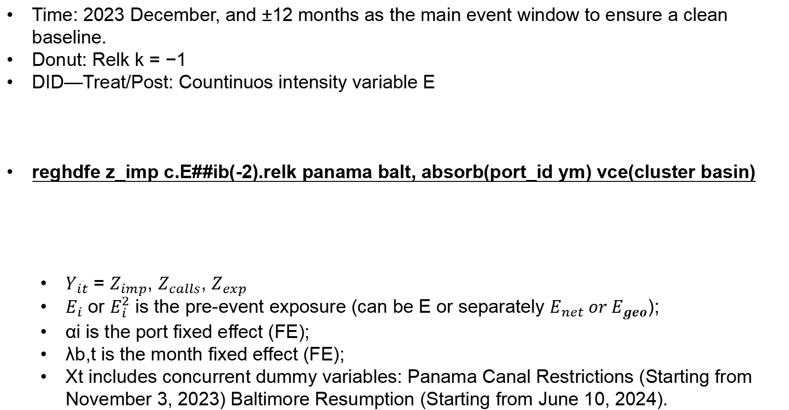
Data Sources & Variable Construction
Main regression
Time: 2023 December, and ±12 months as the main event window to ensure a clean baseline.
Donut: Relk k = −1
DID—Treat/Post: Countinuos intensity variable E
reghdfe z_imp c.E##ib(-2).relk panama balt, absorb(port_id ym) vce(cluster basin)
  $Y_{it}$ = $Z_{imp}$, $Z_{calls}$, $Z_{exp}$
  $E_{i}$ or $E_{i}^{2}$ is the pre-event exposure (can be E or separately $E_{net} or E_{geo}$);
  αi is the port fixed effect (FE);
  λb,t is the month fixed effect (FE);
  Xt includes concurrent dummy variables: Panama Canal Restrictions (Starting from November 3, 2023) Baltimore Resumption (Starting from June 10, 2024).

Slide 24
Data Sources & Variable Construction
Half Life
Convert the “path” into the Peak and Half-Life (HL) for each port.
1.relk_pos#c.E | -0.045
2.relk_pos#c.E | -0.019
3.relk_pos#c.E | -0.164***
4.relk_pos#c.E | -0.055
5.relk_pos#c.E | -0.031
6.relk_pos#c.E | -0.007
7.relk_pos#c.E | -0.093
8.relk_pos#c.E | -0.103
9.relk_pos#c.E | -0.06
10.relk_pos#c.E | -0.113*
12.relk_pos#c.E | -0.122*
13.relk_pos#c.E | -0.144*
14.relk_pos#c.E | -0.055
15.relk_pos#c.E | -0.172
16.relk_pos#c.E | -0.076
17.relk_pos#c.E | -0.210***
18.relk_pos#c.E | -0.159
19.relk_pos#c.E | -0.169**
20.relk_pos#c.E | -0.341***
21.relk_pos#c.E | -0.216**
22.relk_pos#c.E | -0.287***
23.relk_pos#c.E | -0.352***
24.relk_pos#c.E | -0.169*
βkis the “global slope per unit exposure.
To compare how much and how long each port “drops and recovers,” multiply the path coefficient by that port’s E to obtain the predicted path for port i:
Yᵢₖ = Eᵢ ⋅ βₖ
Then obtain each port i’s βₖ for every k.
  Peak: the minimum pred_eff of each port.
  HL: find the earliest k such that pred_eff ≥ Peak / 2.
Table 1: coeffcient of E on calls every month

Slide 25
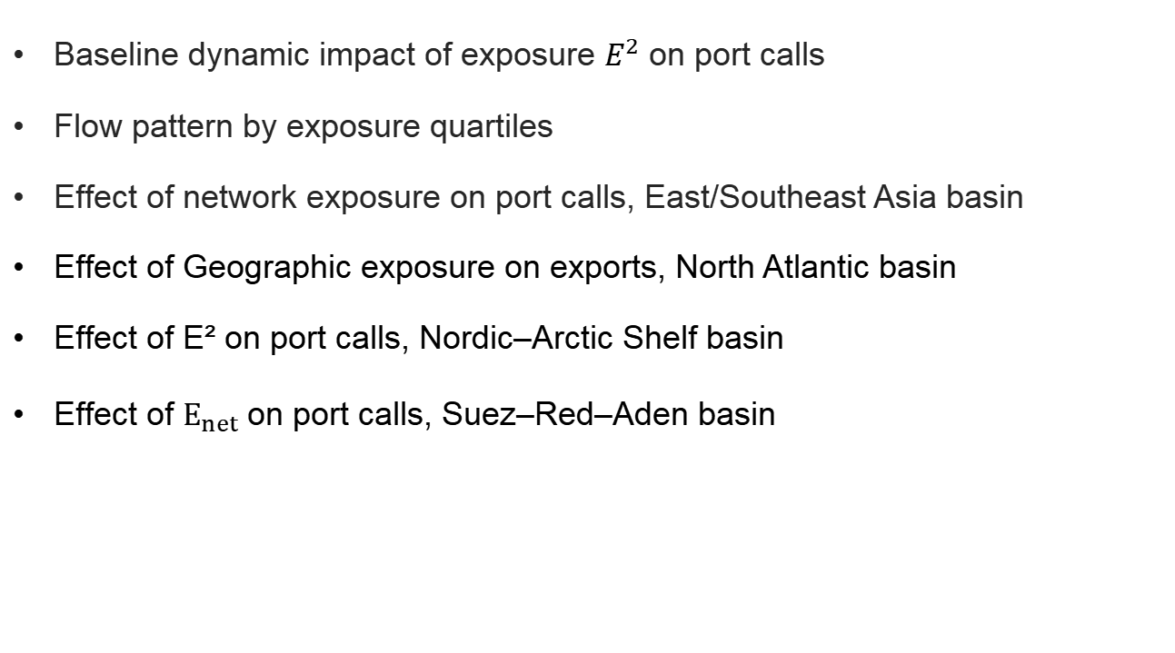
4
Result and Analysis
Baseline dynamic impact of exposure $E^{2}$ on port calls
Flow pattern by exposure quartiles
Effect of network exposure on port calls, East/Southeast Asia basin
Effect of Geographic exposure on exports, North Atlantic basin
Effect of E² on port calls, Nordic–Arctic Shelf basin
Effect of $E_{net}$on port calls, Suez–Red–Aden basin

Slide 26
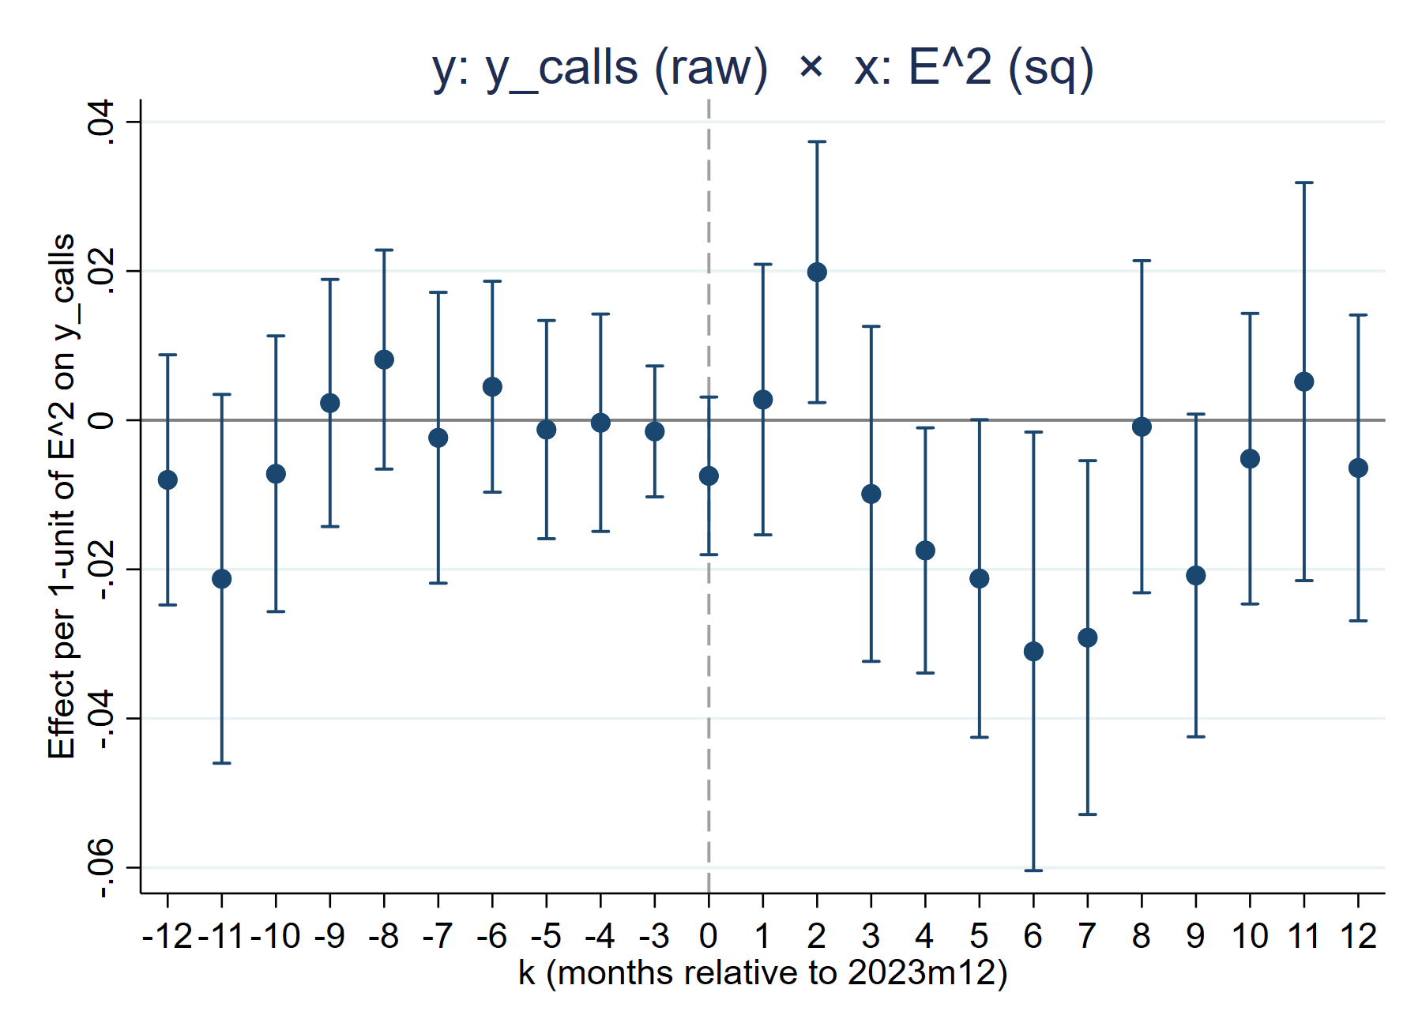
Result and Analysis
Baseline dynamic impact of exposure $E^{2}$ on port calls
Outcome: standardized port-level call index (2019–2023 baseline)
Pre-event: no differential trends across exposure levels
Short run: small positive effects – front-loading and schedule compression.
→ front-loading and temporary schedule compression when routes are first reshuffled
Medium run: sizeable negative effects – longer voyages and tighter fleet capacity.
→ longer Cape detours lengthen round-trips and shrink effective monthly fleet capacity at highly exposed ports
Recovery: partial unwinding as routes and schedules re-optimize.
→ gradual re-optimization of routes and rotations, but losses remain negative within the one-year window
Effect per 1-unit of E² on standardized call index

Slide 27
Result and Anaysis
Flow pattern by exposure quartiles
Setup: Ports are grouped into quartiles by exposure E² (Q1–Q4).
Low-exposure ports: Q1–Q2 stay close to zero – low-exposure ports hardly move.
High-exposure ports: Q4 shows a short-run bump and a large medium-run drop – highly exposed ports bear most of the adjustment.
→rerouting via the Cape and limited fleet capacity concentrate both timing shifts and call losses on the most exposed ports.
Next step: This pattern motivates the basin-level results that follow.
Dynamic effect of squared exposure (E²) on port calls by exposure quartile

Slide 28
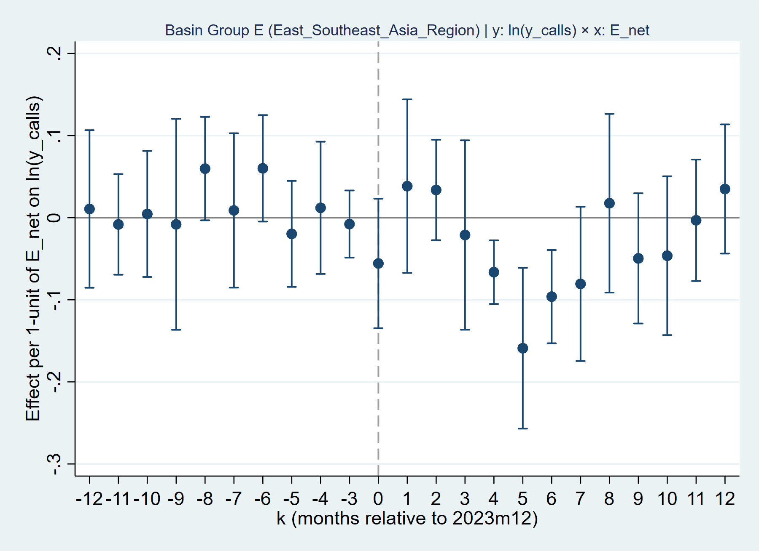
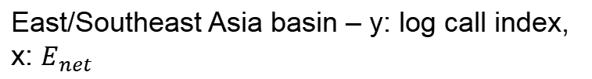
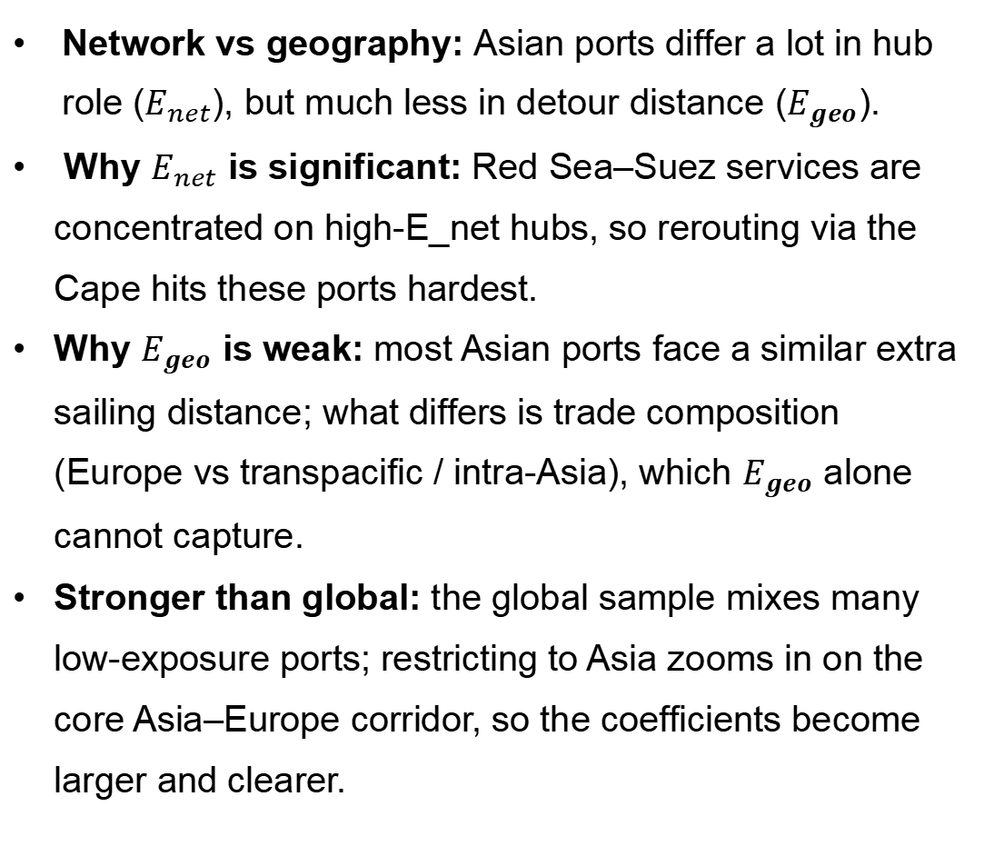
Result and Anaysis
Effect of network exposure on port calls, East/Southeast Asia basin
Network vs geography: Asian ports differ a lot in hub role ($E_{net}$), but much less in detour distance ($E_{geo}$).
Why $E_{net}$ is significant: Red Sea–Suez services are concentrated on high-E_net hubs, so rerouting via the Cape hits these ports hardest.
Why $E_{geo}$ is weak: most Asian ports face a similar extra sailing distance; what differs is trade composition (Europe vs transpacific / intra-Asia), which $E_{geo}$ alone cannot capture.
Stronger than global: the global sample mixes many low-exposure ports; restricting to Asia zooms in on the core Asia–Europe corridor, so the coefficients become larger and clearer.
East/Southeast Asia basin – y: log call index, x: $E_{net}$

Slide 29
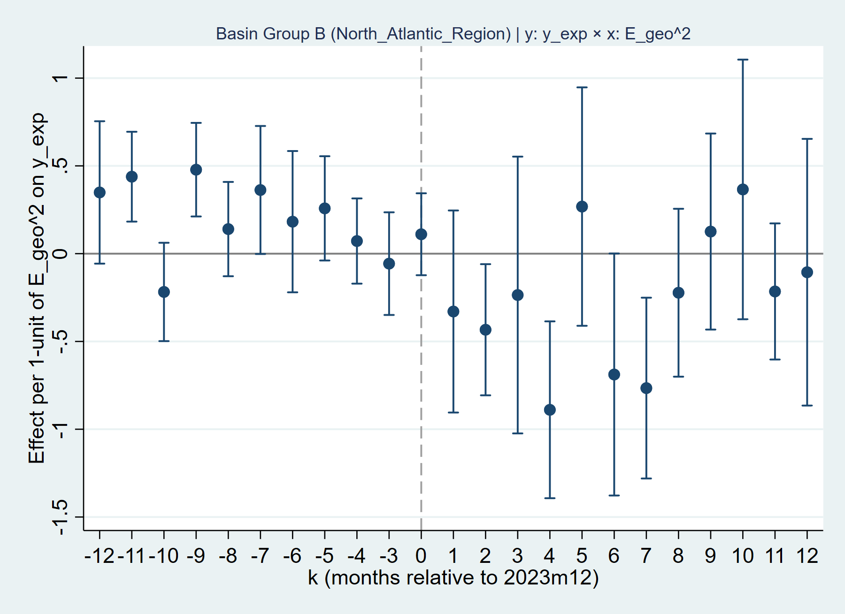
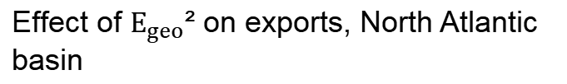
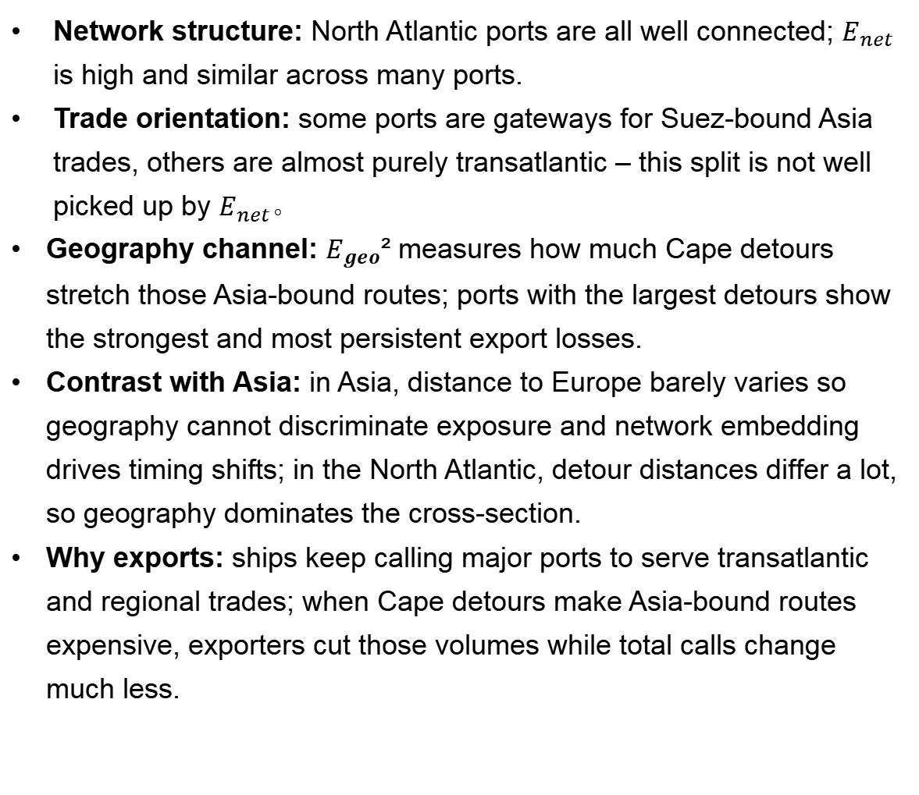
Result and Anaysis
Effect of Geographic exposure on exports, North Atlantic basin
Network structure: North Atlantic ports are all well connected; $E_{net}$ is high and similar across many ports.
Trade orientation: some ports are gateways for Suez-bound Asia trades, others are almost purely transatlantic – this split is not well picked up by $E_{net}$。
Geography channel: $E_{geo}$² measures how much Cape detours stretch those Asia-bound routes; ports with the largest detours show the strongest and most persistent export losses.
Contrast with Asia: in Asia, distance to Europe barely varies so geography cannot discriminate exposure and network embedding drives timing shifts; in the North Atlantic, detour distances differ a lot, so geography dominates the cross-section.
Why exports: ships keep calling major ports to serve transatlantic and regional trades; when Cape detours make Asia-bound routes expensive, exporters cut those volumes while total calls change much less.
Effect of $E_{geo}$² on exports, North Atlantic basin

Slide 30
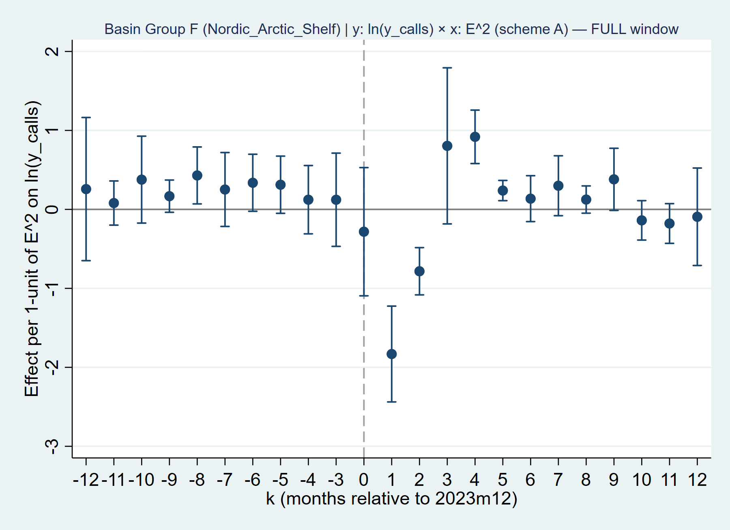
Result and Anaysis
Effect of E² on port calls, Nordic–Arctic Shelf basin
Network position: Nordic–Arctic ports sit at the far end of the Asia–Europe trunk line – they receive the “last leg” of Asia–Europe services.
Traffic mix: their container flows are heavily concentrated in inbound boxes from Asia, especially on Suez-based Asia–Europe routes.
Limited substitution: these ports are the key gateways for their hinterlands, so shippers have few realistic options to switch to nearby ports and move cargo inland instead.
Mechanical delay: when services are rerouted via the Cape, each voyage lengthens from T to T+ΔT; ships and cargo still come, but they arrive one to two months later.
Dynamic pattern: in the transition, calls that “should” arrive in early months are pushed back → short-run gaps (large negative coefficients), then bunching in later months (large positive overshoot), and finally a new steady state with calls back near baseline.
Effect of E² on port calls, Nordic–Arctic Shelf basin

Slide 31
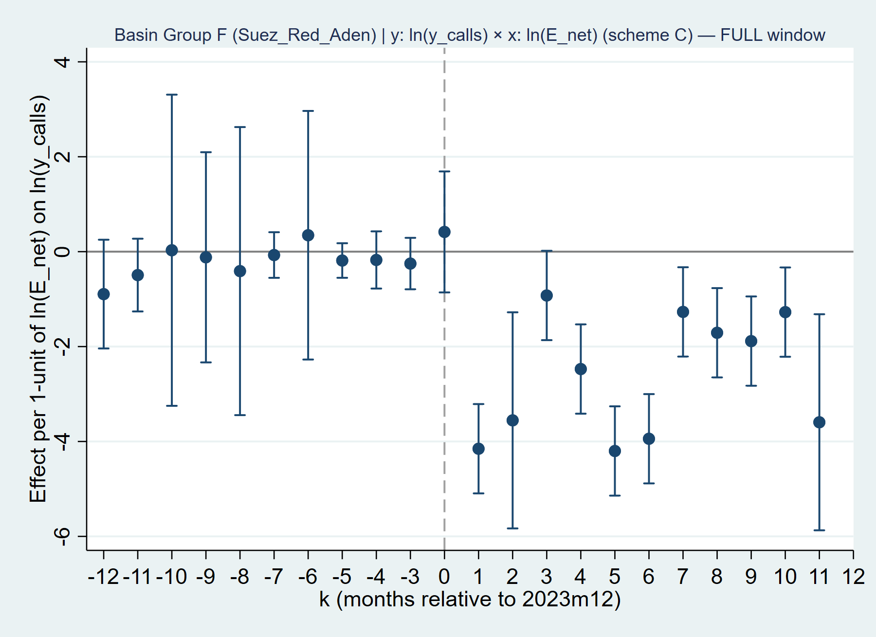

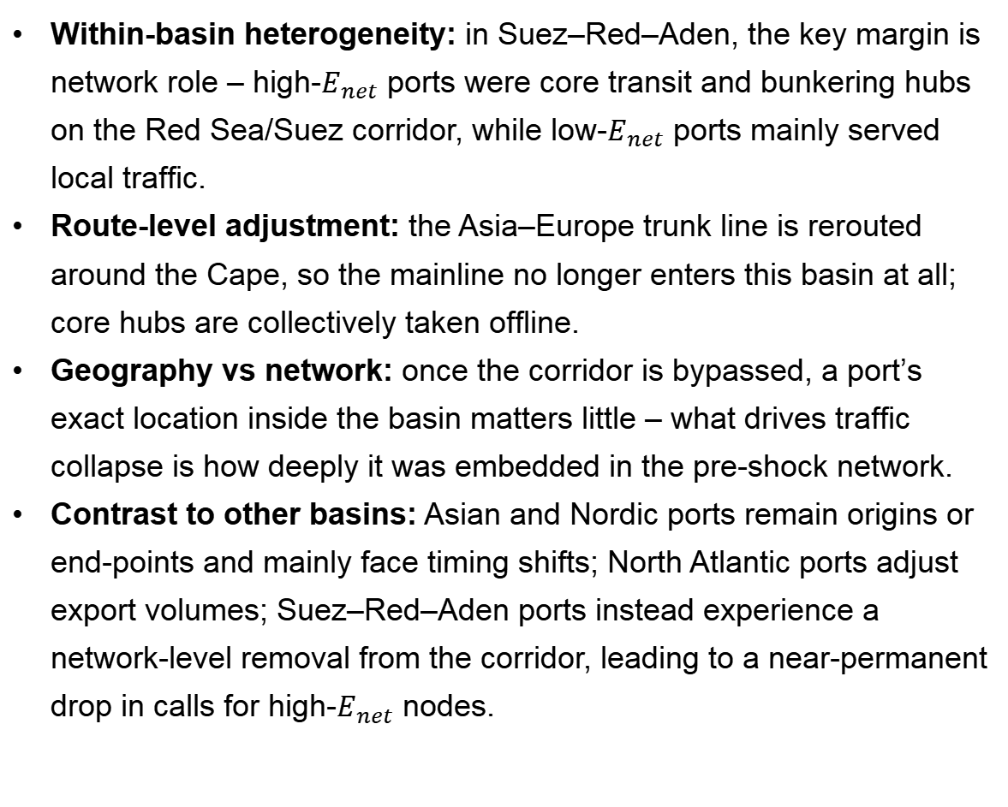
Result and Anaysis
Effect of geographic detour $E^{2}$ on exports, North Atlantic basin
Within-basin heterogeneity: in Suez–Red–Aden, the key margin is network role – high-$E_{net}$ ports were core transit and bunkering hubs on the Red Sea/Suez corridor, while low-$E_{net}$ ports mainly served local traffic.
Route-level adjustment: the Asia–Europe trunk line is rerouted around the Cape, so the mainline no longer enters this basin at all; core hubs are collectively taken offline.
Geography vs network: once the corridor is bypassed, a port’s exact location inside the basin matters little – what drives traffic collapse is how deeply it was embedded in the pre-shock network.
Contrast to other basins: Asian and Nordic ports remain origins or end-points and mainly face timing shifts; North Atlantic ports adjust export volumes; Suez–Red–Aden ports instead experience a network-level removal from the corridor, leading to a near-permanent drop in calls for high-$E_{net}$ nodes.
Effect of $E_{net}$on port calls, Suez–Red–Aden basin

Slide 32
5
Conclusion
Port resilience under the Red Sea shock

Slide 33
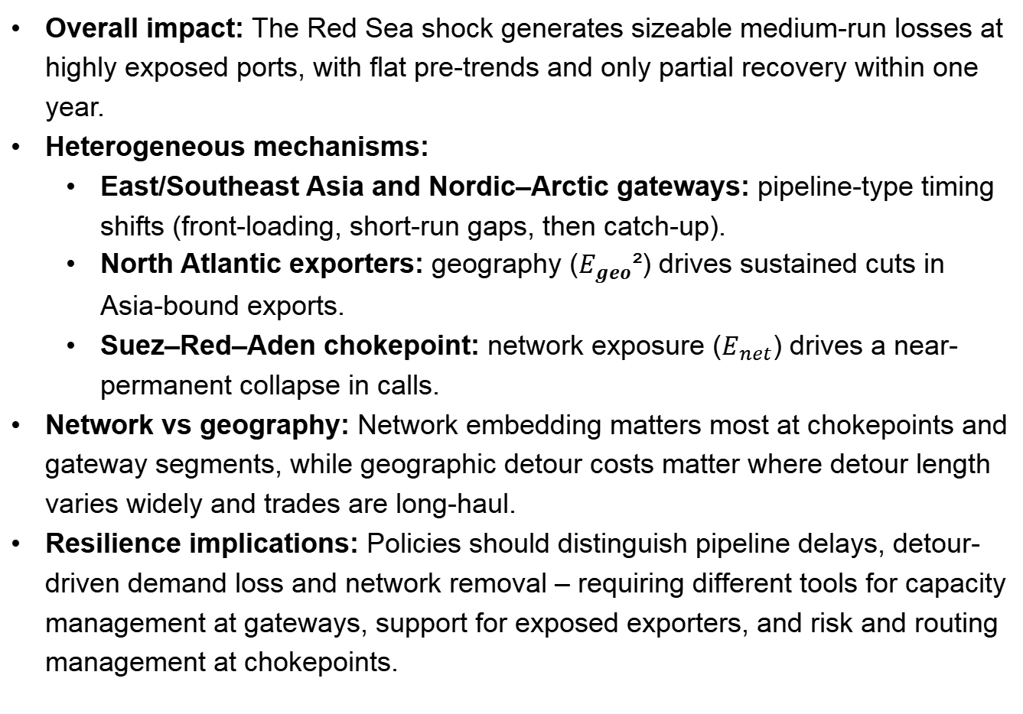
Conclusion – Port resilience under the Red Sea shock
Overall impact: The Red Sea shock generates sizeable medium-run losses at highly exposed ports, with flat pre-trends and only partial recovery within one year.
Heterogeneous mechanisms:
  East/Southeast Asia and Nordic–Arctic gateways: pipeline-type timing shifts (front-loading, short-run gaps, then catch-up).
  North Atlantic exporters: geography ($E_{geo}$²) drives sustained cuts in Asia-bound exports.
  Suez–Red–Aden chokepoint: network exposure ($E_{net}$) drives a near-permanent collapse in calls.
Network vs geography: Network embedding matters most at chokepoints and gateway segments, while geographic detour costs matter where detour length varies widely and trades are long-haul.
Resilience implications: Policies should distinguish pipeline delays, detour-driven demand loss and network removal – requiring different tools for capacity management at gateways, support for exposed exporters, and risk and routing management at chokepoints.

Slide 34
References
Achurra-Gonzalez, P. E., Angeloudis, P., Goldbeck, N., Graham, D. J., Zavitsas, K., & Stettler, M. E. J. (2019). Evaluation of port disruption impacts in the global liner shipping network. Journal of Shipping and Trade, 4, 3.
Arkolakis, C., Costinot, A., & Rodríguez-Clare, A. (2012). New trade models, same old gains? American Economic Review, 102(1), 94–130.
Attinasi, M. G., Boeckelmann, L., Emter, L., Ferrari Minesso, M., Gerinovics, R., Gunnella, V., Meunier, B., & Serafini, R. (2024, April 26). Sailing through storms: The fallout of Red Sea disruptions for global trade and inflation. VoxEU.org.
Bai, X., Ma, Z., & Zhou, Y. (2023). Data-driven static and dynamic resilience assessment of the global liner shipping network. Transportation Research Part E: Logistics and Transportation Review, 170, 103016.
Bai, X., Xu, M., Han, T., & Yang, D. (2022). Quantifying the impact of pandemic lockdown policies on global port calls. Transportation Research Part A: Policy and Practice, 164, 224–241.
Carrière‑Swallow, Y., Deb, P., Furceri, D., Jiménez, D., & Ostry, J. D. (2022). Shipping costs and inflation (IMF Working Paper No. 2022/061). International Monetary Fund.
Dunn, J., & Leibovici, F. (2024, February 7). Global trade implications of Red Sea shipping disruptions. On the Economy (Federal Reserve Bank of St. Louis Blog).
European Central Bank. (2024, February 21). Economic Bulletin, Issue 2/2024.
European Central Bank. (2024, March). ECB staff macroeconomic projections for the euro area, March 2024.
European Parliamentary Research Service. (2024, March 27). Recent threats in the Red Sea: Economic impact on the region.
Faure, M.-A., & Ducruet, C. (2025). The Blue Connection: A systematic and critical review of shipping network research. Networks and Spatial Economics. Advance online publication.
Hamano, M., & Vermeulen, W. N. (2020). Natural disasters and trade: The mitigating impact of port substitution. Journal of Economic Geography, 20(3), 809–856.

Slide 35
Hugot, J., & Umana Dajud, C. (2016). Trade costs and the Suez and Panama Canals (CEPII Working Paper No. 2016‑29). CEPII.
International Monetary Fund. (2024). Monthly port‑level traffic flows at risk from trade disruption in the Red Sea \[Map]. PortWatch.
Kamali, P., Koepke, R., Sozzi, A., & Verschuur, J. (2024, March 7). Red Sea attacks disrupt global trade. IMF Blog.
Korniyenko, Y., Pinat, M., & Dew, B. (2017). Assessing the fragility of global trade: The impact of localized supply shocks using network analysis (IMF Working Paper No. 17/30). International Monetary Fund.
Notteboom, T., Haralambides, H., & Cullinane, K. (2024). The Red Sea crisis: Ramifications for vessel operations, shipping networks, and maritime supply chains. Maritime Economics & Logistics, 26(1), 1–20.
Pratson, L. F. (2023). Assessing impacts to maritime shipping from marine chokepoint closures. Communications in Transportation Research, 3, 100083.
United Nations Conference on Trade and Development. (2023). Review of Maritime Transport 2023. United Nations.
United Nations Conference on Trade and Development. (2024). Review of Maritime Transport 2024. United Nations.
United Nations Conference on Trade and Development. (2024, February 22). Navigating troubled waters: Impact to global trade of disruption of shipping routes in the Red Sea, Black Sea and Panama Canal (UNCTAD rapid assessment No. UNCTAD/OSG/INF/2024/2).
United Nations Conference on Trade and Development. (2025). Liner Shipping Connectivity Index (LSCI) & Port LSCI (PLSCI) — Data Insights.
United Nations Security Council. (2024, March 18). Security Council press statement on the situation in the Red Sea (SC/15631).
U.S. Energy Information Administration. (2024, June 11). Red Sea disruptions increase oil flows around the Cape of Good Hope. Today in Energy.
Verschuur, J., Koks, E. E., & Hall, J. W. (2020). Port disruptions due to natural disasters: Insights into port and logistics resilience. Transportation Research Part D: Transport and Environment, 85, 102393.
Verschuur, J., Koks, E. E., & Hall, J. W. (2022). Ports’ criticality in international trade and global supply‑chains. Nature Communications, 13, 4351.
Verschuur, J., & Hall, J. (2024). Systemic impacts of disruptions at maritime chokepoints (Version 1). Research Square preprint.

Slide 36
Wang, L., Zhang, S., & Chen, R. (2022). Network vulnerability of ports around the South China Sea and the impact on Chinese maritime transport. World Regional Studies, 31(4), 700–712.
Wang, N., Dong, L., Wu, N., & Yan, H. (2016). The change of global container shipping network vulnerability under intentional attack \[蓄意攻击下全球集装箱海运网络脆弱性变化]. Acta Geographica Sinica, 71(2), 293–303.
Wang, Z., Fang, Z., Yu, J., Hu, X., & Gong, J. (2024). Red Sea crisis impacts on maritime shipping networks. Heliyon, 10(22), e40384.
World Bank. (2024, April). Dire Strait: The far‑reaching impact of the Red Sea shipping crisis (MENA FCV Economic Series Brief No. 1).
Wu, D., Yu, C., Zhao, Y., & Guo, J. (2024). Changes in vulnerability of global container shipping networks before and after the COVID‑19 pandemic. Journal of Transport Geography, 114, 103783.
Xu, M., Pan, Q., Muscoloni, A., Xia, H., & Cannistraci, C. V. (2020). Modular gateway‑ness connectivity and structural core organization in maritime network science. Nature Communications, 11, 2849.

