Slide 1
Homework-0
Musical note classification
Report
Student：潘品齊 (Pin-Chi Pan)
ID：R12942103
Project Page：
https://github.com/PANpinchi/DeepMIR_HW0_PANpinchi

Slide 2
Outline
Task 1: Visualize a Mel-Spectrogram
Task 2: Train a Traditional Machine Learning Model
Task 3: Train a Deep Learning Model

Slide 3
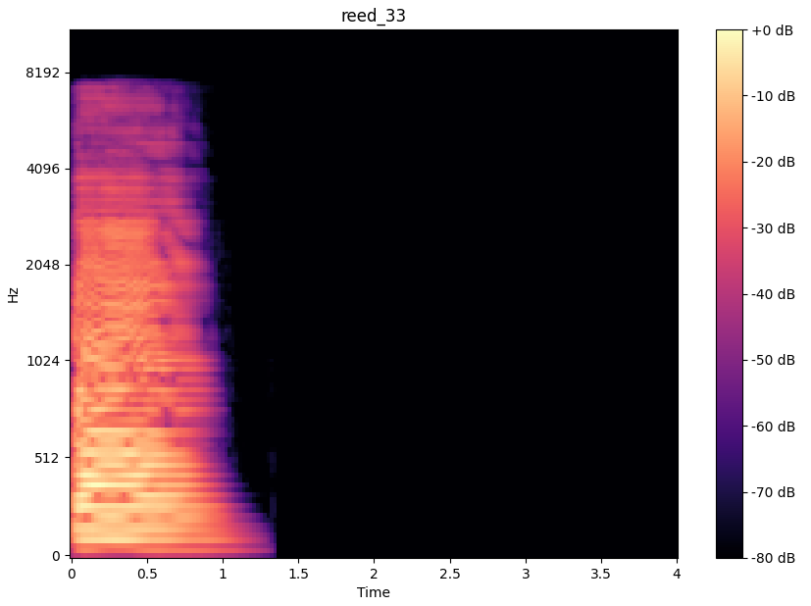
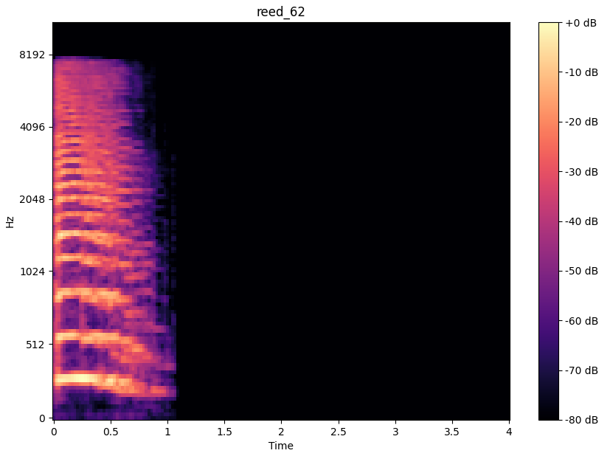
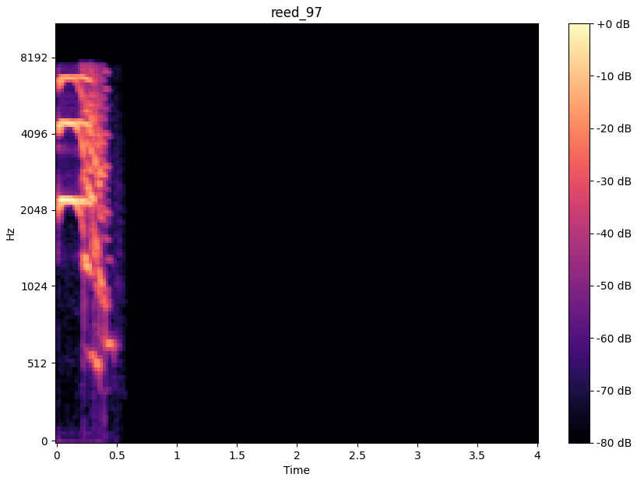
Task 1: Visualize a Mel-Spectrogram
Results
Instruments: reed, Pitches: [33, 62, 97]
FFT Window Size: 2048, Hop Length: 512

Slide 4
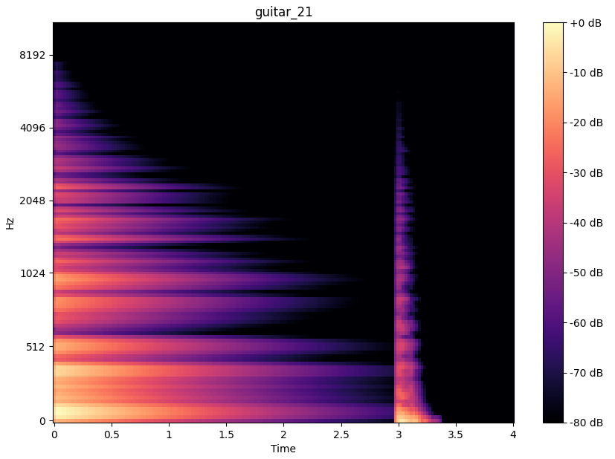
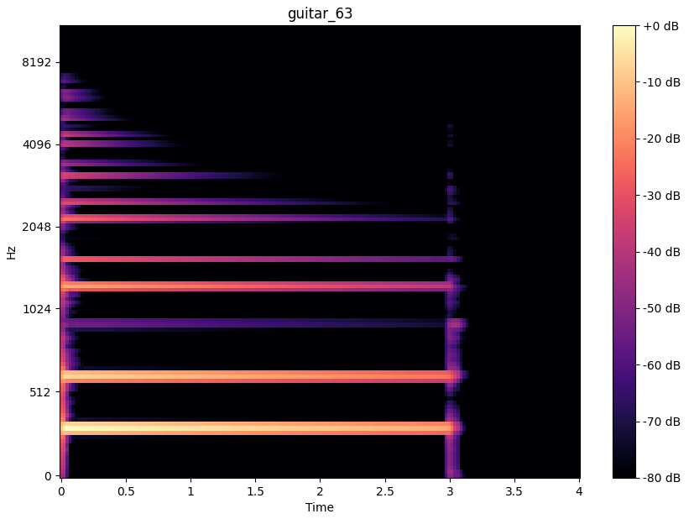
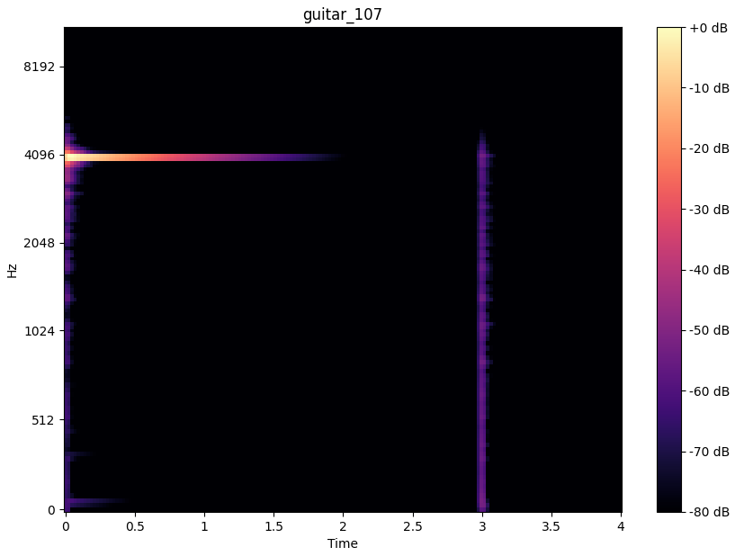
Task 1: Visualize a Mel-Spectrogram
Results
Instruments: guitar, Pitches: [21, 63, 107]
FFT Window Size: 2048, Hop Length: 512

Slide 5
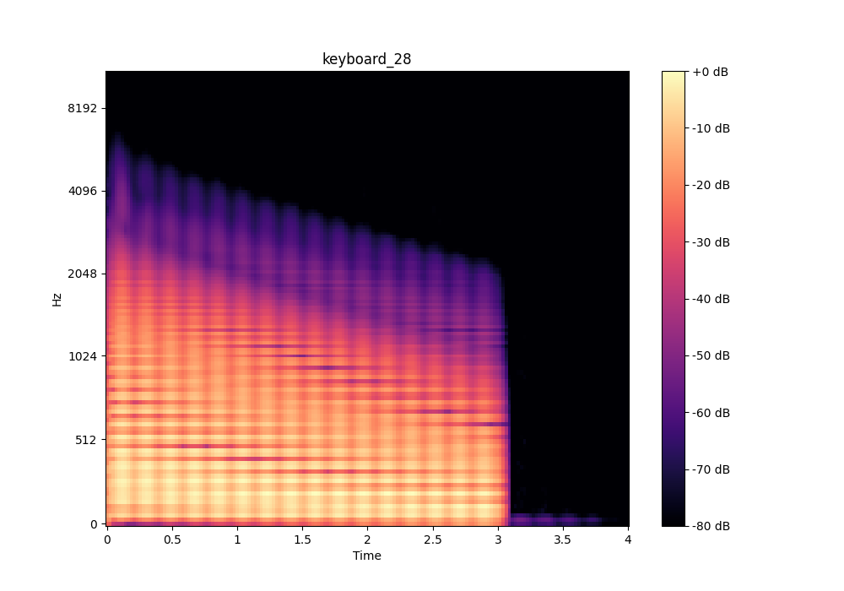
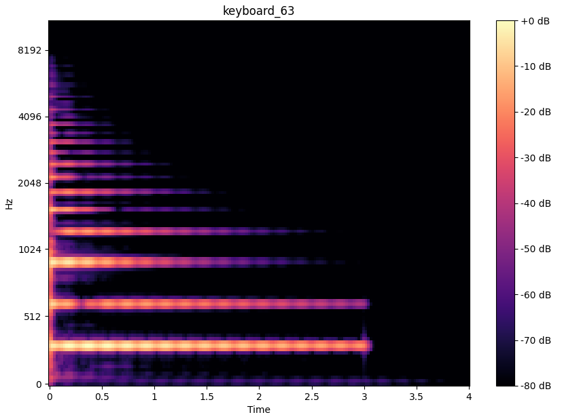
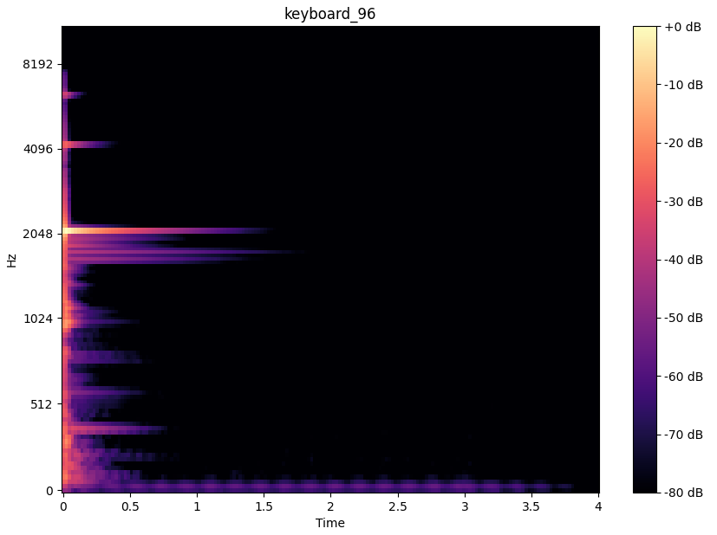
Task 1: Visualize a Mel-Spectrogram
Results
Instruments: keyboard, Pitches: [28, 63, 96]
FFT Window Size: 2048, Hop Length: 512

Slide 6
Task 1: Visualize a Mel-Spectrogram
Analysis
The Mel-spectrograms for three different instruments and pitches reveal distinct spectral characteristics.
The lowest pitch (reed_33, guitar_21, keyboard_28) shows strong energy concentrated in the lower frequencies with minimal high-frequency harmonics, reflecting a bass-heavy sound.

Slide 7
Task 1: Visualize a Mel-Spectrogram
Analysis
The mid-range pitch (reed_62, guitar_63, keyboard_63) displays a balance between fundamental frequencies and richer harmonic overtones, leading to a fuller, more resonant sound.
The highest pitch (reed_97, guitar_107, keyboard_96) has energy concentrated in the higher frequencies with rapid decay, producing a sharp, clear tone with minimal sustain. These differences illustrate how pitch affects the harmonic richness and frequency distribution of instruments sounds.

Slide 8
Task 2: Train a Traditional Machine Learning Model
Feature Extraction
To extract meaningful features from audio, I used mel-spectrograms, which are a time-frequency representation of the audio signal.
I used the following parameters to compute mel-spectrograms:
FFT Window Size: 2048
Hop Length: 512
Mel Filter Banks: 128
After computing the mel-spectrograms, we flattened the 2D arrays to 1D feature vectors for input to the machine learning models.

Slide 9
Task 2: Train a Traditional Machine Learning Model
Implementation of the Five Machine Learning Model
k-Nearest Neighbors (k-NN): A simple, non-parametric algorithm that classifies samples based on the majority vote of their nearest neighbors.
Random Forest: An ensemble learning method that constructs multiple decision trees and outputs the majority vote of their predictions.
Decision Tree: A model that makes decisions based on feature splits, creating a tree-like structure.

Slide 10
Task 2: Train a Traditional Machine Learning Model
Implementation of the Five Machine Learning Model (cont.)
Support Vector Machine (SVM): A powerful classifier that separates classes using a hyperplane in a high-dimensional space.
Logistic Regression: A linear model used for binary or multiclass classification, predicting probabilities for each class.
The models were trained on extracted mel-spectrogram features from the sub-training set and evaluated on the testing set.

Slide 11
Task 2: Train a Traditional Machine Learning Model
Summary of the training process
Dataset Preprocessing: I used the `dataset_preprocessing.py` code to extract the audio file, convert it to the mel-spectrograms, and stored the process results and labels as X_train, y_train, X_test, and y_test, respectively.
Dataset Loading: I used the preprocessed features saved as X_train, y_train, X_test, and y_test for both training and testing. These features were loaded from .npy files.
Model Training: The training was straightforward, with the different classifiers fitting the training set using:
model.fit(X_train, y_train).

Slide 12
Task 2: Train a Traditional Machine Learning Model
Predictions and Evaluation
The models were evaluated using the testing set by making predictions:
y_pred = model.predict(X_test).
I also computed class probabilities:
y_pred_probs = model.predict_proba(X_test).
I computed Top-1 Accuracy, Top-3 Accuracy, and generated a Confusion Matrix to visualize the model's performance.

Slide 13
Task 2: Train a Traditional Machine Learning Model
Results
Model | Top-1 Accuracy (↑) | Top-3 Accuracy (↑)
K-NN | 0.5183 | 0.7322
Random Forest | 0.5696 | 0.8225
Decision Tree | 0.4001 | 0.4238
SVM | 0.4480 | 0.7954
Logistic Regression | 0.2817 | 0.6162
Bold indicates the best and underlined indicates the second-best performance.

Slide 14
Task 2: Train a Traditional Machine Learning Model
Analysis
Random Forest emerged as the best-performing model, leveraging its ensemble nature to achieve both high Top-1 and Top-3 accuracy.
k-NN and SVM showed decent performance, with SVM having a particularly strong Top-3 accuracy (indicating good ranking ability).
Decision Tree and Logistic Regression were less effective, highlighting the importance of non-linear and ensemble methods for this task.
The results indicate that ensemble-based models such as Random Forest are more capable of handling complex, high-dimensional feature spaces.

Slide 15
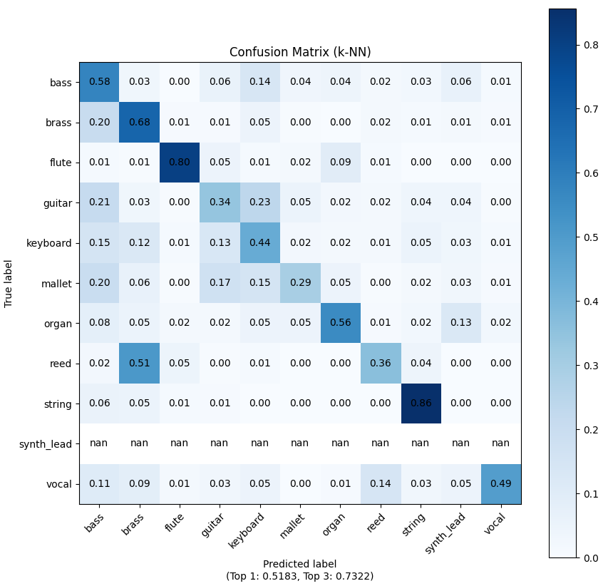
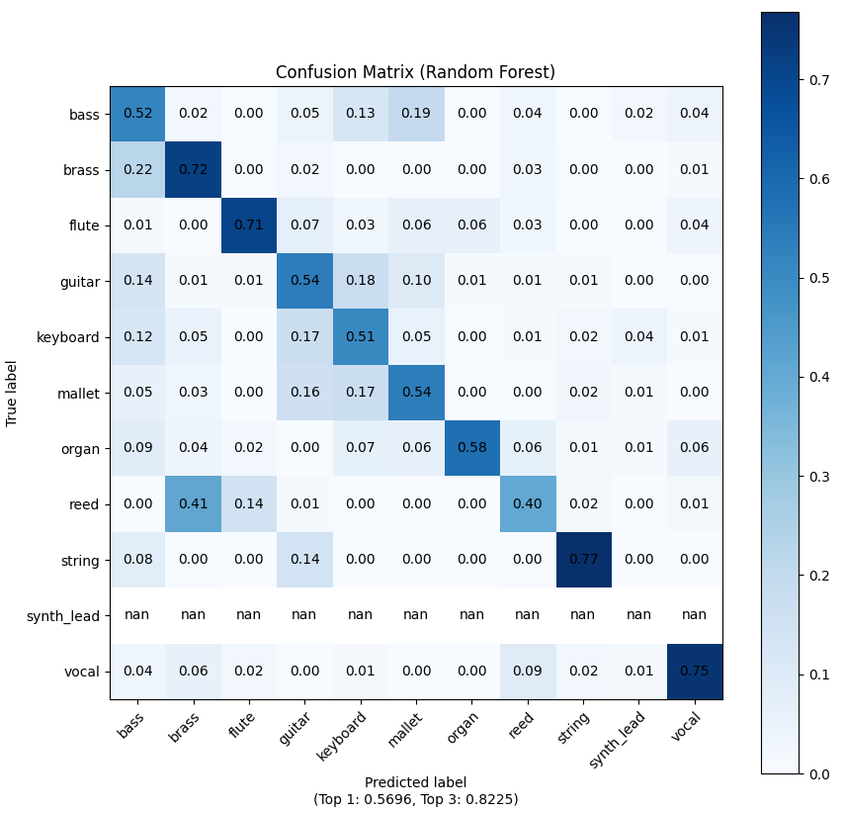
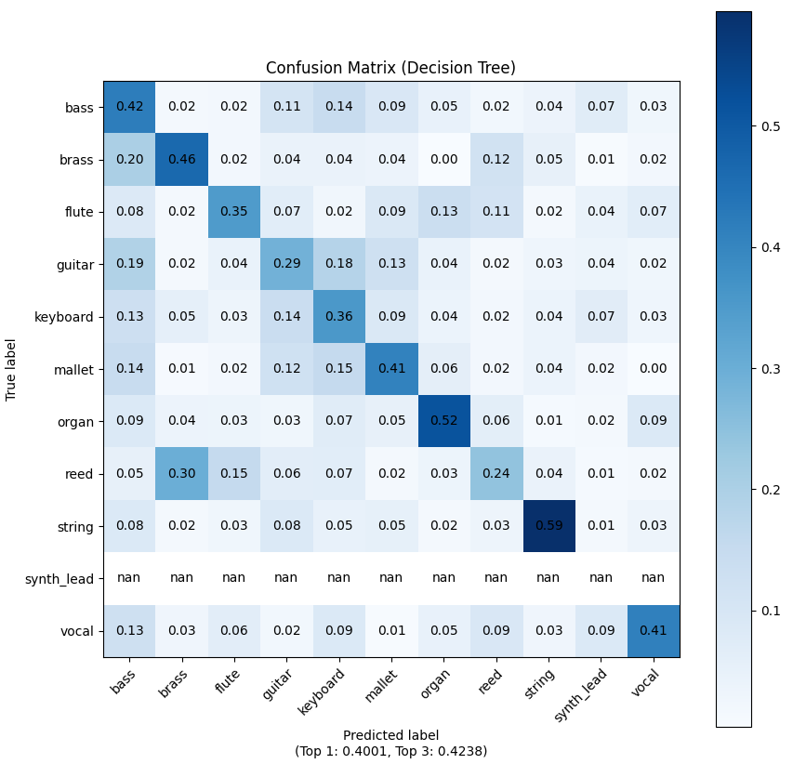
Task 2: Train a Traditional Machine Learning Model
Confusion Matrix (k-NN, Random Forest, Decision Tree)

Slide 16
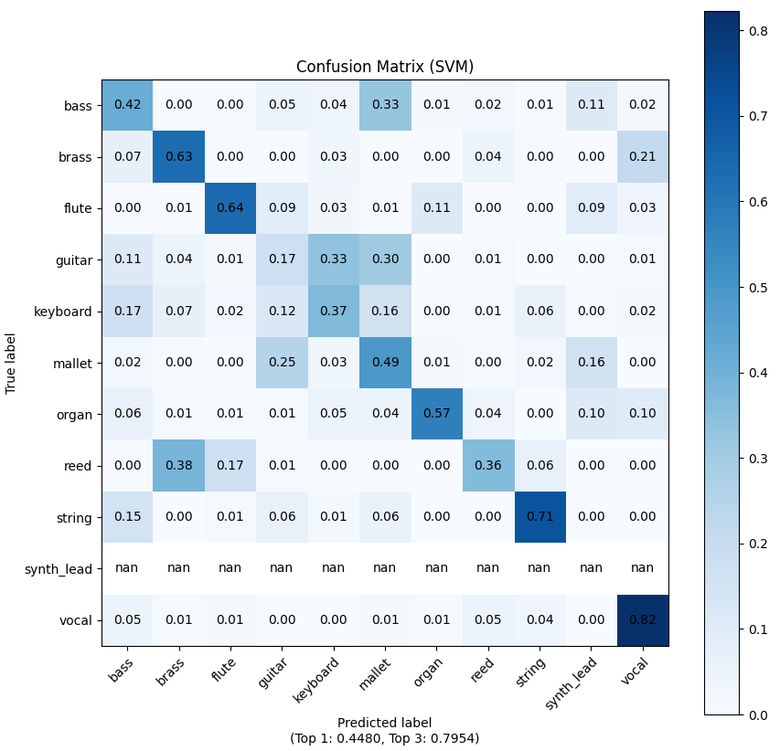
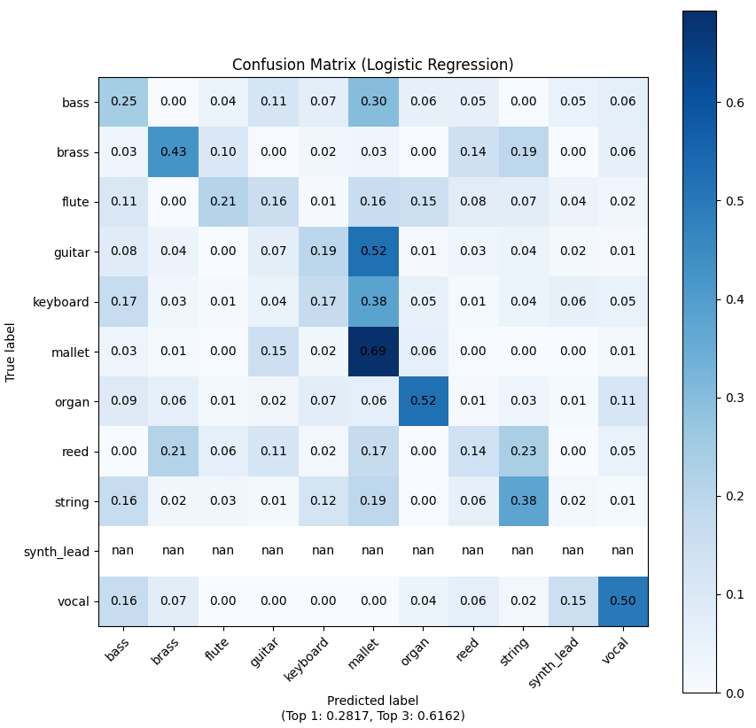
Task 2: Train a Traditional Machine Learning Model
Confusion Matrix (SVM, Logistic Regression)

Slide 17
Task 2: Train a Traditional Machine Learning Model
Analysis
The confusion matrix illustrates how well each ML model performed for each class. Most classes had high diagonal values, indicating good classification accuracy, though some errors occurred between acoustically similar instruments.
The confusion matrix clearly demonstrates which classes were confused with others. For example, some mallet, keyboard and guitar classes were often misclassified due to the similarity of their sound characteristics.

Slide 18
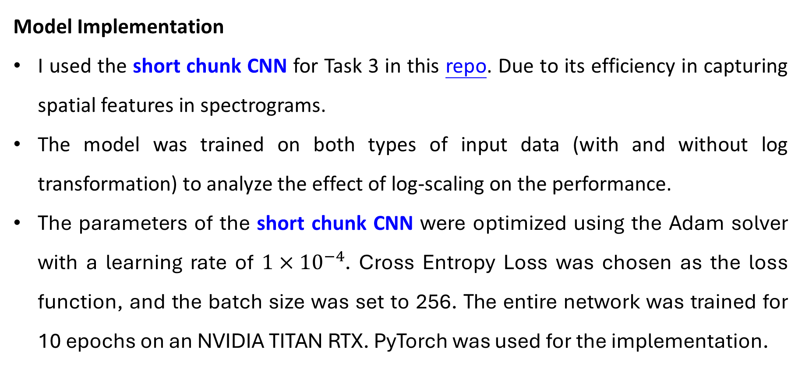
Task 3: Train a Deep Learning Model
Model Implementation
I used the short chunk CNN for Task 3 in this repo. Due to its efficiency in capturing spatial features in spectrograms.
The model was trained on both types of input data (with and without log transformation) to analyze the effect of log-scaling on the performance.
The parameters of the short chunk CNN were optimized using the Adam solver with a learning rate of $1×{10}^{−4}$. Cross Entropy Loss was chosen as the loss function, and the batch size was set to 256. The entire network was trained for 10 epochs on an NVIDIA TITAN RTX. PyTorch was used for the implementation.

Slide 19
Task 3: Train a Deep Learning Model
Model Implementation
Model architecture: A CNN with several convolutional layers followed by batch normalization, ReLU activations, max pooling, and fully connected layers for classification.
Mel-spectrogram extraction: A fixed FFT window size and hop length were used for consistency across experiments.
Training setup: Both models were trained using the same dataset, optimizer, and hyperparameters, with the only difference being the input data format.

Slide 20
Task 3: Train a Deep Learning Model
Results
ShortChunkCNN | Top-1 Accuracy (↑) | Top-3 Accuracy (↑)
With taking the log | 0.7241 | 0.8662
Without taking the log | 0.6353 | 0.8452
Bold indicates the best performance.

Slide 21
Task 3: Train a Deep Learning Model
Analysis
Log Transformation Impact: The model trained with log-transformed Mel-spectrograms achieved higher Top-1 (72.41%) and Top-3 (86.62%) accuracies compared to the model without the log transformation (Top-1: 63.53%, Top-3: 84.52%). This indicates that applying the logarithmic scale to the Mel-spectrogram improves the model's ability to capture the nuances in audio signals, likely due to better handling of the dynamic range of the audio features.

Slide 22
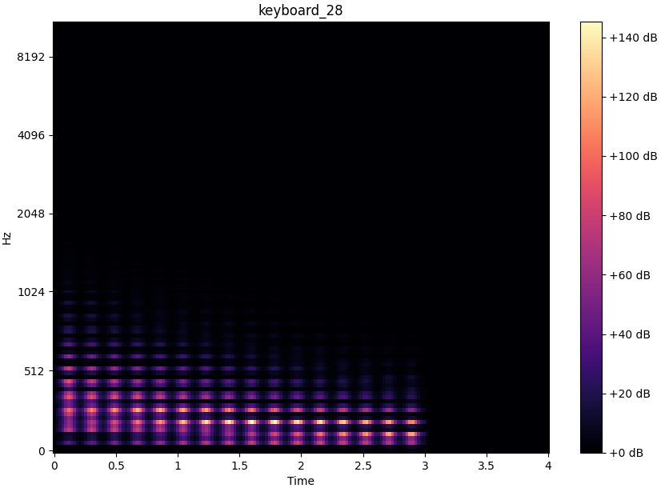
Task 3: Train a Deep Learning Model
Analysis
The log-transformed Mel-spectrograms provide a more balanced representation by compressing the dynamic range, making quieter audio components more noticeable. Without the log transformation, the spectrograms emphasize only the loudest features, limiting the model's ability to capture subtler details. This richer input from log-transformed spectrograms allows the model to learn more effectively, resulting in better Top-1 and Top-3 accuracy.
With taking the log
Without taking the log

Slide 23
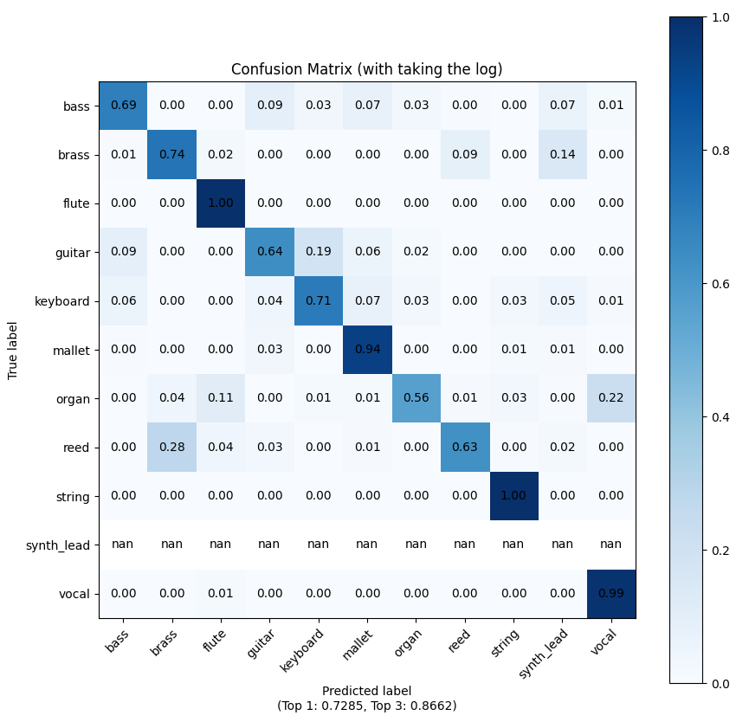
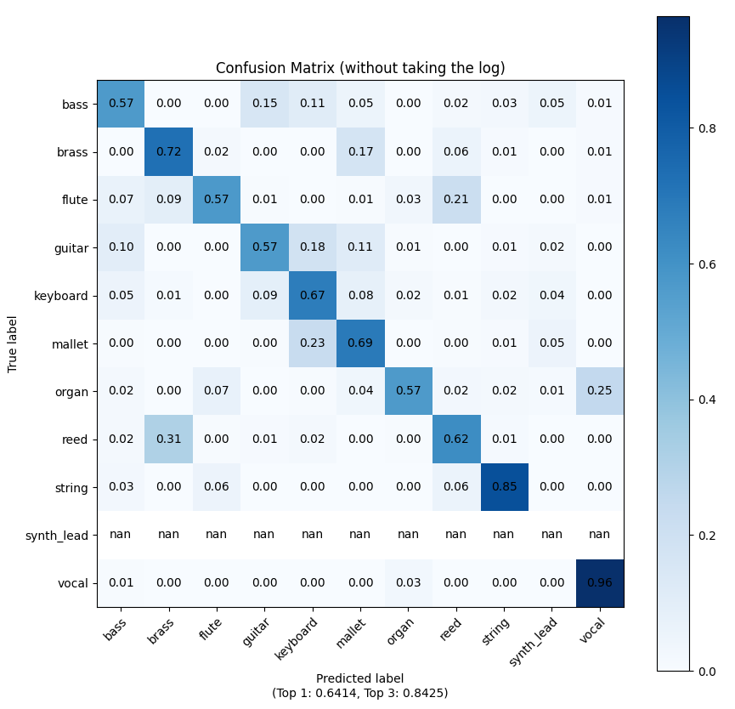
Task 3: Train a Deep Learning Model
Confusion Matrix (with and without taking the log)

Slide 24
Task 3: Train a Deep Learning Model
Analysis
Confusion Matrix Comparison: The confusion matrices for both models show similar patterns, but the model using log-transformed inputs made fewer misclassifications overall. The log transformation likely enhanced the model's capability to distinguish between different classes, especially those with subtle differences in their spectrograms, such as instruments with overlapping frequency ranges.

Slide 25
End
Student：潘品齊 (Pin-Chi Pan)
ID：R12942103
Project Page：
https://github.com/PANpinchi/DeepMIR_HW0_PANpinchi

