Slide 1
JT Seam Carve

Slide 2


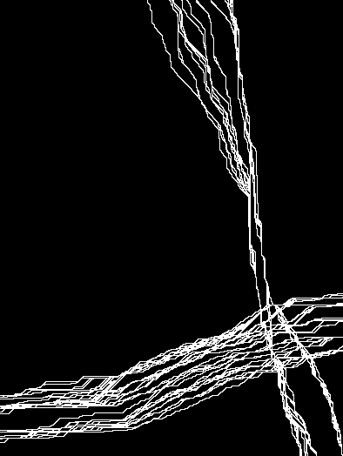
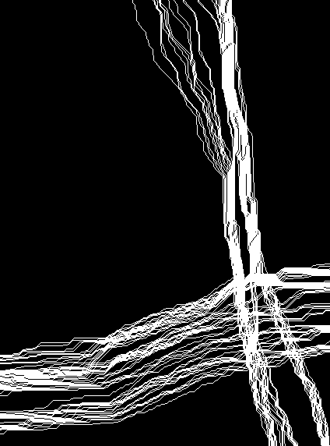



Source
Result
Neighbor Seams
Actual Seams
JT Diff Mask
R,C -> Column
R,C -> Row

