Slide 1
U.S. Flights Analysis
By RAVIRAJ KUKADE
Project Overview
• Objective: Analyze U.S. flight data to uncover patterns in delays and cancellations.
• Tools Used: SQL Server, Power BI, and Excel, GitHub, Python(Pandas).
• Dataset:
1. 5.8 million flight records from U.S. airline performance dataset.
2. 14 Airline records
3. 322 Airport records
Github_link: https://github.com/PARADOXop/U.S.-Airline-Performance-Delay-Analysis

Slide 2
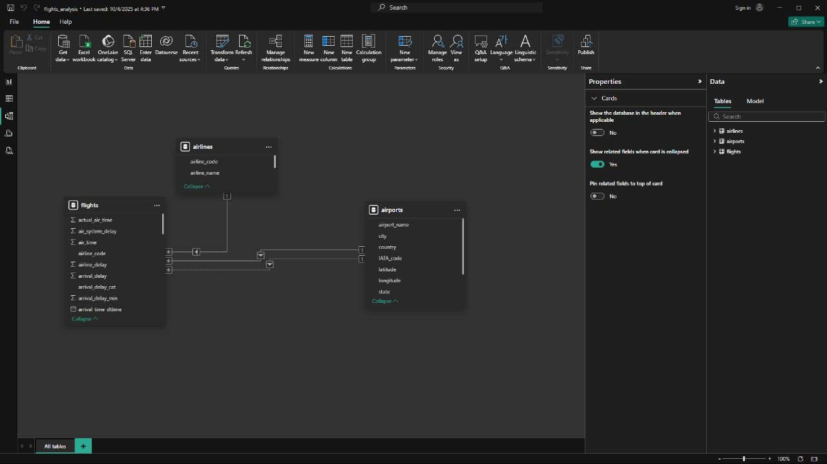
Data Model & Relationships
• Tables Used: airlines, airports, and flights. • Relationships Established:
1. A one-to-many relationship between airlines[airline_code] and flights[airline_code].
2. A one-to-many relationship between airports[IATA_code] and both flights[origin_airport] and flights[destination_airport]. Integrity Check: Ensured referential integrity across all relationships to maintain accurate and consistent data analysis.
Notes:
Briefly discuss schema and how relationships improve analysis.

Slide 3
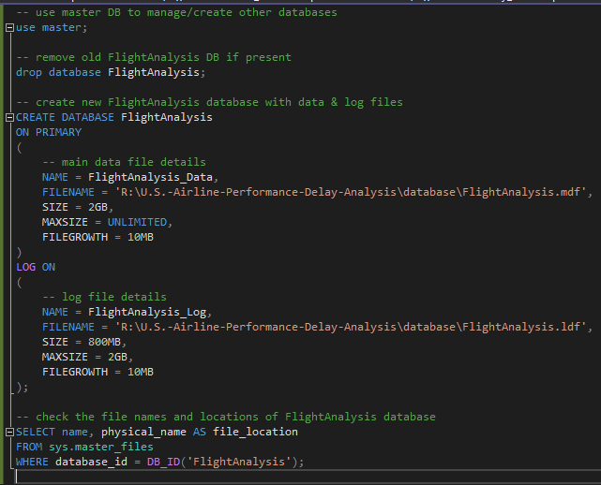
Database Creation
Notes:
Highlight challenges in handling large datasets and cleaning steps.

Slide 4
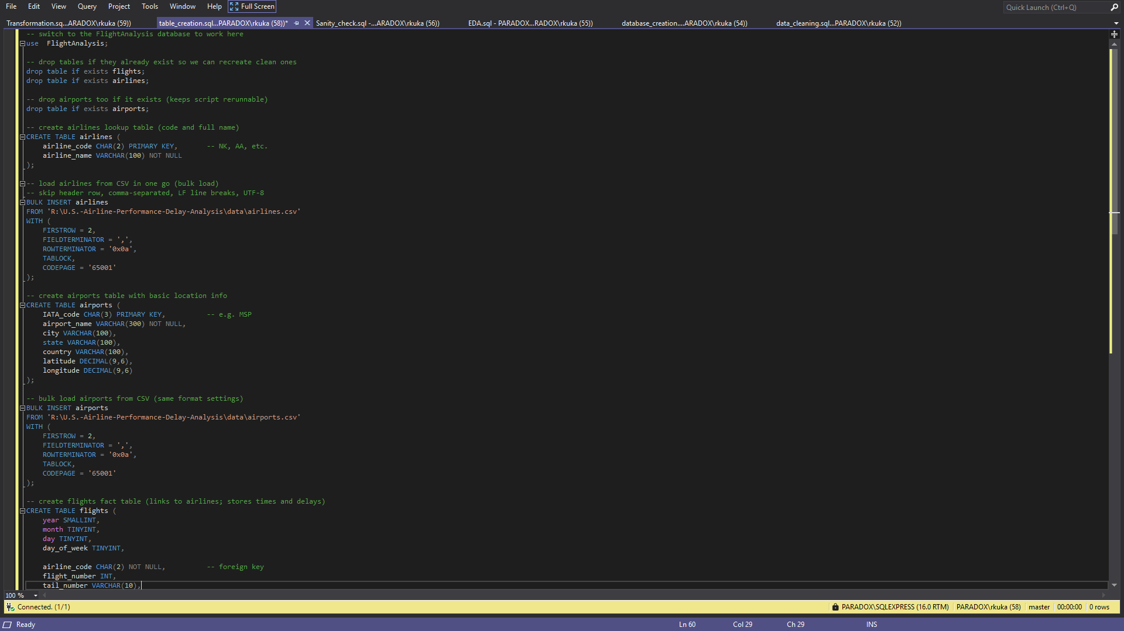
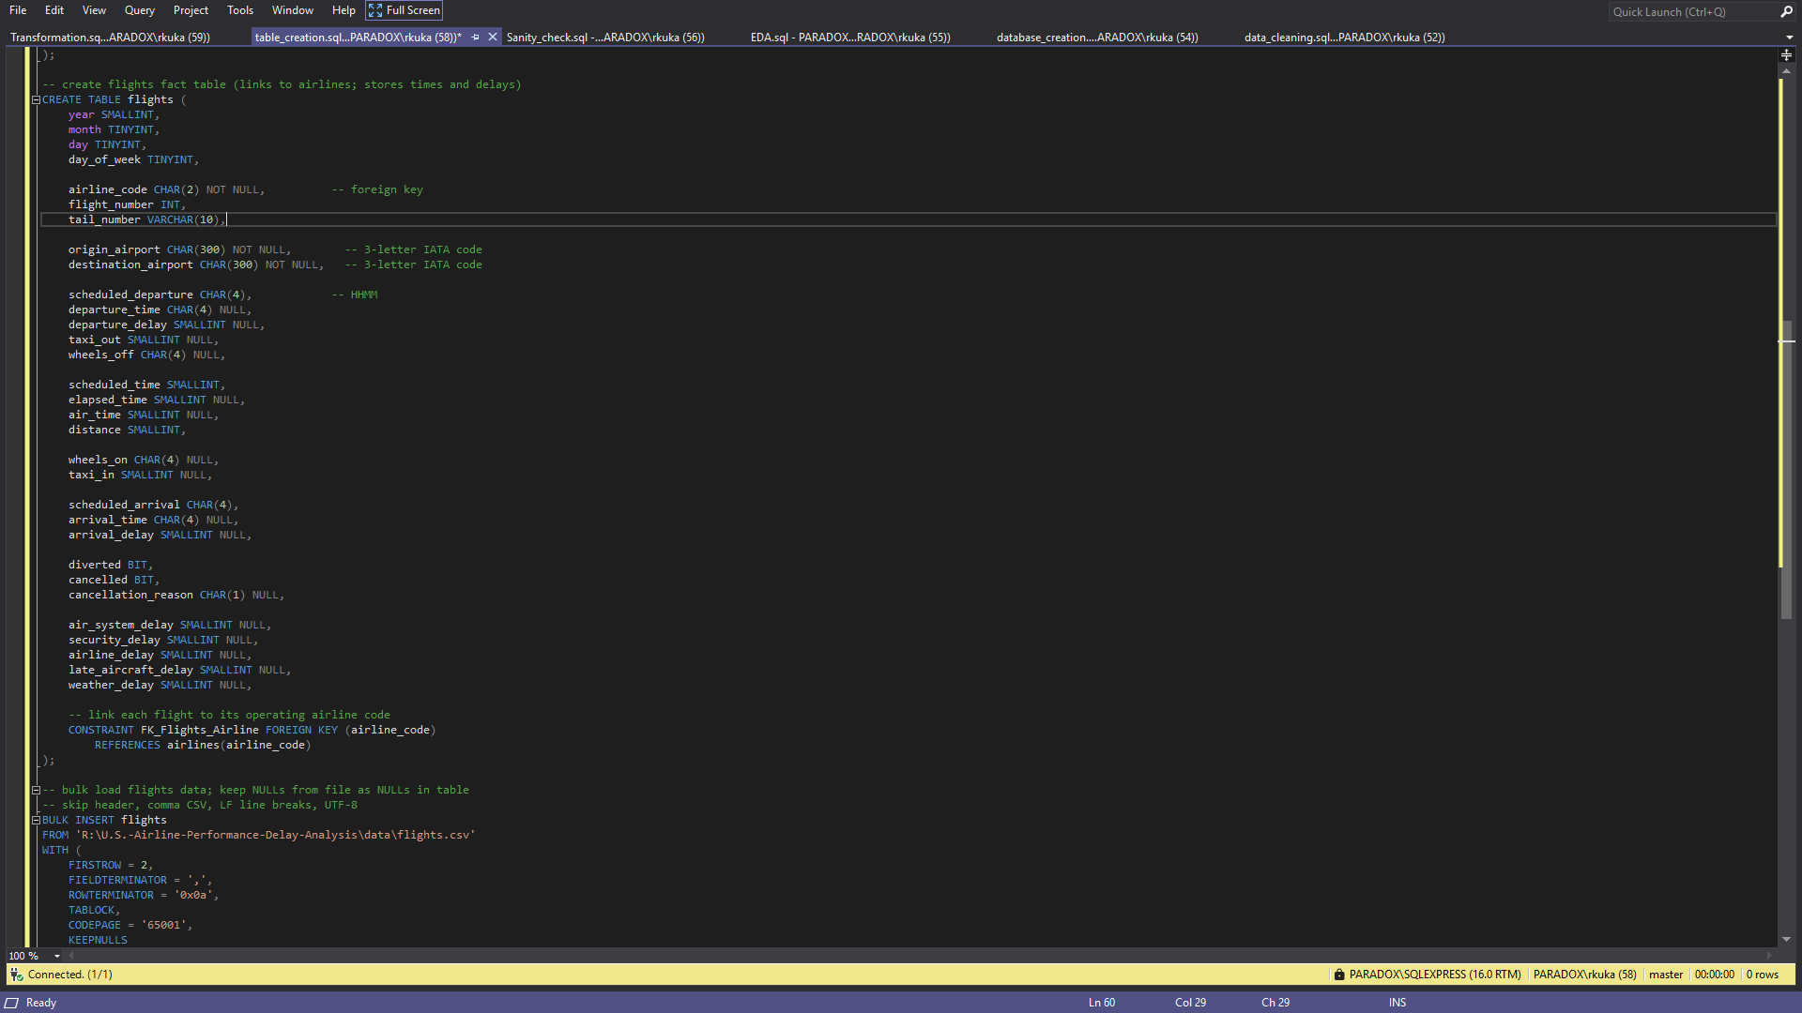
Table Creation and data Injection
Notes:
Highlight challenges in handling large datasets and cleaning steps.

Slide 5
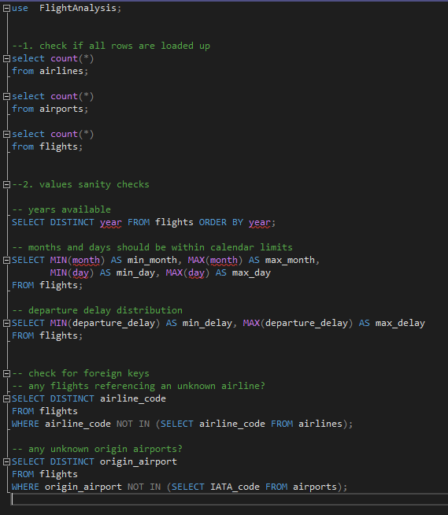
Sanity Check
Data Coverage: Verified available years — confirmed that data include records only for 2015.
Date Validity: Ensured all records have valid date ranges: • 1 ≤ day ≤ 31 • 1 ≤ month ≤ 12
Foreign Key Integrity: • Confirmed that all flights reference valid airlines (no missing or unknown airline codes). • Verified that both origin and destination airports exist in the airports table (no invalid references).
Checked if departure_delay = scheduled_ departure _time – actual_departure_time
checked if arrival_delay = scheduled_ arrival_time – actual_ arrival _time
Notes:
Highlight challenges in handling large datasets and cleaning steps.

Slide 6
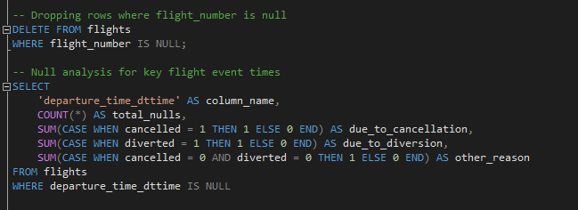
Data Cleaning
There are many rows with null values, but not all of them need to be handled because the null values do not always indicate missing data. For example, if the cancellation reason is null, it means that the flight was not cancelled. Several other columns follow the same logic.
Invalid and null entries — such as missing flight numbers, years, months, days, origin and destination airports, and airlines — were removed. 14k rows had null flights number
Notes:
Highlight challenges in handling large datasets and cleaning steps.

Slide 7
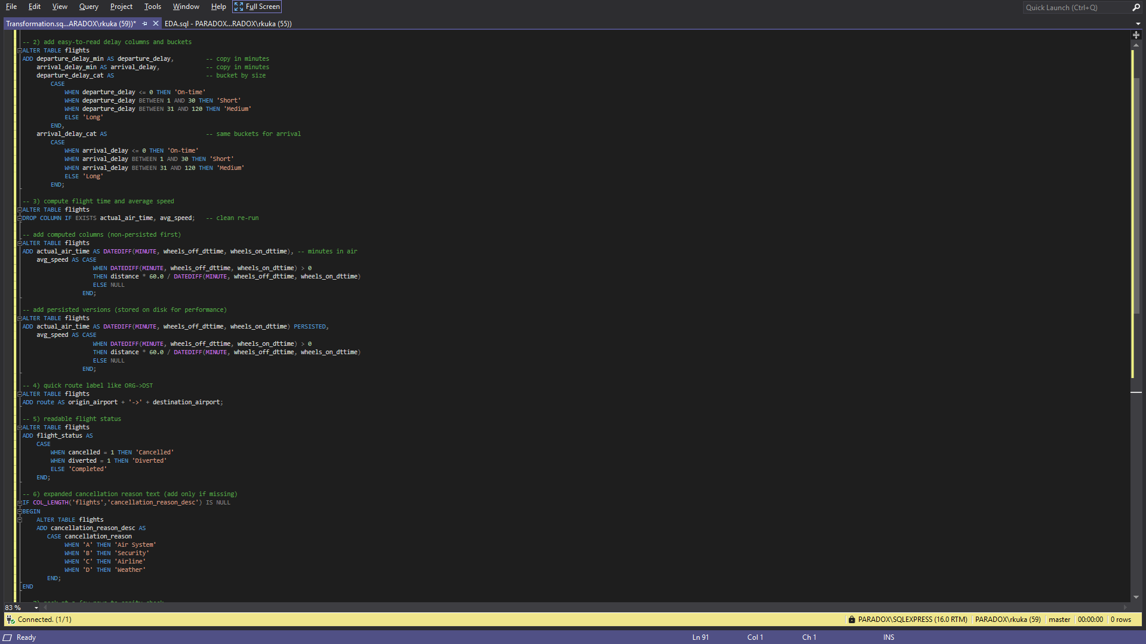
Data Tranformation
• Converted HHMM string columns into DATETIME columns for scheduled_departure, departure_time, wheels_off, wheels_on, arrival_time, and scheduled_arrival. Dropped previous HHMM string to avoid cluster.
• make flight date column from year, month and day column and drop these 3 columns
• Make Delay category for arrival and departure delay
- On-time if delay <= 0
- Short if 1 <= delay <= 30
- Medium if 31 < delay <= 120
- long for remaining
• new cancellation category created for cancellation
- WHEN 'A' THEN 'Air System'
- WHEN 'B' THEN 'Security'
- WHEN 'C' THEN 'Airline'
- WHEN 'D' THEN 'Weather'
• Readable flight status
- WHEN cancelled = 1 THEN 'Cancelled'
- WHEN diverted = 1 THEN 'Diverted'
- ELSE 'Completed'
• Computed departure_delay_min and arrival_delay_min correctly as differences between scheduled and actual times.
• Batches were used for transformation due to the large dataset size (~5.8M rows)
Notes:
Highlight challenges in handling large datasets and cleaning steps.

Slide 8
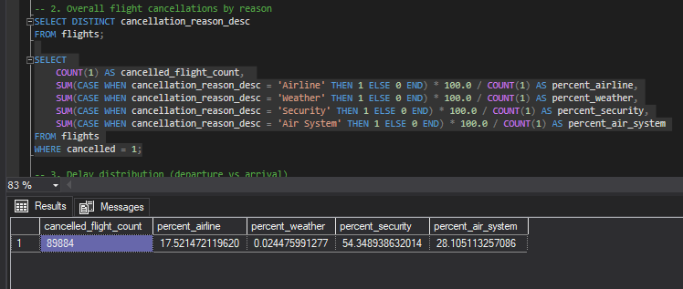
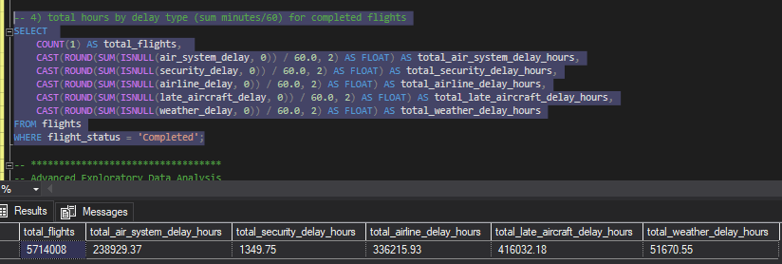
Exploratory Data Analysis(EDA)
Security and air-system contributes 82% of total flights Cancellations, followed by airline issue. Weather the affect least.
• airline, aircraft and air-system cause most of the delay in flights that are completed
Notes:
Highlight challenges in handling large datasets and cleaning steps.

Slide 9
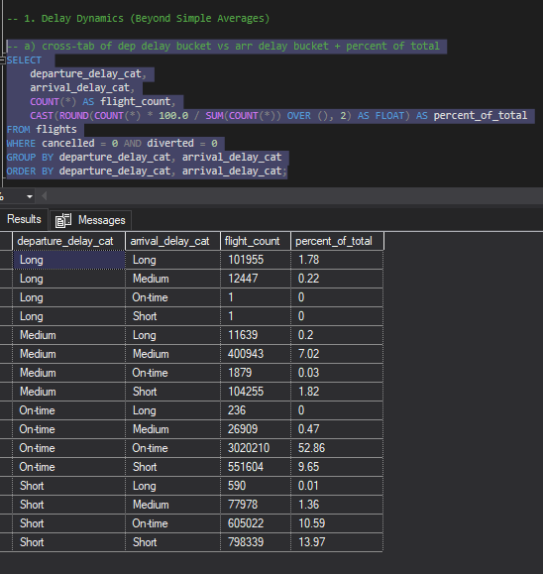
Exploratory Data Analysis(EDA)
Delay Propagation Patterns: Departure vs. Arrival
52.86% flights have both departure and arrival delays categorized as "On-time", which indicates smooth operations without significant delays.
Flights that have long departure delays tend to also experience long arrival delays (1.78% of total flights), showing that initial delays usually propagate till arrival.
Medium departure delays correspond most frequently to medium arrival delays as well (7.02%), but a notable percentage (1.82%) also recover to arrive shortly or on-time.
Short departure delays yield a substantial number of arrivals that are still short delayed (13.97%) or on-time (10.59%), suggesting minor departure delays do not severely impact arrival times.
Very few flights show cases where the arrival delay is significantly different from the departure delay (e.g., long departure delay but on-time arrival or vice versa), indicating some recovery or unexpected delay causes during the flight.
Notes:
Highlight challenges in handling large datasets and cleaning steps.

Slide 10
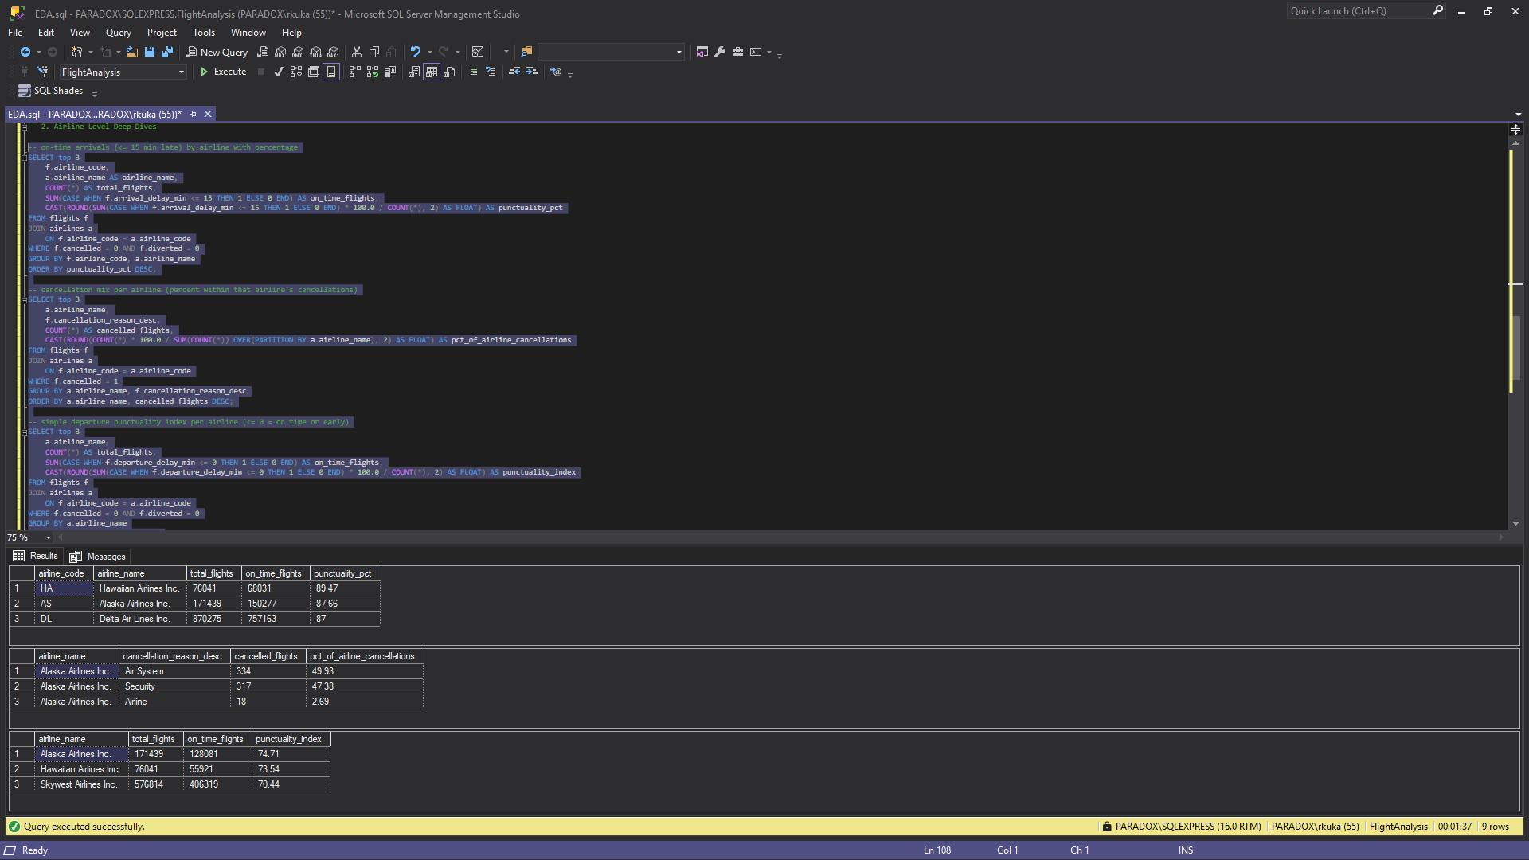
Exploratory Data Analysis(EDA)
Airline EDA
Hawaiian Airlines leads on on-time arrivals with 89.5%, followed by Alaska Airlines at 87.7% and Delta Air Lines at 87%, demonstrating strong arrival punctuality.
For departure punctuality, Alaska Airlines tops the list at 74.7%, closely followed by Hawaiian Airlines at 73.5%, and SkyWest Airlines at 70.4%, indicating good operational reliability in departures.
Alaska Airlines shows the highest cancellation rates, mainly due to air system and security issues, followed by American Airlines and Atlantic Southeast Airlines, highlighting key challenges related to cancellations.
Note: Insights for airport EDA were difficult to obtain and will be explored further using Power BI.
Notes:
Highlight challenges in handling large datasets and cleaning steps.

Slide 11
Dashboard Overview
• Designed an interactive Power BI dashboard.
• KPIs include average delay, cancellation rate, diversion rate and total flights.
• Visuals focus on delay reasons, cancellation reasons, airline performance, Airport and temporal trends.
Notes:
Show full dashboard screenshot here.

Slide 12
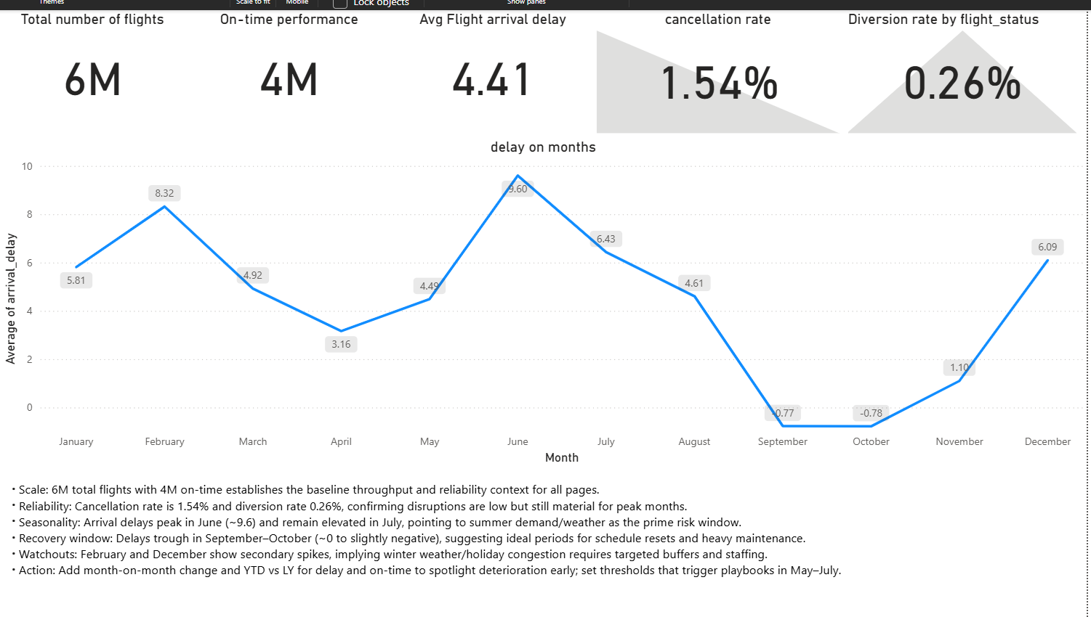
Key KPIs
Notes:
Explain how these KPIs reflect flight reliability.

Slide 13
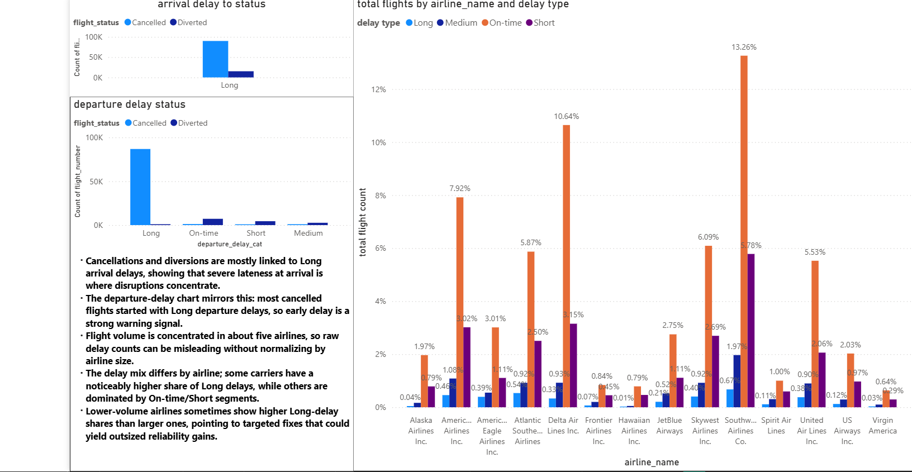
Airline Performance
• Comparison of airlines based on delays and cancellations.
• Identification of best and worst performing airlines.
• Helps target operational improvements.
Notes:
Display bar/column charts for airline performance here.

Slide 14
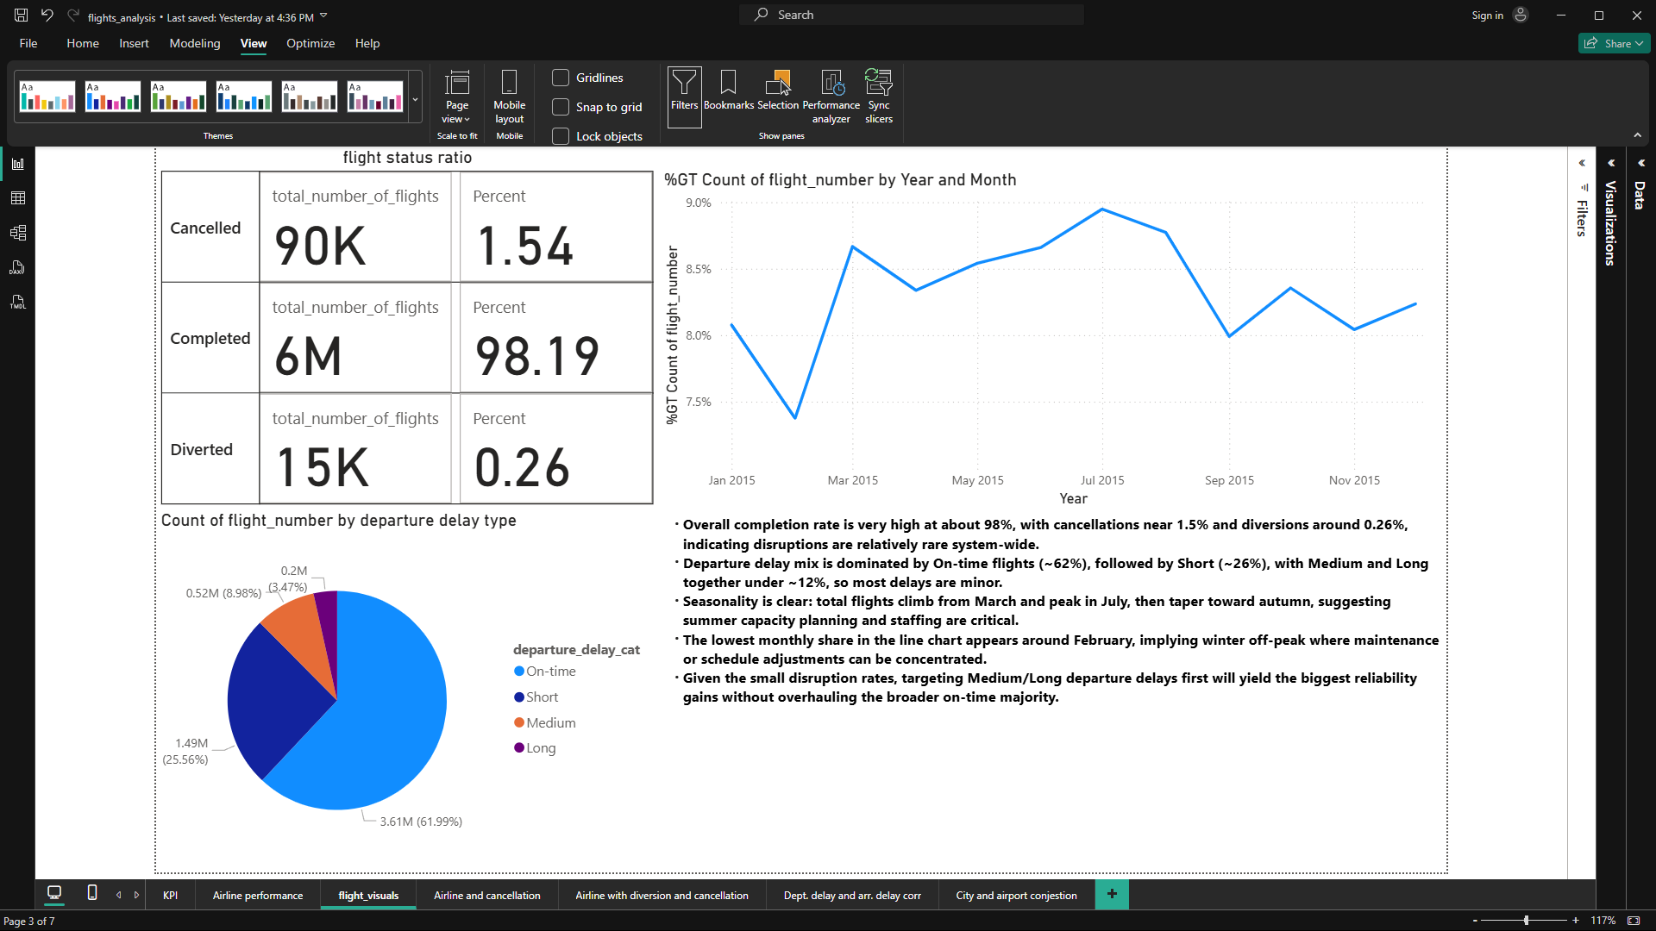
Temporal Trends
• Monthly and yearly flight volumes visualized.
• Seasonal delay and cancellation trends identified.
• Useful for capacity and staffing planning.
Notes:
Show time-series visuals here.

Slide 15
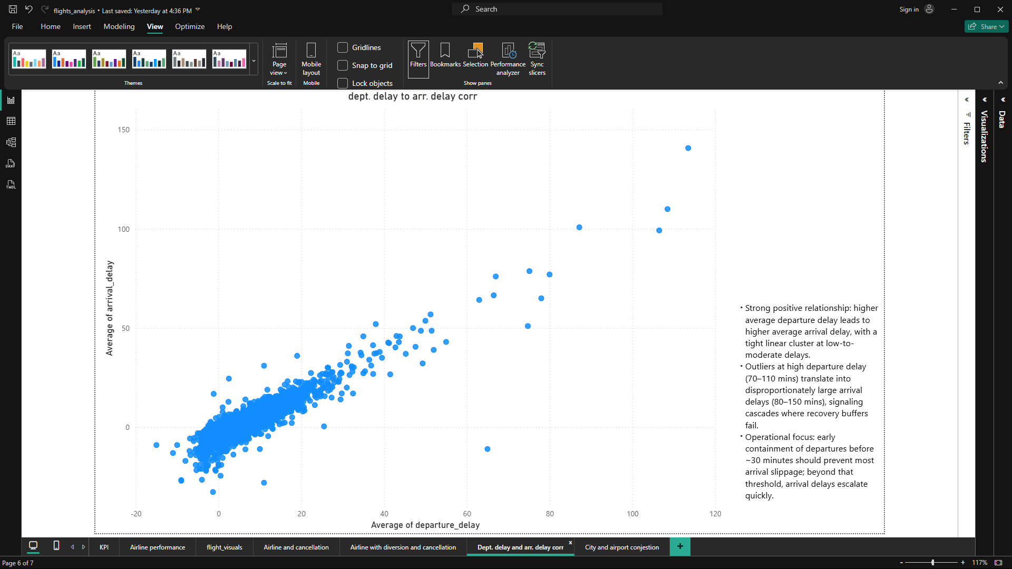
Delay Correlation Analysis
• Examined relationship between departure and arrival delays.
• Positive correlation observed (late departures lead to late arrivals).
• If depart late, it almost always lands late. the scatter shows a straight up trend.
After ~30 mins late at depart, things blow up fast. arrival delay climbs a lot and cancel risk goes up.
Notes:
Show correlation visuals and KPI values here.

Slide 16
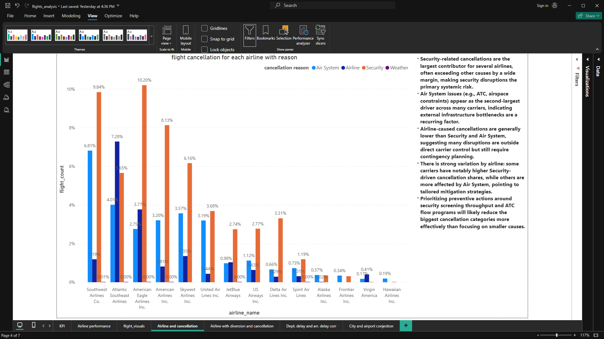
Cancellation Insights
• Major cancellation causes: Weather, Airline, Late Aircraft.
• Weather-related cancellations peaked in winter months.
• Enables better prediction and management strategies.
Notes:
Show pie chart or clustered bar chart here.

Slide 17
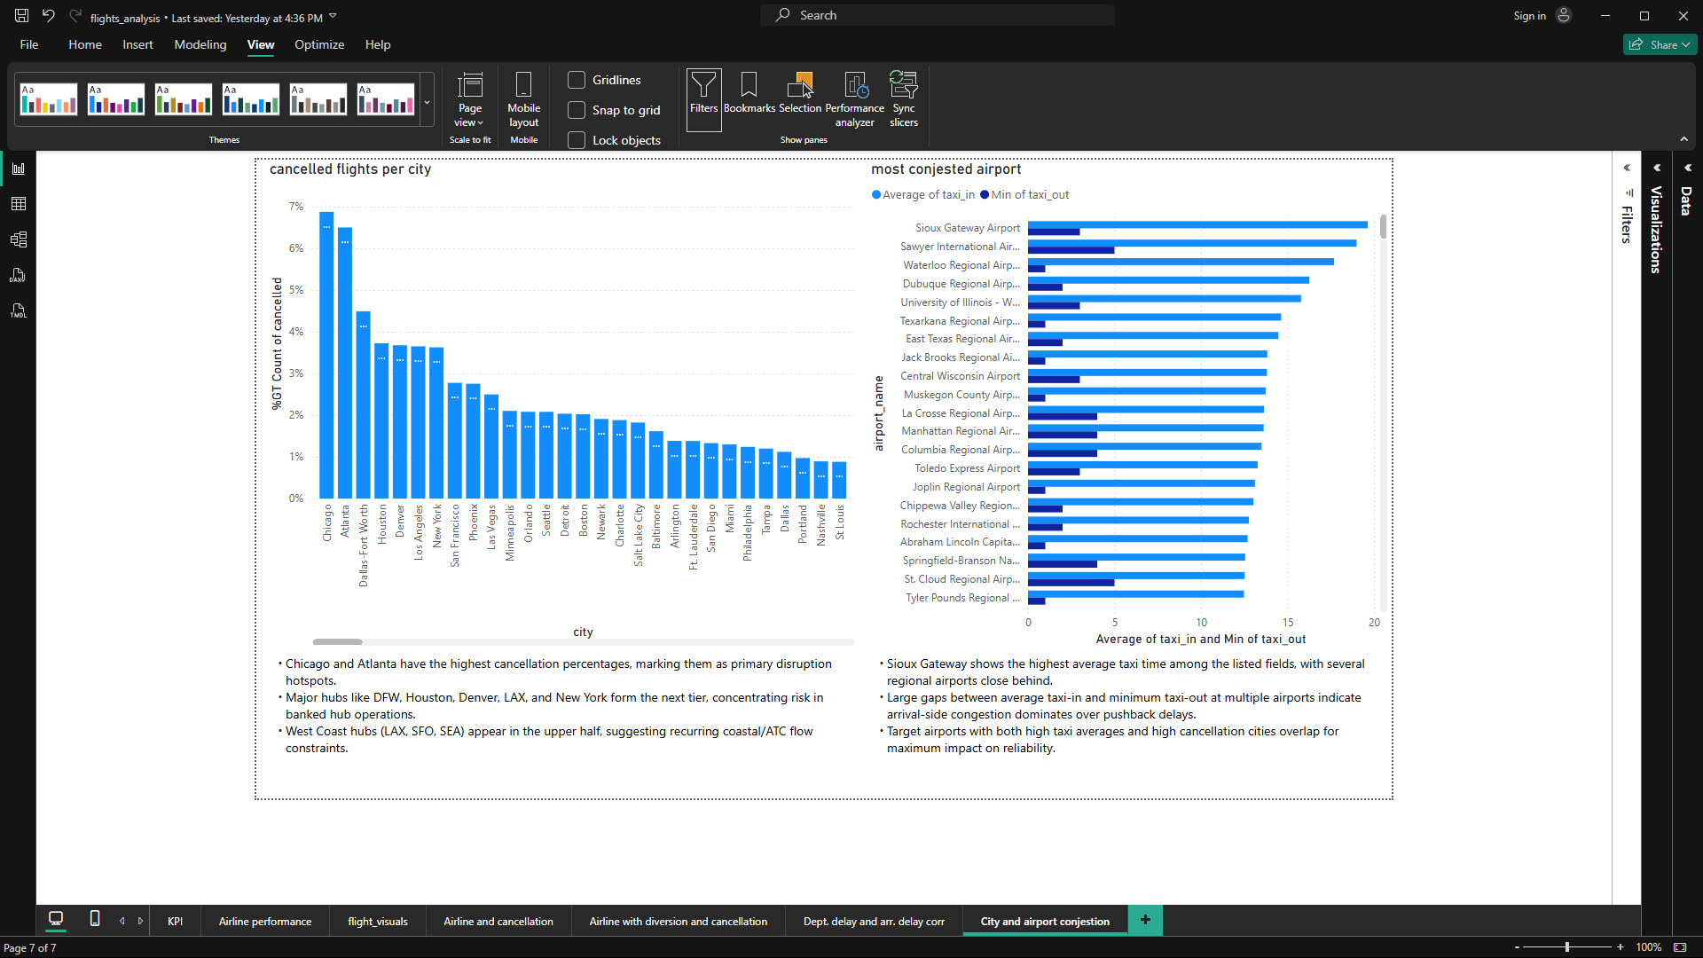
City and Airport Insights
Notes:
Use map or bar chart visuals here.

Slide 18
Conclusions
The airline system performs reliably for most of the year, with a very low overall cancellation (approx. 1.5%) and negligible diversion rate. However, reliability dips during peak summer and winter months due to spikes in delays.
Delay patterns reveal that late departures almost always lead to late arrivals especially after the 30-minute mark, both arrival delays and cancellation risks increase sharply.
A small group of airlines and major hub airports account for most disruptions, with many cancellations driven by security and air-system issues rather than just airline factors.
Chicago and Atlanta consistently see the highest cancellation rates, and several airports experience significant congestion due to long taxi times.
Traffic volume and delays peak in the summer; most delays are short, but preventing long delays is crucial, as they disproportionately lead to cancellations.
Notes:
Summarize findings and emphasize data-driven recommendations.

Slide 19
Business Insights
Boost operational resilience in summer and winter by adding schedule buffers, spare aircraft, and standby crews. Use September to October, the low-delay period, for schedule resets and maintenance.
Focus delay prevention at the departure gate: speed up turnarounds, redesign connections for high-risk chains, and selectively pre-cancel flights during weather or ATC disruptions to minimize wider network impact.
For airlines, target the top root causes of cancellations (e.g., security or airspace control) specific to their operation, and assess performance by delay and cancellation rates rather than raw numbers.
Prioritize disruption planning and tailored playbooks for major hubs like Chicago and Atlanta. At congested airports, optimize gate assignments, ramp staffing, and pushback procedures, especially during peak periods.
Track aircraft with frequent short turnarounds and proactively insert schedule buffers or substitute spares to prevent cascading disruptions.
Monitor key metrics long delay conversion, cancellation triggers, and connection protection and move to earlier boarding and strategic holding of key flights during periods of heightened risk.
Notes:
Summarize findings and emphasize data-driven recommendations.

Slide 20
Thank You
• U.S. Flights Analysis Project
• By RAVIRAJ KUKADE
Check Progress: https://github.com/users/PARADOXop/projects/7
Notes:
Conclude presentation and invite questions.

