Slide 1
Using a Smartphone for Behavior Change Studies
An Introduction to Fittle
28 August 2017

Slide 2
A Behavior Change Study involves (for this discussion)
Pre-study (Performed outside of Fittle)
Hypotheses, Experiment Design, Recruiting, Screening, Pre-survey/assessment, Assigning people to study conditions, etc.
Study (Using Fittle)
Asking people to do things
Assessing what they do
Communicating about their doings
Adjusting the ask and repeat, not necessarily in this order
Post-Study (Performed outside of Fittle)
Post-survey, Analyze the data, Compensate participants, etc.
Part of the study is implemented
by the system described here

Slide 3
Fittle Stakeholders
Roles | Responsibilities
Domain Expert | Develops programs of activities in a domain and authors descriptions of those activities (content such as activity descriptions and daily messaging)
Study Administrator | Sets up a study and coordinates and oversees the people's participation in the study. This includes assigning people into the study, running pre-/post- surveys etc.
Participant | Participates in behavior change studies as the intended audience for Fittle content.
System Programmer | (Optional) Supports ‘agile’ study development by developing and/or maintaining the PARCcoach code base and ancillary data (e.g., edit internal JavaScript Object Notation, JSON, files).
Coach Designer | (Optional) Creates external coaching agent(s) that interacts with PARCcoach throung an App Programming Interface (API)

Slide 4
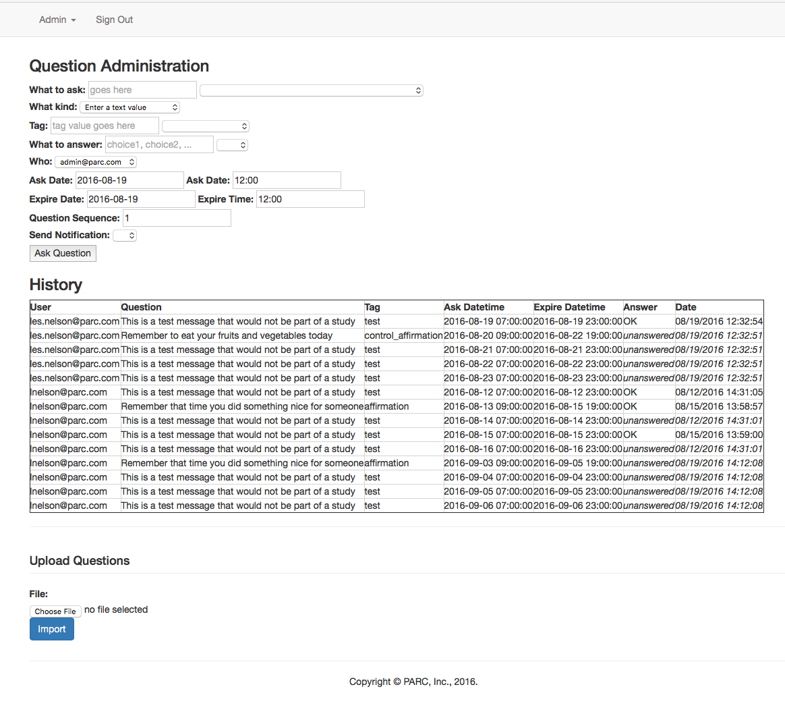
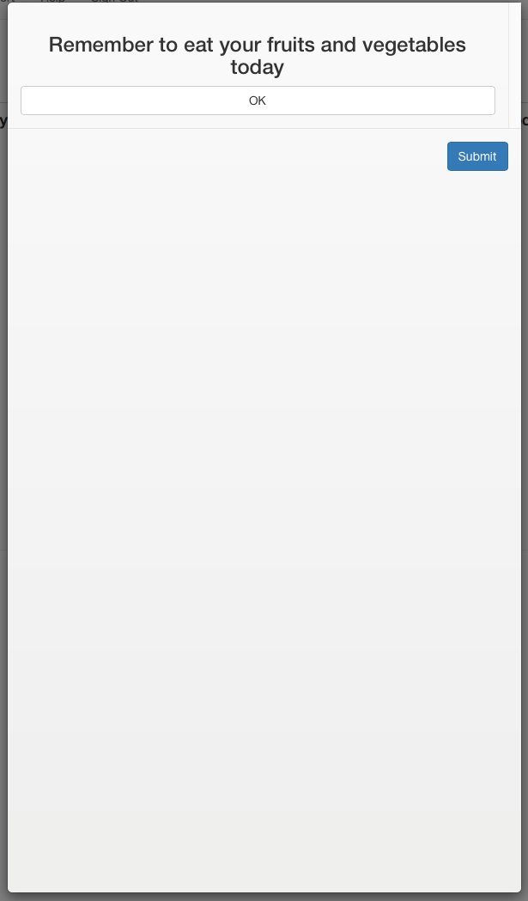
Studies Presented in Two Views
Admin via Web
User in App
Activities/ Reports
Questions/ Answers

Slide 5
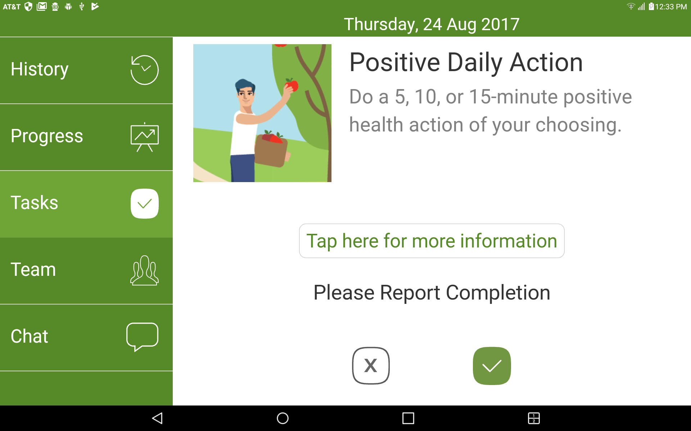
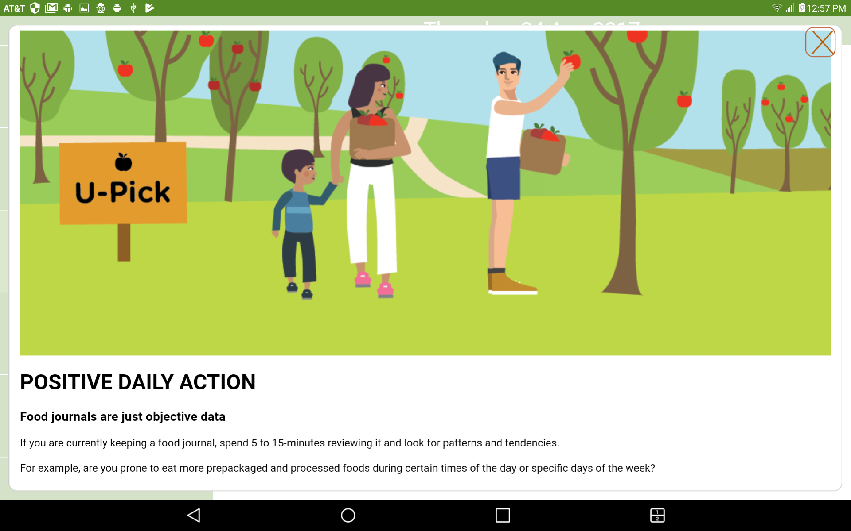
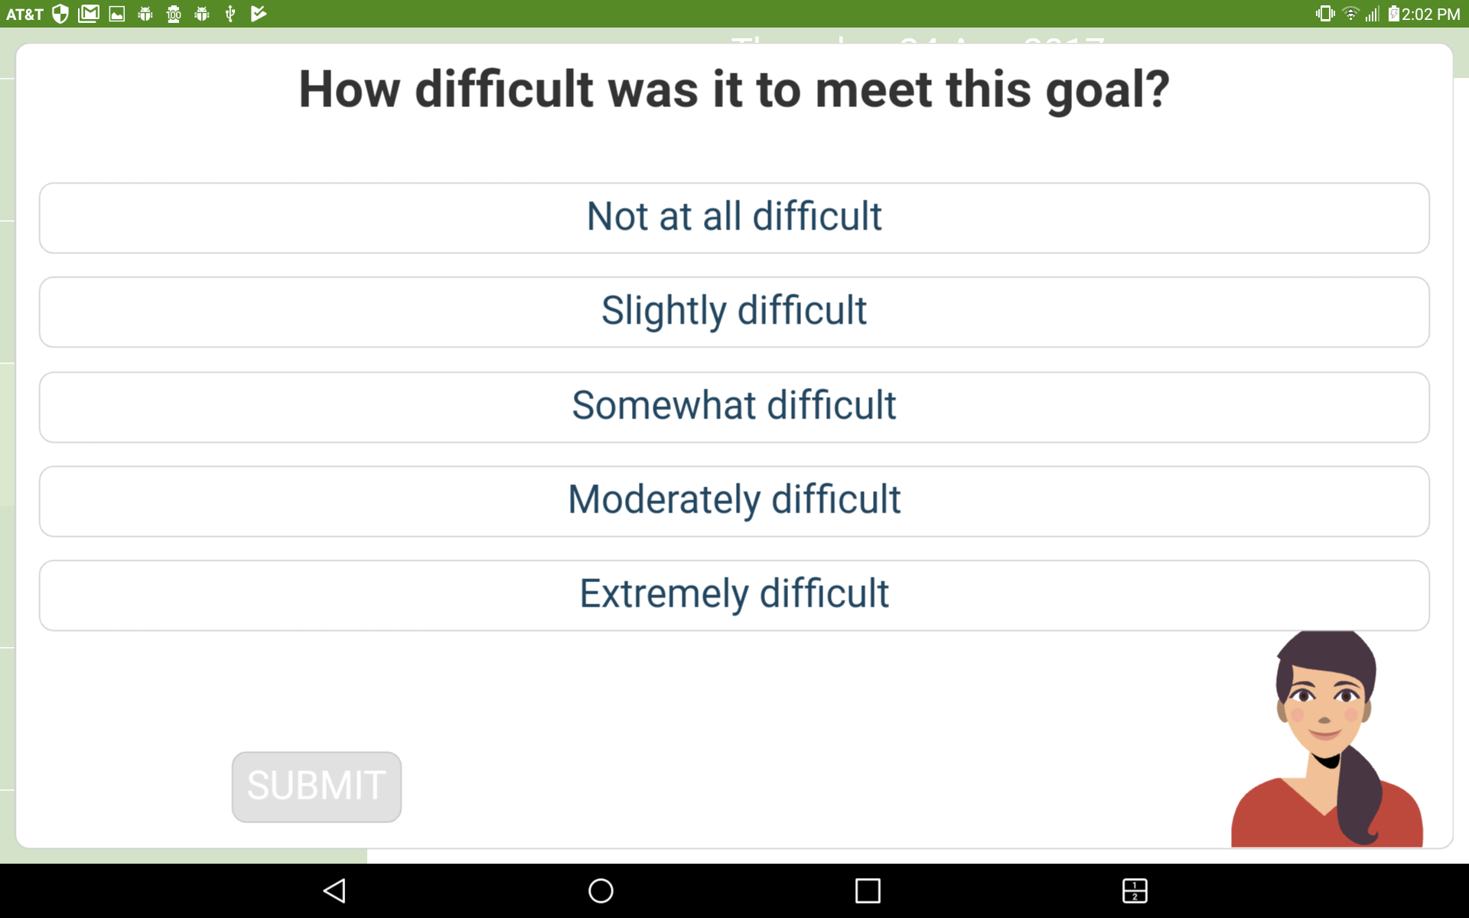
DEMO: About today
👈
👉
👈
👆
👈
👆

Slide 6
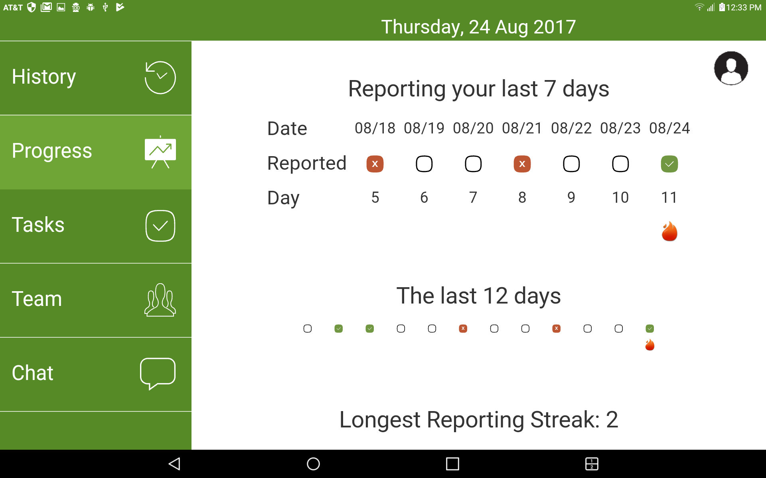
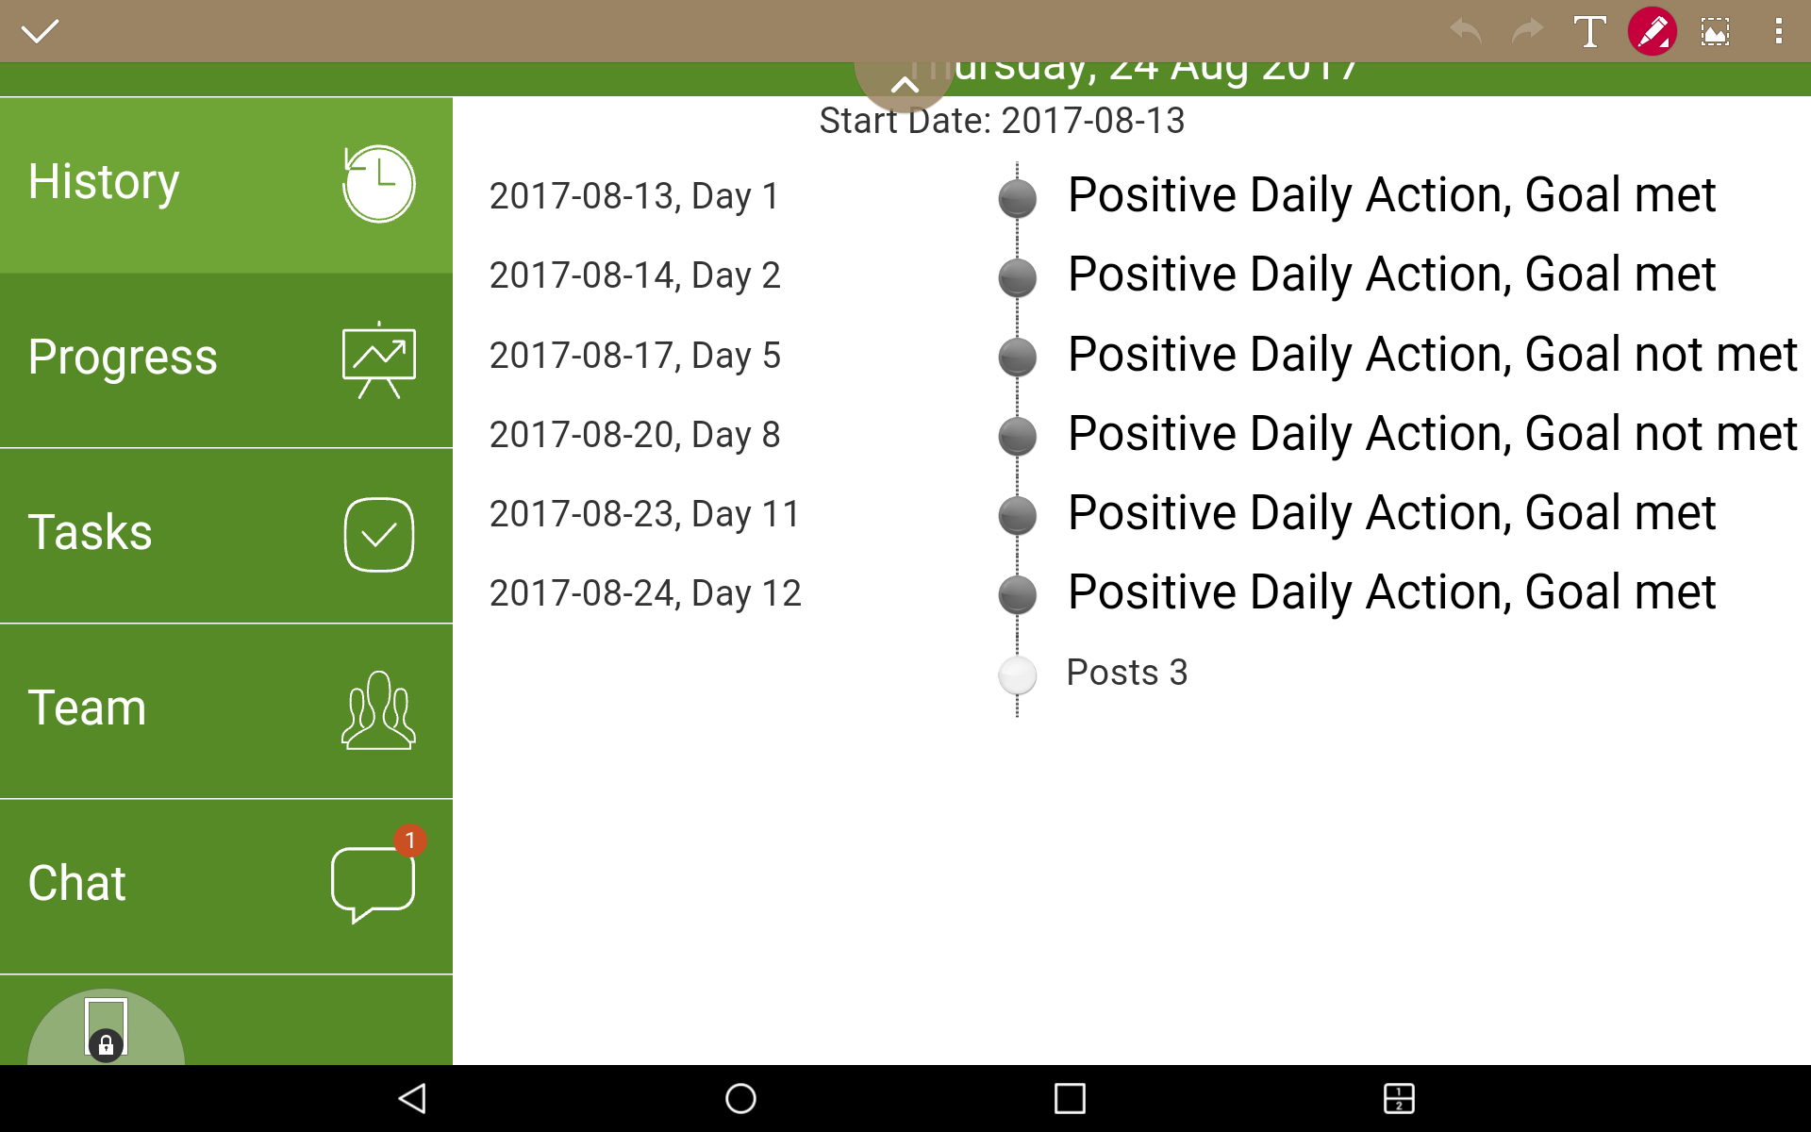
DEMO: About what’s happened
👉
👉

Slide 7
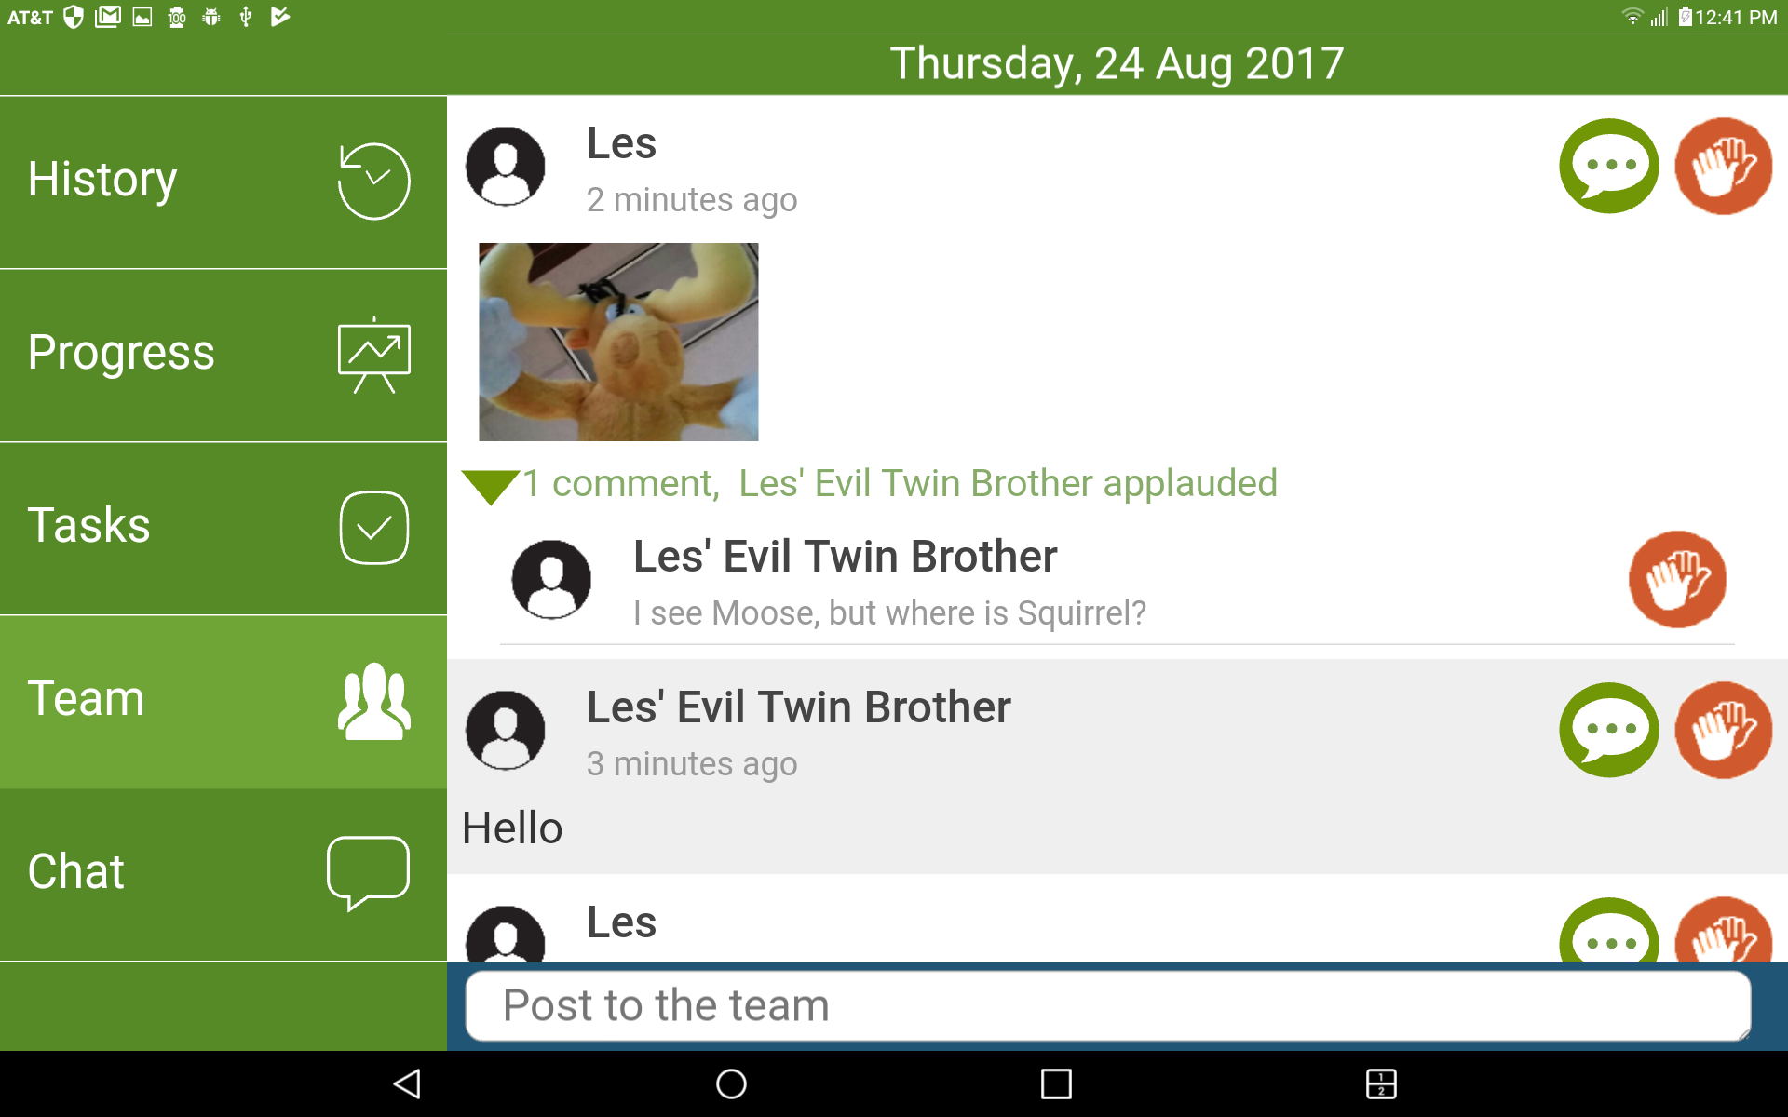
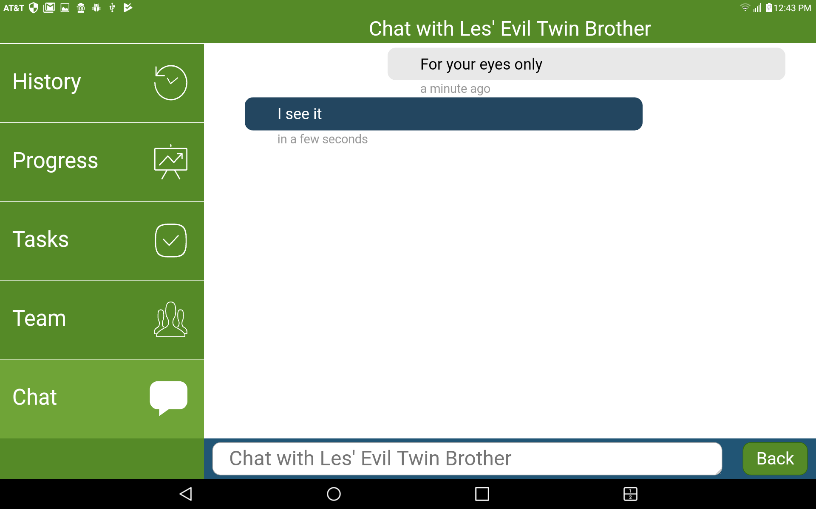
DEMO: About socializing
👉
👉

Slide 8
What the App Does Daily
Is Study over ?
Yes
Point to Post Survey
Start
No
Is Question pending ?
Yes
Show Question
Is Question answered ?
Yes
Save Answer
No
No
Is Activity scheduled ?
Show Activity
Is Activity reported ?
Yes
Save Report
No
Question Pending: AskDateTime <= Now < ExpireDateTime
Activity Scheduled: By Date (Today+00:00 <= Now < Today+24:00)

Slide 9
Developing Studies: Define using a Few Concepts
Message Schedule
condition
condition
isAssignedTo
Participant
hasA
isAsked
Question/ Message
answer
isAssigned
Activity/ Goal
report
Defined by Admin imports (JSON)
Generated from imports

Slide 10
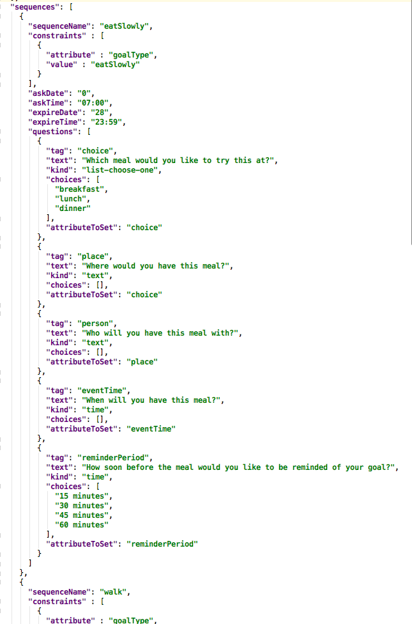
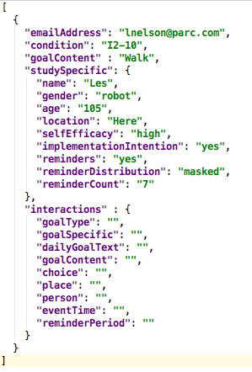
Example Study Admin specs: JSON
Questions
Participants
Schedule
Activities
‘Interactive’ Question Schedule

Slide 11
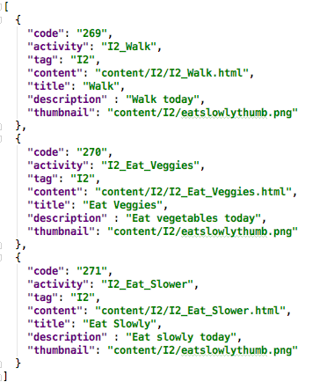
How to Run a Study: Design
What activities are participants going to do on which days?
What messaging are people going to get on which days and under what constraints (e.g., constrained by treatment vs. control condition)?

Slide 12
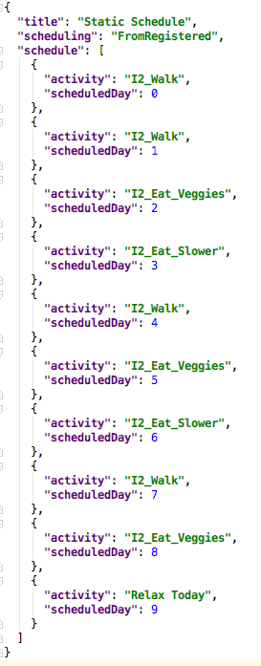
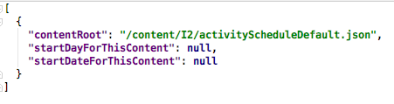
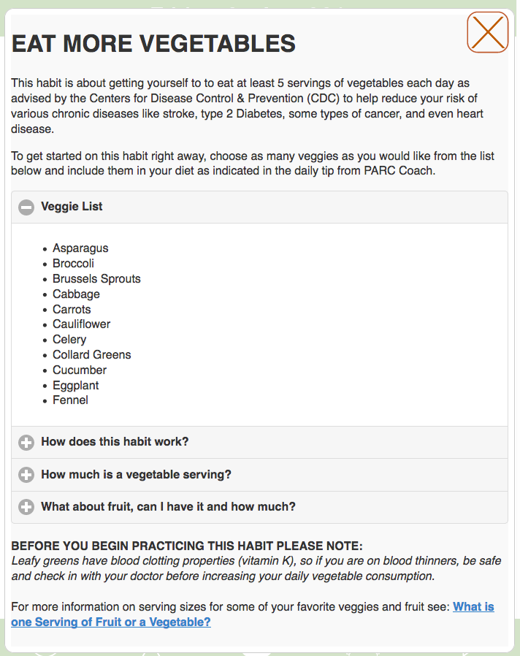
How to Run a Study: Design
What activities are participants going to do on which days?

Slide 13
How to Run a Study
Design the Study, including the following concepts:
What activities are participants going to do on which days?
What messaging are people going to get on which days and under what constraints (e.g., constrained by treatment vs. control condition)?
Set up the Study Logistics
What individuals will participate, in what condtions?

Slide 14
How to Run a Study
Design the Study, including the following concepts:
What activities are participants going to do on which days?
What messaging are people going to get on which days and under what constraints (e.g., constrained by treatment vs. control condition)?
Set up the Study Logistics
What individuals will participate, in what condtions?

Slide 15
Adding in a Coaching Model
Coach/
Agent
gets Condition From
asks
gets Answer From
assigns
gets Report From
Participant
isAsked
Question/ Message
answer
condition
isAssigned
Activity/ Goal
is Described By
Coach will request via JSON API
e.g., /questions/create/…
e.g., /activities/read/...
report
Card

