Slide 1

Programming for Artists

Slide 2
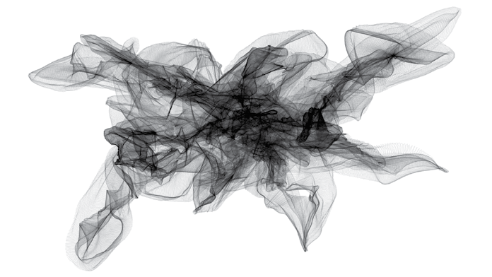
Drawing with particles by 01010101 (2009)

Slide 3

Cartesian Creatures by David Dessen (2007)

Slide 4
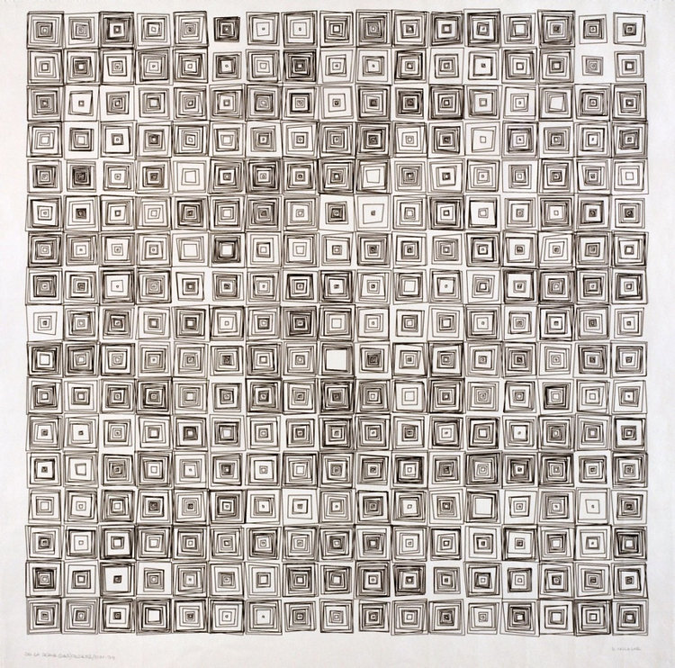
(Dés)Ordres by Vera Molnár (1974)

Slide 5
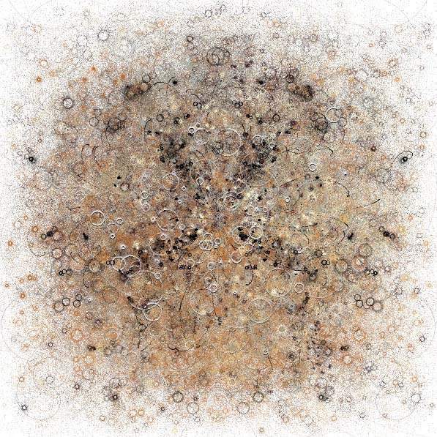
Bubble Chamber by Jared Tarbell (2003)

Slide 6
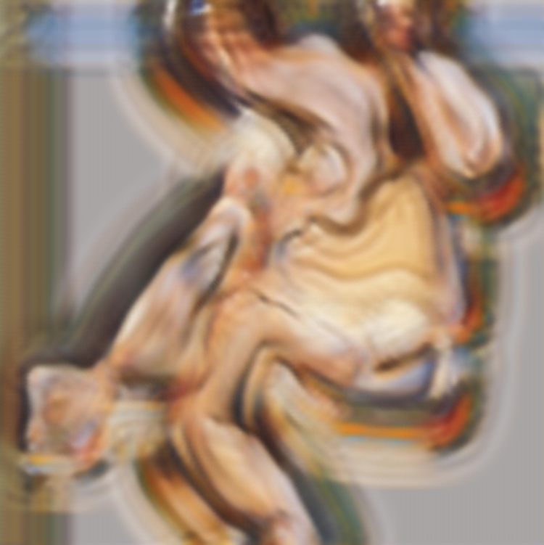
Nude Portrait by Robbie Barrat (2018)

Slide 7
Nude Portrait by Robbie Barrat (2018)

Slide 8
What is code?
A series of instructions for the computer
A precise way of explaining how to do something
Written in a programming language
Facilitate communication between human and machine, rather than human and human

Slide 9
Code as an artistic tool
Like a paintbrush which can be used to paint a wall
Add interactivity
Artists, designers, architects use software to realise artistic vision – learning code gives more flexibility
Generative art - “taking strict, cold, logical processes and subverting them into creating illogical, unpredictable, and expressive results. […] Generative art is about creating the organic using the mechanical.”

Slide 10
Organic vs Mechanical
From the standpoint of Taoist philosophy natural forms are not made but grown, and there is a radical difference between the organic and the mechanical.
Things which are made, such as houses, furniture, and machines, are an assemblage of parts put together, or shaped, like sculpture, from the outside inwards.
But things which grow shape themselves from within outwards—they are not assemblages of originally distinct parts; they partition themselves, elaborating their own structure from the whole to the parts, from the simple to the complex.
Alan Watts, 1958

Slide 11
Getting Started
Search for “openprocessing” and open link
Sign up
Create first sketch
Change the background to pink
  background(‘pink’)
noLoop();

Slide 12

Canvas
We need canvas to draw
We need to know how big the canvas is (width & height)
createCanvas(width,height)
Width and height are pixels

Slide 13
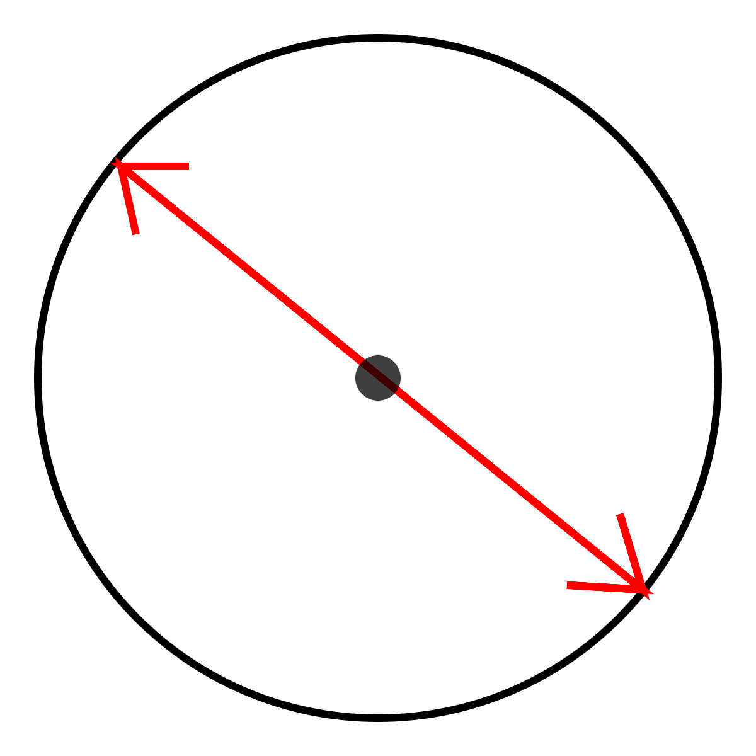
Circles
Two pieces of information
  Location
  Diameter

Slide 14
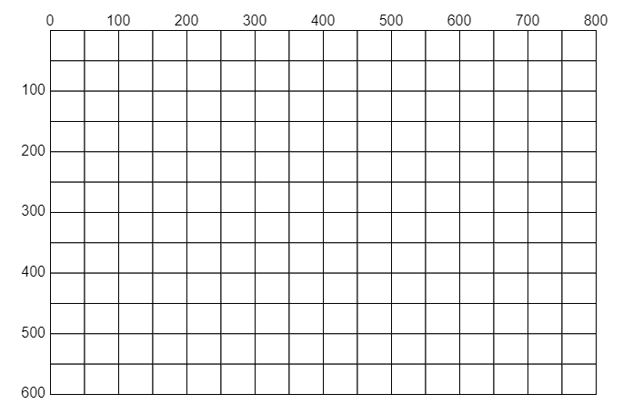
Coordinate system
(computer)
X
Y

Slide 15
Draw some circles
Canvas is measured in pixels, which are TINY!
Ellipse to circle like rectangle to square
Try drawing some circles: ellipse(x, y, diameter)
Examples:
  ellipse(0,0,200);
  ellipse(150,120,50);
  ellipse(180,200,20);

Slide 16
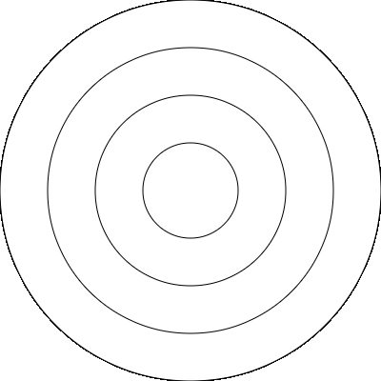
Try making this

Slide 17
Saving and forking
Go through saving work on openprocessing
Talk about forking work
Let them fork my work to try it out

Slide 18
Other shapes
Rectangle:
  rect(x,y,width,height)
  x and y refer to top left corner
Line:
  line(startX, startY, endX, endY)
Check p5 reference for more shapes
  http://p5js.org/reference

Slide 19
Some grammar for code
Read from top to bottom
Semi colon at end of line
Case sensitive
Commands to the computer look like this
  ellipse(argument1, arguement2);
  The brackets make the command run
  The arguments are information we give the command, e.g. how big to make circle or where to put circle

Slide 20
Colours
Named colours
  ‘darkolivegreen’
  ‘dimgrey’
  ‘dodgerblue’
Try changing the colour of the circles by using typing the following before the circles:
  fill(‘purple’);
More colours: colours.neilorangepeel.com

Slide 21
More Colour
Grayscale – color(100)
  If one number provided to color command it will use grayscale
  0 is black, 255 is white
RGB – color(red,green,blue)
Hex codes – color(‘#6495ED’)

Slide 22
Randomness
Computers can come up with random numbers
To pick a random number you want to know the range
random(100);
  This picks a number between 0 and 100
random(100,200);
  This picks a number between 100 and 200
Try giving your circles a random size or location

Slide 23
Random Colour
Lists, in a computer program, are surrounded by square brackets
  [1,2,3,4]
We can have a list of named colours:
  [‘red’, ‘green’, ‘blue’, ‘yellow’]
We can use the random instruction to tell the computer to pick a random colour
  random([‘darkcyan’, ‘olive’, ‘yellowgreen’])
Try giving the circles random colours

Slide 24

Putting it together
Try finding your own colours to use
Try having some things random and others not – for example you could pick a specific size for your circles
See what happens if you change the range for the randomness
background(‘#94A537’);
fill( random([‘green’, ‘purple’]) );
circle(random(800),random(500),random(100));

Slide 25
Variables
A way of saving a value to use later
Can use them to easily change the size of several shapes
Can use it to easily move connected shapes
Could use it to give several shapes the same random number or random colour
Built in variables: width, height, windowWidth, windowHeight

Slide 26
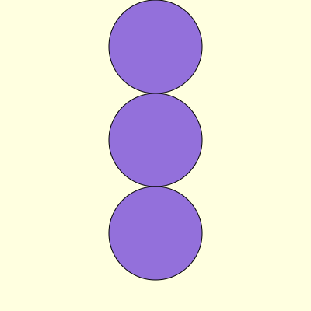
Worked Example

Slide 27
Functions
Grouping commands together
function randomCircle() {
  fill(random([‘red’,’black’]));
  circle(random(width),random(height),100);
}
Can give them ‘arguments’:
function randomCircle(diameter) {
  fill(random([‘red’,’black’]));
  circle(random(width),random(height),diameter);
}

Slide 28

Challenge
Try making this shape
Try making its location random
Try making its colour random

Slide 29
Loops
Counts numbers
We choose starting number
We choose number it ends at
We choose whether we count up, down, and how much we add or subtract each time
Each time the loop counts it performs an action, the action can be based on the number the loop is at in the count

Slide 30
If this then that

Slide 31
Loop inside a loop

Slide 32
Toolbelt
Lines
Shapes
Colours
Other inputs
Randomness
Repetition
Displacement
Algorithms

