Slide 1

DIGITAL TWIN ECOSYSTEM FOR
ENERGY-EFFICIENT CLASSROOM LIGHTING
A Real-Time 3D Simulation & Algorithmic Assessment Framework Built in Unity 3D
GUIDED BY – PROF. (DR.) SUDHAKAR PANDEY
C Paresh
Ishant Singh
Mahima Shukla
MINOR PROJECT
Presented By:
National Institute of Technology
Raipur, India
1/14

Slide 2
INTRODUCTION & REAL-WORLD MOTIVATION
23% – 42%
10.7 hrs/day
970+ lux
of educational building
energy goes to lighting
lights left ON in empty
classrooms (55 rooms surveyed)
over-designed fixtures vs.
500 lux standard (EN 12464-1)
What is a Digital Twin?
▸
A real-time, interactive 3D virtual replica of a physical classroom running in Unity 3D
▸
Zero hardware risk — simulate & prove savings before buying any sensors or IoT devices
▸
Instant time travel — compress an entire semester's energy data into seconds
▸
Scenario testing — toggle between control algorithms with a single keypress
💡 KEY INSIGHT: Our Digital Twin enables facility managers to test energy-saving strategies virtually — saving time, cost, and risk before any physical deployment.
3/14

Slide 3
RESEARCH PROBLEMS & CHALLENGES
1
Human Negligence & Energy Waste
63.6% probability lights remain powered ON overnight after the final lecture ends. Field survey: 9 university buildings, 55 classrooms.
2
Binary Manual Switches
Traditional wall switches provide zero context-awareness — no adaptation to occupancy, daylight, or class schedule variations.
3
High Capital Risk for IoT Retrofitting
Campus-wide deployment of smart sensors faces uncertain ROI. Institutions need proof of savings before committing budget.
4
Uniform Luminance Waste
Window-adjacent zones and interior corridor zones receive identical artificial illumination, ignoring free natural sunlight from 9 AM to 1 PM.
5
No Spatial Simulation Platform
Traditional facility management uses static spreadsheet calculations — unable to capture real-time 3D spatial lighting dynamics or zone-wise dimming.
4/14

Slide 4
LITERATURE REVIEW & COMPARATIVE ANALYSIS
Paper Title & Reference | Year & Journal | Methodology | Critical Limitation
Digital Twin Assessment for Classroom Lighting (Seo & Yun) — Base Paper | 2022 MDPI Buildings | • Probabilistic occupancy model • Mathematical EUI calculation • Field survey of 55 classrooms | Static formula evaluation; lacked real-time 3D interactive physics simulation
BIM & Digital Twin for Electrical Systems (Industrial Case Study) | 2023 IEEE Access | • BIM model integration • Industrial electrical layout • Digital twin for maintenance | High computational overhead; tailored for industrial not academic environments
Adaptive Lighting & Thermal Comfort via Deep RL (Zhang et al.) | 2024 Applied Energy | • Deep Reinforcement Learning • Joint lighting & HVAC control • Sensor-driven adaptation | Requires intensive training data; computationally expensive for basic retrofit decisions
IoT Smart Home Energy Dispatch via ESP32/MQTT (Kumar et al.) | 2023 Sensors (MDPI) | • Rule-based microcontroller • ESP32 & MQTT protocol • Web-based monitoring | Tested only on residential micro-loads; ignores commercial daylight harvesting
LoRa IoT Home Automation (Server-Based Approach) | 2022 Journal of Computing & Info Science | • LoRa technology • IoT-enabled web automation • Server-based control | No AI/ML or intelligent decision-making; does not evaluate energy efficiency
5/14

Slide 5
RESEARCH GAPS → PROJECT OBJECTIVES MAPPING
Identified Research Gap | Obj 1: 3D Spatial Visualization | Obj 2: Timetable & Day-Night Engine | Obj 3: Multi-Scenario Algorithm Suite | Obj 4: Live Analytics & HUD Dashboard
Absence of spatial zone modeling (Window vs Corridor side) | ✔ | — | ✔ | —
High capital barrier for IoT pilot deployments | ✔ | ✔ | ✔ | ✔
Inability to simulate rapid time acceleration (semester → seconds) | — | ✔ | — | ✔
Lack of real-time cumulative savings feedback during operation | — | — | ✔ | ✔
Disregard of ergonomic lux thresholds (over-lighting >970 lux vs 500 lux) | ✔ | — | ✔ | —
No visual scenario comparison tool for facility managers | ✔ | ✔ | ✔ | ✔
✅ RESULT: Every project objective directly bridges a documented real-world deployment gap — ensuring academic and practical relevance.
6/14

Slide 6
DIGITAL TWIN SYSTEM ARCHITECTURE
LAYER 1: PHYSICAL ENVIRONMENT
• Procedural Room Geometry: 11.5m × 9.0m × 3.0m (ClassroomBuilder.cs)
• 12 LED Panel Fixtures: 1.2m × 0.3m panels with Spot Lights (75° angle, 6m range)
• 3-Zone Row Layout: Row1_Window | Row2_Center | Row3_Corridor
• Emissive Shader Materials: Dynamic emission color for ON/OFF visual feedback
• Directional Sun Light: Simulated solar path (rotation 35°, -110°, 0°)
• Assets: Floor, 4 Walls, Window Glass, Blackboard, Teacher Podium, Student Desks
LAYER 2: SIMULATION ENGINE CORE (C#)
• Accelerated Time Clock: 1 real second = 15 simulated minutes (24-hour cycle)
• Occupancy Logic: isOccupied = (time >= 9:00 AM && time <= 6:00 PM)
• Daylight Detection: isDaylightStrong = (time >= 9:00 AM && time <= 1:00 PM)
• Power Constants: FULL_POWER = 65W/fixture, DIMMED_POWER = 34W/fixture
• Energy Accumulator: cumulativeEnergyWh += currentPowerW × deltaTimeHours
LAYER 3: ALGORITHMIC CONTROL & TELEMETRY
• 5 Control Scenarios: Baseline(0), Manager(1), PIR(2), Dimming(3), Daylight(4)
• Real-Time Keyboard Switching: Keys 0-4 toggle scenarios during simulation
• Live OnGUI Dashboard: Time, Occupancy, Scenario, Power(W), Energy(kWh), Saved(%)
• Baseline Differential Tracker: Computes % savings against always-ON reference
7/14

Slide 7
MATHEMATICAL MODEL & PHOTOMETRIC STANDARDS
📐 ENERGY CONSUMPTION FORMULATION
💡 PHOTOMETRIC COMPLIANCE (EN 12464-1)
Time Steps Calculation:
n = d × 24 × (60 / Δt)
Cumulative Energy (Wh):
Eᵢ = (Δt / 60) × Σ ( Pₜ,ᵢ × LPₜ,ᵢ )
Where:
d = Number of analysis days
Δt = Time step in minutes (simulation step)
Pₜ,ᵢ = Light state at time t {0 = OFF, 1 = ON}
LPₜ,ᵢ = Power consumption at step t (Watts)
Eᵢ = Total energy consumed (Watt-hours)
Current vs Standard Illuminance:
EXISTING: ~970 lux (Over-Designed) ⚠️
STANDARD: 500 lux ✓
From SimulationEngine.cs (actual values):
Full Power per fixture: 65 W
Dimmed Power per fixture: 34 W
Total fixtures: 12 panels
Full Load (12 × 65W): 780 W
Dimmed Load (12 × 34W): 408 W
Dimming Ratio: 34/65 ≈ 52.3%
Energy Saved by Dimming: ~47.7%
Digital Twin Ecosystem for Energy-Efficient Classroom Lighting | Minor Project
8/14

Slide 8
BENCHMARKED CONTROL SCENARIOS
5 distinct strategies implemented in SimulationEngine.cs — switchable via keyboard keys [0-4]
0
1
2
3
4
BASELINE
MANAGER CUTOFF
PIR MOTION SENSOR
ILLUMINANCE DIMMING
DAYLIGHT HARVESTING
No control. Lights remain ON
regardless of occupancy.
Scheduled cutoff: all lights
forced OFF after 6:00 PM.
Occupancy-driven: lights OFF
when room is empty.
Quantitative dimming: 970 lux
down to 500 lux standard.
Window-side Row 1 OFF
from 9 AM to 1 PM.
All lights = ON
if (time >= 18:00)
lights = OFF
if (!occupied)
lights = OFF
power = 34W
(from 65W)
if (daylight)
windowLights = OFF
780 W
~62%
saved
~63%
saved
~47%
saved
~5-8%
saved
Hotkey: 0
Hotkey: 1
Hotkey: 2
Hotkey: 3
Hotkey: 4
🔗 HYBRID: PIR + Dimming (Scenario 2×3) achieves maximum ~80.5% savings — the best of both worlds!
9/14

Slide 9
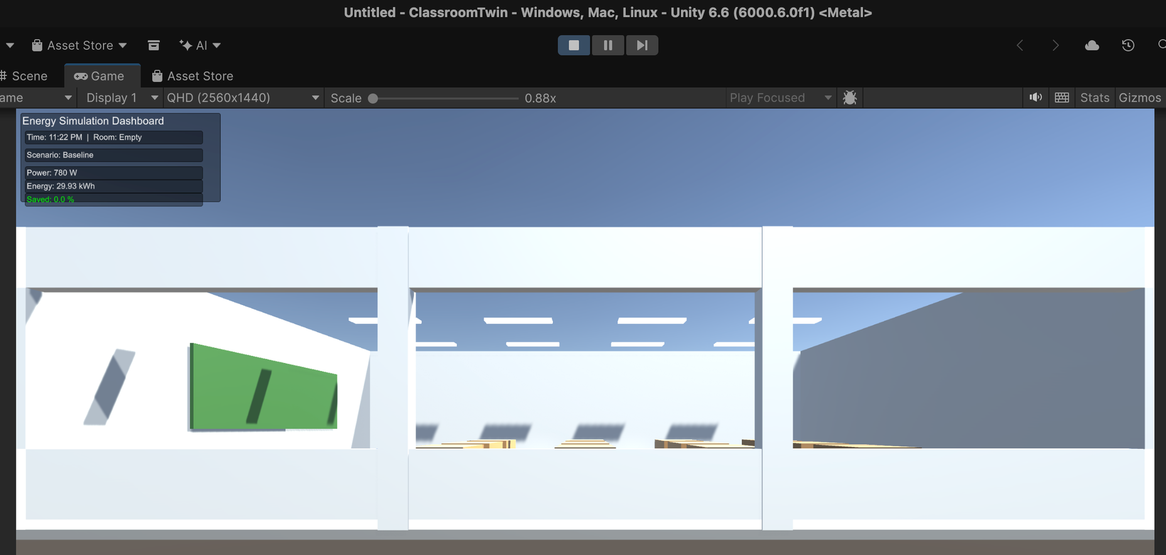
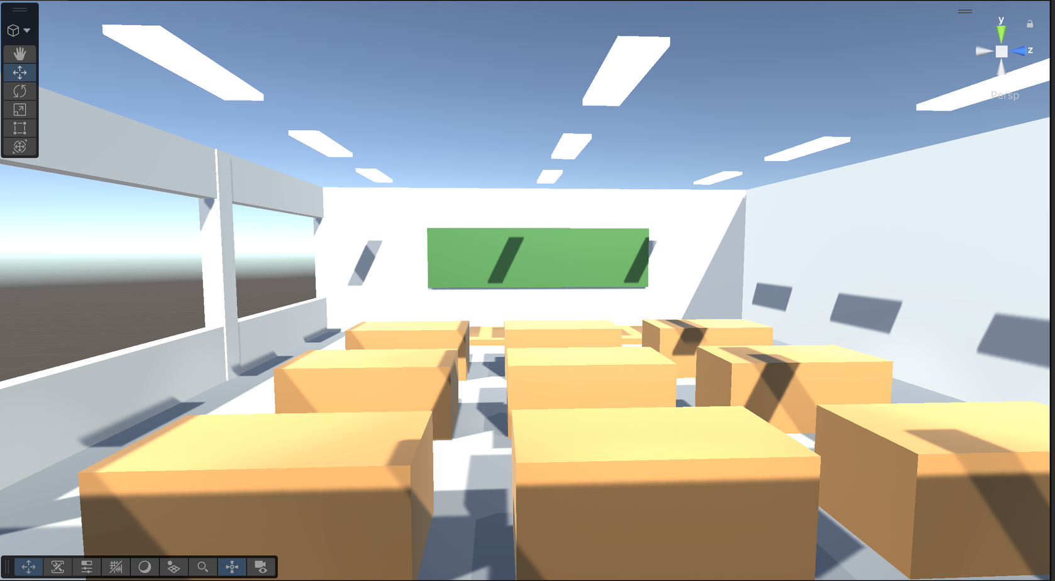
DIGITAL TWIN 3D CLASSROOM — VISUAL GALLERY
10/14

Slide 10
WHAT WE BUILT: SIMULATION WALKTHROUGH
🏫 PROCEDURAL 3D ENVIRONMENT
📊 LIVE TELEMETRY DASHBOARD (OnGUI)
Room Dimensions:
11.5m × 9.0m × 3.0m (from ClassroomBuilder.cs)
Floor:
Gray concrete slab (11.5m × 9.0m)
⏰ Time:
01:55 PM | Room: Occupied
Walls:
4 walls — Front (blackboard), Back, Corridor, Window
🎛️ Scenario:
Baseline (Key 0)
Windows:
Transparent glass with 2 pillars, sill + header
Blackboard:
4.5m wide, dark green, mounted at 1.6m height
⚡ Power:
780 W (12 × 65W = Full Load)
Teacher Podium:
1.5m × 6.0m raised platform
🔋 Energy:
3.86 kWh (cumulative)
Student Desks:
Grid layout (7 columns × 3 rows = 12 desks)
💚 Saved:
0.0 % (vs Baseline reference)
LED Fixtures:
12 panels across 3 rows (4 per row)
→ Panel Size:
1.2m × 0.3m, mounted at 2.95m ceiling
→ Spotlight:
Spot type, 75° angle, 6.0m range, 4500K color
⌨️ REAL-TIME KEYBOARD CONTROLS:
Sun Light:
Directional, rotation (35°, -110°, 0°)
[0] Baseline [1] Manager [2] PIR [3] Dimming [4] Daylight
Time Speed: 1 real sec = 15 sim minutes (full day in ~96 seconds)
11/14

Slide 11
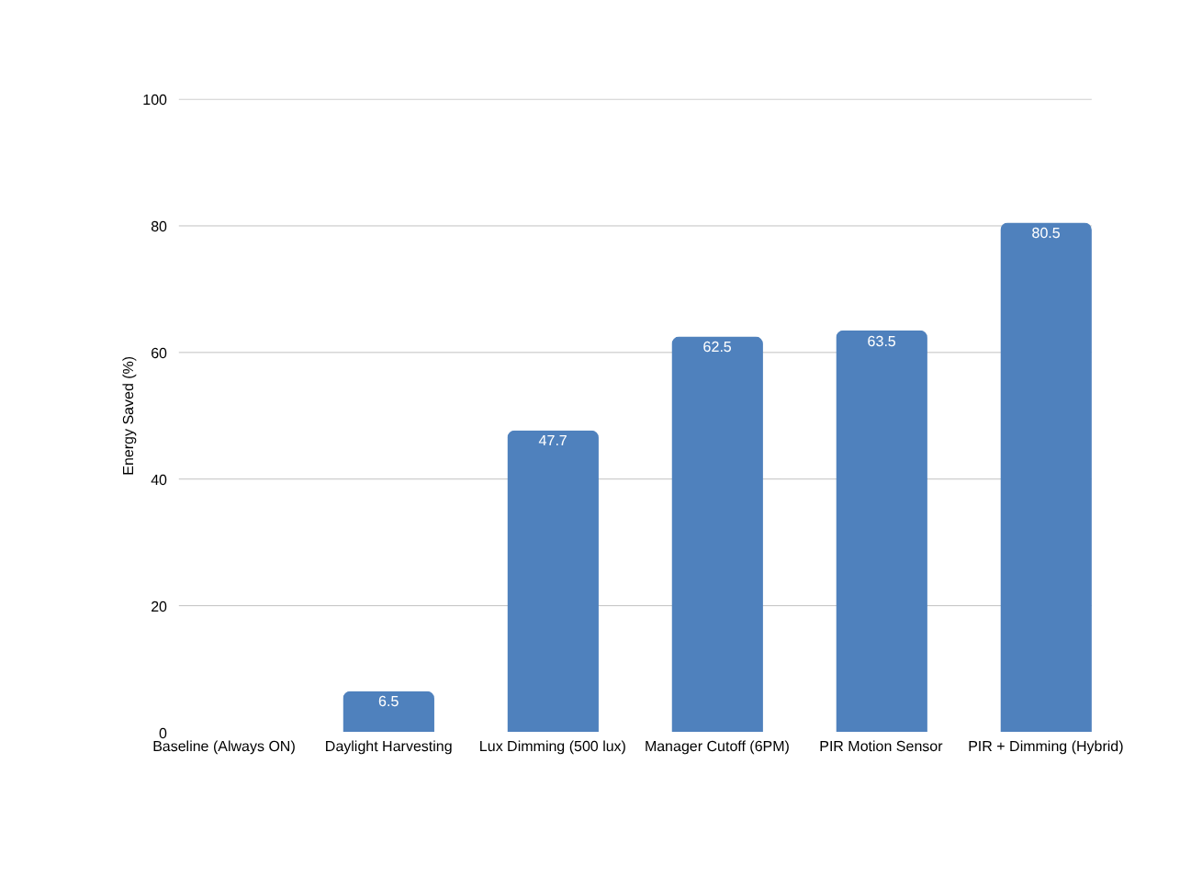
WHAT WE IMPROVED: ENERGY SAVINGS ANALYSIS
🔬 KEY FINDINGS
Finding 1:
A simple 6 PM scheduled cutoff saves ~62.5% energy with ZERO additional hardware cost.
Finding 2:
PIR occupancy sensor alone achieves ~63.5% — nearly identical to manager cutoff.
Finding 3:
Dimming to 500 lux standard saves ~47.7% while maintaining EN 12464-1 compliance.
★ BEST RESULT:
PIR + Dimming hybrid achieves 80.5% energy reduction — reducing 780W full load to just ~156W average.
12/14

Slide 12
FUTURE SCOPE & ENHANCEMENT ROADMAP
🔧 HARDWARE INTEGRATION
🤖 AI & COMPUTER VISION
📈 SCALE & DEPLOYMENT
ESP32 + IoT Relay Boards
YOLOv8 Occupancy Detection
Multi-Room Campus Twin
→ MQTT/WebSocket bridge to Unity
→ Camera-based head counting
→ Extend to 55 classrooms simulation
→ Bi-directional physical-virtual sync
→ Replace basic PIR with zone-wise
→ Building-level energy dashboard
occupancy heat maps
BH1750 Ambient Light Sensor
Cloud-Connected Dashboard
→ Feed real-time outdoor lux values
Deep Reinforcement Learning
→ Web-based remote monitoring
→ Auto-calibrate daylight harvesting
→ Joint optimization: lighting + HVAC
→ Historical analytics & reporting
→ Adaptive learning from patterns
Raspberry Pi Edge Gateway
Digital Twin Marketplace
→ Central campus data aggregation
Predictive Scheduling
→ Reusable prefabs for other campuses
→ Multi-classroom fleet management
→ ML-based timetable prediction
→ Plug-and-play deployment toolkit
→ Pre-emptive light control
→ Open-source contribution
13/14

Slide 13
CONCLUSION & REFERENCES
✅ PROJECT ACHIEVEMENTS
📚 KEY REFERENCES
✔
Successfully engineered a physics-compliant 3D Digital Twin classroom (11.5m × 9.0m) in Unity 6.6 using procedural C# generation — zero external 3D modeling tools required.
[1] Seo, H.; Yun, W.-S. (2022). "Digital Twin-Based Assessment Framework for Energy Savings in University Classroom Lighting." Buildings, 12, 544. MDPI.
[2] EN 12464-1 Standard: "Light and Lighting — Lighting of Work Places — Indoor Work Places."
[3] Unity Technologies. Unity 6.6 Documentation — Lighting, Materials, and Scripting API.
[4] Building energy statistics — IEA reports on 20-40% global building energy consumption.
[5] MDPI Sensors — IoT-based smart home energy monitoring frameworks (2023).
✔
Implemented 5 distinct energy-saving control algorithms (Baseline, Manager, PIR, Dimming, Daylight Harvesting) with real-time switching via keyboard hotkeys.
✔
Quantified that university classrooms can save up to 80.5% electricity through the PIR + Dimming hybrid strategy (from 780W down to ~156W average load).
✔
Demonstrated that a simple administrative 6 PM cutoff policy achieves 62.5% savings with zero additional hardware investment.
✔
Built a live analytics dashboard (OnGUI) displaying real-time power demand, cumulative energy consumption, and percentage savings for immediate visual feedback.
THANK YOU
14/14

