Slide 1

Simulating the Emergency Department – UCSD Health
Raaiha Humayun Kabir

Slide 2
Problem Overview
2. Patients Overflowing
Avg wait time : 4h 14m
Increasing wait times at different steps
3. Limited Resources & Problem
Limited cubicle beds
Need to decrease the use of hallway beds and surge tent beds.
1. Root Causes
ED visits rose by 7.4%
High-severity visits rising
4. Simulation Engine
Gain clear overview
Select effective interventions to decrease:
# of patients in ED hallway
EDIP volume
EDIP LOS

Slide 3
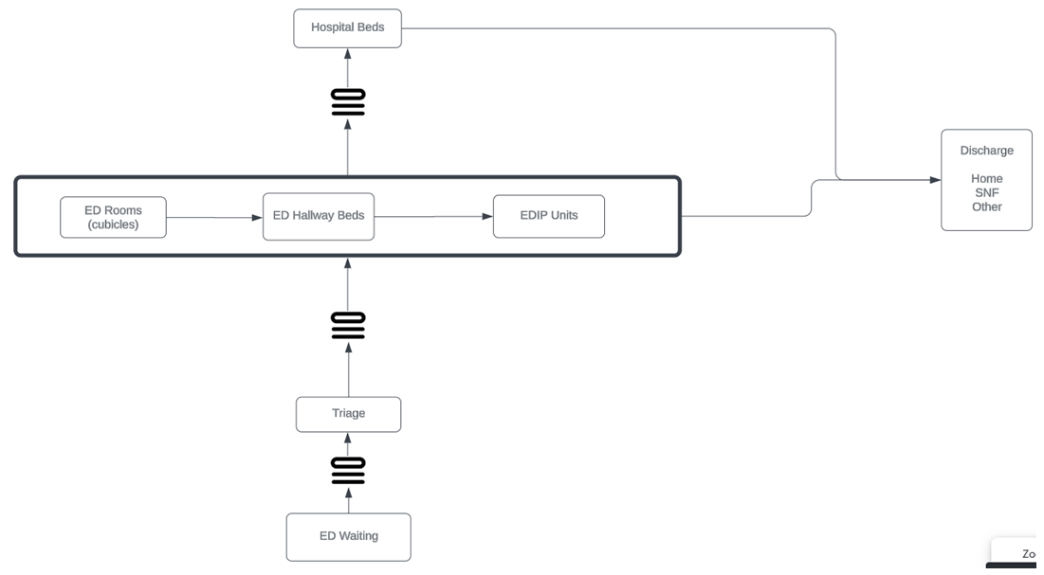

Solution - Discrete Event Based Simulation
160 beds
Hospital Treatment time - Log normal distribution
32 EDIP beds.
Wait time determined by bed availability
50 Cubicles
27 Hallway beds
ED Treatment time - Log normal distribution
ESI 1-5
Probability based
80 weeks
Hourly arrival rate
Data from Jan 2022- April 2023
Notes:
2023 CLARITY Data Set
Inpatient data during ED stay
Day of the Week, Hour of the Day, Triage Risk Level and Time Between Checkpoints
No of patients admitted to the hospital and their LOS
Simulated Patient Data

Slide 4
Why Simulation is Essential Beyond AI Predictions
Detailed Process Modeling
Simulations capture the complexity of hospital workflows, offering a more granular view of operations compared to predictive models that focus on specific outcomes.
Scenario Testing
Simulations enable "what-if" scenario testing, allowing hospitals to experiment with interventions without disrupting operations—something AI models may not offer.
Complementary to AI
Simulations test AI insights in realistic environments, refining decision-making through dynamic scenario testing.

Slide 5
Key Differences Between Previous Iterations and Current Model
Queue-Based Simulation
The current simulation is fully queue-based, where patients acquire resources based strictly on real-time availability
Actual Wait Times
All wait times are based on patients' actual waiting for resources rather than being drawn from predefined distributions.
Simplified Inputs
The only inputs required are patient arrival rates and treatment time distributions, streamlining the model for greater accuracy and ease of use.

Slide 6
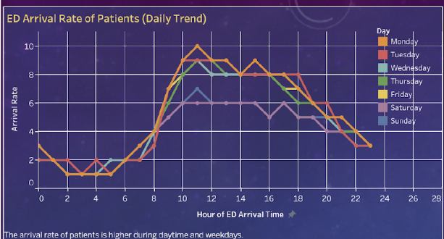
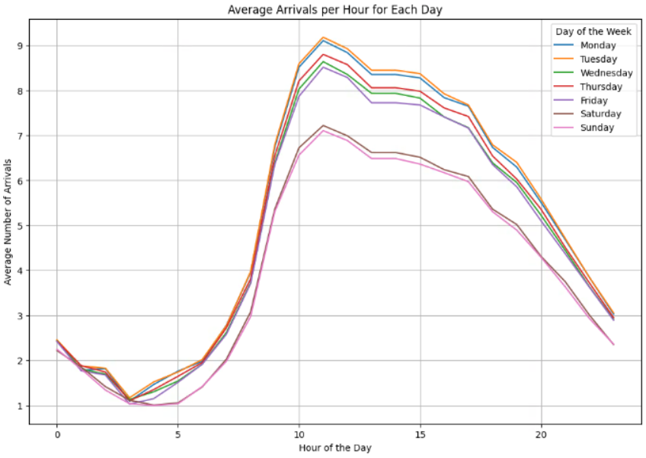
Input - Average Arrival Rate of Patients
Peak during the daytime hours, especially between 10 AM and 2 PM on weekdays
Simulation
Real world
Notes:
This chart illustrates the daily trends in patient arrival rates at the emergency department (ED) across different days of the week. Notably, the arrival rates peak during the daytime hours, especially between 10 AM and 2 PM on weekdays, indicating a higher demand for ED services during these times.

Slide 7
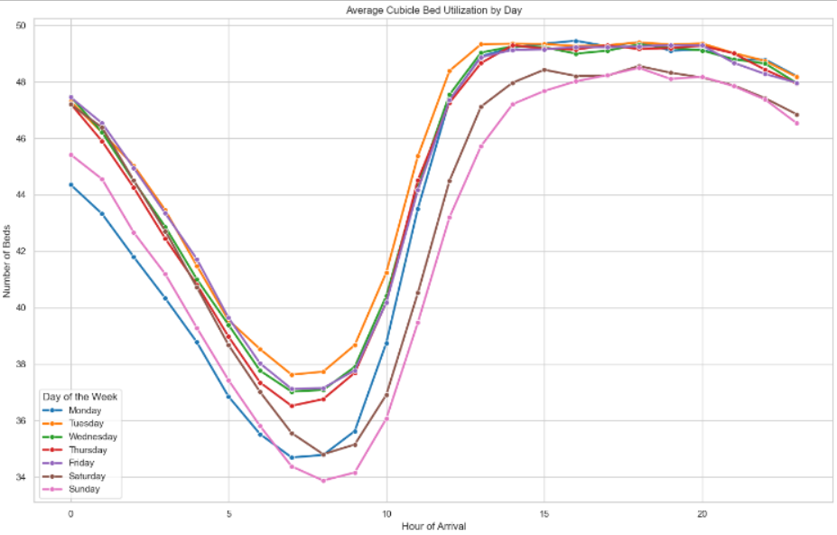
Simulated Cubicle Bed Utilization
High evening utilization, Consistent with Patient Arrival Rates.

Slide 8
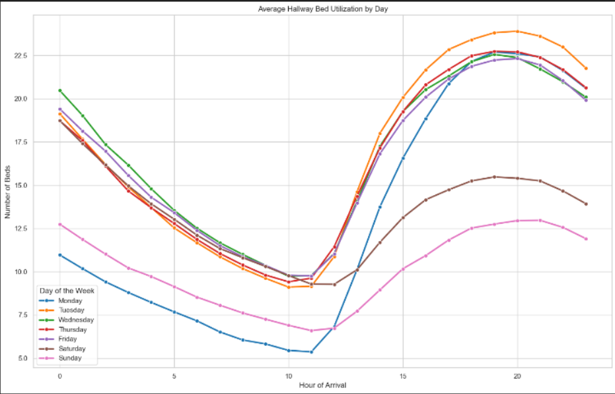
Simulated Hallway Bed Utilization
All days show a similar pattern with utilization dipping to its lowest around early-morning and peaking in the late evening.
Evening hours (from around 7 PM onwards) show the highest utilization, consistently close to 100% across all days.

Slide 9
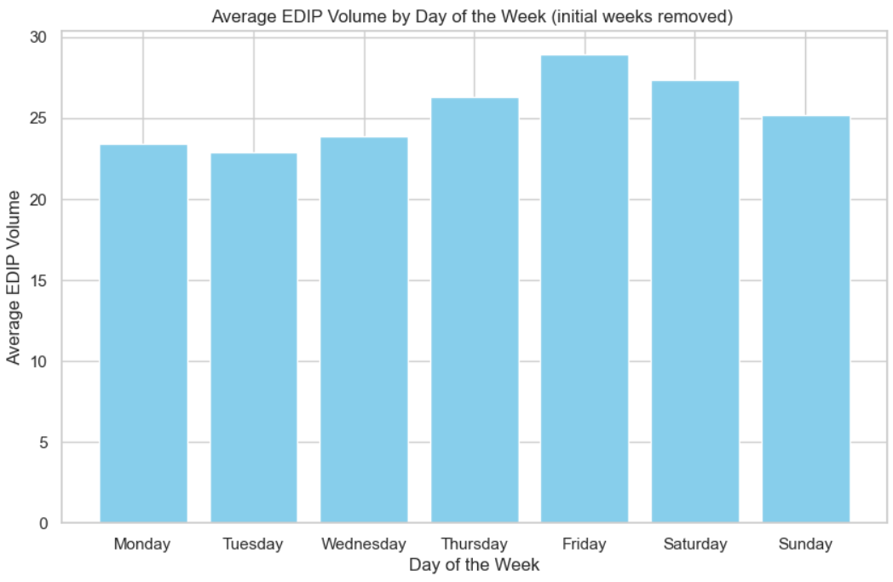
Simulated EDIP Volumes
Friday and Saturday – highest volume
EDIP clears out over the weekend
Effect can be seen on Monday

Slide 10
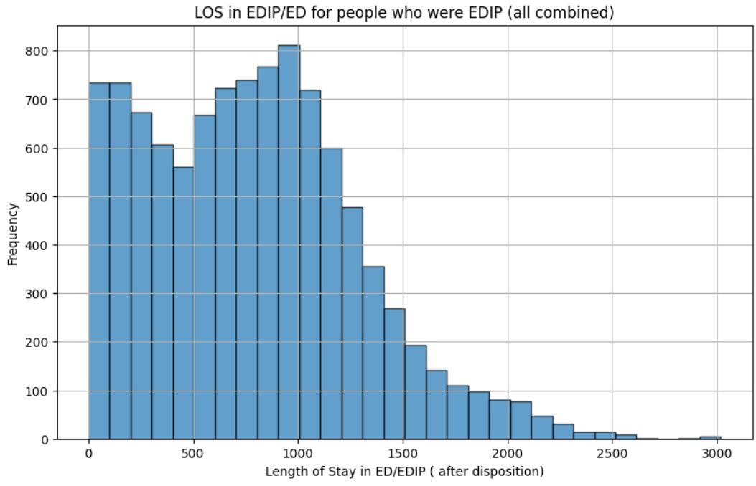
Simulated EDIP LOS
Most EDIP patients have a stay of 10–17 hours, peaking around 16 hours
Significant portion of patients experience a length of stay longer than 24 hours
Max is a little over 2 days

Slide 11
Intervention #1: Reduce LOS for 50% SNF patients
Randomly select 50% of the patients with the disposition 'SNF'
Check if their LOS is greater than 3 days
Reduce their hospital stay by 1 day

Slide 12
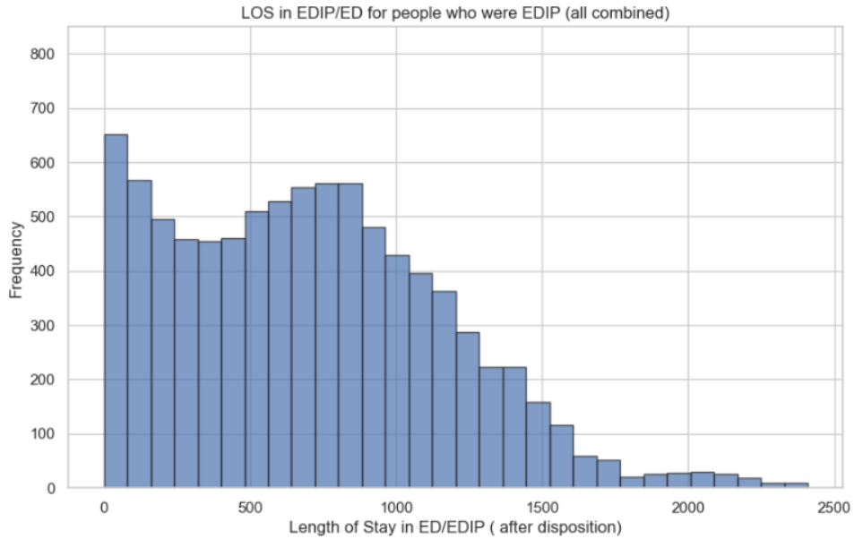
Intervention #1- EDIP LOS
Original Simulation Intervention #1
Reduced Long Stays: The intervention reduced stays beyond 1.4 days, while the original shows a tail extending to 2 days.
Shift Toward Shorter Stays: The peak in the intervention is between 0.35–0.5 days (8–12 hours), indicating shorter wait compared to the original simulation.

Slide 13
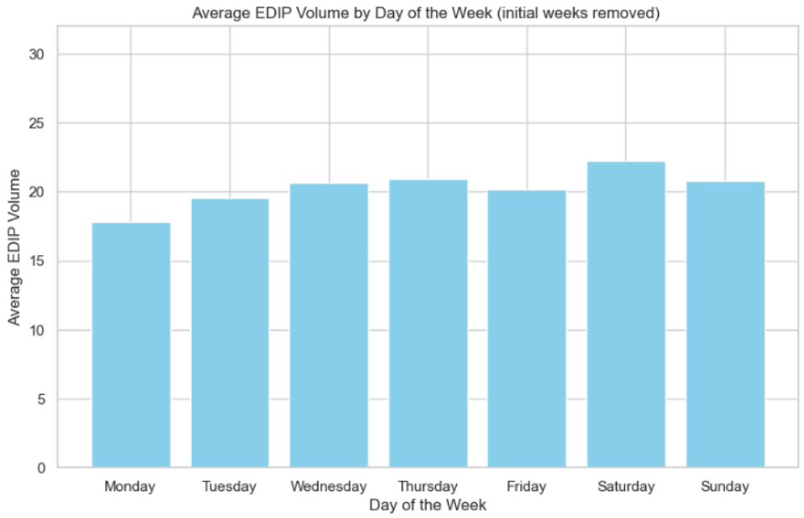
Intervention #1- EDIP Average Volumes
Original Simulation Intervention #1
Lower Volumes: Intervention reduces EDIP volumes to 15-20, compared to 25-30 in the original.

Slide 14
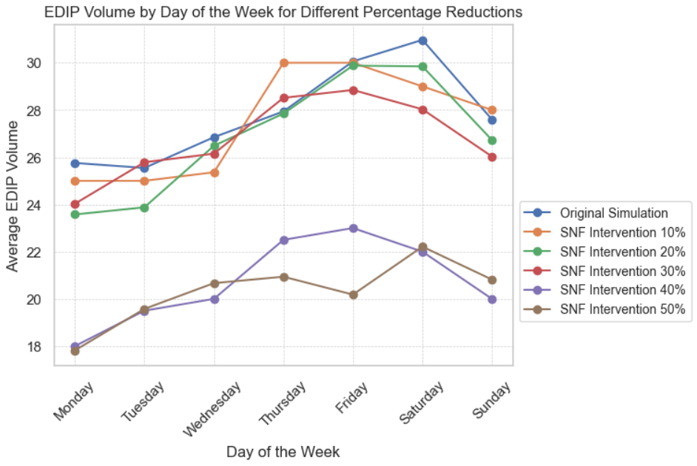
Sensitivity Analysis for SNF LOS Reduction Intervention

Slide 15
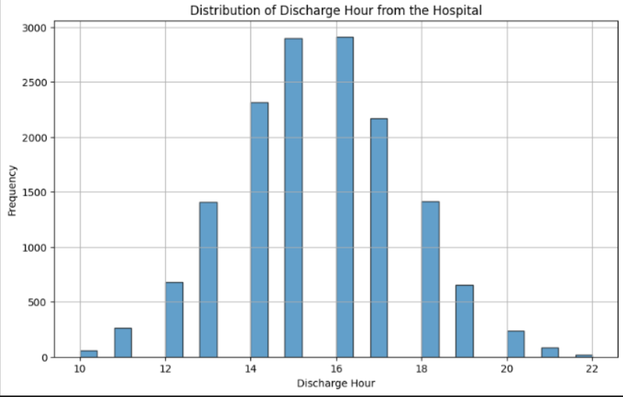
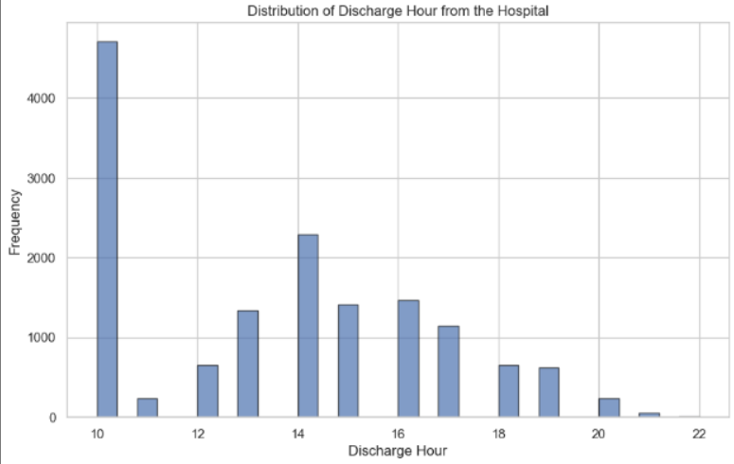
Intervention #2: Early Discharges
Shift Discharge time for 50% of the patients discharging between 3 – 6 pm to 10 am
Adjust the hospital stay time accordingly
Original Simulation Intervention #2

Slide 16
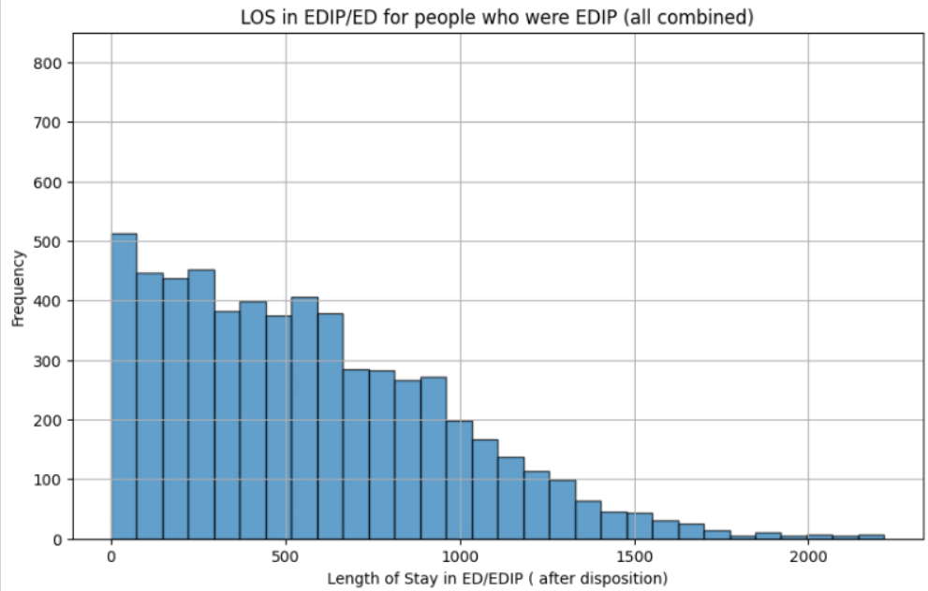
Intervention #2 - EDIP LOS
Original Simulation Intervention #2
Limits stays to 1.4 days (2000 minutes), while the original shows patients with stays as long as 2 days (3000 minutes).
More patients with stays under 0.7 days (1000 minutes), whereas the original simulation had a larger spread of longer stays.

Slide 17
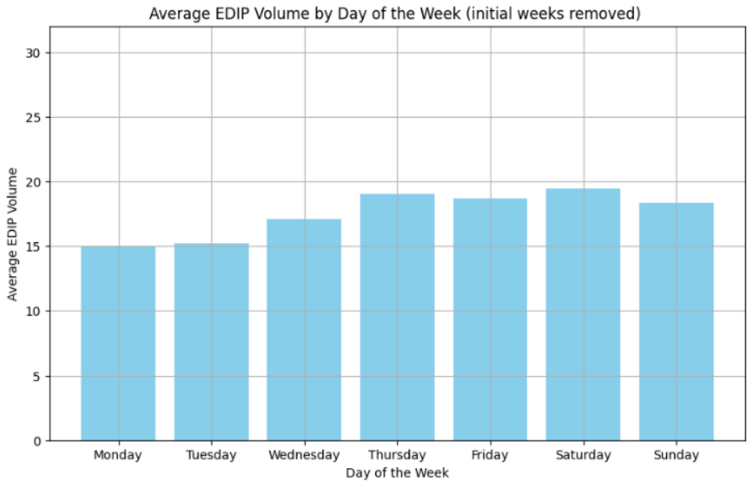
Intervention #2 - EDIP Average Volumes
Original Simulation Intervention #2
Lower Peak Volumes: Intervention peaks at 20 EDIP volumes, compared to 25-30 in the original.

Slide 18
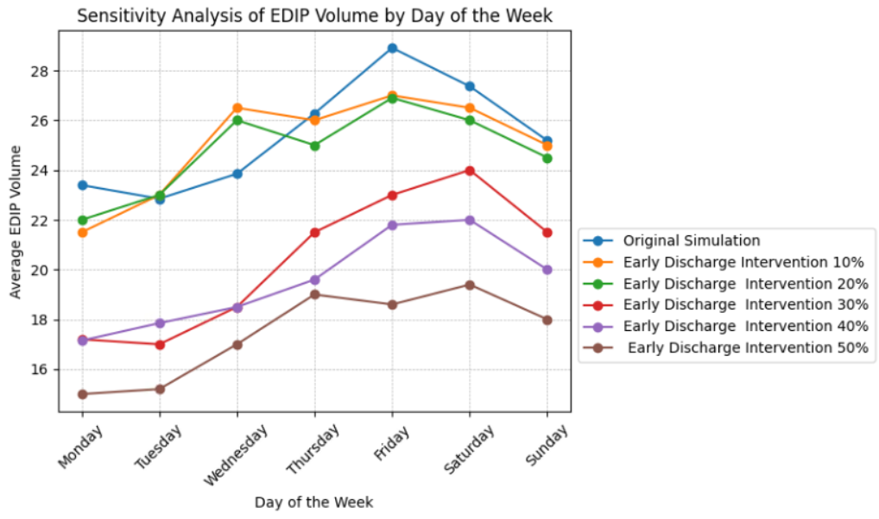
Sensitivity Analysis for Early Discharge Intervention

Slide 19
Next Steps
Include Surgical Impact: Assess how surgical cases affect ED admissions to identify potential bottlenecks.
Separate Treatment vs. Discharge: Clarify the distinction between treatment time and discharge to optimize patient flow.
Test More Interventions: Implement additional interventions to further reduce wait times and improve efficiency.

Slide 20
Thank You

Slide 21
Intervention #3 Diversion to Urgent Care
After triage, patients with lower ESI levels (typically levels 4 and 5) are identified
90% of these patients are diverted to Urgent care
In the simulation they will not occupy an ED beds
More focused on reducing incoming patients in the ED

Slide 22
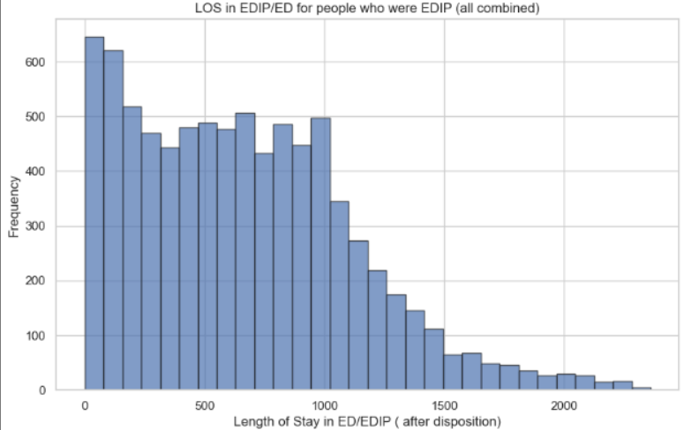
Intervention #3 - EDIP LOS
Original Simulation Intervention #3
Limits stays to less than 3000, although not as effective as the other interventions
More patients with stays under 0.5 days, quicker turnover compared to the original simulation.

Slide 23
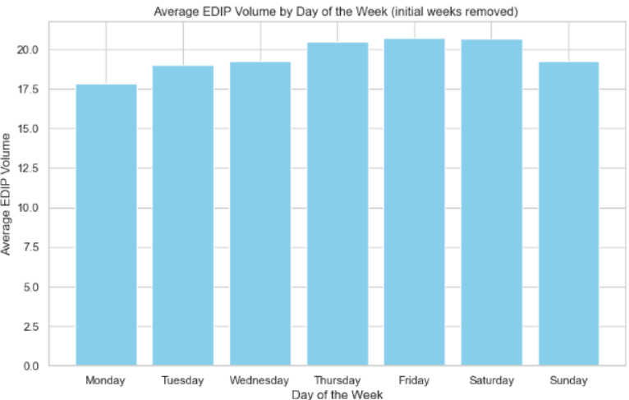
Intervention #3 - EDIP Average Volumes
Original Simulation Intervention #3
Lower Volumes: Intervention has reduced EDIP volumes to around 17-22, compared to the original, which has volumes ranging from 20-30.

Slide 24
Assumptions
Patient Bed Assignment: Patients are assigned to either an EDIP or hospital bed based on the longest expected treatment time.
Surge Tent Patients: Surge Tent patients are managed and treated similarly to regular ED patients.
Sequential Opening of EDIP Areas: EDIP areas are currently opened in a sequential manner.
Hospital Bed Capacity Estimation: The capacity for hospital beds dedicated to ED patients is estimated using metrics such as Length of Stay (LOS), average daily admissions, and EDIP volumes during the corresponding period.
Hospital Bed Allocation for ED Patients: ED patients receive hospital beds when previously admitted ED patients are discharged, freeing up capacity.

Slide 25
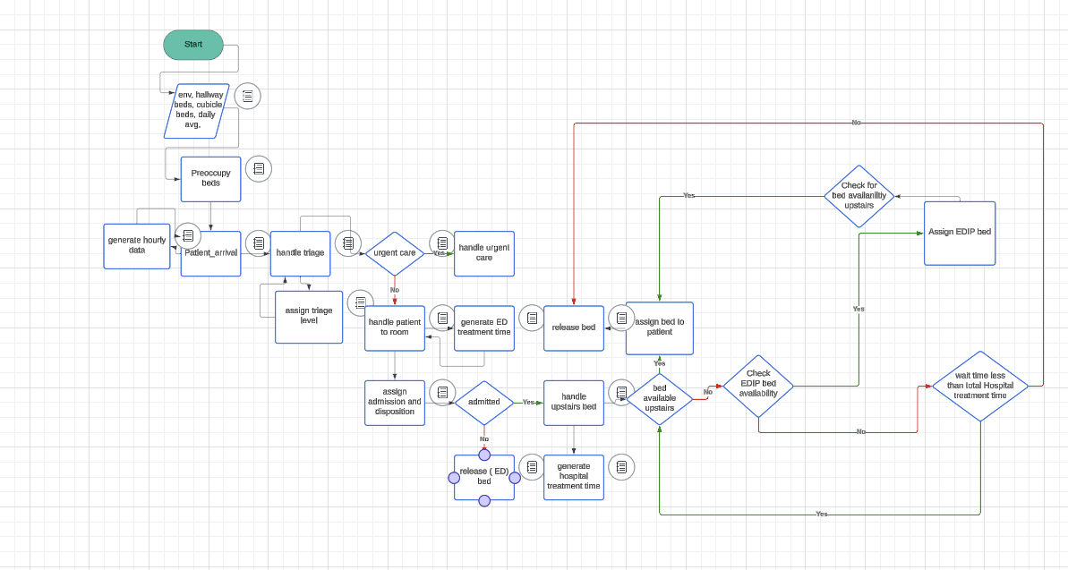
Solution – Code Flow
Notes:
2023 CLARITY Data Set
Inpatient data during ED stay
Day of the Week, Hour of the Day, Triage Risk Level and Time Between Checkpoints
No of patients admitted to the hospital and their LOS
Simulated Patient Data

Slide 26
Useful Terminology Overview
ESI: Emergency Severity Index, a measure of the urgency of the case.
Disposition: Outcome of the visit (e.g., Admit, Discharge, Expired).
Triage Duration Mins: Duration of triage.
Triage2Room Mins: Time from triage to being taken to a room.
Triage2Dispo Mins: Time from triage to disposition.
EDArrDOW and EDArrHOD: Day of week and hour of day for arrival.
DispoDOW and DispoHOD: Day of week and hour of day for disposition.
Dispo2Departure Mins: Time from disposition to departure.
Departure2DC Hours: Time from departure to discharge completion.

Slide 27
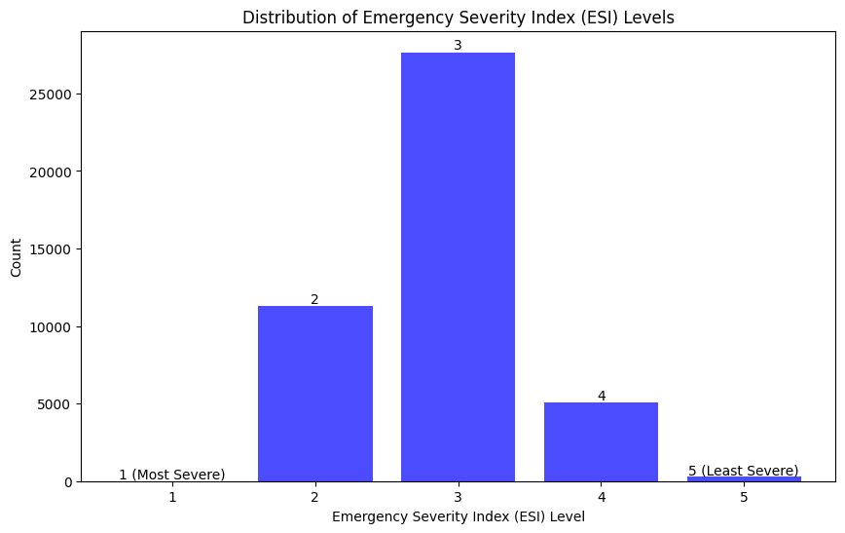
1: Immediate, life threatening
2: Emergency, could become life threatening
3: Urgent, not life threatening
4: Semi-urgent, not life threatening
5: Non-urgent, needs treatment when time permits
Notes:
Level 1: Immediate, life threatening
Level 2: Emergency, could become life threatening
Level 3: Urgent, not life threatening
Level 4: Semi-urgent, not life threatening
Level 5: Non-urgent, needs treatment when time permits

Slide 28
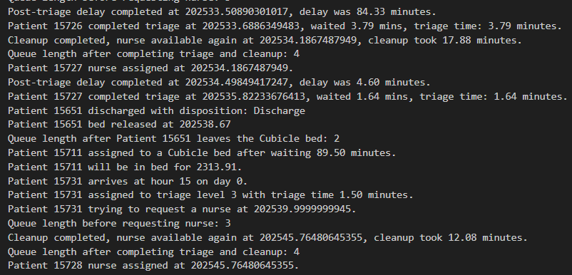
Simulation Output
Simulation Time: 80 Weeks

Slide 29
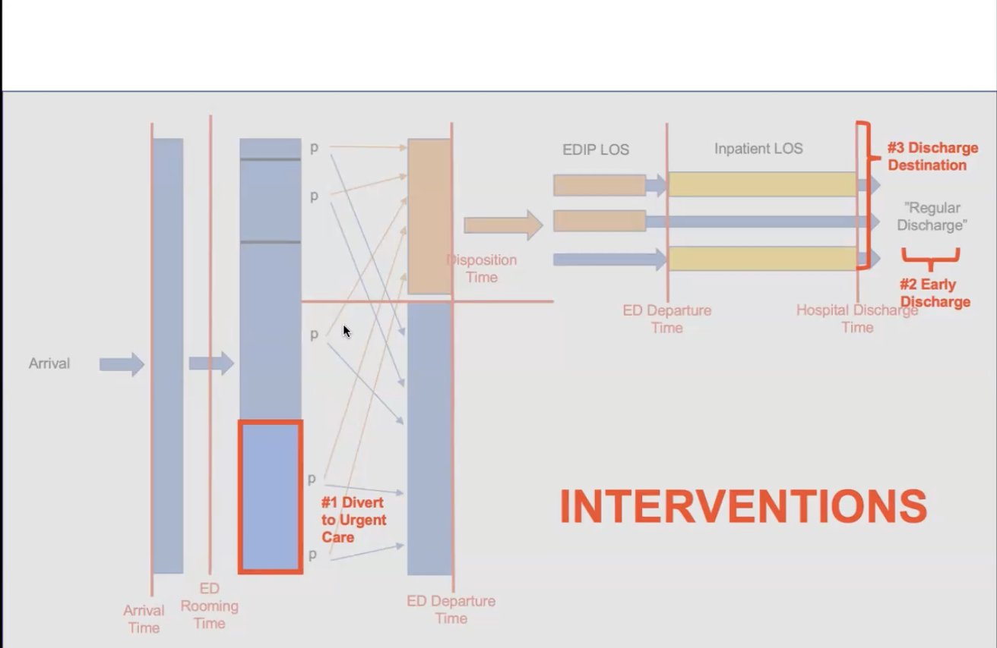
Possible Interventions
Reduce 1 day of hospitalization for 50% of SNF patients.
Speed up the discharge process
Divert lower ESI ranking patients to Urgent care

Slide 30
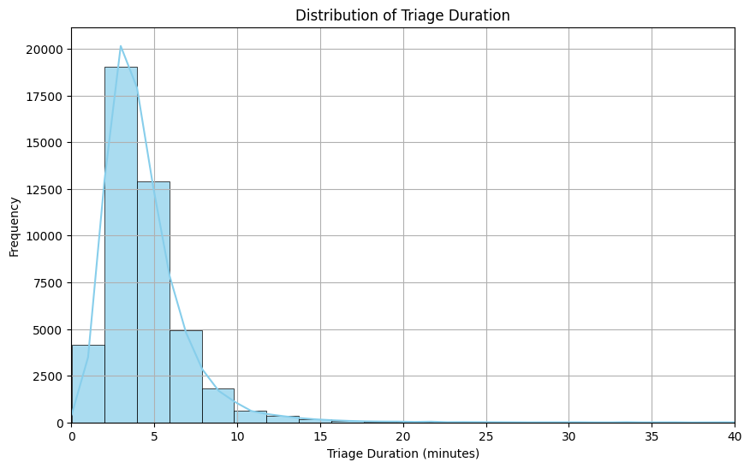
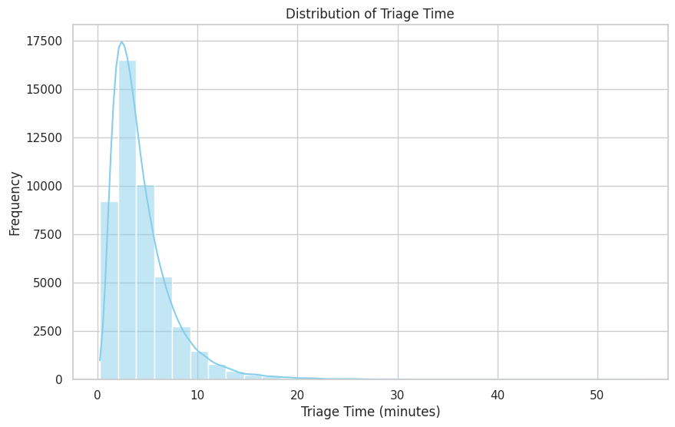
Distribution of Triage Times
Real
Simulation
Both peak at shorter durations, with most triage times falling below 10 minutes
The similar right-skewed distribution shows that the majority of triages are quick, but there’s a long tail of cases taking longer.

Slide 31
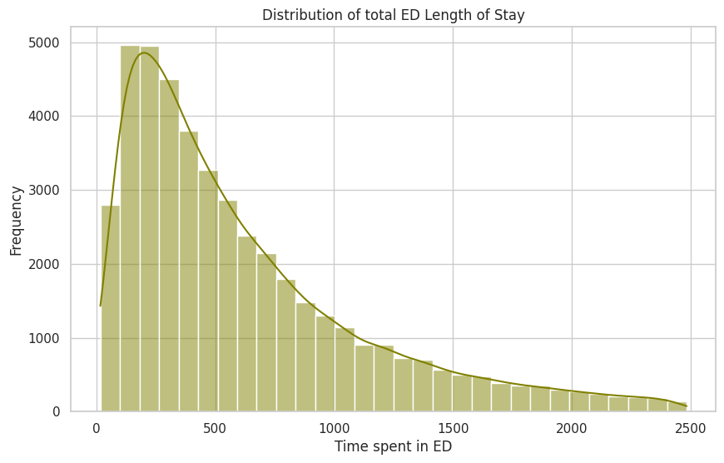
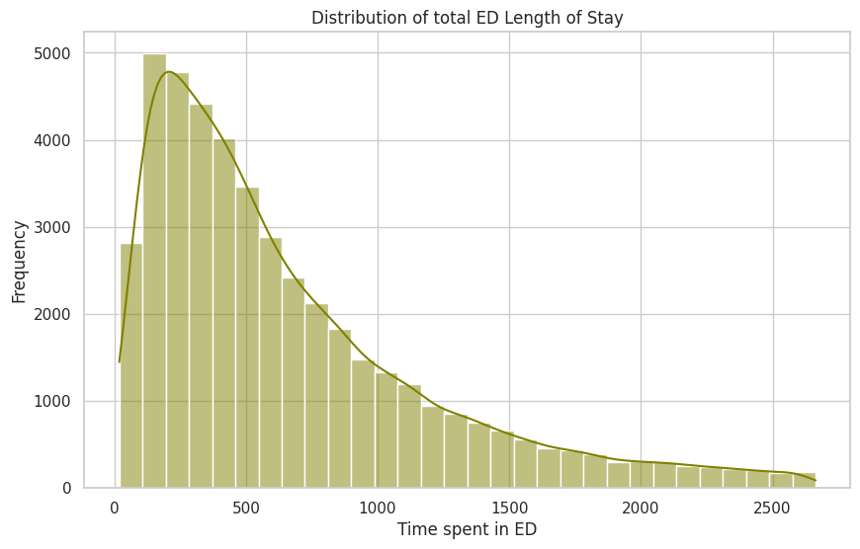
Distribution of Length of Stay in ED Times
Intervention 2 Original Simulation
Intervention 2 has the peak frequency at around 200 - 300 minutes is more concentrated than the original simulation.

Slide 32
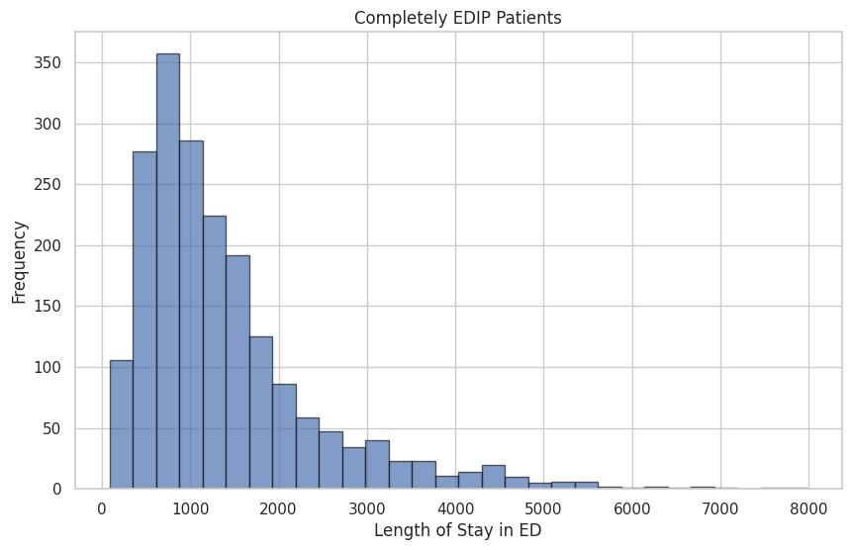
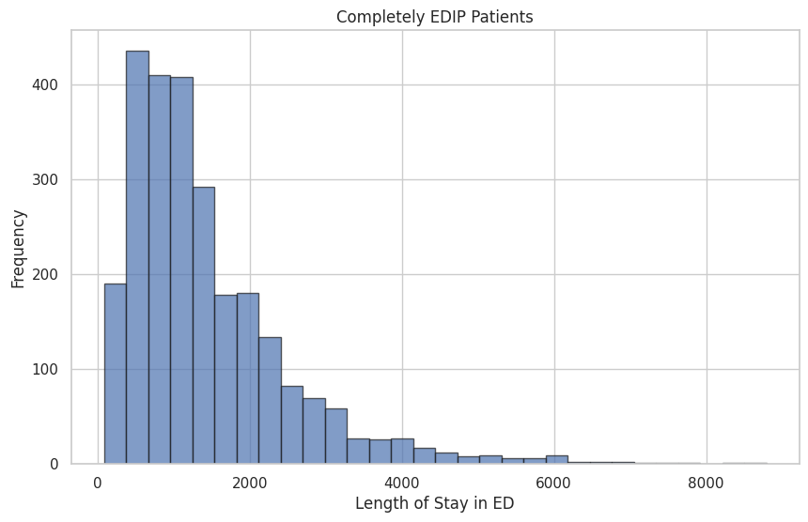
Distribution of Completely EDIP Times
1700
Intervention 2 Original Simulation
Notable reduction in long-duration stays at 6,000 minutes in the Intervention 2 simulation, enhancing patient flow and reducing ED congestion.

Slide 33
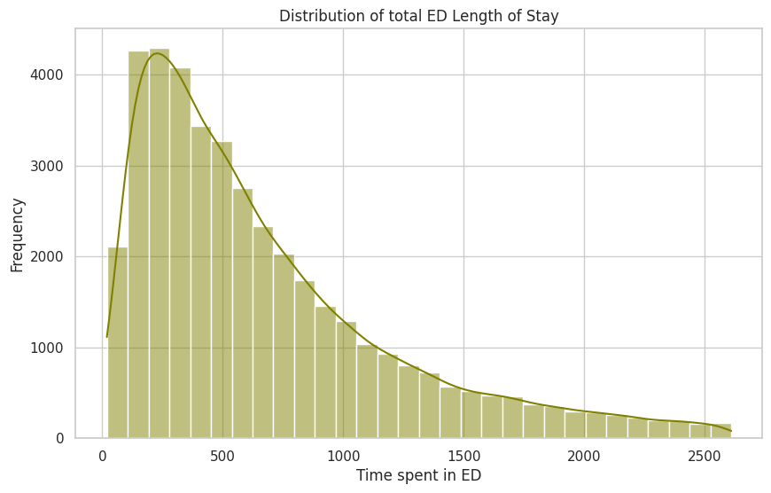
Distribution of Length of Stay in ED Times
Intervention 1 Original Simulation
Intervention 1 has the peak frequency at around 200-300 minutes is lower than in the original simulation. This suggests that the diversion to urgent care has successfully reduced the volume of patients around 200-300 minutes

Slide 34
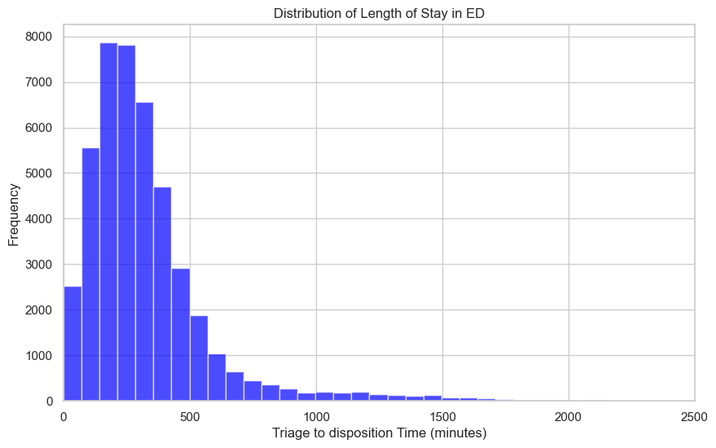
Distribution of Length of Stay in ED Times
200 300
200 300
Real Simulation
Both right-skewed distribution
Both rapid drop-off in frequency at the peak around 200-300 mins
Notes:
both from real data and from simulation, share the characteristic of a right-skewed distribution, illustrating that the majority of stays in the emergency department (ED) are of shorter duration, with a rapid drop-off in frequency as the length of stay increases. Both distributions indicate that most of the ED stays are concentrated in the earlier time brackets, diminishing as the length of stay grows.

Slide 35
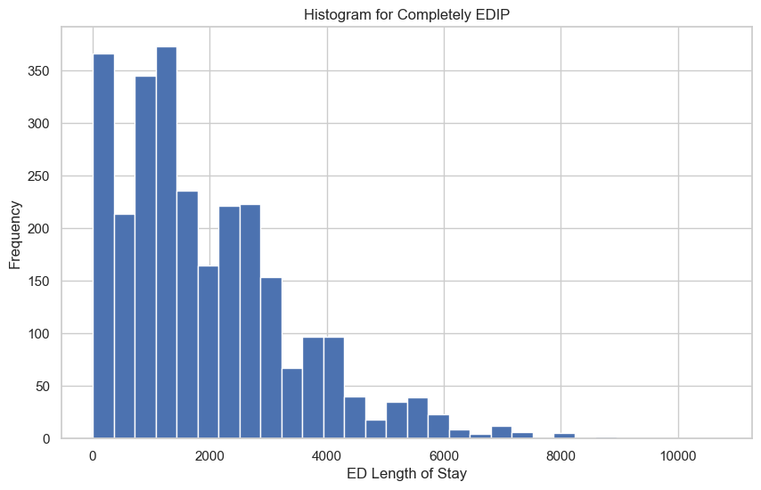
Distribution of Completely EDIP Times
1700
1700
Real Simulation
Both histograms show a right-skew distribution
The peak frequency in both histograms occurs within the first 1700 minutes (approximately 33 hours)
The range extends up to around 8000 minutes in both charts
Notes:
Both the real and simulated histograms show a similar right-skewed distribution, indicating most EDIP stays are short, with a peak under 2000 minutes. The presence of long tailsabout in both charts illustrates the occasional lengthy stays. This similarity confirms the simulation’s effectiveness in reflecting real-world patient stay dynamics in the ED.

