Slide 1
Funding flows

Slide 2
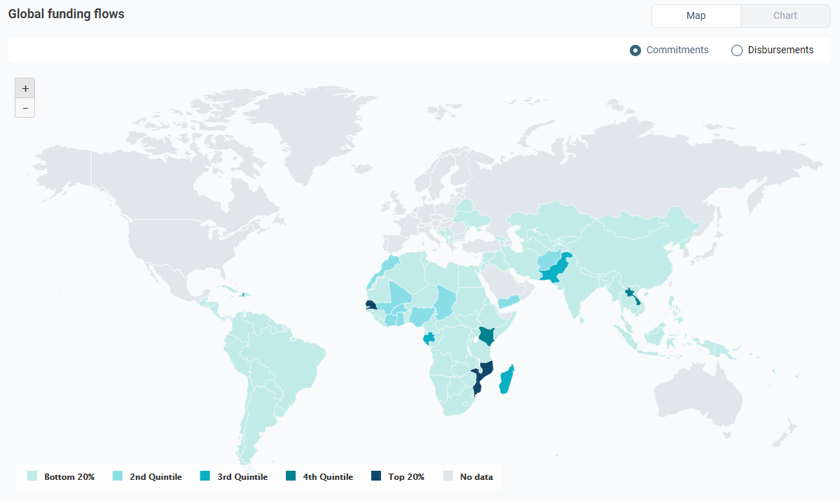


The values are in USD. Source: PARIS21 (2021), Partner Report on Support to Statistics. See the methodology note for details.
https://paris21-data.github.io/CH_methodology_note/about-the-data.html#paris21-press-data
This map shows funding flows (commitments or disbursements) to data & statistics to recipients grouped by quantiles. Click on a recipient to see the total amount and its breakdown by providers.
https://paris21-data.github.io/CH_methodology_note/financing-dev-data.html#commitments-and-disbursements

Slide 3
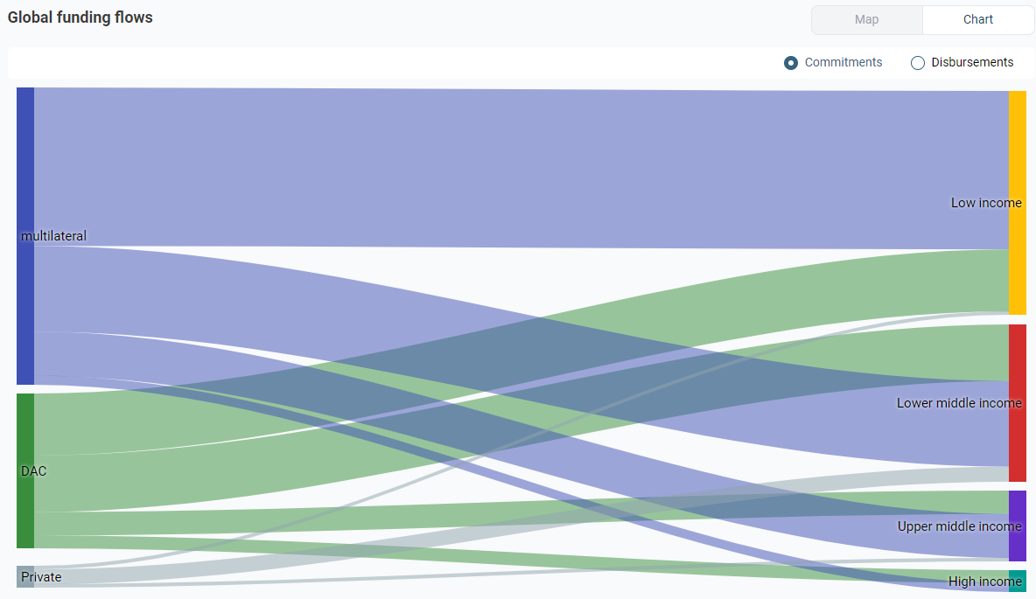
The values are in USD. Source: PARIS21 (2021), Partner Report on Support to Statistics. See the methodology note for details.
https://paris21-data.github.io/CH_methodology_note/about-the-data.html#paris21-press-data
This chart shows funding flows (commitments or disbursements) from providers (right) to recipient groups (left), the width of the bands is proportional to the amount.
https://paris21-data.github.io/CH_methodology_note/financing-dev-data.html#commitments-and-disbursements

Slide 4
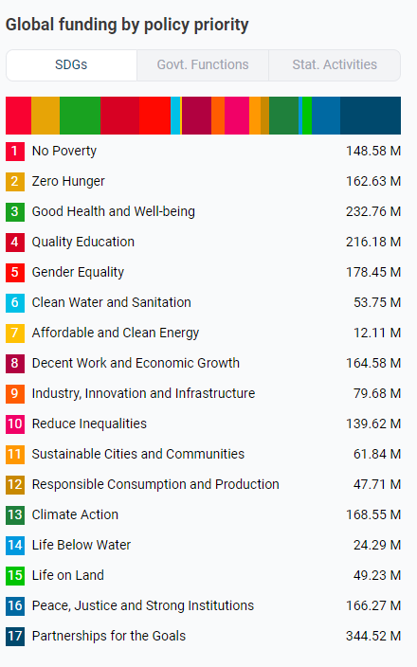
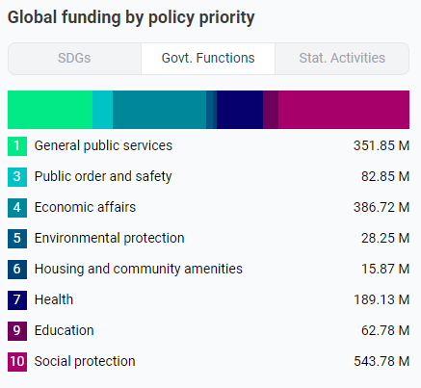
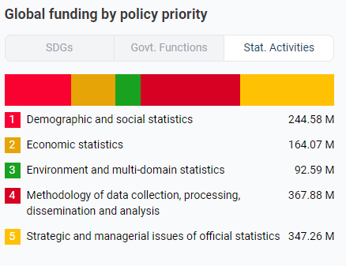
The values are in USD. Source: PARIS21 (2021), Partner Report on Support to Statistics. See the methodology note for details.
The values are in USD. Source: PARIS21 (2021), Partner Report on Support to Statistics. See the methodology note for details.
https://paris21-data.github.io/CH_methodology_note/about-the-data.html#CSA
https://paris21-data.github.io/CH_methodology_note/about-the-data.html#COFOG
The values are in USD.. Source: PARIS21 (2021), Partner Report on Support to Statistics. See the methodology note for details.
https://paris21-data.github.io/CH_methodology_note/about-the-data.html#SDG
This list shows aggregate funding flows (commitments) to data & statistics by statistical activity (CSA).
This list shows aggregate funding flows (commitments) to data & statistics by government function (COFOG).
This list shows aggregate funding flows (commitments) to data & statistics by Sustainable Development Goal (SDGs).
https://paris21-data.github.io/CH_methodology_note/financing-dev-data.html#commitments-and-disbursements

Slide 5
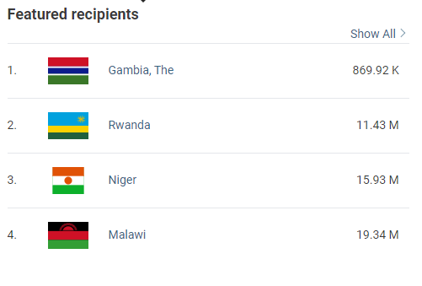
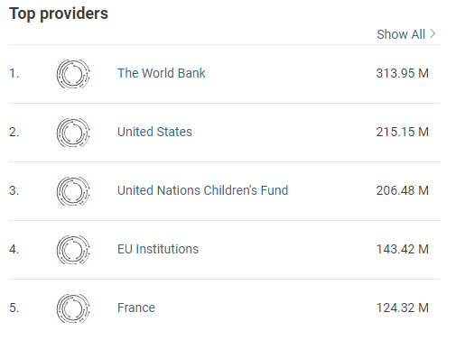
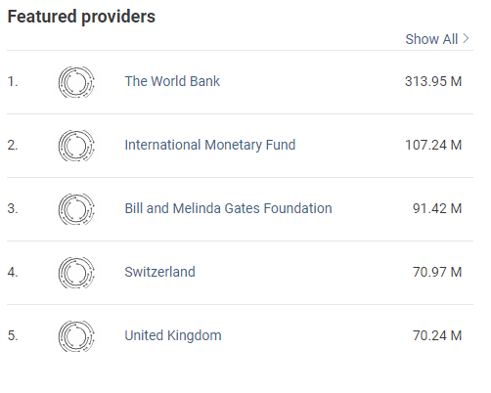
The values pertain to 2017-2019 and are in USD. Source: PARIS21 (2021), Partner Report on Support to Statistics. See the methodology note for details.
The values pertain to 2017-2019 and are in USD. Source: PARIS21 (2021), Partner Report on Support to Statistics. See the methodology note for details.
The values pertain to 2017-2019 and are in USD. Source: PARIS21 (2021), Partner Report on Support to Statistics. See the methodology note for details.
https://paris21-data.github.io/CH_methodology_note/about-the-data.html#paris21-press-data
https://paris21-data.github.io/CH_methodology_note/about-the-data.html#paris21-press-data
https://paris21-data.github.io/CH_methodology_note/about-the-data.html#paris21-press-data
This list shows countries with an in-depth recipient profile on the platform and the amount of external support (commitments) they received.
This list shows the top providers for data and statistics and the amount of funding (commitments).
This list shows the providers with in-depth profiles on the platform and the amount of funding (commitments) to data and statistics.
https://paris21-data.github.io/CH_methodology_note/about-the-data.html#paris21---pilot-assessments
https://paris21-data.github.io/CH_methodology_note/about-the-data.html#oecd-data-for-development-profiles
https://paris21-data.github.io/CH_methodology_note/about-the-data.html#paris21-press-data

Slide 6
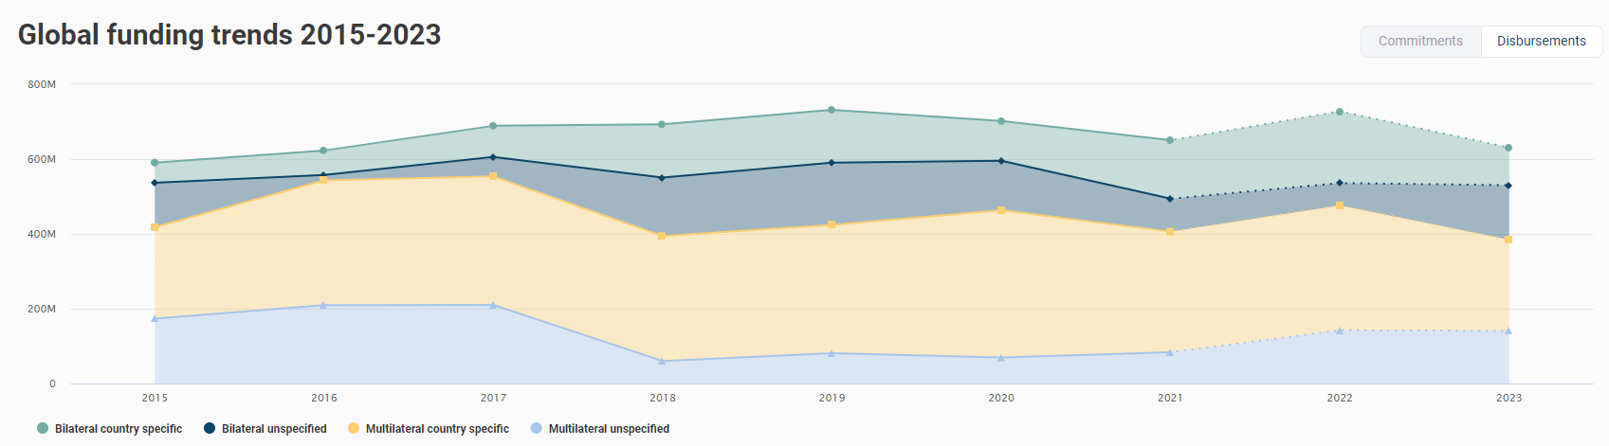
The values are in USD. Source: PARIS21 (2021), Partner Report on Support to Statistics. See the methodology note for details.
https://paris21-data.github.io/CH_methodology_note/about-the-data.html#paris21-press-data
This chart shows the time series of external support (commitments or disbursements) to data and statistics grouped by type of providers. It displays also nowcasting (upto 2021) and forecasting (upto 2023).
https://paris21-data.github.io/CH_methodology_note/about-the-data.html#nowcasting
https://paris21-data.github.io/CH_methodology_note/about-the-data.html#forecasting

Slide 7
Gender channel

Slide 8
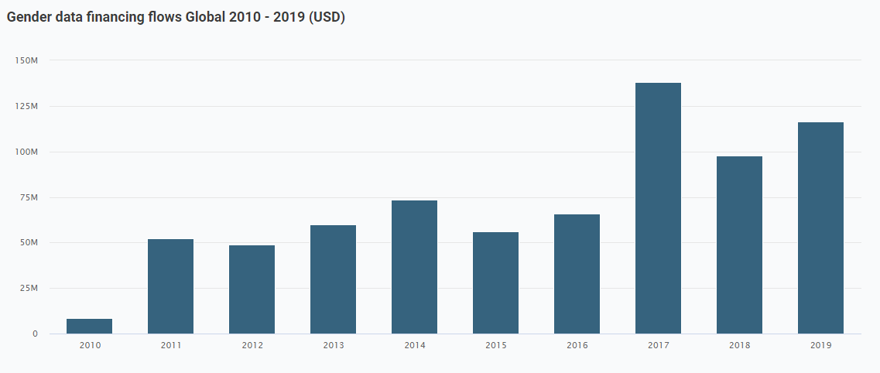
The values are in constant USD. Source: PARIS21 (2021), Partner Report on Support to Statistics. See the methodology note for details.
https://paris21-data.github.io/CH_methodology_note/about-the-data.html#funding-opportunities-in-statistical-systems
This chart shows the external gender data-relevant funding (commitments) for the selected geography.
https://paris21-data.github.io/CH_methodology_note/about-the-data.html#press-gender-data-financing-projects

Slide 9
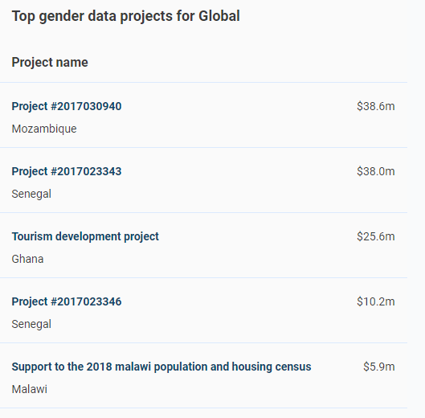
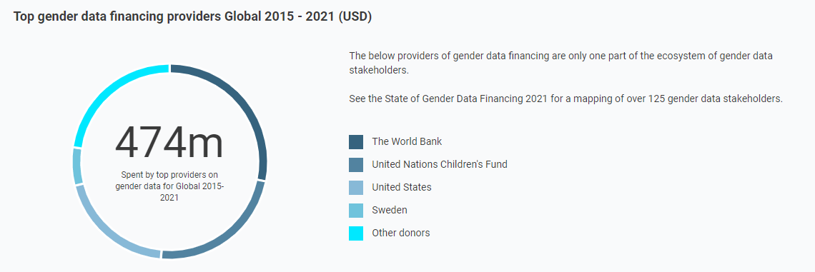
The values are in constant USD. Source: PARIS21 (2021), Partner Report on Support to Statistics. See the methodology note for details.
https://paris21-data.github.io/CH_methodology_note/about-the-data.html#gender-data-financing
This visualisation lists the top five providers for gender data financing for the selected geography. The doughnut chart shows the respective amount spent.
The values are in constant USD. Source: PARIS21 (2021), Partner Report on Support to Statistics. See the methodology note for details.
This list shows the top five projects (by funding) for gender data financing for the selected geography.

Slide 10
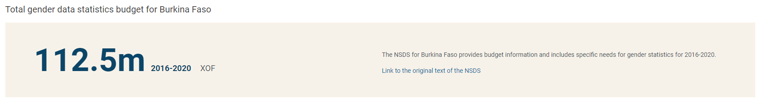
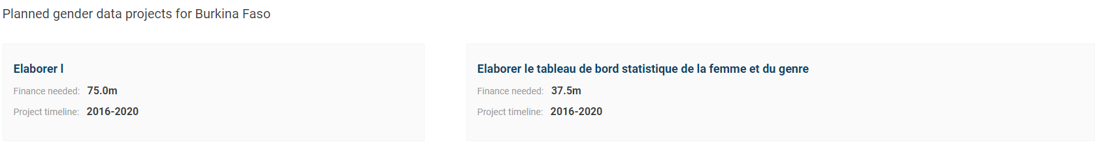
https://paris21-data.github.io/CH_methodology_note/about-the-data.html#gender-relevant-survey-inventory
The values are in local currency. Source: The country's NSDS and other planning documents. See the methodology note for details.
This is the total gender data budget for the selected geography over the latest NSDS time period.
https://paris21-data.github.io/CH_methodology_note/about-the-data.html#press-gender-data-financing-projects
The values are in local currency. Source: PARIS21 (2021), Partner Report on Support to Statistics. See the methodology note for details.
This list shows the available breakdown of gender data financing activities for selected geography over the latest NSDS time period. .

Slide 11
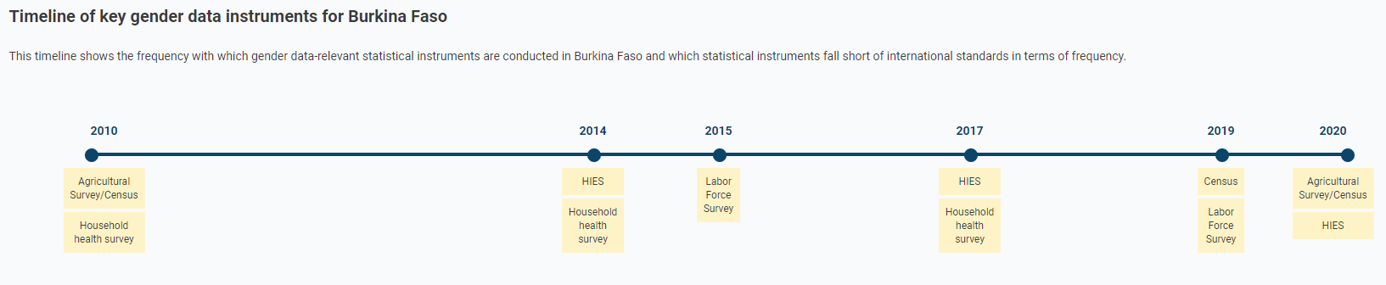
Sources: MICS, DHS, World Bank, ILO, FAO, and UNSD. See the methodology note for details.
https://paris21-data.github.io/CH_methodology_note/about-the-data.html#gender-relevant-survey-inventory
This timeline shows the frequency with which gender data-relevant statistical instruments are conducted in selected geography and are displayed in number of instruments.

Slide 12
https://paris21-data.github.io/CH_methodology_note/about-the-data.html#gender-data-relevant-indices
Source: Open Data Watch (ODW)
The ODIN-Gender Index describes the coverage and openness of data for 27 indicators that require sex-disaggregated data or are otherwise relevant to gender equality as part of the Open Data Inventory (ODIN) framework.
https://paris21-data.github.io/CH_methodology_note/about-the-data.html#world-bank-statistical-performance-indicators
Source: The World Bank
The Statistical Performance Indicators is a framework for measuring the performance of national statistical systems and tracking their progress. This visualisation displays the overall index score
https://paris21-data.github.io/CH_methodology_note/about-the-data.html#gender-data-relevant-indices
Source: The World Bank
The Women, Business and the Law index displays the overall result of an analysis of the laws and regulations affecting women's economic inclusion.
https://paris21-data.github.io/CH_methodology_note/about-the-data.html#gender-data-relevant-indices
Source: The Organisation for Economic Co-operation and Development (OECD)
The OECD Development Centre’s Social Institutions and Gender Index (SIGI) measures discrimination against women in social institutions. By taking into account laws, social norms and practices, the SIGI captures the underlying drivers of gender inequality with the aim to provide the data necessary for transformative policy change. Each overall index is transformed into a 0-100 index score using percent ranking

Slide 13
Funding opportunities- Recipient profiles

Slide 14
RCP 1
The values are in USD. Source: PARIS21 (2021), Partner Report on Support to Statistics. See the methodology note for details.
https://paris21-data.github.io/CH_methodology_note/about-the-data.html#paris21-press-data

Slide 15
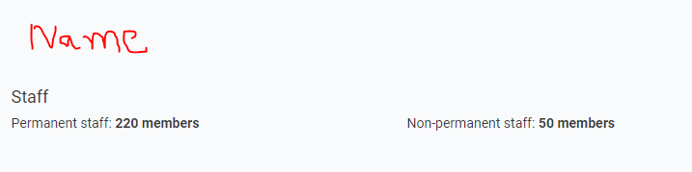
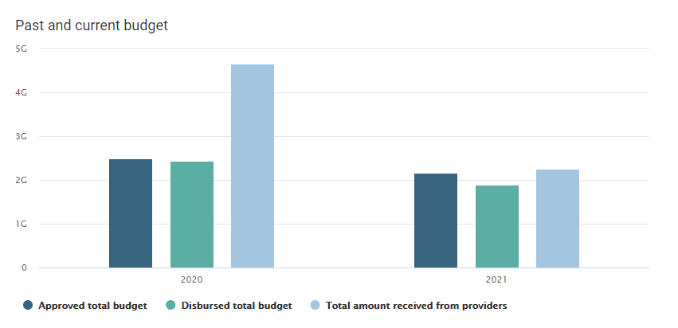
RCP 2, 3 & 4
A
https://paris21-data.github.io/CH_methodology_note/about-the-data.html#unsd-world-bank-paris21-cape-town-global-action-plan-implementation-survey
Source: UNSD, World Bank, and PARIS21 (2021), Cape Town Global Action Plan Monitoring Survey. See the methodology note for details.
RCP 5
A
Text for local currency version
The values are in local currency. UNSD, World Bank, and PARIS21 (2021), Cape Town Global Action Plan Monitoring Survey. See the methodology note for details.
This chart shows total approved budget and disbursed
budget of the NSO and total on-budget support for the NSO in the fiscal year 2020 and 2021.
The values are in USD. UNSD, World Bank, and PARIS21 (2021), Cape Town Global Action Plan Monitoring Survey. See the methodology note for details.
This chart shows total approved budget and disbursed
budget of the NSO and total on-budget support for the NSO in the fiscal year 2020 and 2021.

Slide 16
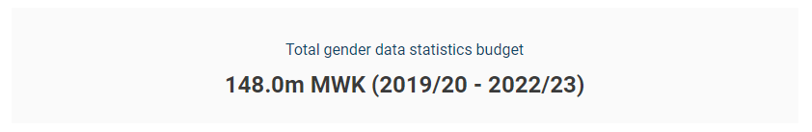
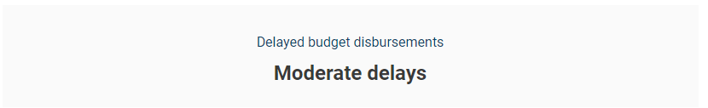
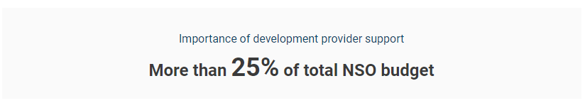
RCP 6
GEN
Source: The country's NSDS and other planning documents. See the methodology note for details.
https://paris21-data.github.io/CH_methodology_note/about-the-data.html#paris21---pilot-assessments
RCP 7
A
https://paris21-data.github.io/CH_methodology_note/about-the-data.html#unsd-world-bank-paris21-cape-town-global-action-plan-implementation-survey
Source: UNSD, World Bank, and PARIS21 (2021), Cape Town Global Action Plan Monitoring Survey. See the methodology note for details.
RCP 8
A
Source: UNSD, World Bank, and PARIS21 (2021), Cape Town Global Action Plan Monitoring Survey. See the methodology note for details.

Slide 17
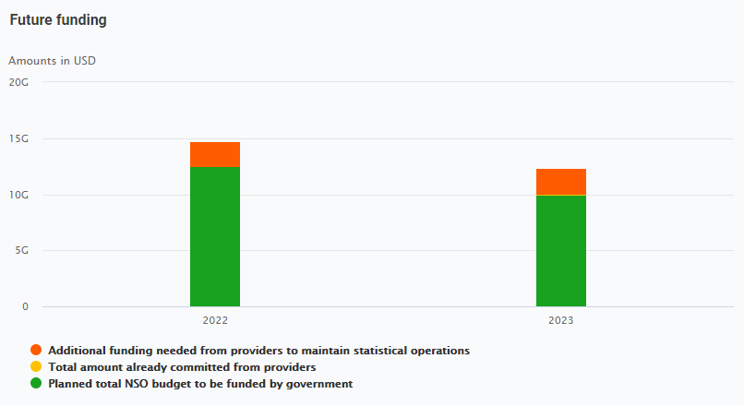
RCP 9
A
Text for local currency version
The values are in local currency. UNSD, World Bank, and PARIS21 (2021), Cape Town Global Action Plan Monitoring Survey. See the methodology note for details.
Source: UNSD, World Bank, and PARIS21 (2021), Cape Town Global Action Plan Monitoring Survey. See the methodology note for details.
This chart shows total budget planned to be funded by the government, total amount already committed by providers and additional funding needed to maintain statistical operation of the NSO for the fiscal year 2022 and 2023.
https://paris21-data.github.io/CH_methodology_note/about-the-data.html#unsd-world-bank-paris21-cape-town-global-action-plan-implementation-survey
This chart shows total budget planned to be funded by the government, total amount already committed by providers and additional funding needed to maintain statistical operation of the NSO for the fiscal year 2022 and 2023.

Slide 18
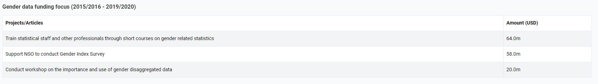
RCP 10
GEN
Source: The country's NSDS and other planning documents. See the methodology note for details.
https://paris21-data.github.io/CH_methodology_note/about-the-data.html#paris21---pilot-assessments

Slide 19
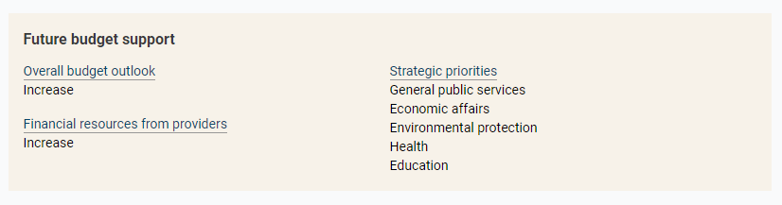
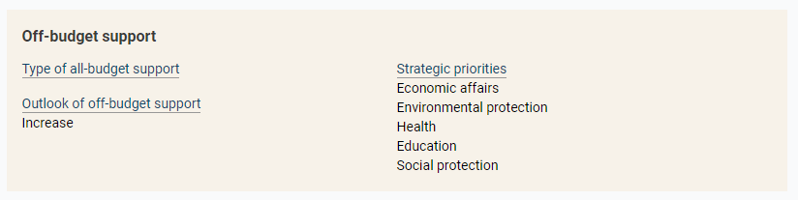
RCP 11 - 13
+ RCP 14 - 16
A
A
Source: UNSD, World Bank, and PARIS21 (2021), Cape Town Global Action Plan Monitoring Survey. See the methodology note for details.
https://paris21-data.github.io/CH_methodology_note/about-the-data.html#unsd-world-bank-paris21-cape-town-global-action-plan-implementation-survey

Slide 20
RCP 17a
SCM
Source: PARIS21 (2020), Statistical Capacity Monitor. See the methodology note for details.
https://paris21-data.github.io/CH_methodology_note/about-the-data.html#paris21-statistical-capacity-monitor
SCM
RCP 17b
Source: Open Data Watch (2020), Open Data Inventory. See the methodology note for details.
https://paris21-data.github.io/CH_methodology_note/about-the-data.html#open-data-watch---open-data-inventory
SPI
RCP 17c
Source: The World Bank (2021), Statistical Performance Index. See the methodology note for details.
https://paris21-data.github.io/CH_methodology_note/about-the-data.html#world-bank-statistical-performance-indicators

Slide 21
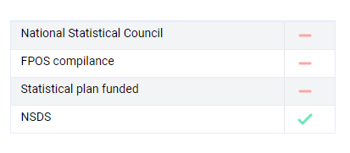

SCM
RCP 17d
Source: PARIS21 (2021), Statistical Capacity Monitor. See the methodology note for details.
https://paris21-data.github.io/CH_methodology_note/about-the-data.html#paris21-statistical-capacity-monitor
RCP 18 (NSO projects)
B
Data below are sourced from the pilot assessments by PARIS21. Pilot assessments provided a precise picture of the diversity of financing to data and statistics on the ground. They were conducted in July – September 2021. See the methodology note for details.
https://paris21-data.github.io/CH_methodology_note/about-the-data.html#paris21---pilot-assessments

Slide 22
RCP 19 - 21
B
C
Data below are sourced from the pilot assessments by PARIS21. Pilot assessments provided a precise picture of the diversity of financing to data and statistics on the ground. They were conducted in July – September 2021. See the methodology note for details.
https://paris21-data.github.io/CH_methodology_note/about-the-data.html#paris21---pilot-assessments

Slide 23
Funding opportunities- Providers profiles

Slide 24


PVP – 1, 2, and 3
DCD
Source: OECD (2021), Data for Development Profiles. See the methodology note for details.
https://paris21-data.github.io/CH_methodology_note/about-the-data.html#oecd-data-for-development-profiles
P21
Source: PARIS21 (2021), Partner Report on Support to Statistics. See the methodology note for details.
https://paris21-data.github.io/CH_methodology_note/about-the-data.html#paris21-press-data

Slide 25
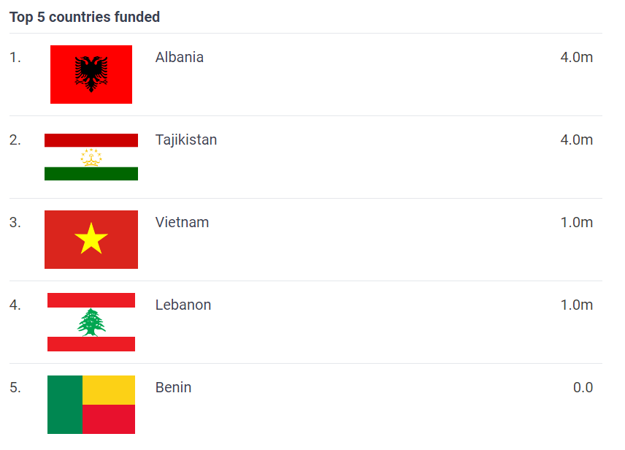
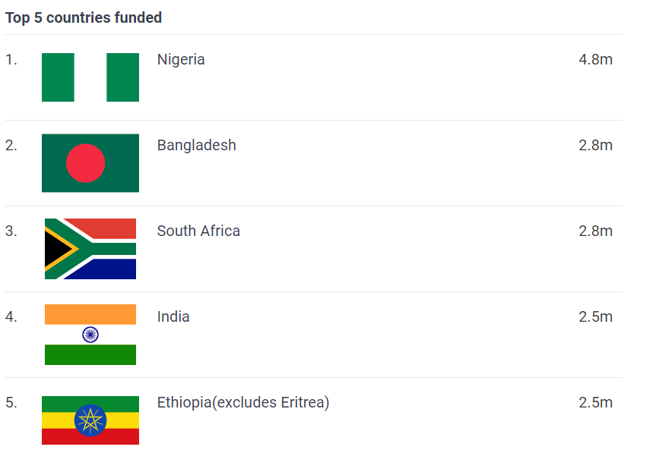
PVP – 5
DCD
P21
The values are in USD. Source: OECD (2021), Data for Development Profiles. See the methodology note for details.
The values are in USD. Source: PARIS21 (2021), Partner Report on Support to Statistics. See the methodology note for details.
https://paris21-data.github.io/CH_methodology_note/about-the-data.html#oecd-data-for-development-profiles
https://paris21-data.github.io/CH_methodology_note/about-the-data.html#paris21-press-data
This lists shows the top five recipient countries supported by the provider for the period 2017-2019.
This lists shows the top five recipient countries supported by the provider for the period 2017-2019.

Slide 26
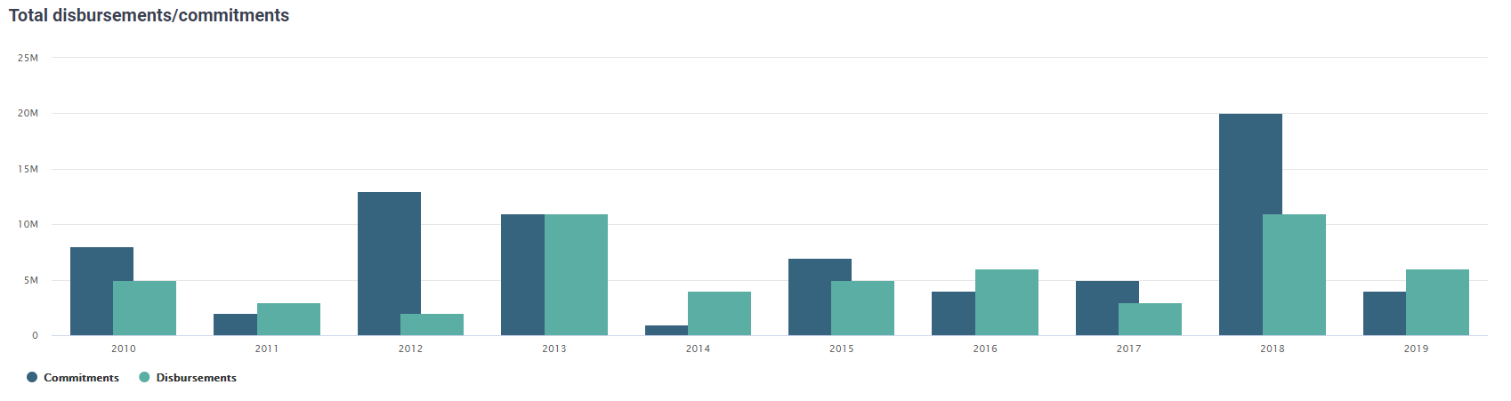
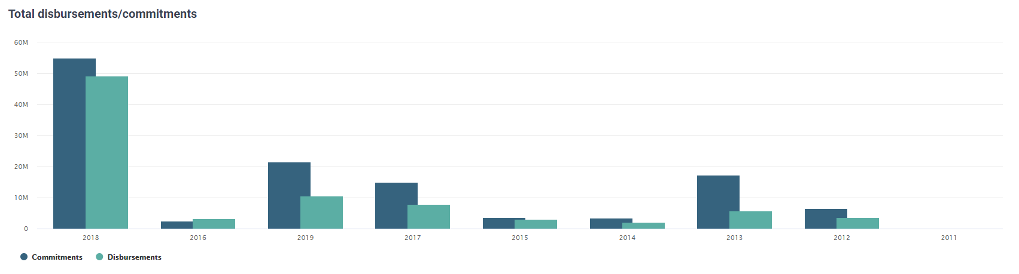
PVP – 6
DCD
P21
The values are in USD. Source: OECD (2021), Data for Development Profiles. See the methodology note for details.
The values are in USD. Source: PARIS21 (2021), Partner Report on Support to Statistics. See the methodology note for details.
https://paris21-data.github.io/CH_methodology_note/about-the-data.html#oecd-data-for-development-profiles
https://paris21-data.github.io/CH_methodology_note/about-the-data.html#paris21-press-data
This chart aggregates the disbursements and commitments of the provider for the period shown.
This chart aggregates the disbursements and commitments of the provider for the period shown.

Slide 27
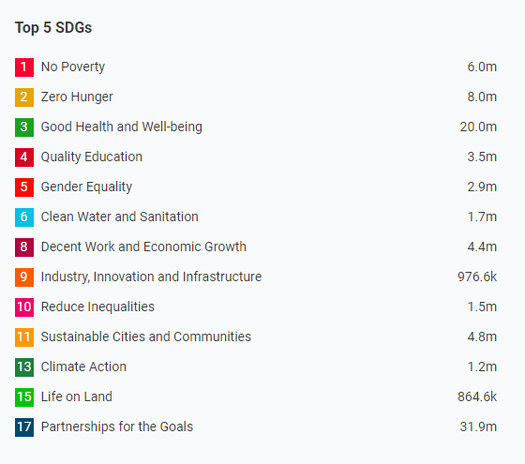
PVP – 7
P21
The values are in USD. Source: PARIS21 (2021), Partner Report on Support to Statistics. See the methodology note for details.
https://paris21-data.github.io/CH_methodology_note/about-the-data.html#paris21-press-data
This list shows total project budget according to SDGs. Top five SDGs with the highest budget displayed. Data obtained using a classification algorithm. Projects after 2012 are classified based on their project description.

Slide 28
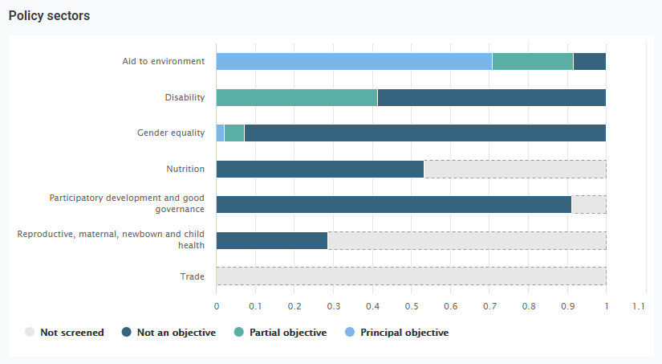
PVP – 8a
DCD
The values are in USD. Source: OECD (2021), Data for Development Profiles. See the methodology note for details.
https://paris21-data.github.io/CH_methodology_note/about-the-data.html#oecd-data-for-development-profiles
This chart is based on gross disbursements. Policy markers for disability and nutrition were reported for the first time for 2018 and 2019 and the figure reports their share in total official development assistance to data and statistics in these two years combined.

Slide 29
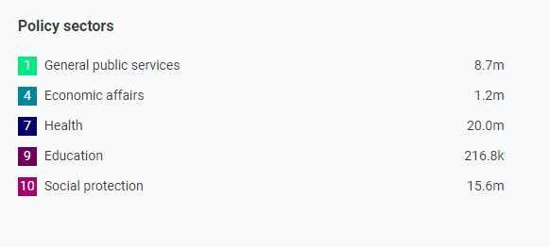
PVP – 8b
P21
The values are in USD. Source: PARIS21 (2021), Partner Report on Support to Statistics. See the methodology note for details.
https://paris21-data.github.io/CH_methodology_note/about-the-data.html#paris21-press-data
This list shows the total project budget according to policy sectors. Data obtained using a classification algorithm. Projects after 2012 are classified based on their project description.

Slide 30
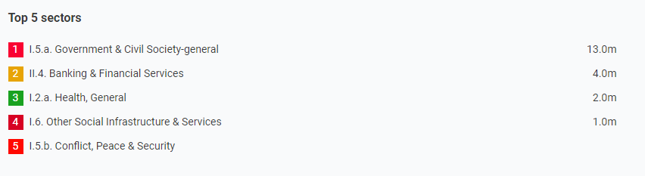
PVP – 9a
DCD
The values are in USD. Source: OECD (2021), Data for Development Profiles. See the methodology note for details.
https://paris21-data.github.io/CH_methodology_note/about-the-data.html#oecd-data-for-development-profiles
This list show the core sectors supported by the provider.

Slide 31
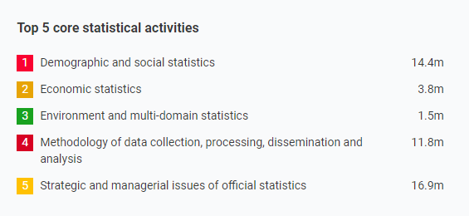
PVP – 9b
P21
The values are in USD. Source: PARIS21 (2021), Partner Report on Support to Statistics. See the methodology note for details.
https://paris21-data.github.io/CH_methodology_note/about-the-data.html#paris21-press-data
This list shows total project budget according to statistical activities. Data obtained using a classification algorithm. Projects after 2012 are classified based on their project description.

Slide 32
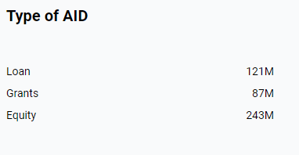
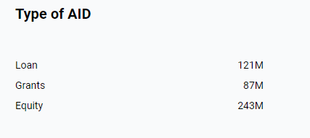
PVP – 10
DCD
P21
The values are in USD. Source: OECD (2021), Data for Development Profiles. See the methodology note for details.
The values are in USD. Source: PARIS21 (2021), Partner Report on Support to Statistics. See the methodology note for details.
https://paris21-data.github.io/CH_methodology_note/about-the-data.html#oecd-data-for-development-profiles
https://paris21-data.github.io/CH_methodology_note/about-the-data.html#paris21-press-data

Slide 33
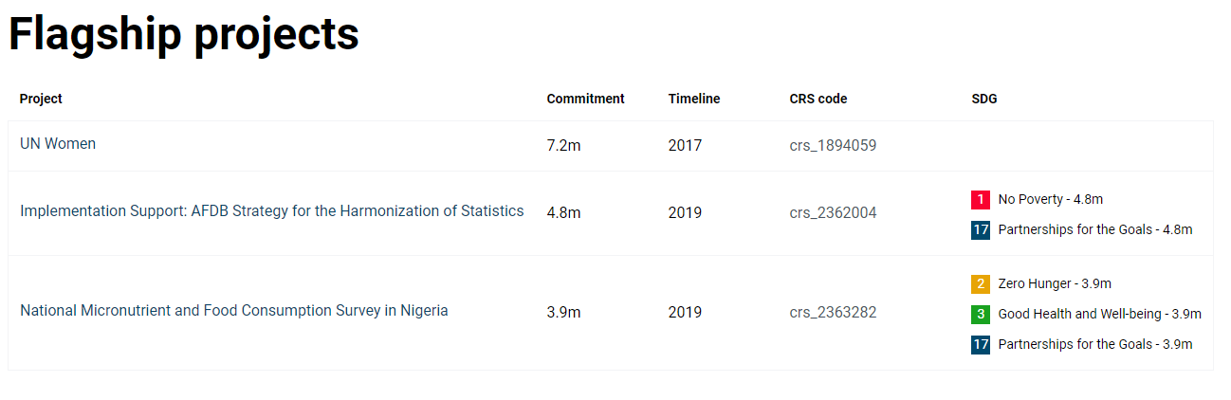
PVP – 11
P21
The commitment values are in USD. Source: PARIS21 (2021), Partner Report on Support to Statistics. See the methodology note for details.
https://paris21-data.github.io/CH_methodology_note/about-the-data.html#paris21-press-data

Slide 34
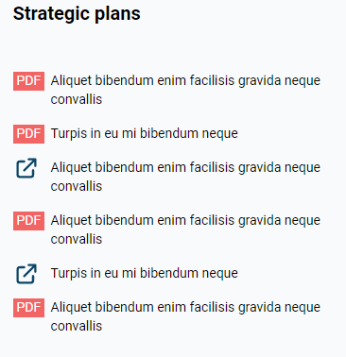
PVP – 13
DCD
P21
This information is sourced by PARIS21 (2021). See the methodology note for details.
https://paris21-data.github.io/CH_methodology_note/about-the-data.html#funding-opportunities-in-statistical-systems

Slide 35
Project profiles

Slide 36
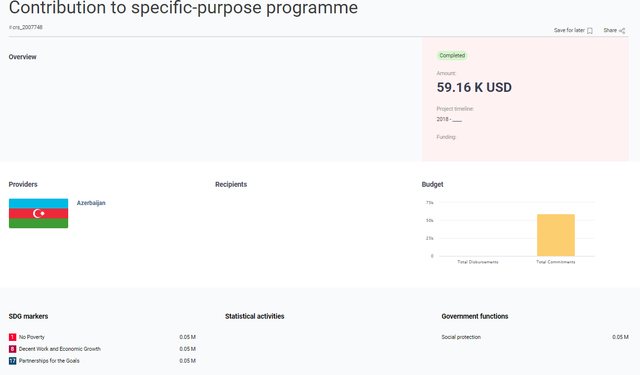
The values on this page are in nominal USD. Source: PARIS21 (2021), Partner Report on Support to Statistics. See the methodology note for details.
https://paris21-data.github.io/CH_methodology_note/about-the-data.html#paris21-press-data

