Slide 1
PRESS methodology Modernization
April 2025

Slide 2
Content
CRS Data
Methodological Requirements
Current Methodology
Methodology Proposal
Project Set-up
Classification method
Summary new methodology
Comparison current vs proposed methodology
Up for discussion

Slide 3
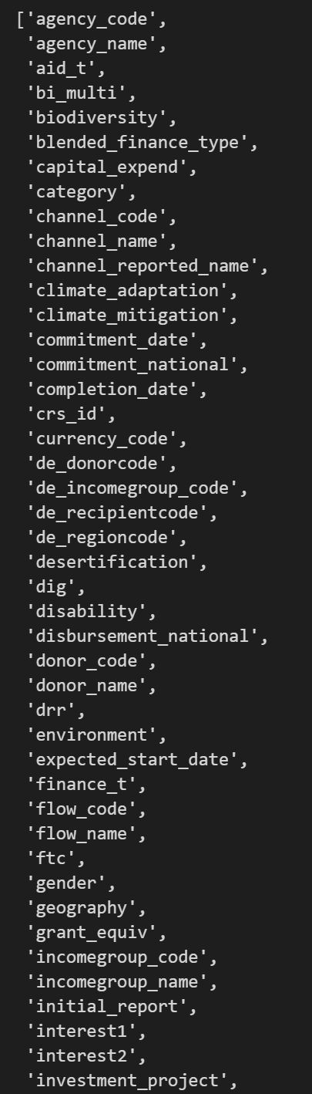
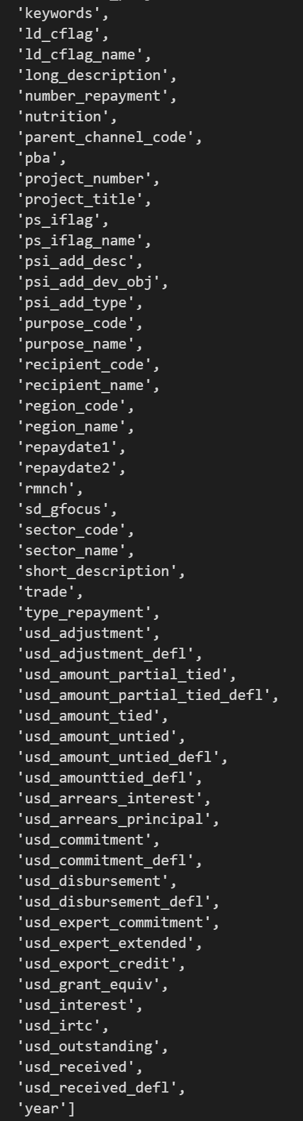
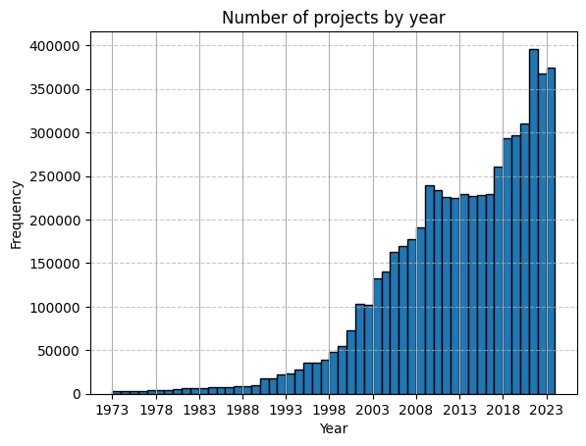
1. CRS Data
CRS data
available variables
entire CRS dataset:
5.8m observations (projects) for 98 variables from 1973-2023
variables necessary for our classification methodology:
texts: project_title, short_description, long_description
markers: purpose_code, channel_code, gender, rmnch

Slide 4
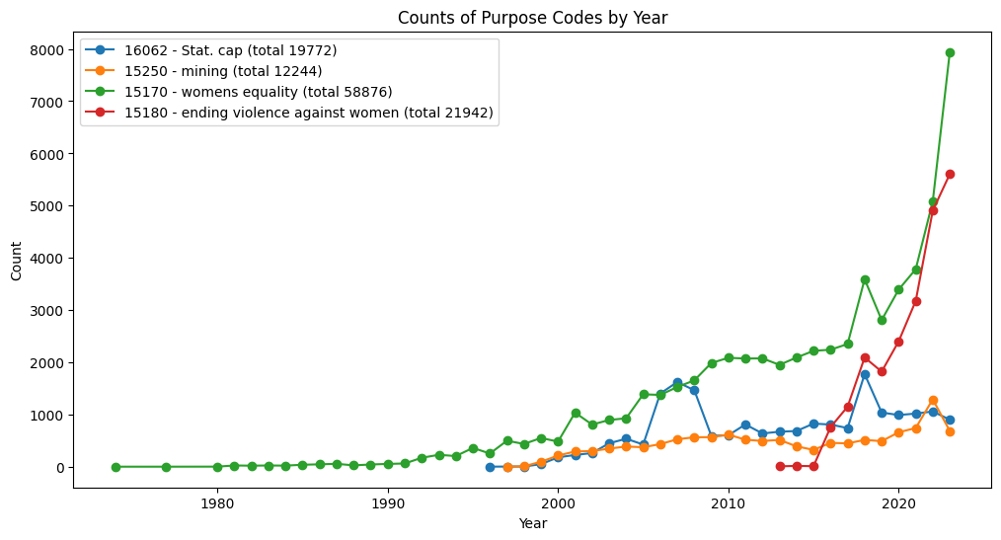
1. CRS Data
Purpose codes and other project marker
statistics marker
purpose codes: 16062 – Statistical capacity building
15250 – Removal of land mines and explosive
remnants of war (for blacklisting)
gender markers
purpose codes: 15170 - Women’s equality organizations and institutions
15180 - Ending violence against women and girls
Channel code: 41146 - UN woman
CRS gender marker: 0: When gender equality is not targeted
1: When gender equality is a significant objective
2: When gender equality is a principal objective.
policy marker: rmnch - reproductive, maternal, newborn and child health (since 2013)

Slide 5
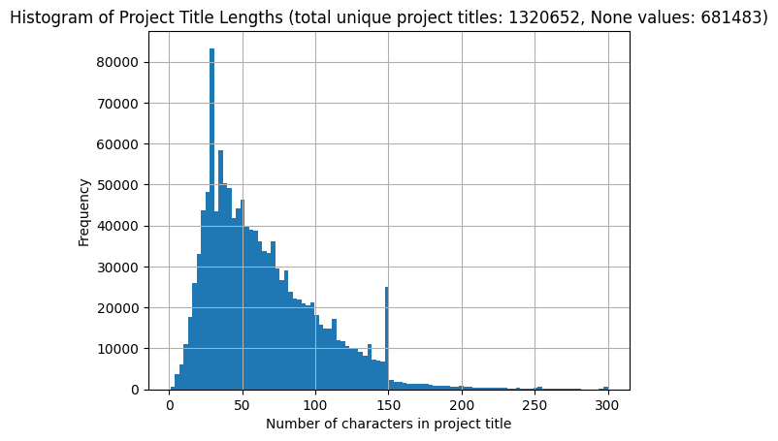
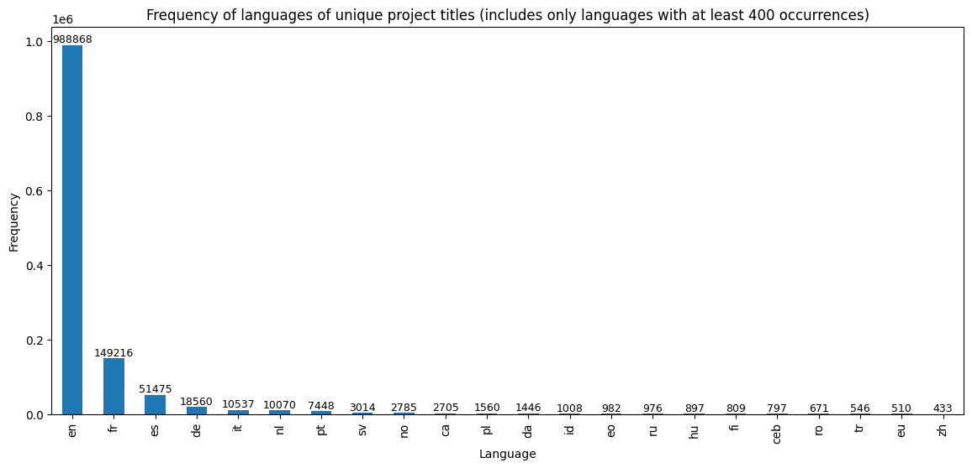
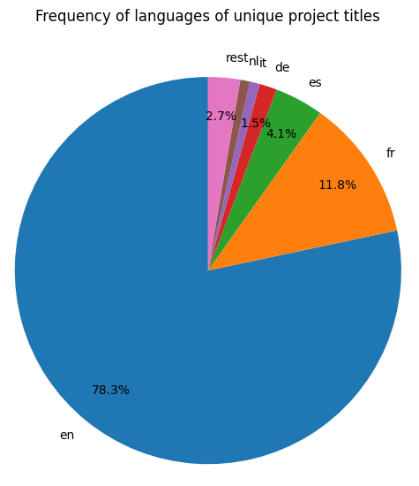
1. CRS Data
Project titles
Language analysis for project titles
using library fasttext (see here for comparison of popular language detection packages), all algorithms a bit shaky on very short texts
takeaway from language analysis: almost all project titles in either en/fr/es/de/it, rest misclassification due to too short project title or abbreviations used (e.g. “SEM. EVALUA. DIAKONIA SA”, “SUA&TARP II”)

Slide 6
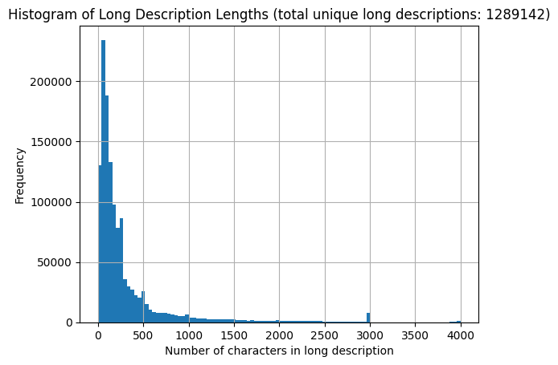
1. CRS Data
Long descriptions
examples:
to strengthen the capacity of National Malaria Control Programs to generate, analyze, and utilize genomic data to support malaria control and elimination efforts in 16 countries in sub-saharan Africa
to improve donor funding alignment and coordination of global levers in support of health sector goals
Energy efficiency investment (steam plant). Steam is used to produce energy. The current 20MW steam boiler and associated facility was built in the 1960's and is operated on a petroleum basis. This investment will finance and install a new steam plant powered by natural gas. This reduces pollutant emissions. Environmental effects: The new steam boiler system improves power generation through improved power generation technology while increasing energy efficiency. The project thus supports the fight against climate change. SDGs 1, 8 and 17 apply.
CENTRALE GEOTHERMIQUE DE LAHENDONG
Development of educated classes in society, promotion of international exchange and networking
Fernão Mendes Pinto scholarship
to provide direct grant to Borno State for PHC strengthening leveraging lessons from the RI basket fund model and the NSHIP implementation in the state

Slide 7
2. Methodological Requirements
Due to the structure of our data with titles, short and long descriptions in multiple language, as well as projects marked as statistical projects through purpose code 16062, two types of methodological requirements can be distinguished:
Requirements due to data structure:
Multilingual Reporting
classification methodology should work on multiple languages
Positive-unlabeled learning problem
in our case, we have a robust set of labeled projects for which a reporter has assigned a positive label (for statistics: purpose code 16062), but no negatively labeled projects for which we definitively know they have no statistics/data component
Requirements from us:
Accuracy
to us, accuracy is more important than e.g. computing time
Interpretability
classification methodology should offer the possibility to provide insight into how it arrives at a classification (e.g. relative importance of words for XGBoost, i.e. which words are weighted how much)
Variance estimation
it would be helpful to quantify the uncertainty for the numbers we report (e.g. 875m ± 0.2m)
(6. Potential additional P21 requirements)
any additional requirements from P21, e.g. constraint on computational requirements (CPU vs GPU) …

Slide 8
3. Current Methodology
All steps
Preparation
Downloading CRS datasets: 1 year, 1 dataset
Create project ID: hashed string based on projectnumber, crsid, year, purposecode, usd_disbursement, recipientcode (df_crs_hash)
A – Title pattern matching (see methodology note for more details)
Clean text: remove punctuation & numbers, lowercase letters in titles, short description, long description
Language detection of titles: uses CLD2 to detect the language of the project title
Detecting keywords in titles: keyword matching for statistics & gender from keyword lists (see next slide)
Marking projects with purpose code: 16062 – Statistical capacity building, 15250 - Removal of land mines, 15170-15180 – Gender purpose codes
Final marker: (statistics keyword match or stat purpose code) & (not mining title & not mining purpose code) (similar for gender)
B – Text mining
idea: more projects have statistics component beyond A -> identification through long description
Identify long descriptions for text mining: use long description only if it’s different from title and short description
Calculation of odds ratio for every term in statistical project’s long description compared to non-statistical project (no stat marker)
Using odds ratio to filter projects without statistics purpose code and statistics title

Slide 9
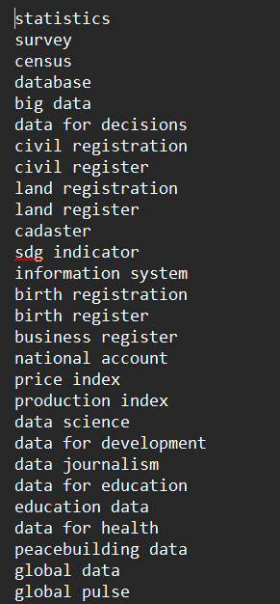
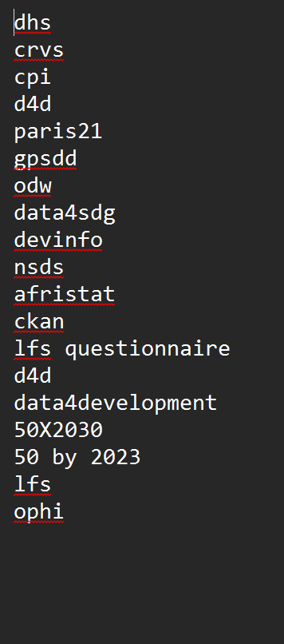
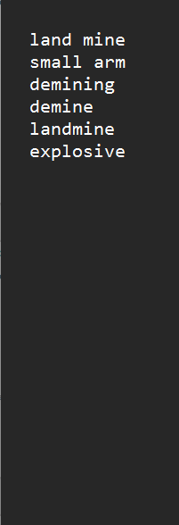
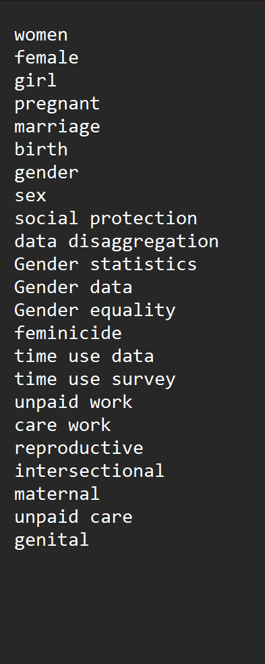
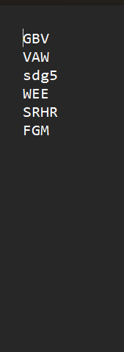
3. Current Methodology
Keywords
keywords stat
acronyms stat
blacklist stat
keywords gender
acronyms gender
statistics
4 languages (en, fr, es, de)
1 list for keywords, 1 list for acronyms, 1 blacklist (mining projects to be excluded, frequently include “survey”)
gender
4 languages (en, fr, es, de)
1 list for keywords, 1 list for acronyms, no blacklist

Slide 10
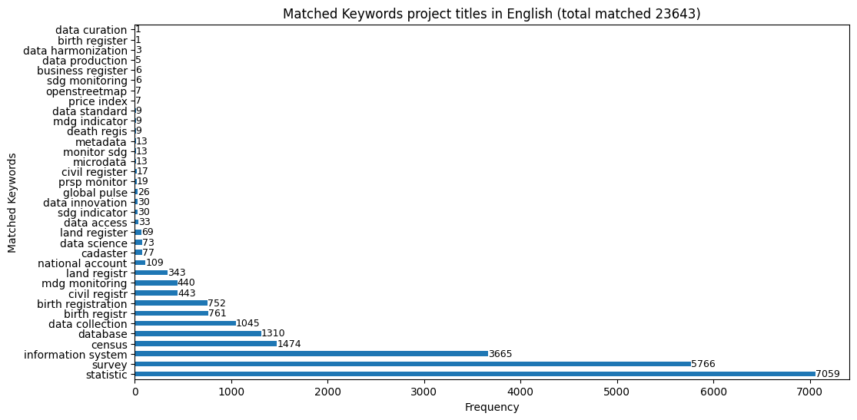
3. Current methodology
Project titles
A – Title pattern matching
number of matched keywords with current keyword lists and search in unique project titles for entire CRS dataset (from 1973-2023)

Slide 11
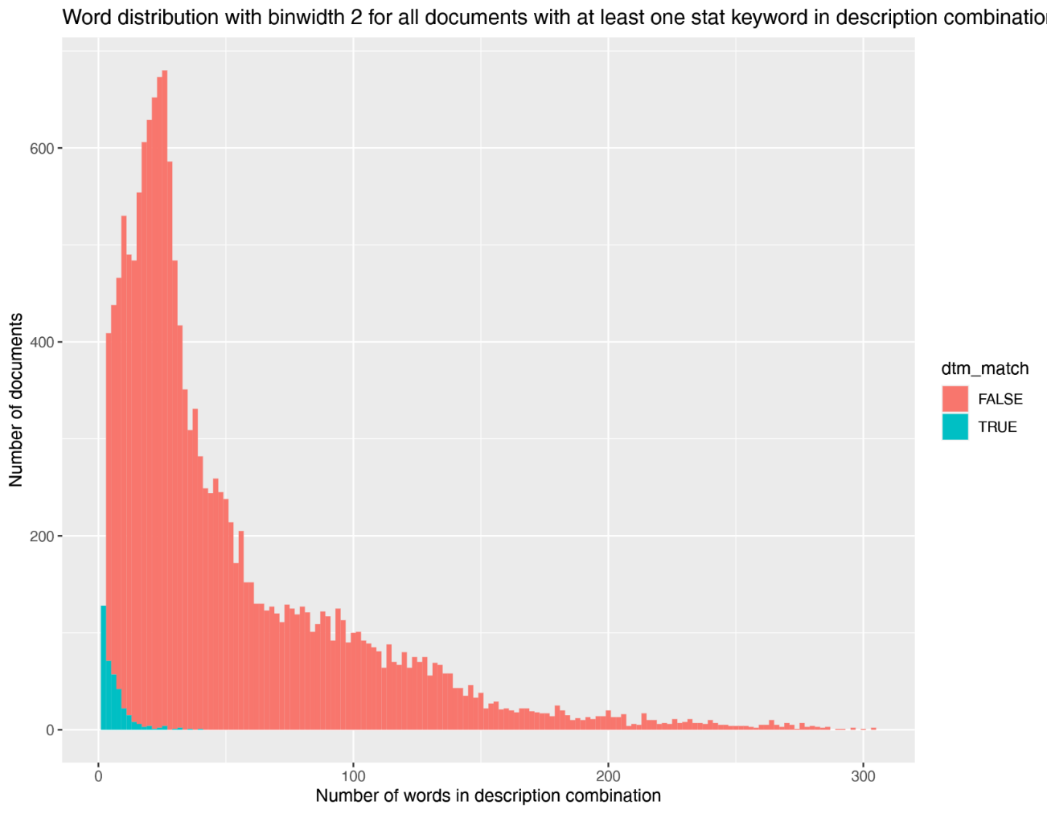
3. Current Methodology
B – Text mining
Currently frequency-based approach using odds ratio of words that appear frequently in long description of statistics project
Issues with frequency-based approach:
Independence of descriptions lengths and statistics match
reasonable to assume that description length and statistics match are independent -> also long text can be statistical
Accuracy much higher with modern approaches
For title matching: stemming instead of lemmatization
plot from previous frequency-based approach, green projects with matched long description, orange not matched

Slide 12
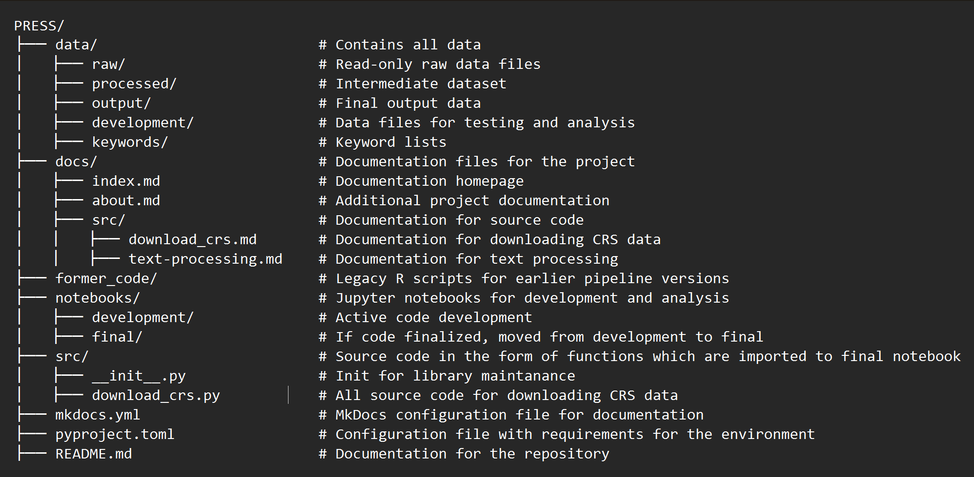
4. Methodology Proposal
1. Project Set-up
language: Python
source code maintained as .py files in src folder, eventual pipeline in final notebook
code development in notebooks/development folder
package dependency management with pyproject.toml – facilitates eventual publication as a package
documentation:
use of short commit intervals
code documentation integrated with mkdocs: automatic static documentation website created from src functions, could be later published directly from github repository using github pages (see next page)

Slide 13
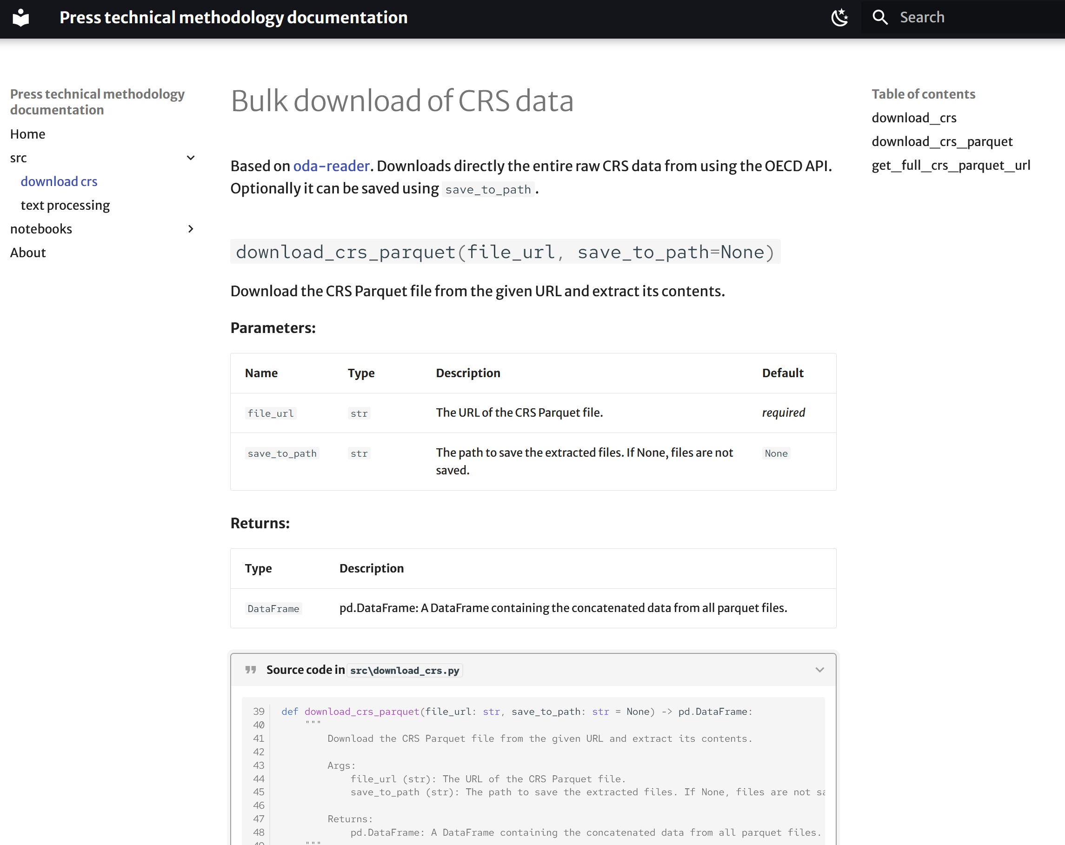
4. Methodology Proposal
static documentation website that automatically documents the source code in the src folder
addition of multiple tabs possible directly from markdown files
could host entire methodology note, if desired

Slide 14
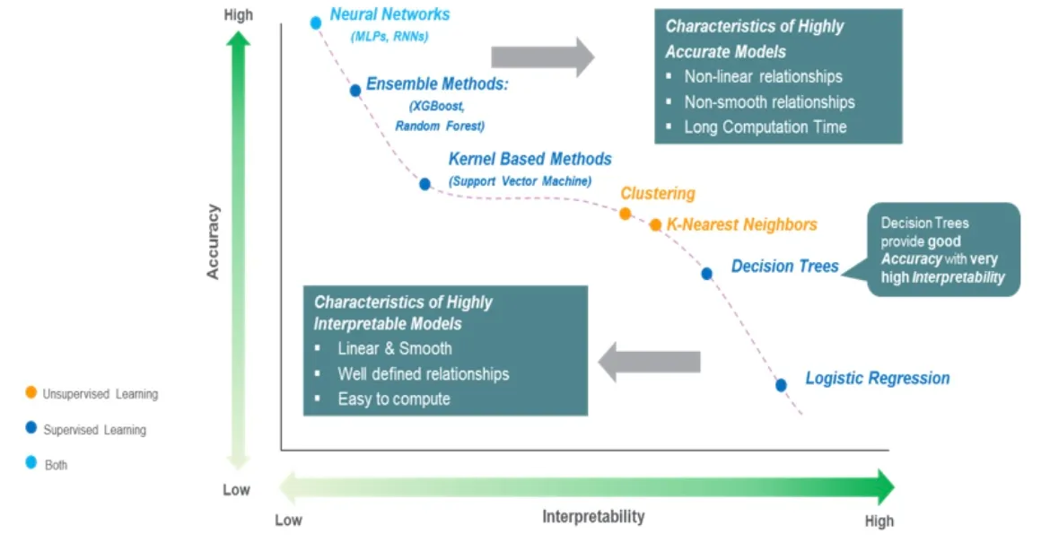
4. Methodology Proposal
2. Classification Method
How to choose a model?
First, we need to sort our requirements according to their importance:
Accuracy: To us, measuring the funding correctly should be the most important requirement
Multilingualism: Since approx. 22% of descriptions are not in English, the methodology should work on multiple languages
Interpretability: In general, the more complex models become, the more difficult it is to understand exactly how data is classified. However, there are techniques to get insight into how data is classified for very complex models.
Base requirements:
Text classification: our task is a binary text classification, but this applies to all models
Positive-unlabeled learning problem: this applies to all models and therefore doesn’t need to be considered during model selection
Variance estimation: it’s possible to estimate the variance for all models
Most important requirement –Accuracy
in general, the more complex the model is, the more accurate it is. Since this is our most important criterion, modern neural networks provide the highest accuracy

Slide 15
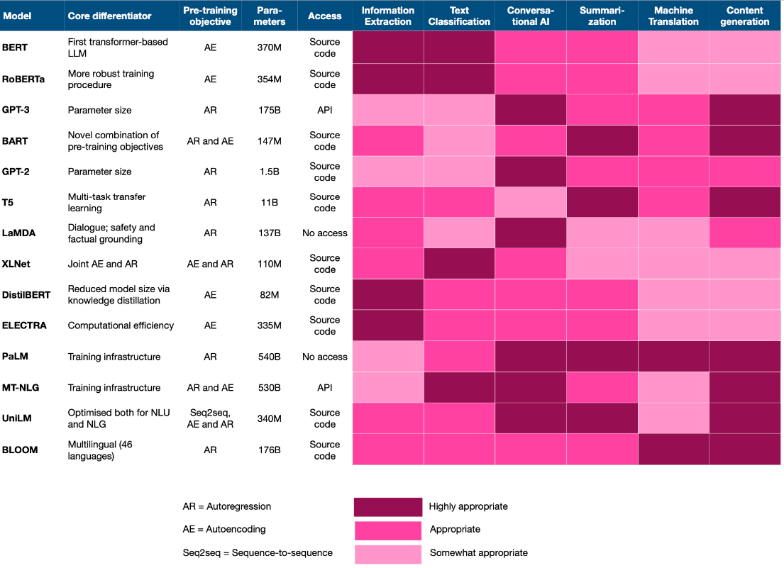
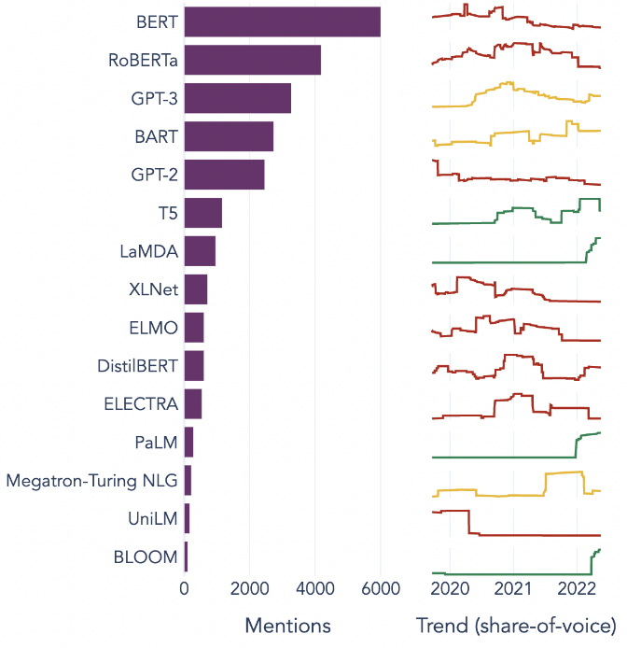
4. Methodology Proposal
Which NN is suitable in our case?
Requirements:
Accuracy
Multilingualism
Binary Text classification
To get an impression on which models are most frequently used in NLP and text classification, see their specifications and mentions on the right. By far, the open-sourced BERT (Bidirectional Transformers for Language Understanding, 2019 - 128489 citations) by Google AI and all its adaptations (most prominently RoBERTa, DistilBERT, mBERT) are by far the most studied NNs for NLP in the literature.
most important modern NN in NLP (Towards Data Science, 2022)
mentions of NNs online (Towards Data Science, 2022)

Slide 16
4. Methodology Proposal
Which NN is suitable in a multilingual setting?
Requirements:
Accuracy
Multilingualism
Binary Text classification
From BERT, there are namely two adaptations that are tailor-made for multilingual data:
1. multilingual BERT (mBert): trained on the entire Wikipedia of the 104 most utilized languages, it reaches almost the accuracy as single language models
2. XLM-RoBERTa (XLM-R): adaptation by Meta AI, in addition to Wikipedia training data, trained additionally on common crawl data of the internet and outperforms mBERT especially on low-resource languages
In our case, as it is a simple binary text classification task mostly in English with a large training set available, both will likely perform equally well. Either both can be tested, or the XLM-R can be chosen due to its performance on low-resource languages. For more information on their performance comparison, see original XLM-R paper, as well as an evaluation paper by Google.
Both are easily available trough the Hugging Face API in the form of its transformers library, which is very easy to use and deploy.

Slide 17
4. Methodology Proposal
Positive-unlabeled learning problem
statistical projects
?
purpose codes & title matching
Robust positively marked set
Rest combination non-stat & ?
statistical projects
non-stat projects
?

Slide 18

4. Methodology Proposal
Positive-unlabeled learning problem
solution:
Create training set with negatives as randomly sampled from ?
Train classifier based on training set
Recreate training set with classified negatives with high probability in class non-stat
Train classifier based on recreated training set
statistical projects
?
Robust training
and validation set
Test set
statistical projects
non-stat projects
non-stat projects
?
classification

Slide 19
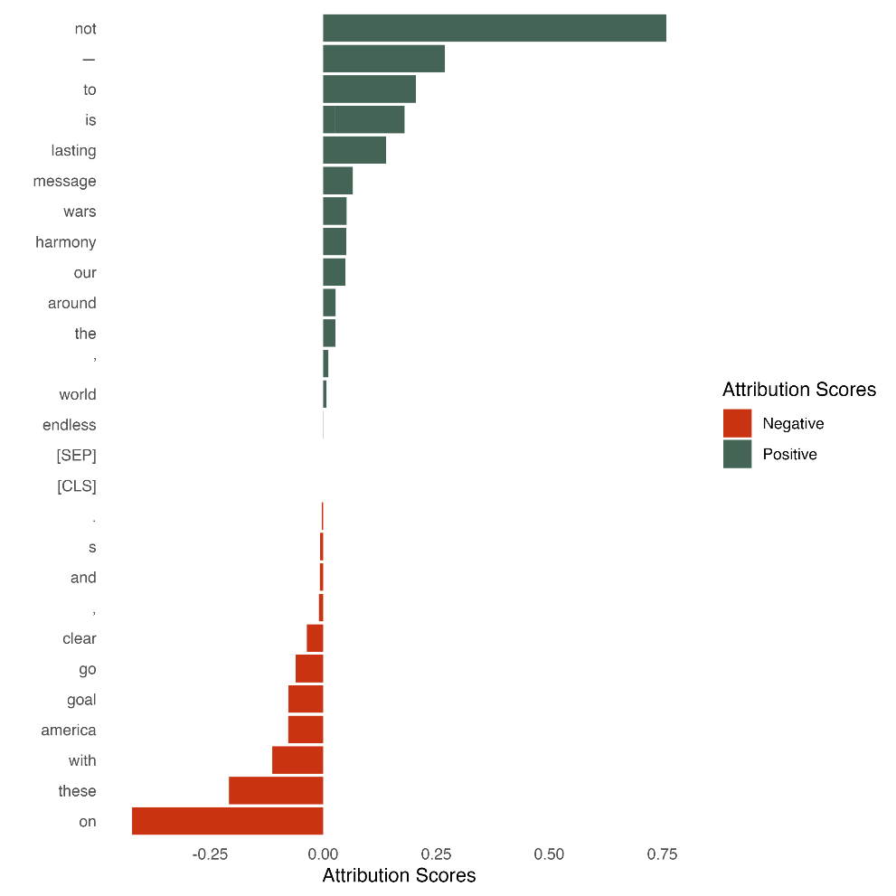
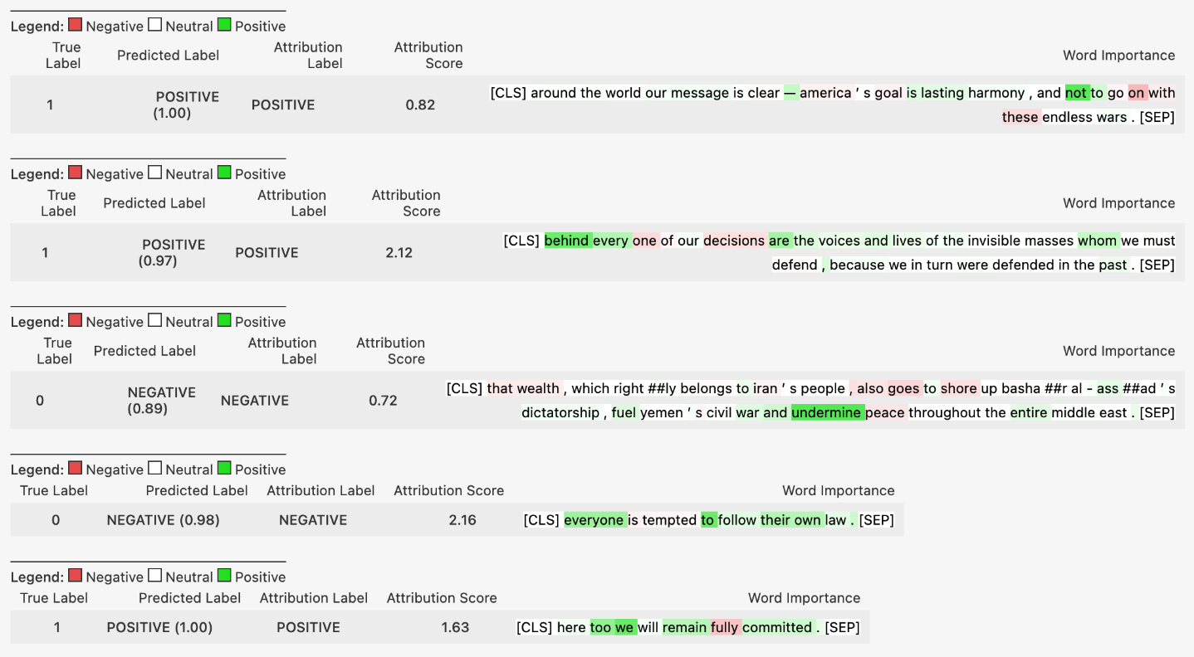
4. Methodology Proposal
Interpretability
solution:
Word importance: for every long description, a word importance is assigned to every word - > inspection of positively classified long descriptions
other methods: SHAP values, attention visualization,…
word importance for one sentence
word importance for multiple sentences (example for sentiment analysis)

Slide 20
4. Methodology Proposal
3. Summary new methodology
Preparation
Bulk download from Website: Automatic download of entire CRS dataset from OECD data explorer
ID creation: Create IDs for unique projects
A – Title pattern matching – same as before with minor adaptations:
For new methodology, we use the same tittle pattern matching procedure as before with minor improvements (updated language detection library, lemmatization instead of stemming). The underlying assumption that a project is mainly focused on statistics if the respective keyword appears in the project title seems very reasonable. Therefore, by matching keywords in titles, we can introduce an additional focus on topics of our choice (e.g. data science,…) instead of just relying on the purpose codes. In addition, this would allow to adapt the methodology easily to new topics (e.g. AI, environment,…) by just exchanging the keyword lists (and potentially selecting different purpose codes).
B – Text mining with new methodology:
Data augmentation: not strictly necessary, but could improve performance and easy to implement with readily available libraries. Measures could include: synonym swaps (to make training set more robust), translations from en to fr/es/de (more labeled data for minority languages)
Create Training/validation set: Use purpose code & title match as positive label, randomly sample negative labeled from rest
Fine-tune NN: download models and test if feasible on local machine/CPU. Likely necessary to use services which provide GPU compute but overall our task is not too resource intensive (XLM-R 550m parameters vs. 8B for smallest Llama which can be used for inference locally on CPU), therefore free services like Google colab could be sufficient (upgrade to 10$ monthly plan available)
Repeat 2.-4. to solve positive-labeled learning problem: replace randomly sampled negatives in training set with samples with high predicted negative probability. Alternatively: Use a zero-shot classification (without fine-tuning) before creating the training/validation set -> fine-tune only once
Choose threshold for inclusion: every project will be given a probability 0-1 that it is a statistics project. A threshold could be chosen based on common metrics (accuracy, precision, recall, F1) or manual inspection of descriptions around for various thresholds.

Slide 21
4. Methodology Proposal
4. Comparison current vs proposed methodology
 | Steps | Current methodology | Proposed methodology
Preparation |  | Manual Individual file download | Automatic bulk download from API
A – Title pattern matching | Clean text | Remove punctuation, numbers,… | Remove punctuation, numbers,…
 | Language detection | CLD2 | fasttext
 | Keyword detection | Stemming | Lemmatization
 | Create final markers | Use purpose code & title match | Use purpose code & title match
B – Text mining |  | Odds ratio for common words in matched long descriptions | Data augmentation
 |  | Match acc. to threshold | Fine-tune NN
 |  |  | Predict using fine-tuned NN

Slide 22
Up for discussion
Open questions:
Methodology note update until new methodology implemented?
DAC donor profile collaboration continued? previously differing keyword lists
Outreach to OECD data science community for feedback/testing/review?
Keyword list review?
Additional P21 requirements?

